Slide 1
Internetworking
Datagram Forwarding

Slide 2
Topics Covered
Introduction
Connectionless Service
Virtual Packets
The IP Datagram
The IP Datagram Header Format
Forwarding an IP Datagram
Network Prefix Extraction and Datagram Forwarding
Longest Prefix Match
Destination Address and Next-Hop Address
Best-Effort Delivery
IP Encapsulation
Transmission Across an Internet
MTU and Datagram Fragmentation
Reassembly of a Datagram from Fragments
Collecting the Fragments of a Datagram
The Consequence of Fragment Loss
Fragmenting a Fragment

Slide 3
Connectionless Service
In some application, programs remain unaware of the underlying physical networks
  they can send/receive data without knowing the details of
    the LAN to which a computer connects
    the remote network to which the destination connects
What services that will be offered by a network?
  connection-oriented service
  connectionless service
  or a combination of both
TCP/IP include protocols for both
  An unreliable connectionless delivery service
  A reliable connection-oriented service
    that uses the underlying connectionless service
The design forms the basis for all Internet communication

Slide 4
Virtual Packets
In connectionless each packet travels independently
  It contains information that identifies the intended recipient
How does a packet pass across the Internet?
  A host
    creates a packet
    places the destination address in the packet header
    and then sends the packet to a nearby router
  A router
    receives a packet
    uses the destination address to select the next router on the path
    and then forwards the packet
  Eventually, the packet reaches a router that can deliver the packet to its final destination

Slide 5
Virtual Packets
What format is used for an Internet packet?
  Internet consists of heterogeneous networks
    that use incompatible frame formats
    it cannot adopt any of the hardware frame formats
A router cannot simply reformat the frame header
  because the two networks may use incompatible addressing
To overcome heterogeneity
  IP defines a packet format that is independent of the hardware
  The result is a universal, virtual packet
    that can be transferred across the underlying hardware intact
  As the term virtual implies
    The Internet packet format is not tied directly to any hardware
    The underlying hardware does not understand or recognize an Internet packet
  As the term universal implies
    Each host or router in the Internet contains protocol software that recognizes Internet packets

Slide 6
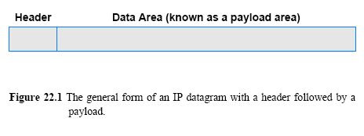
The IP Datagram
TCP/IP uses the name IP datagram to refer to a packet
Figure 22.1 illustrates an IP datagram format
  Each datagram consists of a header followed by data area (payload)
    The amount of data carried in a datagram is not fixed
    The size of a datagram is determined by the application that sends data
    A datagram can contain as little as a single octet of data or at most 64K

Slide 7
The IP Datagram Header Format
What does a datagram header contain?
  It contains information used to forward the datagram
A datagram head contains information, such as:
  the address of the source (the original sender)
  the address of the destination (the ultimate recipient)
  and a field that specifies the type of data being carried in the payload
Each address in the header is an IP address
  MAC addresses for the sender and recipient do not appear
Each field in an IP datagram header has a fixed size
  which makes header processing efficient

Slide 8
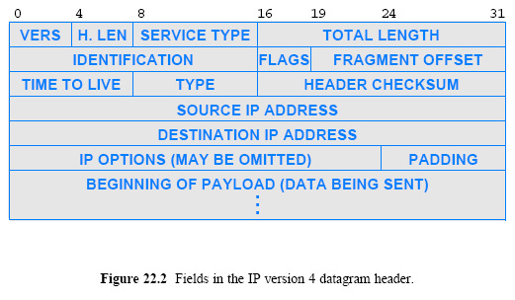
The IP Datagram Header Format

Slide 9
The IP Datagram Header Format
VERS
  Each datagram begins with a 4-bit protocol version number
  (the figure shows a version 4 header)
H.LEN
  4-bit header specifies the number of 32-bit quantities in the header
  If no options are present, the value is 5
SERVICE TYPE
  8-bit field that carries a class of service for the datagram
  (seldom used in practice)
  Chapter 28 explains the DiffServ interpretation of the service type field
TOTAL LENGTH
  16-bit integer that specifies the total number of bytes in the datagram
  (including both the header and the data)
IDENTIFICATION
  16-bit number (usually sequential) assigned to the datagram
    used to gather all fragments for reassembly to the datagram
FLAGS
  3-bit field with individual bits specifying whether the datagram is a fragment
    If so, then whether the fragment corresponds to the rightmost piece of the original datagram
FRAGMENT OFFSET
  13-bit field that specifies where in the original datagram the data in this fragment belongs
  the value of the field is multiplied by 8 to obtain an offset

Slide 10
The IP Datagram Header Format
TIME TO LIVE
  8-bit integer initialized by the original sender
  it is decremented by each router that processes the datagram
  if the value reaches zero (0)
    the datagram is discarded and an error message is sent back to the source
TYPE
  8-bit field that specifies the type of the payload
HEADER CHECKSUM
  16-bit ones-complement checksum of header fields
  it is computed according to Algorithm 8.1
SOURCE IP ADDRESS
  32-bit Internet address of the original sender
  (the addresses of intermediate routers do not appear in the header)
DESTINATION IP ADDRESS
  The 32-bit Internet address of the ultimate destination
  The addresses of intermediate routers do not appear in the header
IP OPTIONS
  Optional header fields used to control routing and datagram processing
  Most datagrams do not contain any options
    which means the IP OPTIONS field is omitted from the header
PADDING
  If options do not end on a 32-bit boundary
    zero bits of padding are added to make the header a multiple of 32 bits

Slide 11
Forwarding an IP Datagram
The Internet uses next-hop forwarding
Each router along the path
  receives the datagram
  extracts the destination address from the header
  uses the destination address to determine a next hop
    to which the datagram should be sent
  then forwards the datagram to the next hop
    either the final destination or another router
To make the selection of a next hop efficient, an IP router uses a forwarding table
A forwarding table is initialized when the router boots
  and must be updated if the topology changes or hardware fails

Slide 12
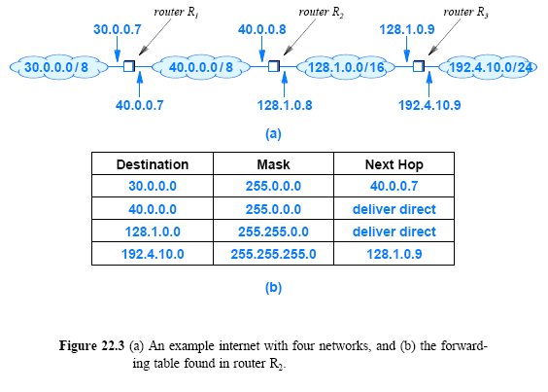
Forwarding an IP Datagram

Slide 13
Network Prefix Extraction and Datagram Forwarding
The process of using a forwarding table to select a next hop for a given datagram is called forwarding
The mask field in a forwarding table entry is used to extract the network portion of an address during lookup
When a router encounters a datagram with destination IP address D
  the forwarding function must find an entry in the forwarding table that specifies a next hop for D
  The software examines each entry in the table by using the mask in the entry to extract a prefix of address D
  It compares the resulting prefix to the Destination field of the entry
    If the two are equal, the datagram will be forwarded to the Next Hop

Slide 14
Network Prefix Extraction and Datagram Forwarding
The bit mask representation makes extraction efficient
  the computation consists of a Boolean and between the mask and destination address, D
  the computation to examine the i^{th} entry in the table can be as:
  if ( (Mask[i] & D) == Destination[i] ) forward to NextHop[i]
As an example
  Consider a datagram destined for address 192.4.10.3
  Assume the datagram arrives at the center router, R₂, in Figure 22.3
  Assume the forwarding searches entries of the table in order
    The first entry fails since 255.0.0.0 & 192.4.10.3 ≠ 30.0.0.0
    After rejecting the second and third entries in the table
    The routing software eventually chooses next hop 128.1.0.9 because
    255.255.255.0 & 192.4.10.3 == 192.4.10.0

Slide 15
Longest Prefix Match
Figure 22.3 contains a trivial example
  In practice, Internet forwarding tables can be extremely large and the forwarding algorithm is complex
Internet forwarding tables can contain a default entry
  that provides a path for all destinations that are not explicitly listed
A network manager can specify a host-specific route
  it directs traffic destined to a specific host along a different path than traffic for other hosts on the same network
An important feature of an Internet forwarding table is that address masks can overlap

Slide 16
Longest Prefix Match
Suppose a router's forwarding table contains entries for the following two network prefixes:
  128.10.0.0/16 and 128.10.2.0/24
What happens if a datagram arrives destined to 128.10.2.3?
Matching procedure succeeds for both of the entries
  a Boolean and of a 16-bit mask will produce 128.10.0.0
  a Boolean and with a 24-bit mask will produce 128.10.2.0
Which entry should be used?
  To handle ambiguity that arises from overlapping address masks, Internet forwarding uses a longest prefix match
    Instead of examining the entries in arbitrary order
    forwarding software arranges to examine entries with the longest prefix first
In the example above, Internet forwarding will choose the entry that corresponds to 128.10.2.0/24

Slide 17
Destination Address and Next-Hop Address
What is the relationship between the destination address in a datagram header and the address of the next hop to which the datagram is forwarded?
The DESTINATION IP ADDRESS field in a datagram contains the address of the ultimate destination
  it does not change as the datagram passes through the Internet
When a router receives a datagram
  the router uses the ultimate destination, D
  to compute the address of the next router to be sent, N
The router forwards a datagram to the next hop, N
  the header in the datagram retains destination address D

Slide 18
Best Effort Delivery
Term best-effort to describe the service of IP protocol
IP makes a best-effort to deliver each datagram
  IP does not guarantee that it will handle all problems
The following problems can occur in IP protocol
  Datagram duplication
  Delayed or out-of-order delivery
  Corruption of data
  Datagram loss
IP is designed to run over any type of network
  network equipment can experience interference from noise
Packets following one path may take longer than those following another path
  this can result in out-of-order delivery

Slide 19
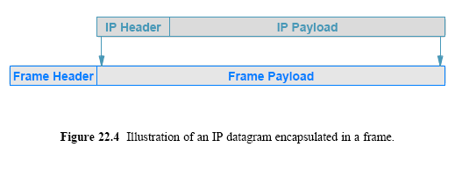
IP Encapsulation
How can a datagram be transmitted across a physical network that does not understand the datagram format?
  The answer lies in a technique known as encapsulation
When an IP datagram is encapsulated in a frame
  the entire datagram is placed in the payload area of a frame
The network hardware treats a frame that contains a datagram exactly like any other frame
  hardware does not examine or change the contents of the payload

Slide 20
IP Encapsulation
How does a receiver know whether the payload of an incoming frame contains an IP datagram or other data?
  Sender/receiver must agree on the value used in the frame type field
  Software on the sending computer assigns the frame type field
When a frame arrives with the IP value in its type field
  the receiver knows that the payload area contains an IP datagram
    For example, the Ethernet specifies that the type field of a frame carrying an IP datagram is assigned 0x0800
Encapsulation requires the sender to supply the MAC address of the next computer
  to which the datagram should be sent

Slide 21
Transmission Across an Internet
After the sender selects a next hop
  the sender encapsulates the datagram in a frame
  and transmits the result across the physical network
When the frame reaches the next hop
  the receiving software examines the IP datagram
If the datagram must be forwarded across another network
  a new frame is created
Figure 22.5 illustrates how a datagram is encapsulated and unencapsulated as it travels along a path
Each network can use a different hardware technology than the others
  meaning that the frame formats and frame header sizes can differ

Slide 22
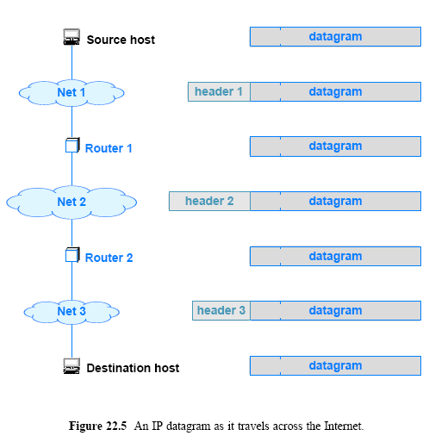
Transmission Across an Internet

Slide 23
Transmission Across an Internet
Frame headers do not accumulate during a trip through the Internet
When a datagram arrives
  the datagram is removed from the incoming frame before being encapsulated in an outgoing frame
When the datagram reaches its final destination
  the frame header will be the header of the last network over which the datagram arrived
  once the header is removed, the result is the original datagram

Slide 24
MTU and Datagram Fragmentation
Each hardware technology specifies the maximum amount of data that a frame can carry
  The limit is known as a Maximum Transmission Unit (MTU)
There is no exception to the MTU limit
  Network hardware is not designed to accept or transfer frames that carry more data than the MTU allows
  A datagram must be smaller or equal to the network MTU
    or it cannot be encapsulated for transmission
In an internet that contains heterogeneous networks, MTU restrictions create a problem
A router can connect networks with different MTU values
  a datagram that a router receives over one network can be too large to send over another network

Slide 25
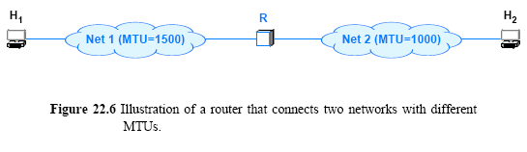
MTU and Datagram Fragmentation
Figure 22.6 (below) illustrates a router that interconnects two networks with MTU values of 1500 and 1000
  Host H attaches to a network with an MTU of 1500
    and can send a datagram that is up to 1500 octets
  Host H attaches to a network that has an MTU of 1000
    which means that it cannot send/receive a datagram larger than 1000 octets
  If host H sends a 1500-octet datagram to host H
    router R will not be able to encapsulate it for transmission across network 2

Slide 26
MTU and Datagram Fragmentation
To solve the problem of heterogeneous MTUs
  a router uses a technique known as fragmentation
When a datagram is larger than the MTU of the network over which it must be sent
  the router divides the datagram into smaller pieces called fragments
  and sends each fragment independently
A fragment has the same format as other datagrams
  a bit in the FLAGS field of the header indicates whether a datagram is a fragment or a complete datagram
Other fields in the header are assigned information for the ultimate destination to reassemble fragments
  to reproduce the original datagram
The FRAGMENT OFFSET specifies where in the original datagram the fragment belongs

Slide 27
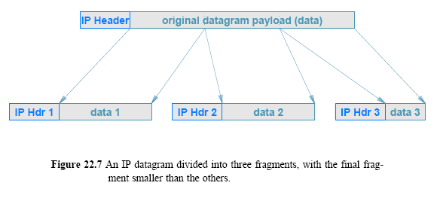
MTU and Datagram Fragmentation
A router uses the network MTU and the header size to calculate
  the maximum amount of data that can be sent in each fragment
  and the number of fragments that will be needed
The router then creates the fragments
  It uses fields from the original header to create a fragment header
    For example, the router copies the IP SOURCE and IP DESTINATION fields from the datagram into the fragment header
  It copies the appropriate data from the original datagram into the fragment
  Then it transmits the result

Slide 28
Reassembly of a Datagram from Fragments
Recreating a copy of the original datagram from fragments is called reassembly
Each fragment begins with a copy of the original datagram header
  all fragments have the same destination address as the original datagram from which they were derived
The fragment that carries the final piece of data has an additional bit set in the header
  Thus, a host performing reassembly can tell whether all fragments have arrived successfully
The ultimate destination should reassemble fragments

Slide 29
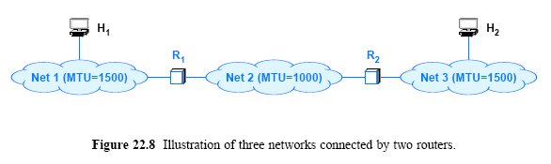
Reassembly of a Datagram from Fragments
Consider the configuration in Figure 22.8
  if host H₁ sends a 1500-octet datagram to host H₂, router R₁ will divide the datagram into two fragments, which it will forward to R₂
  Router R₂ does not reassemble the fragments
    Instead R uses the destination address in a fragment to forward the fragment as usual
  The ultimate destination host, H₂, collects the fragments and reassembles them to produce the original datagram

Slide 30
Reassembly of a Datagram from Fragments
Requiring the ultimate destination to reassemble fragments has two advantages:
First, it reduces the amount of state information in routers
  When forwarding a datagram, a router does not need to know whether the datagram is a fragment
Second, it allows routes to change dynamically
  If an intermediate router were to reassemble fragments, all fragments would need to reach the router
By postponing reassembly until the ultimate destination
  IP is free to pass some fragments from a datagram along different routes than other fragments
  That is, the Internet can change routes at any time
  (e.g., to route around a hardware failure)

Slide 31
Collecting the Fragments of a Datagram
Fragments from multiple datagrams can arrive out-of-order
  Individual fragments can be lost or arrive out-of-order
How does it reassemble fragments that arrive out-of-order?
A sender places a unique identification number in the IDENTIFICATION field of each outgoing datagram
When a router fragments a datagram
  the router copies the identification number into each fragment
A receiver uses the identification number and IP source address in an incoming fragment
  to determine the datagram to which the fragment belongs
The FRAGMENT OFFSET field tells a receiver where data in the fragment belongs in the original datagram

Slide 32
Fragment Loss
A datagram cannot be reassembled until all fragments arrive
A problem arises when one or more fragments from a datagram arrive and other fragments are delayed or lost
The receiver must save (buffer) the fragments
  that have arrived in case missing fragments are only delayed
A receiver cannot hold fragments an arbitrarily long time
  because fragments occupy space in memory
IP specifies a maximum time to hold fragments
When the first fragment arrives from a given datagram
  the receiver starts a reassembly timer
If all fragments of a datagram arrive before the timer expires
  the receiver cancels the timer and reassembles the datagram
If the timer expires before all fragments arrive
  the receiver discards the fragments that have arrived

Slide 33
Fragment Loss
The result of IP's reassembly timer is all-or-nothing:
  either all fragments arrive and IP reassembles the datagram,
  If not then IP discards the incomplete datagram
There is no mechanism for a receiver to tell the sender which fragments have arrived
  The sender does not know about fragmentation
If a sender retransmits, the datagram routes may be different
  a retransmission would not necessarily traverse the same routers
    also, there is no guarantee that a retransmitted datagram would be fragmented in the same way as the original

Slide 34
Fragmenting a Fragment
What happens if a fragment eventually reaches a network that has a smaller MTU?
It is possible to fragment a fragment when needed
  A router along the path divides the fragment into smaller fragments
If networks are arranged in a sequence of decreasing MTUs
  each router along the path must further fragment each fragment
Designers work carefully to insure that such situations do not occur in the Internet
In any case, IP does not distinguish between original fragments and subfragments
A receiver cannot know if an incoming fragment is the result of one router fragmenting a datagram or multiple routers fragmenting fragments
Making all fragments the same has an advantage
  a receiver can perform reassembly of the original datagram
    without first reassembling subfragments
    this saves CPU time, and reduces the amount of information needed in the header of each fragment

