Slide 1
Internetworking
Support Protocols
and
Technologies

Slide 2
Topics Covered
Address Resolution
The Address Resolution Protocol (ARP)
ARP Message Format
ARP Encapsulation
ARP Caching and Message Processing
The Conceptual Address Boundary
Internet Control Message Protocol (ICMP)
ICMP Message Format and Encapsulation
Protocol Software, Parameters, and Configuration
Dynamic Host Configuration Protocol (DHCP)
DHCP Protocol Operation and Optimizations
DHCP Message Format
Indirect DHCP Server Access Through a Relay
Network Address Translation (NAT)
NAT Operation and Private Addresses
Transport-Layer NAT (NAPT)
NAT and Servers
NAT Software and Systems for Use at Home

Slide 3
Address Resolution
A crucial step of the forwarding process requires a translation:
  forwarding uses IP addresses
  a frame transmitted must contain the MAC address of the next hop
  IP must translate the next-hop IP address to a MAC address
The principle is:
  IP addresses are abstractions
    provided by protocol software
  Network does not know how to locate a computer from its IP address
    the next-hop address must be translated to an equivalent MAC address
Translation from a computer's IP address to an equivalent hardware address is known as address resolution
  And an IP address is said to be resolved to the correct MAC address
Address resolution is local to a network

Slide 4
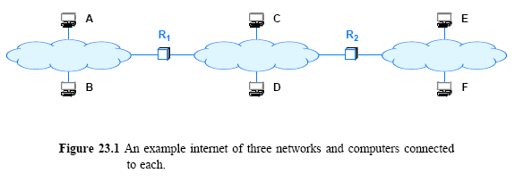
Address Resolution
One computer can resolve the address of another computer only if both computers attach to the same physical network
  A computer never resolves the address of a computer on a remote network
  Address resolution is always restricted to a single network.
For example, consider the simple internet in Figure 23.1

Slide 5
Address Resolution Protocol
What algorithm does software use to translate?
  The answer depends on the protocol and hardware addressing
    here we are only concerned with the resolution of IP
Most hardware has adopted the 48-bit Ethernet
In Ethernet: Address Resolution Protocol (ARP)
Consider Figure 23.2
  Suppose B needs to resolve the IP address of C
  B broadcasts a request that says:
  “I'm looking for the MAC address of a computer that has IP address C”
  The broadcast only travels across one network
  An ARP request message reaches all computers on a network
  When C receives a copy of the request along other hosts
    Only C sends a directed reply back to B that says:
  “I'm the computer with IP address C, and my MAC address is M”

Slide 6
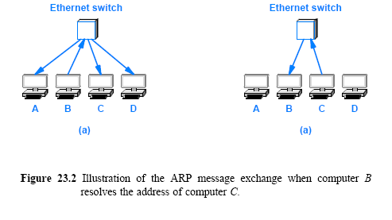
Address Resolution Protocol

Slide 7
ARP Message Format
Rather than restricting ARP to IP and Ethernet
  The standard describes a general form for ARP messages
  It specifies how the format is adapted for each type of protocol
Choosing a fixed size for a hardware address is not suitable
  New network technologies might be invented that have addresses larger than the size chosen
  The designers included a fixed-size field at the beginning of an ARP message to specify the size of the hardware addresses being used
For example, when ARP is used with an Ethernet
  the hardware address length is set to 6 octets
    because an Ethernet address is 48 bits long

Slide 8
ARP Message Format
To increase the generality of ARP
  the designers also included an address length field
ARP protocol can be used to bind an arbitrary high-level address to an arbitrary hardware address
In practice, the generality of ARP is seldom used
  most implementations of ARP are used to bind IP addresses to Ethernet addresses
Figure 23.3 illustrates the format of an ARP message
  when the protocol is used with an IP version 4 address (4 octets) and Ethernet hardware address (6 octets)
  each line of the figure corresponds to 32 bits of an ARP message

Slide 9
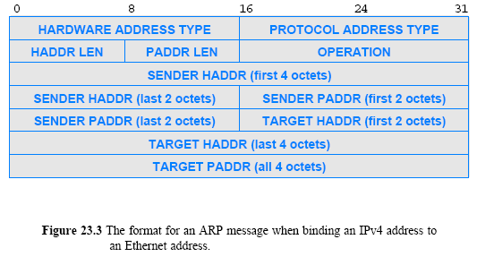
ARP Message Format

Slide 10
ARP Message Format
HARDWARE ADDRESS TYPE
  16-bit field that specifies the type of hardware address being used
  the value is 1 for Ethernet
PROTOCOL ADDRESS TYPE
  16-bit field that specifies the type of protocol address being used
  the value is 0x0800 for IPv4
HADDR LEN
  8-bit integer that specifies the size of a hardware address in bytes
PADDR LEN
  8-bit integer that specifies the size of a protocol address in bytes
OPERATION
  16-bit field that specifies whether the message
    request (the field contains 1) or
    response (the field contains 2)
SENDER HADDR
  HADDR LEN bytes for the sender's hardware address
SENDER PADDR
  PADDR LEN bytes for the sender's protocol address
TARGET HADDR
  HADDR LEN bytes for the target's hardware address
TARGET PADDR
  PADDR LEN bytes for the target's protocol address

Slide 11
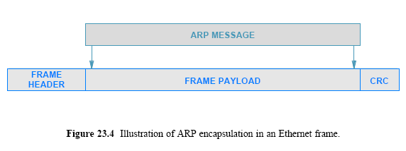
ARP Encapsulation
When it travels across a physical network
  an ARP message is encapsulated in a hardware frame
An ARP message is treated as data being transported
  the network does not parse the ARP message or interpret fields
Figure 23.4 illustrates ARP encapsulation in an Ethernet frame

Slide 12
ARP Encapsulation
The type field in the frame header specifies that the frame contains an ARP message
A sender must assign the appropriate value to the type field
  before transmitting the frame
And a receiver must examine the type field
  in each incoming frame
Ethernet uses type field 0x806 to denote an ARP message
The same value is used for both ARP requests/ responses
  Frame type does not distinguish between types of ARP messages
  A receiver must examine the OPERATION field in the message
    to determine whether an incoming message is a request or a response

Slide 13
ARP Caching and Message Processing
Sending an ARP request for each datagram is inefficient
  Three (3) frames traverse the network for each datagram
  (an ARP request, ARP response, and the data datagram itself)
Most communications involve a sequence of packets
  a sender is likely to repeat the exchange many times
To reduce network traffic
  ARP software extracts and saves the information from a response
    so it can be used for subsequent packets
  The software does not keep the information indefinitely
    Instead, ARP maintains a small table of bindings in memory
ARP manages the table as a cache
  an entry is replaced when a response arrives
  the oldest entry is removed whenever the table runs out of space or after an entry has not been updated for a long period of time
  ARP starts by searching the cache when it needs to bind an address

Slide 14
ARP Caching and Message Processing
If the binding is present in the cache
  ARP uses the binding without transmitting a request
If the binding is not present in the cache
  ARP broadcasts a request
  waits for a response
  updates the cache
  and then proceeds to use the binding
The cache is only updated when an ARP message arrives (either a request or a response)
Algorithm 23.1 outlines the procedure for handling an incoming ARP message

Slide 15
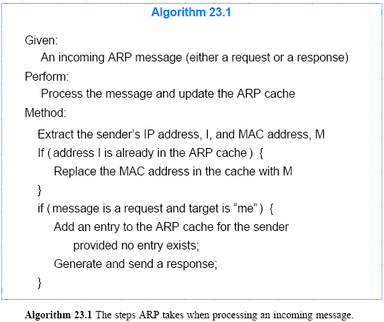
ARP Caching and Message Processing

Slide 16
The Conceptual Address Boundary
ARP provides an important conceptual boundary between MAC addresses and IP addresses:
  ARP hides the details of hardware addressing
  It allows higher layers of software to use IP addresses
There is an important conceptual boundary imposed between the network interface layer and all higher layers
Figure 23.5 illustrates the addressing boundary

Slide 17
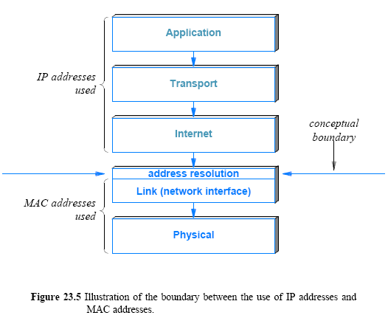
The Conceptual Address Boundary

Slide 18
Internet Control Message Protocol (ICMP)
IP defines a best-effort communication service
  datagrams can be lost, duplicated, delayed, or delivered out of order
It seems best-effort service does not need error detection!
  But IP attempts to avoid errors and to report problems when they occur
We have already seen one example of error detection in IP:
  Header checksum is used to detect transmission errors
  When a host creates an IP datagram
    the host includes a checksum that covers the entire header
  Whenever a datagram is received
    the checksum is verified to ensure that the header arrived intact
The IP header contains a TIME TO LIVE field used to prevent a datagram from circulating forever
  if the forwarding tables in routers incorrectly introduce a circular path

Slide 19
Internet Control Message Protocol (ICMP)
Response to a checksum error is following:
  Datagram must be discarded immediately without more processing
  The receiver cannot trust any fields in the datagram header
    because the receiver cannot know which bits were altered
  The receiver cannot send an error message back to the sender
    because the receiver cannot trust the source address in the header
  Thus, the receiver has no option but to discard the damaged datagram
IP includes a companion protocol, ICMP
  It is used to report errors back to the original source
IP and ICMP are co-dependent
  IP depends on ICMP to report errors
  and ICMP uses IP to carry error messages
Many ICMP messages have been defined
Figure 23.6 lists key ICMP messages and their purpose

Slide 20
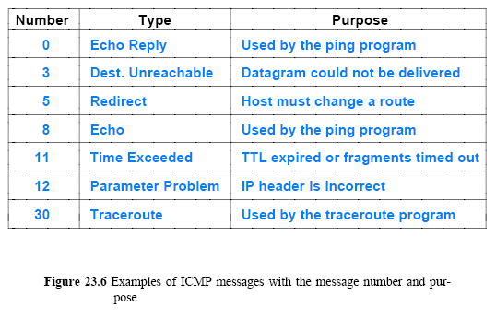
Internet Control Message Protocol (ICMP)

Slide 21
Internet Control Message Protocol (ICMP)
As in Figure 23.6, ICMP contains two message types:
  messages used to report errors
  messages used to obtain information
For example
  Time Exceeded and Destination Unreachable are for reporting errors
    when a datagram cannot be delivered successfully
A destination is unreachable if no route exists to the address
A datagram times out if
  either the TTL count in the header expires or
  fragments of the datagram do not arrive before the timer expires
Echo Request and Echo Reply do not correspond to an error
  Instead, they are used by the ping application to test connectivity
  When a host receives an echo request message
    ICMP software on a host or router sends an echo reply that carries the same data as the request

Slide 22
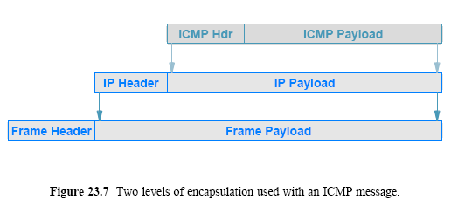
ICMP Message Format and Encapsulation
ICMP uses IP to transport each error message:
  when a router has an ICMP message to send
    it creates an IP datagram and encapsulates the ICMP message in it
  the ICMP message is placed in the payload area of the IP datagram
  the datagram is then forwarded as usual
    with the complete datagram being encapsulated in a frame for transmission

Slide 23
ICMP Message Format and Encapsulation
ICMP messages do not have special priority
  They are forwarded like any other datagram, with one minor exception
If an ICMP error message causes an error
  no error message is sent
The reason should be clear:
  the designers wanted to avoid the Internet becoming congested carrying error messages about error messages

Slide 24
Protocol Software, Parameters, and Configuration
Once a host or router has been powered on, OS is started and the protocol software is initialized
How does the protocol software in a host or router begin operation?
For a router, the configuration manager must specify initial values for items such as
  the IP address for each network connection
  the protocol software to run
  and initial values for a forwarding table
  the configuration is saved, and a router loads the values during startup
Host configuration usually uses a two-step process, known as bootstrapping
  A protocol was invented to allow a host to obtain multiple parameters with a single request, known as the Bootstrap Protocol (BOOTP)
  Currently, DHCP is used to take care of most configuration needed

Slide 25
Dynamic Host Configuration Protocol (DHCP)
Various mechanisms have been created to allow a host computer to obtain parameters
An early mechanism known as the Reverse Address Resolution Protocol (RARP) allowed a computer to obtain an IP address from a server
ICMP has Address Mask Request and Router Discovery messages
  can obtain the address mask used and the address of a router
Each of the early mechanisms was used independently
  requests were broadcast and a host typically configured layers from lowest to highest
DHCP allows a computer to join a new network and obtain an IP address automatically
  The concept has been termed plug-and-play networking

Slide 26
Dynamic Host Configuration Protocol (DHCP)
When a computer boots
  the client computer broadcasts a DHCP Request
  the server sends a DHCP Reply
    DHCP uses the term offer to denote the message a server sends
    and we say that the server is offering an address to the client
We can configure a DHCP server to supply two types of addresses:
  permanently assigned addresses as provided by BOOTP or
  a pool of dynamic addresses to be allocated on demand
Typically, a permanent address is assigned to a server, and a dynamic address is assigned to an arbitrary host
In fact, addresses assigned on demand are not given out for an arbitrary length of time

Slide 27
Dynamic Host Configuration Protocol (DHCP)
DHCP issues a lease on the address for a finite period
  The use of leases allows a DHCP server to reclaim addresses
When the lease expires
  the server places the address to the pool of available addresses
  this allows the address to be assigned to another computer
When a lease expires, a host can choose to relinquish the address or renegotiate with DHCP to extend the lease
  Negotiation occurs concurrent with other activity
Normally, DHCP approves each lease extension
  A computer continues to operate without any interruption
  However, a server may be configured to deny lease extension for administrative or technical reasons
  DHCP grants absolute control of leasing to a server
  If a server denies an extension request
    the host must stop using the address

Slide 28
DHCP Message Format
DHCP adopted a slightly modified version of the BOOTP message format
Figure 23.8 illustrates the DHCP message format
  OP specifies whether the message is a Request or a Response
  HTYPE and HLEN fields specify the network hardware type and the length of a hardware address
  FLAGS specifies whether it can receive broadcast or directed replies
  HOPS specifies how many servers forwarded the request
  TRANSACTION IDENTIFIER provides a value that a client can use to determine if an incoming response matches its request
  SECONDS ELAPSED specifies how many seconds have elapsed since the host began to boot
  Except for OPTIONS (OP), each field in a DHCP message has a fixed size

Slide 29
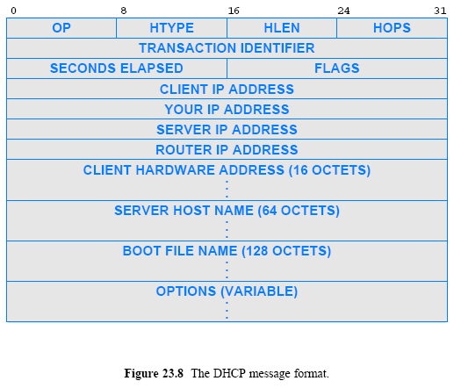
DHCP Message Format

Slide 30
Network Address Translation (NAT)
The Internet has expanded and addresses became scarce
  subnet and classless addressing (CIDR) were introduced to help conserve addresses
Another mechanism was invented that allows multiple computers at a site to share a single, globally valid IP address, known as Network Address Translation (NAT)
NAT provides transparent communication
  a host in the Internet always appears to receive communication from a single computer rather than from one of many computers at the site
NAT runs as an in-line service
  It must be placed on the connection between the Internet and a site
Most implementations embed NAT in another device
  such as a Wi-Fi wireless access point or an Internet router

Slide 31
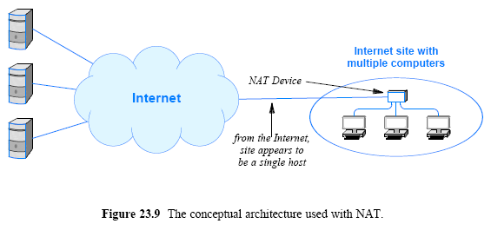
Network Address Translation (NAT)

Slide 32
NAT Operation and Private Addresses
The goal of NAT is to provide an illusion
When viewed from the Internet
  the site appears to consist of a single host computer that has been assigned a valid IP address
  all datagrams sent from the site appear to originate from one host
  and all datagrams sent to the site appear to be sent to one host
When viewed from a host in the site
  the Internet appears to accept and route private addresses
A single IP address cannot be assigned to multiple computers
  if two or more computers use the same address
    conflicts arise because multiple computers will respond to an ARP request

Slide 33
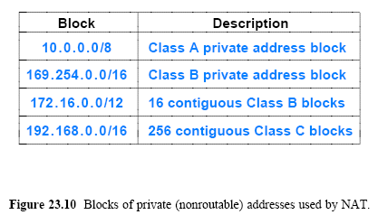
NAT Operation and Private Addresses
NAT solves the problem by using two (2) types of addresses
  The NAT device itself is assigned a single globally-valid IP address
    as if the NAT device were a host on the Internet
  Each computer at the site is assigned a unique private address
    also known as a non-routable address

Slide 34
NAT Operation and Private Addresses
Private addressing is only used inside a site
Before a datagram from the site can be allowed onto the Internet
  NAT must translate the private IP into a globally valid IP address
NAT must translate the globally valid IP address in an incoming packet to a private address
  before transferring a datagram to a host at the site
Basic function of NAT is a two-way translation, such as
  the source address translation
    as a datagram passes from the site to the Internet and
  the destination address translation
    as a datagram passes from the Internet to the site

Slide 35
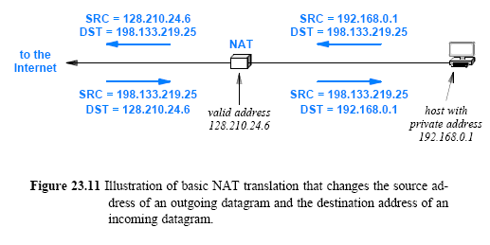
NAT Operation and Private Addresses

Slide 36
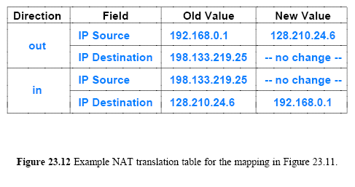
NAT Operation and Private Addresses
Most implementations of NAT use a translation table
  to store the information needed to rewrite addresses

Slide 37
Transport Layer NAT (NAPT)
NAT handles situations in which each host at a site communicates with a unique server in the Internet
If two hosts at the site attempt to communicate with remote server X,
  the translation table will contain multiple entries for X
  and NAT will not be able to route incoming datagrams
Basic NAT also fails in some situations, such as
  Consider problems when two or more applications running on a given host at a site attempt simultaneous communication with different destinations on the Internet

Slide 38
Transport Layer NAT (NAPT)
A variation of NAT, called Network Address and Port Translation (NAPT) avoids such problems:
  It allows a site to have arbitrary numbers of applications running on arbitrary hosts
    all communicating simultaneously with arbitrary destinations throughout the Internet
  most networking professionals assume the term NAT means NAPT
Applications use protocol port numbers to distinguish among services
In addition to a table of source and destination addresses
  NAPT uses port numbers to associate each datagram with a TCP or UDP flow

Slide 39
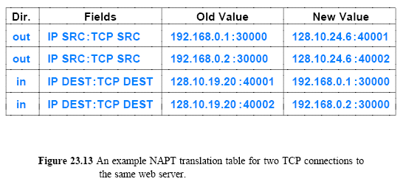
Transport Layer NAT (NAPT)
Instead of stopping at the IP-layer
  NAPT operates on transport-layer headers
NAPT entries contain a 4-tuple of source and destination IP addresses and protocol port numbers
To avoid a conflict
  NAPT must choose an alternative TCP source port for the connections

