Slide 1
Internetworking
UDP: Datagram Transport Service

Slide 2
Topics Covered
Transport Protocols and End-to-End Communication
The User Datagram Protocol
The Connectionless Paradigm
Message-Oriented Interface
UDP Communication Semantics
Modes of Interaction and Broadcast Delivery
Endpoint Identification with Protocol Port Numbers
UDP Datagram Format
The UDP Checksum and the Pseudo Header
UDP Encapsulation

Slide 3
Transport Protocols and End-to-End Communication
IP cannot distinguish among multiple application programs running on a given host
  If a user runs an email application and a web browser at the same time or runs multiple copies of a given application
    they must be able to communicate independently
From IP's point of view, the source and destination fields in a datagram identify a host
  IP does not contain additional bits to identify an application on the host
  We say that IP treats a computer as an endpoint of communication
Transport-layer protocols are known as end-to-end protocols
  a transport protocol allows an application to be an endpoint of communication
TCP/IP placed end-to-end protocols in Layer 4

Slide 4
The User Datagram Protocol
TCP/IP suite contains two transport protocols
  User Datagram Protocol (UDP)
  Transmission Control Protocol (TCP)
They differ in the service they offer to applications
UDP is less complex and easy to understand
UDP can be characterized as:
End-to-end
  UDP can distinguish among multiple applications running on a given computer
Connectionless
Message-oriented
  UDP sends and receives individual messages

Slide 5
The User Datagram Protocol
Best-effort Delivery
  It offers applications the same best-effort delivery semantics as IP
Arbitrary Interaction
  UDP allows an application
    to send to many other applications
    receive from many other applications
    or communicate with exactly one other application
Operating System Independent
  UDP provides a means of identifying application programs
  It does not depend on identifiers used by the local OS
UDP is sometimes characterized as a thin protocol layer

Slide 6
The Connectionless Paradigm
UDP uses a connectionless communication paradigm
  means that an application using UDP does not need to pre-establish communication before sending data
  an application can generate and send data at any time
  UDP allows an application to delay an arbitrarily long time between the transmission of two messages
UDP does not maintain state
UDP does not use control messages
  communication consists only of the data messages themselves
UDP has extremely low overhead

Slide 7
Message-Oriented Interface
UDP offers applications a message-oriented interface
Each time an application requests that UDP send data
  UDP places the data in a single message for transmission
  UDP does not divide a message into multiple packets
  UDP does not combine messages for delivery
Message-oriented interface has several consequences:
  On the positive side
    applications preserve data boundaries
      each message will be exactly the same as was transmitted
  On the negative side
    each UDP message must fit into a single IP datagram

Slide 8
Message-Oriented Interface
IP datagram size forms an absolute limit on the size
UDP message size can lead to inefficient use of the network
If an application sends extremely small messages
  datagrams will have a large ratio of header octets to data octets
If an application sends extremely large messages
  datagrams may be larger than the network MTU
  datagrams will be fragmented by IP
An application programmer can achieve higher efficiency by using large transfers
  With UDP, however, sending large messages leads to less efficiency
    because large messages cause fragmentation

Slide 9
UDP Communication Semantics
UDP uses IP for all delivery
UDP provides best-effort delivery semantics as IP
This means messages can be:
  Lost
  Duplicated
  Delayed
  Delivered out-of-order
  Corrupted
UDP's best-effort delivery semantics have important consequences for applications
  An application must either be immune to the problems or the programmer must take additional steps to detect and correct problems

Slide 10
UDP Communication Semantics
As an example of an application that can tolerate packet errors, consider an audio transmission
  If the sender places a small amount of audio in each message
    the loss of a single packet produces a small gap in the playback
    This gap will be heard as a pop or click
    This undesirable noise can be annoying in some cases
At the opposite extreme, consider an on-line shopping application
  Such applications do not use UDP
    because packet errors can have serious consequences
    (e.g., duplication of a message that carries a catalog order can result in
    two orders, with double charges being made to the buyer's credit card)

Slide 11
Modes of Interaction and Broadcast Delivery
UDP allows four styles of interaction:
  1-to-1
  1-to-many
  Many-to-1
  Many-to-many
An application using UDP has a choice
A 1-to-many interaction can be achieved as follows
  An application to repeatedly send a message to multiple recipients, UDP allows an application to transmit the message via IP multicast or broadcast
    For example, local broadcast can be specified by using IP's limited broadcast address, 255.255.255.255

Slide 12
Endpoint Identification with Protocol Port Numbers
How should UDP identify an application as an endpoint?
  UDP could use the same mechanism that the OS uses
  Because UDP must span heterogeneous computers
    no common mechanism exists
For example
  some OS use process identifiers
  others use job names
  and others use task identifiers
To avoid ambiguity
  UDP defines an abstract set of identifiers called protocol port numbers that are independent of the OS
  UDP must provide a mapping between protocol port numbers and the program identifiers that the OS uses
All computers running UDP recognize the standard protocol port numbers, independent of the OS

Slide 13
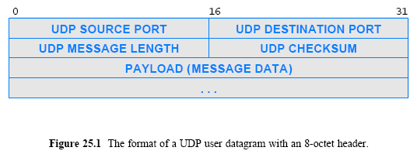
UDP Datagram Format
Each UDP message is called a user datagram and consists of two parts:
  a short header that specifies the sending and receiving application
  a payload that carries the data being sent

Slide 14
The UDP Checksum and the Pseudo Header
UDP header contains a 16-bit field named UDP checksum (optional)
  A sender can either choose to compute a checksum or set all bits of the checksum field to zero
When a message arrives at the destination
  UDP software examines the checksum field
  and only verifies the checksum if the value is nonzero
UDP uses a ones-complement checksum
  if the computed checksum has a value of zero
    a sender uses the all-ones form of zero
To verify that messages to reach the correct destination without incurring the overhead of additional header fields
  UDP extends the checksum

Slide 15
The UDP Checksum and the Pseudo Header
UDP software includes a pseudo header that contains
  source
  destination
  type (i.e., PROTO) fields from the IP datagram and a UDP datagram length
  The sender computes a checksum as if the UDP header contained extra fields
Similarly, to verify a checksum
  a receiver must obtain the UDP length, and the source, destination, and type fields from the IP datagram
  the receiver appends them to the UDP message before verifying the checksum

Slide 16
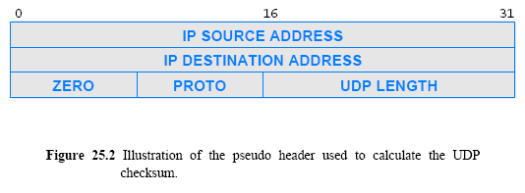
The UDP Checksum and the Pseudo Header

Slide 17
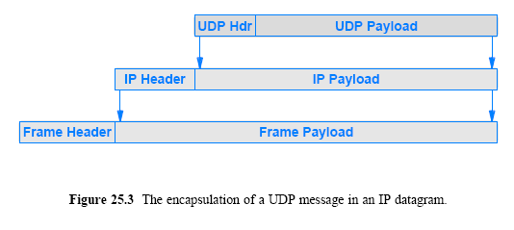
UDP Encapsulation
Each UDP datagram is encapsulated in an IP datagram for transmission across the Internet

