Slide 1
Internetworking
TCP: Reliable Transport Service

Slide 2
Topics Covered
The Transmission Control Protocol
The Service TCP Provides to Applications
End-to-End Service and Virtual Connections
Techniques That Transport Protocols Use
Techniques to Avoid Congestion
The Art of Protocol Design
Techniques Used in TCP to Handle Packet Loss
Adaptive Retransmission
Comparison of Retransmission Times
Buffers, Flow Control, and Windows
TCP's Three-Way Handshake
TCP Congestion Control
TCP Segment Format

Slide 3
The Transmission Control Protocol
A programmer assumes
  the data will arrive correctly
    or the OS will inform the application that an error has occurred
  OS guarantees that data will be delivered reliably
Protocol software must provide the following:
  Guarantee prompt and reliable communication
  Data be delivered in exactly the same order that it was sent
  There be no loss or duplication
In the TCP/IP suite, the Transmission Control Protocol (TCP) provides reliable transport service

Slide 4
The Service TCP Provides to Applications
The service offered by TCP has the following features:
Connection Orientation
  an application must first request a connection to a destination
Point-to-Point Communication
  each TCP connection has exactly two endpoints
Complete Reliability
  TCP guarantees that the data sent across a connection will be delivered completely and in order
Full Duplex Communication
  allows data to flow in either direction
Stream Interface
  an application sends a continuous sequence of octets
  it does not group data into records or messages
Reliable Connection Startup
  TCP allows two applications to reliably start communication
Graceful Connection Shutdown
  TCP insures that both sides have agreed to shut down the connection

Slide 5
End-to-End Service and Virtual Connections
TCP is classified as an end-to-end protocol
  it provides communication between an application on one computer to an application on another computer
The connections in TCP are called virtual connections
  because connections are achieved in software
TCP software modules on two machines exchange messages to achieve the illusion of a connection
TCP uses IP to carry messages
  IP treats each TCP message as data to be transferred

Slide 6
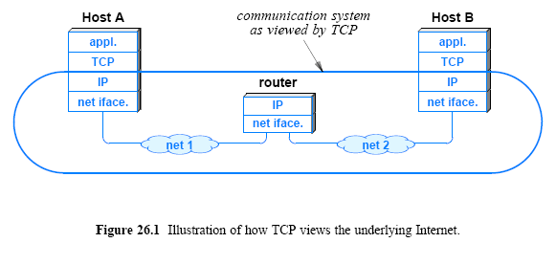
End-to-End Service and Virtual Connections

Slide 7
Techniques That Transport Protocols Use
An end-to-end transport protocol must be carefully designed to achieve efficient and reliable transfer
The major problems/issues to be considered, such as
Unreliable Communication
  Messages sent across the Internet
    They can be lost, duplicated, corrupted, delayed, or delivered out of order
End System Reboot
  either of the two end systems might crash and reboot
Heterogeneous End Systems
  A sender can generate data so fast that it overruns a slow receiver
Congestion in the Internet
  If senders aggressively transmit data
    intermediate switches and routers can become overrun
There are techniques that communication systems use to overcome some of the problems
  For example, to compensate for bits that are changed during transmission
    a protocol might include parity bits
    a checksum
    or a cyclic redundancy check (CRC)
Transport protocols do more than detect errors
  they employ techniques that can repair or circumvent problems
Transport protocols use a variety of tools
  to handle some of the most complicated communication problems

Slide 8
Techniques That Transport Protocols Use
To handle duplicate packets and out-of-order deliveries
  transport protocols use sequencing
The sender attaches a sequence number to each packet
The receiver stores both the sequence number of the last packet received in order
  as well as a list of additional packets that arrived out of order
The receiver examines the sequence number
  to determine how the packet should be handled
If the packet is the next one expected (i.e., has arrived in order)
  the protocol software delivers the packet to the next highest layer
  the protocol checks its list
    to see whether additional packets can also be delivered
If the packet has arrived out of order
  the protocol software adds the packet to the list
If the packet has already been delivered or the sequence number matches one of the packets waiting on the list
  the software discards the new copy

Slide 9
Techniques That Transport Protocols Use
To handle packet loss
  transport protocols use positive acknowledgement (ACK) with retransmission
Whenever a frame arrives intact
  the receiver sends a small ACK message that reports successful reception
Sender ensures that each packet is transferred successfully
Whenever it sends a packet
  the sender starts a timer
If an acknowledgement arrives before the timer expires
  the software cancels the timer
If the timer expires before an acknowledgement arrives
  the protocol sends another copy of the packet and starts the timer again
Sending a second copy is known as retransmitting
  retransmission cannot succeed if a hardware failure has permanently disconnected the network or if the receiving computer has crashed
  there is a bound for the maximum number of retransmissions

Slide 10
Techniques That Transport Protocols Use
Extraordinarily long delays can lead to replay errors
For example, consider the following sequence of events
  Assume two computers agree to communicate at 1 PM
  One computer sends a sequence of 10 packets to the other
  A hardware problem causes packet 3 to be delayed
    Assume routes change to avoid the hardware problem
  Protocol software on the sending computer retransmits packet 3 and sends the remaining packets without error
  At 1:05 PM the two computers agree to communicate again
  After the second packet arrives, the delayed copy of packet 3 arrives from the earlier conversation
  Packet 3 arrives from the second conversation
A packet from an earlier conversation might be accepted and the correct packet discarded as a duplicate

Slide 11
Techniques That Transport Protocols Use
Replay errors can also occur with control packets
Consider a situation in which two application programs form a TCP connection, communicate, close the connection, and then form a new connection
  The message of closing the connection might be duplicated and one copy might be delayed long enough for the second connection to be established
A protocol should be designed so that the duplicate message will not cause the second connection to be closed
To prevent replays, protocols mark each session with a unique ID
  (e.g., the time the session was established), and require the unique ID to be present in each packet
The protocol discards any arriving packet that contains an incorrect ID
An ID must not be reused until a reasonable time has passed

Slide 12
Techniques That Transport Protocols Use
Techniques are available to prevent a fast computer from sending so much data to overrun a slower receiver
  Flow control techniques are employed to handle the problem
The simplest form of flow control is a stop-and-go
  a sender waits after transmitting each packet
  when the receiver is ready for another packet, the receiver sends a control message, usually a form of ACK
  stop-and-go protocols result in extremely low throughput
Another flow control technique known as sliding window
  The sender and receiver use a fixed window size
    which is the maximum amount of data that can be sent before an acknowledgement arrives
  The sender retains a copy in case retransmission is needed
  The receiver must have preallocated buffer space

Slide 13
Techniques That Transport Protocols Use
If a packet arrives in sequence
  the receiver
    passes the packet to the receiving application
    and transmits an ACK to the sender
When an ACK arrives
  the sender
    discards its copy of the ACKed packet
    and transmits the next packet
Figure 26.2 illustrates sliding window mechanism
Sliding window can increase throughput dramatically
  compare the sequence of transmissions with a stop-and-go scheme and a sliding window scheme

Slide 14
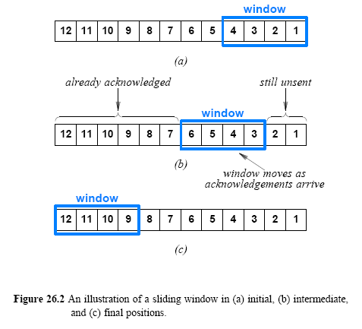
Techniques That Transport Protocols Use

Slide 15
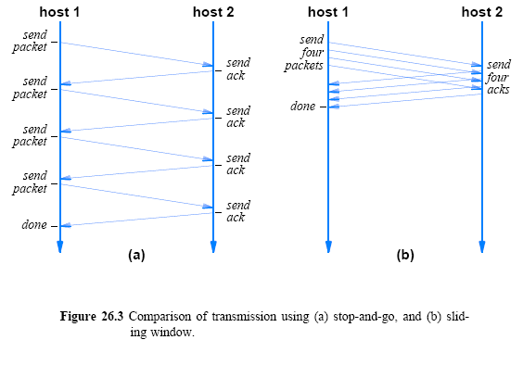
Techniques That Transport Protocols Use

Slide 16
Techniques That Transport Protocols Use
To understand the significance of sliding window
  imagine an extended communication that involves many packets
  For such networks, a sliding window protocol can increase performance substantially. The potential improvement is:
  where
    T_{w} is the throughput that can be achieved with a sliding window protocol
    T_{g} is the throughput that can be achieved with a stop-and-go protocol
    W is the window size
Throughput cannot be increased arbitrarily, by just increasing the window size
  The bandwidth of the underlying network imposes an upper bound; bits cannot be sent faster than the hardware can carry them
  The equation can be rewritten (B is the underlying bandwidth):

Slide 17
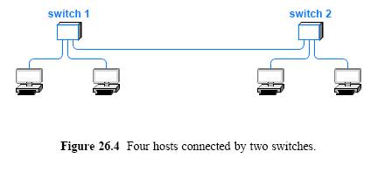
Techniques to Avoid Congestion
How easily can congestion occur?
Consider case in Figure 26.4 (below)

Slide 18
Techniques to Avoid Congestion
Assume each connection in Figure 26.4 operates at 1 Gbps
Consider what happens if both computers attached to switch1 attempt to send data to a computer attached to switch2
  Switch1 receives data at an aggregate rate of 2 Gbps, but can only forward 1 Gbps to switch2
  This situation is known as congestion
Congestion results in delay
If congestion persists
  the switch will run out of memory and begin discarding packets
Retransmission can be used to recover lost packets
  But retransmission sends more packets into the network
If the situation persists, network can become unusable
  this condition is known as congestion collapse

Slide 19
Techniques to Avoid Congestion
In the Internet, congestion usually occurs in routers
Transport protocols attempt to avoid congestion collapse
  by monitoring the network and reacting quickly once congestion starts
There are two basic approaches:
Arrange for intermediate systems (i.e., routers) to inform a sender when congestion occurs
  implemented either by having routers send a special message to the source of packets when congestion occurs
  or by having routers set a bit in the header of each packet that experiences delay caused by congestion
Use increased delay or packet loss as an estimate of congestion
  Implemented by the computer that receives the packet including information in the ACK to inform the original sender

Slide 20
Techniques to Avoid Congestion
Using delay and loss to estimate congestion is reasonable in the Internet because:
  Modern network hardware works well
  Most delay and loss results from congestion, not hardware failures
The appropriate response to congestion
  Reducing the rate at which packets are being transmitted
  Sliding window protocols can achieve the effect of reducing the rate by temporarily reducing the window size

Slide 21
Techniques Used in TCP to Handle Packet Loss
Which techniques does TCP use to achieve reliability?
  The answer is complex
    because TCP uses a variety of schemes that are combined in novel ways
TCP uses retransmission to compensate for packet loss
TCP provides data flow in both directions
  both sides of a communication participate in retransmission
  when TCP receives data, it sends an ACK back to the sender
Whenever it sends data
  TCP starts a timer, and retransmits the data if the timer expires

Slide 22
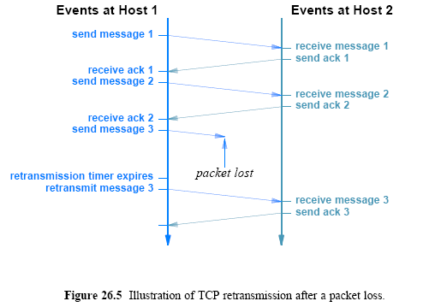
Techniques Used in TCP
to Handle Packet Loss

Slide 23
Techniques Used in TCP to Handle Packet Loss
TCP's retransmission is the key to its success
  because it handles communication across an arbitrary path
TCP must be ready to retransmit any message that is lost
How long should TCP wait before retransmitting?
  ACKs from a computer on a LAN are expected to arrive within a few ms
  but a satellite connection requires hundreds of ms
On one hand
  waiting too long for such an ACK leaves the network idle and does not maximize throughput
On the other hand
  retransmitting quickly does not work well on a satellite connection
    because the unnecessary traffic consumes network bandwidth and lowers throughput

Slide 24
Adaptive Retransmission
Before TCP was invented
  transport protocols used a fixed value for retransmission delay
  the protocol designer or network manager chose a value that was large enough for the expected delay
TCP designers realized that a fixed timeout would not operate well for the Internet
  Thus, they chose to make TCP's retransmission adaptive
  TCP monitors current delay on each connection
    It adapts (changes) the retransmission timer accordingly

Slide 25
Adaptive Retransmission
How can TCP monitor Internet delays?
TCP cannot know the exact delays
  TCP estimates round-trip delay for each active connection by measuring the time needed to receive a response
  TCP records the time at which the message was sent
When a response arrives
  TCP subtracts the time the message was sent from the current time to produce a new estimate of the round-trip delay for that connection
As it sends data packets and receives ACKs
  TCP generates a sequence of round-trip estimates
  It uses a statistical function to produce a weighted average
  TCP keeps an estimate of the variance
  It uses a linear combination of the estimated mean and variance to compute estimated time

Slide 26
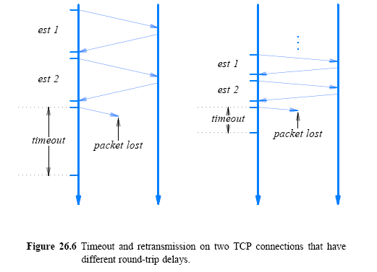
Comparison of Retransmission Times

Slide 27
Buffers, Flow Control, and Windows
TCP uses a window mechanism to control the flow of data
Unlike the simplistic packet-based window scheme described above
  a TCP window is measured in bytes
When a connection is established
  each end of the connection allocates a buffer
    to hold incoming data and sends the size of the buffer to the other end
As data arrives
  receiving TCP sends ACKs, which specify the remaining buffer size
Window to refer to the buffer space available at any time
  a notification that specifies the size of the window is known as a window advertisement
  a receiver sends a window advertisement with each ACK

Slide 28
Buffers, Flow Control, and Windows
If the receiver can read data as quickly as it arrives
  a receiver will send a positive window advertisement along with each ACK
If the sender operates faster than the receiver
  incoming data will eventually fill the receiver's buffer
  causing the receiver to advertise a zero (0) window
A sender that receives a zero window advertisement
  must stop sending
    until the receiver again advertises a positive window

Slide 29
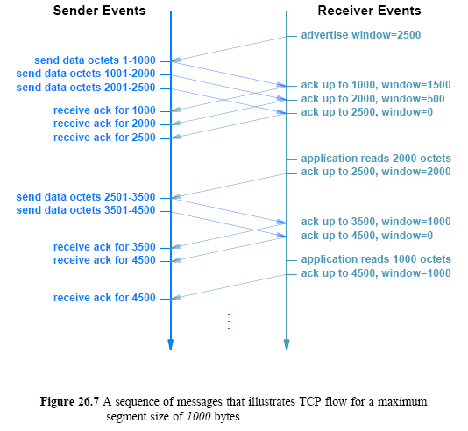
Buffers, Flow Control, and Windows

Slide 30
TCP's Three-Way Handshake
To establish or terminate connections reliably
  TCP uses a 3-way handshake
    in which three messages are exchanged
During the 3-way handshake to start a connection
  each side sends a control message that specifies an initial buffer size (for flow control) and a sequence number
TCP's 3-way exchange is necessary and sufficient to ensure unambiguous agreement
  despite packet loss, duplication, delay, and replay events
The handshake insures that TCP will not open or close a connection until both ends have agreed

Slide 31
TCP's Three-Way Handshake
Term synchronization segment (SYN segment) to describe the control messages used in a 3-way handshake to create a connection
Term FIN segment (short for finish segment) to describe control messages used in a 3-way handshake to close a connection
Figure 26.8 illustrates the 3-way handshake to create a connection
A key aspect of the 3-way handshake is the selection of sequence numbers
  TCP requires each end to generate a random 32-bit sequence number that becomes the initial sequence

Slide 32
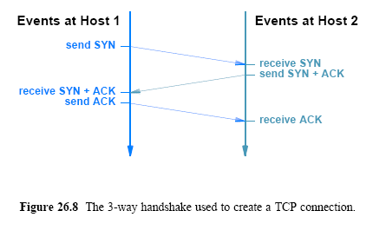
TCP's Three-Way Handshake
Connection Establishment

Slide 33
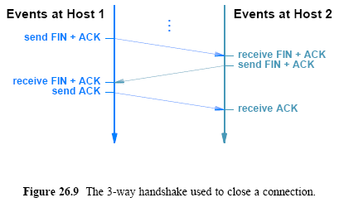
TCP's Three-Way Handshake
Connection Termination

Slide 34
TCP Congestion Control
One of the most interesting aspects of TCP is a mechanism for congestion control
In the Internet, delay or packet loss is more likely to be caused by congestion than a hardware failure
Retransmission can exacerbate the problem of congestion
  by injecting additional copies of a packet
To avoid congestion collapse
  TCP uses changes in delay as a measure of congestion
  It responds to congestion by reducing the rate at which it retransmits data
Although we think of reducing the rate of transmission
  TCP does not compute a data rate
  Instead, TCP bases transmission on buffer size
    That is, the receiver advertises a window size, and the sender can transmit data to fill the receiver's window before an ACK is received

Slide 35
TCP Congestion Control
To control the data rate
  TCP imposes a restriction on the window size
By temporarily reducing the window size
  the sending TCP effectively reduces the data rate
TCP can achieve a reduction in data rate
  by temporarily reducing the window size
In the extreme case where loss occurs
  TCP temporarily reduces the window to one-half of its current value
TCP uses a special congestion control mechanism when starting a new connection or when a message is lost
  instead of transmitting enough data to fill the receiver's buffer
    TCP begins by sending a single message containing data

Slide 36
TCP Congestion Control
If an acknowledgement arrives without additional loss
  TCP doubles the amount of data being sent and sends two additional messages
If both acknowledgements arrive
  TCP sends four messages, and so on
The exponential increase continues
  until TCP is sending half of the receiver's advertised window
When one-half of the original window size is reached
  TCP slows the rate of increase and increases the window size linearly
    as long as congestion does not occur
The approach is known as slow start
TCP's congestion control mechanisms respond well to increases in traffic
  By backing off quickly, TCP is able to alleviate congestion

Slide 37
TCP Segment Format
TCP uses a single format for all messages
  including messages that carry data, those that carry ACKs, and messages that are part of the 3-way handshake used to create or terminate a connection (SYN and FIN)
TCP uses the term segment to refer to a message
Figure 26.10 illustrates the TCP segment format
A TCP connection contains two streams of data
  one flowing in each direction
If the applications at each end are sending data simultaneously
  TCP can send a single segment that carries outgoing data
  The ACK for incoming data, and a window advertisement that specifies the amount of additional buffer space available for incoming data
Some of the fields in the segment refer to the data stream traveling in the forward direction
  while other fields refer to the data stream traveling in the reverse direction

Slide 38
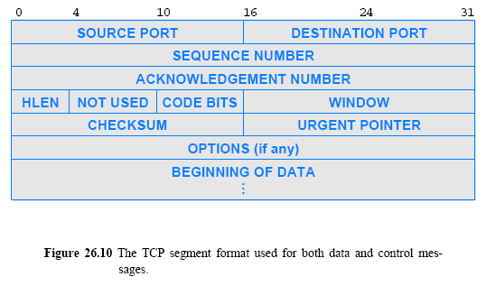
TCP Segment Format

Slide 39
TCP Segment Format
ACKNOWLEDGEMENT NUMBER
  specifies the sequence number of the data that is expected next
WINDOW
  specifies how much additional buffer space is available beyond the ACKed data
    The ACK always refers to the first position for which data is missing
  If segments arrive out of order, a receiving TCP generates the same ACK multiple times until the missing data arrives
SEQUENCE NUMBER
  Refers to outgoing data, it gives the sequence number of the first byte of data being carried in the segment
  A receiver uses the sequence number to reorder segments that arrive out of order and to compute an acknowledgement number
DESTINATION PORT
  identifies which application program on the receiving computer should receive the data
SOURCE PORT
  identifies the application program that sent the data
CHECKSUM
  contains a checksum that covers the TCP segment header and the data

