Slide 1
Introduction and Internet Applications
Internet Trends

Slide 2
Overview
Resource Sharing
Growth of the Internet
Resource Sharing to Communication
Text to Multimedia
Recent Trends

Slide 3
Resource Sharing
Initial computer networks were built to extend existing resources
  Access a shared peripheral device (i.e. printer)
Early networks were designed to share large-scale computing power
The U.S. Department of Defense Advanced Research Projects Agency (DARPA) funded the initial networking research project
  Researchers needed powerful computers
  ARPA planned to interconnect all computers with a network
  Working system called the ARPANET was developed
DARPA’s Approach
  Gathered some of the best minds available
  Focused them on computer network research
The Internet grew out of the work done on the ARPANET

Slide 4
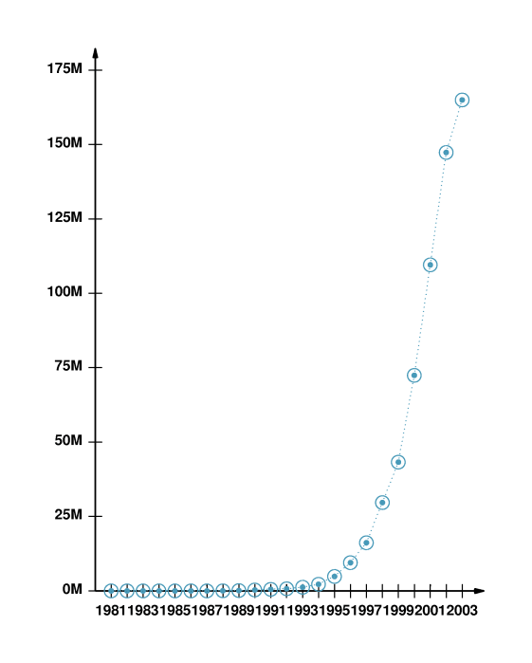
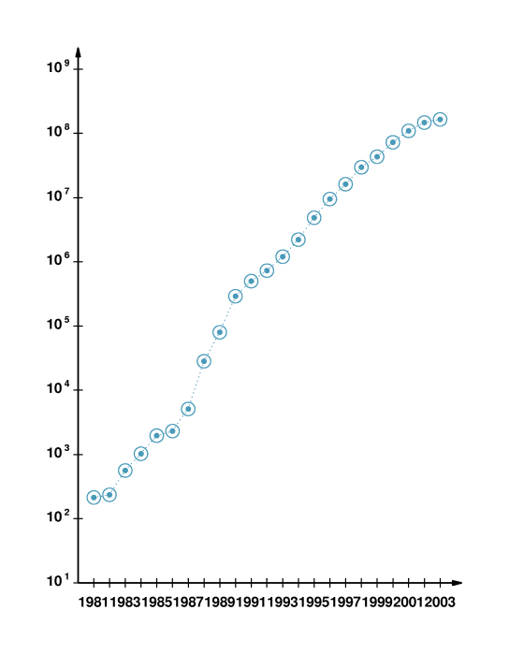
Growth of the Internet
Number of Computers Attached to the Internet
Internet Growth

Slide 5
Resource Sharing to Communication
Internet growth prompted two significant changes in the Internet:
  Communication speeds increased dramatically
  Broad appeal computer applications
  Internet is no longer dominated by scientists and engineers, scientific applications, or access to computational resources
Two technological changes fueled the paradigm shift:
  Higher communication speeds
    Enabled applications to transfer large volumes of data quickly
  The advent of powerful, affordable, personal computers
    Provided the computational power needed for complex computation and graphical displays

Slide 6


Text to Multimedia
Major shift has occurred in the data being sent across the Internet
  Internet communication initially involved textual data
    By the 1990s, applications arose that allowed users to transfer images easily
    By the late 1990s, users began sending video clips and full-motion videos
    Similar transition in audio
Higher bandwidths have made it possible to communicate high-resolution video and high-fidelity audio

Slide 7
Recent Trends
New technologies and new applications continue to emerge
Some of the most significant transitions have occurred as traditional communication systems
  Voice telephone network and cable television, moved from analog to digital and adopted Internet technology
  Support for mobile users is accelerating
One of the most interesting aspects of the Internet
  Internet applications change even though the underlying technology essentially remains the same
The availability of high-quality teleconferencing systems
Some social networking applications such as
  Facebook
  YouTube
Social network applications
  Sets of people know each other only through the Internet

Slide 8
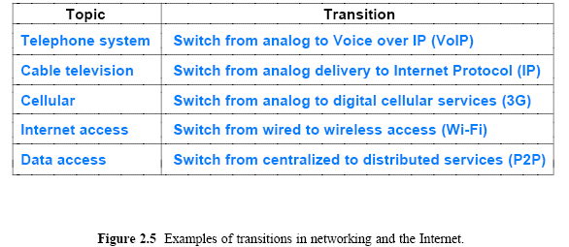
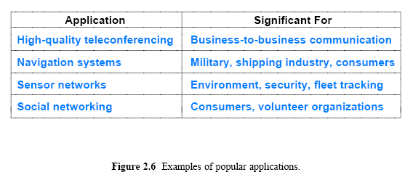
Recent Trends

