Slide 1
Introduction and Internet Applications
Traditional Internet Applications

Slide 2
Topics Covered
Application-Layer Protocols
Representation and Transfer
Web Protocols
Document Representation with HTML
Uniform Resource Locators and Hyperlinks
Web Document Transfer with HTTP
Caching in Browsers
Browser Architecture
File Transfer Protocol (FTP)
FTP Communication Paradigm
Electronic Mail
The Simple Mail Transfer Protocol (SMTP)

Slide 3
Topics Covered
ISPs, Mail Servers, and Mail Access
Mail Access Protocols (POP, IMAP)
Email Representation Standards (RFC2822, MIME)
Domain Name System (DNS)
Domain Names That Begin with www
The DNS Hierarchy and Server Model
Name Resolution
Caching in DNS Servers
Types of DNS Entries
Aliases and CNAME Resource Records
Abbreviations and the DNS
Internationalized Domain Names
Extensible Representations (XML)

Slide 4
Application-Layer Protocols
Whenever a programmer creates two network applications, the programmer specifies some details, such as:
  The syntax and semantics of messages that can be exchanged
  Whether the client or server initiates interaction
  Actions to be taken if an error arises
  How the two sides know when to terminate communication
There are two broad types of application-layer protocols that depend on the intended use:
  Private communication
  Standardized service

Slide 5
Application-Layer Protocols
Private communication
  A programmer creates a pair of applications that communicate over the Internet with the intention that the pair is for private use
  Interaction between the two applications is straightforward
    code can be written without writing a formal protocol specification
Standardized service
  Expectation is that many programmers will create server software to offer the service or client software to access the service, in this case
    Application protocol must be documented independent of implementation
    The specification must be precise and unambiguous
The size of a protocol specification depends on the complexity of the service

Slide 6
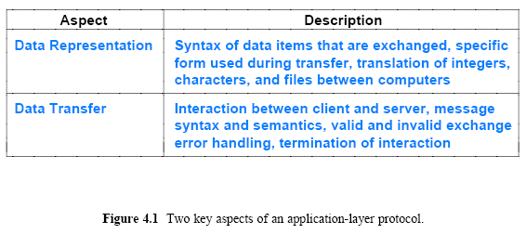
Representation and Transfer
Application-layer protocols specify two aspects of interaction
  Representation
  Transfer

Slide 7
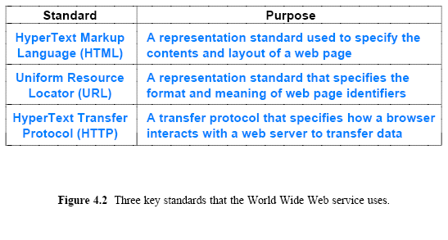
Web Protocols
The World Wide Web (WWW) is one of the most widely used services in the Internet
Web is complex
  many protocol standards have been devised to specify various aspects and details

Slide 8
Document Representation with HTML
HyperText Markup Language (HTML) is a representation standard that specifies the syntax of a web page
HTML has the following general characteristics:
  Uses a textual representation
  Describes pages that contain multimedia
  Follows a declarative rather than procedural paradigm
  Provides markup specifications instead of formatting
  Permits a hyperlink to be embedded in an arbitrary object
  Allows a document to include metadata
HTML allows a programmer to specify a complex web page that contains graphics, audio, and video, as well as text
  We should have used hypermedia in the name instead of hypertext

Slide 9
Document Representation with HTML
HTML is classified as declarative
  It allows one to specify what is to be done, not how to do it
HTML is classified as a markup language
  It only gives general guidelines for display and does not include detailed formatting instructions
  HTML allows a page to specify the level of importance of a heading
  HTML does not require the author to specify the exact font, typeface, point size, or spacing for the heading
    HTML extensions have been created that do allow the specification of an exact font, typeface, point size, and formatting
    A browser chooses all display details
  The use of a markup language is important
    because it allows a browser to adapt the page to the underlying display hardware
    a page can be formatted for a high resolution or low resolution display, a large screen or a small hand-held device such as an iPhone or PDA

Slide 10
Document Representation with HTML
To specify markup
  HTML uses tags embedded in the document
  Tags provide structure as well as formatting
Tags control all display
  white space (i.e., extra lines and blank characters) can be inserted at any point in the HTML document
    without any effect on the formatted version that a browser displays
HTML tags are case insensitive
  does not distinguish between uppercase and lowercase letters
Examples:
  IMG tag to encode a reference to an external image
    Additional parameters can be specified in an IMG tag to specify the alignment of the figure with surrounding text

Slide 11
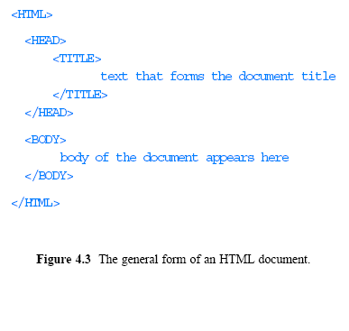
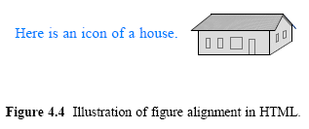
Document Representation with HTML

Slide 12
Uniform Resource Locators and Hyperlinks
The Web uses a syntactic form known as a Uniform Resource Locator (URL) to specify a web page
The general form of a URL is:
where
  protocol is the name of the protocol used to access the document
  computer_name is the domain name of the computer on which the document resides
  port (optional) port number at which the server is listening
  document_name (optional) name of the document
  % (optional) parameters for the page
  Example:

Slide 13
Uniform Resource Locators and Hyperlinks
In a typical URL, a user can omit many of the parts
Which omits
  the protocol (http is assumed)
  the port (80 is assumed)
  the document name (index.html is assumed)
  and parameters (none are assumed)
A URL contains the information a browser needs to retrieve a page
Browser uses the separator characters
  colon, slash, and percent, to divide the URL into four components:
    a protocol, a computer name, a document name, and parameters
Browser uses the computer name and protocol port to form a connection to the server on which the page resides
Browser uses the document name and parameters to request a page

Slide 14
Web Document Transfer with HTTP
HyperText Transfer Protocol (HTTP) is the primary transfer protocol that a browser uses to interact with a web server
A browser is a client that extracts a server name from a URL and contacts the server
Most URLs contain an explicit protocol reference of http:// or omit the protocol altogether (HTTP is assumed)
HTTP can be characterized as follows:
  Uses textual control messages
  Transfers binary data files
  Can download or upload data
  Incorporates caching

Slide 15
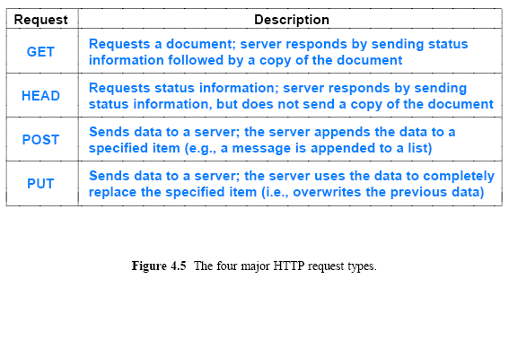
Web Document Transfer with HTTP
Once it establishes a connection
  a browser sends an HTTP request to the server
Figure 4.5 (below) lists the four major request types

Slide 16
Web Document Transfer with HTTP
The most common form of interaction begins with the browser requesting a page from the server
The browser (client) sends a GET request over
The server responds by sending a header, a blank line, and the requested document
A GET request has the following form:
GET /item version CRLF
  item gives the URL for the item being requested,
  version specifies a version of the protocol (HTTP/1.0 or HTTP/1.1)
  CRLF denotes two ASCII characters
    carriage return and linefeed, that are used to signify the end of a line of text
Version information is important in HTTP
  it allows the protocol to change and yet remain backward compatible
  a browser sends version information which allows
  a server to choose the highest version that they can both understand

Slide 17
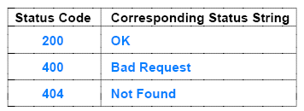
Web Document Transfer with HTTP
The first line of a response header contains a status code
  that tells the browser whether the server handled the request
  If the request was incorrectly formed or the requested item was not available, the status code pinpoints the problem
    For example, a server returns status code 404 if the requested item cannot be found
    When it honors a request, a server returns status code 200
Additional lines of the header give further information, such as
  its length
  when it was last modified
  and the content type

Slide 18
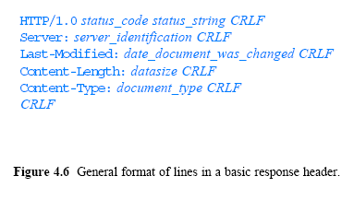
Web Document Transfer with HTTP

Slide 19
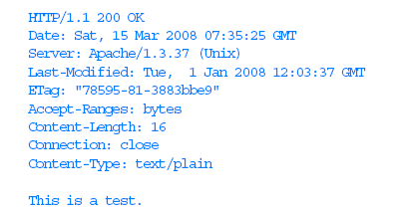
Web Document Transfer with HTTP
Figure 4.8 shows sample output from an Apache web server
The item being requested is a text file containing 16 characters
  (i.e., the text This is a test. plus a NEWLINE character)
Although the GET request specifies HTTP version 1.0, the server runs version 1.1
The server returns 9 lines of header, a blank line, and the contents of the file

Slide 20
4.8 Caching in Browsers
Caching provides an important optimization for web access
  because users tend to visit the same web sites repeatedly
Much of the content at a given site consists of large images
  Graphics Image Format (GIF)
  Joint Picture Encoding Group (JPEG)
Such images often contain backgrounds or banners
  they do not change frequently
A browser can reduce download times significantly
  by saving a copy of each image in a cache on the user's disk and using the cached copy
What happens if the document on the web server changes after a browser stores a copy in its cache?
  How can a browser tell whether its cached copy is stale?

Slide 21
Caching in Browsers
Whenever a browser obtains a document from a web server, the header specifies the last time the document was changed
A browser saves the Last-Modified date information along with the cached copy
  A browser makes a HEAD request to the server and compares the Last-Modified date of the server's copy to the Last-Modified date in the cached
  If the cached version is stale, the browser downloads the new version
Algorithm 4.1 summarizes caching, but omits several minor details
  For example, HTTP allows a web site to include a No-cache header that specifies a given item should not be cached
Browsers do not cache small items
  because the time to download the item with a GET request is approximately the same as the time to make a HEAD request and keeping many small items in a cache can increase cache lookup times

Slide 22
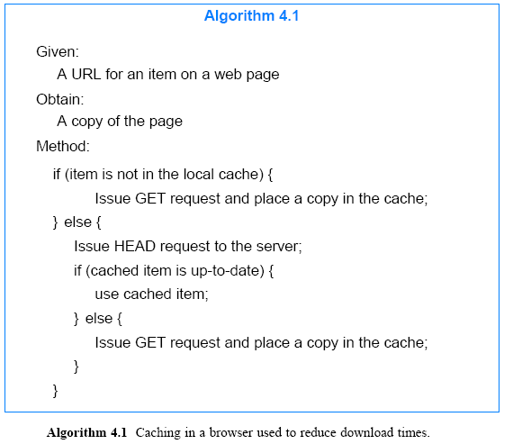
Caching in Browsers

Slide 23
Browser Architecture
A browser structure is complex
A browser must understand HTTP
A browser also provides support for other protocols
  a browser must contain client code for each of the protocols used
  the browser must know how to interact with a server and how to interpret responses
  a browser must know how to access the FTP service

Slide 24
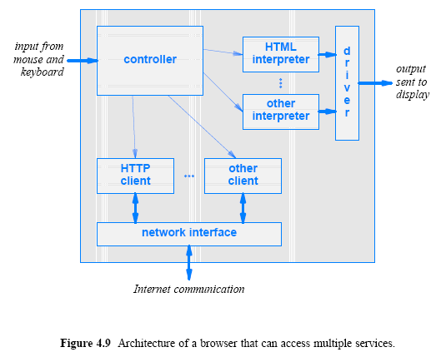
Browser Architecture

Slide 25
File Transfer Protocol (FTP)
A file is the fundamental storage abstraction
A file can hold an arbitrary object (e.g., a document, spreadsheet, computer program, graphic image, or data)
FTP can send a copy of a file from one computer to another - provides a powerful mechanism for the exchange of data
File transfer across the Internet is complicated because computers are heterogeneous.
Each computer system may have a different:
  file representations
  type information
  naming
  file access mechanisms

Slide 26
File Transfer Protocol (FTP)
On some OS, the extension .jpg is used for a JPEG image, and on others, the extension is .jpeg
On some OS, each line in a text file is terminated by a single LINEFEED character
  On some OS may require CARRIAGE RETURN and LINEFEED
Some OS use slash (/) as a separator in file names, and others use a backslash (\)
An OS may define a set of user accounts that are each given the right to access certain files
  the account information differs among computers, so user X on one computer is not the same as user X on another

Slide 27
File Transfer Protocol (FTP)
FTP can be characterized as:
Arbitrary File Contents (can transfer any type of data)
Bidirectional Transfer (download or upload)
Support for Authentication and Ownership
  FTP allows each file to have ownership and access restrictions
Ability to Browse Folders
Textual Control Messages
  The control messages are sent as ASCII text
Accommodates Heterogeneity
  FTP hides the details of individual computer OS
Mostly FTP protocol is invisible
  FTP is invoked automatically by a browser when a user requests a file download

Slide 28
FTP Communication Paradigm
FTP employs the way a client and server interact
  a client establishes a connection to an FTP server and sends a series of requests to which the server responds
  an FTP server does not send responses over the same connection on which the client sends requests
    Instead, the original connection the client creates, called a control connection, is reserved for commands
  Each time the server needs to download or upload a file, the server opens a new connection
    To distinguish them from the control connection, the connections used to transfer files are called data connections
FTP inverts the client-server relationship for data connections
Figure 4.10 illustrates the interaction

Slide 29
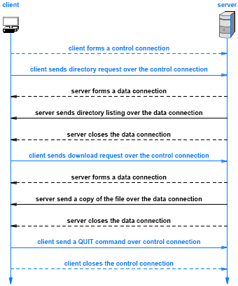
Figure 4.10 Illustration of FTP connections during a typical session

Slide 30
FTP Communication Paradigm
Figure 4.10 omits several important details
  For example, after creating the control connection, a client must log into the server
    provides a USER command that the client sends to provide a login name
    provides a PASS command that the client sends to provide a password
  The server sends a numeric status response over the control connection to let the client know whether the login was successful.
    A client can only send other commands after a login is successful
When accessing public files, a client uses anonymous login
  which consists of user name anonymous and password mostly guest
What protocol port number should a server specify when connecting to the client?

Slide 31
FTP Communication Paradigm
A client allocates a protocol port on its local OS and sends the port number to the server
  That is, the client binds to the port to await a connection
  Then transmits a PORT command over the control connection to inform the server about the port number being used
Algorithm 4.2 summarizes the steps
FTP protocol may face problems in certain cases
  transmission of a protocol port number will fail if one of the two endpoints lies behind a Network Address Translation (NAT) device, such as a wireless router used in a residence or small office
    Chapter 23 explains that FTP is an exception to support FTP, a NAT device recognizes an FTP control connection, inspects the contents of the connection, and rewrites the values in a PORT command

Slide 32
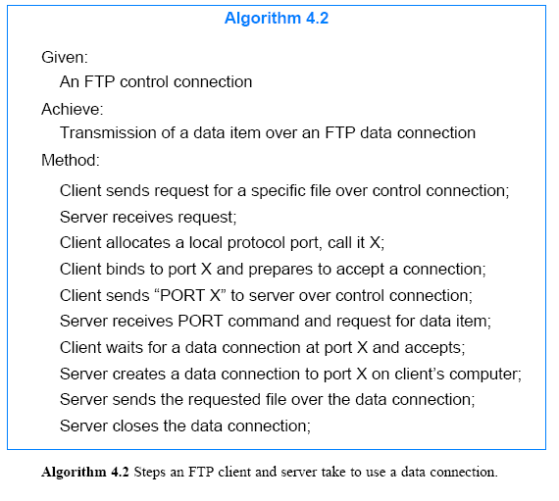

Slide 33
Electronic Mail
One of the most widely used Internet applications
Figure 4.11 illustrates the architecture of electronic email
Email software is divided into two conceptually pieces:
  An email interface application
    A mechanism for a user to compose and edit outgoing messages as well as read and process incoming email
  A mail transfer program
    acts as a client to send a message to the mail server on the destination computer; the mail server accepts incoming messages and deposits each in the appropriate user's mailbox

Slide 34
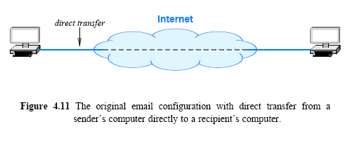
Electronic Mail

Slide 35
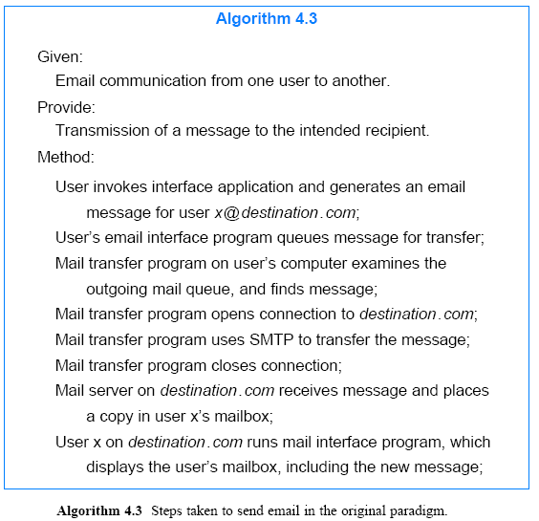

Slide 36
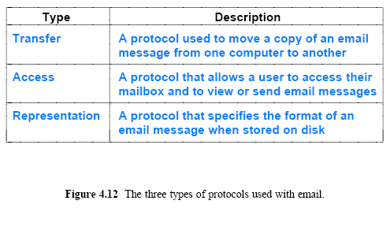
Electronic Mail
The specifications used for Internet email can be divided into three broad categories as Figure 4.12 lists

Slide 37
The Simple Mail Transfer Protocol (SMTP)
The Simple Mail Transfer Protocol (SMTP) is the standard protocol that a mail transfer program uses
SMTP can be characterized as:
  Follows a stream paradigm
  Uses textual control messages
  Only transfers text messages
  Allows a sender to specify recipients’ names and check each name
  Sends one copy of a given message
SMTP has a restriction to send only textual content
  MIME standard that allows email to include attachments such as graphic images or binary files
SMTP can send a single message to multiple recipients
  The protocol allows a client to list users and then send a single copy of a message for all users on the list

Slide 38
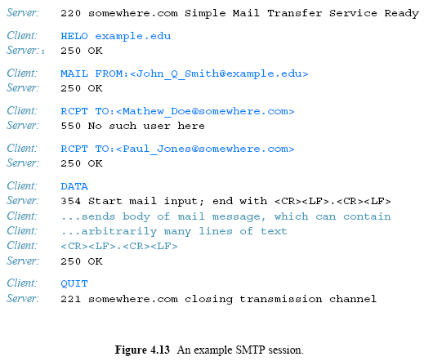

Slide 39
ISPs, Mail Servers, and Mail Access
Most users leave their computer running continuously and do not know how to configure and manage an email server
ISPs began offering email services
  An ISP runs an email server and provides a mailbox for each user
    each ISP provides interface that allows a user to access their mailbox
Figure 4.14 illustrates the arrangement
Email access follows one of two forms:
  A special-purpose email interface application
  A web browser that accesses an email web page

Slide 40
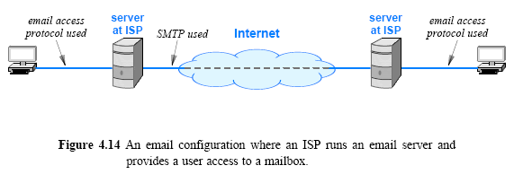
ISPs, Mail Servers, and Mail Access

Slide 41
ISPs, Mail Servers, and Mail Access
The web browser approach is straightforward:
  an ISP provides a special web page that displays messages from a user's mailbox
The chief advantage of using a web page for email
  ability to read email from any computer
  a user does not need to run a special mail interface application
Using a special mail application can download an entire mailbox onto a local computer, such as a laptop
  when connected to the Internet, a user can run an email program that downloads an entire mailbox onto the laptop
  the user can then process email when the laptop is disconnected from the Internet (e.g., while on an airplane).
  once Internet connectivity is regained, it communicates with the server at the ISP to upload email the user has created and download any new email

Slide 42
Mail Access Protocols (POP, IMAP)
Protocols have been created that provide email access
An access protocol is distinct from a transfer protocol
  access only involves a single user interacting with a single mailbox
  transfer protocols allow a user to send mail to other users
Access protocols have the following characteristics:
  Provide access to a user’s mailbox
  Permit a user to view headers, download, delete, or send messages
  Client runs on user’s personal computer
  Server runs on a computer that stores user’s mailbox
Viewing a list of messages without downloading the message contents is useful
  Especially in cases where the link between two parties is slow
  For example, a user browsing on a cell phone may look at headers and delete spam without waiting to download the message contents

Slide 43
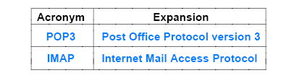
Mail Access Protocols (POP, IMAP)
A variety of mechanisms available for email access
  Some ISPs provide free email access software to their subscribers
  In addition, two standard email access protocols have been created
Figure 4.15 (below) lists the standard protocol names
Two protocols differ in many details
  In particular, each provides its own authentication mechanism that a user follows to identify themselves

Slide 44
Email Representation Standards (RFC2822, MIME)
Two important email representation standards exist:
  RFC (Request For Comments) 2822 Mail Message Format
  Multi-purpose Internet Mail Extensions (MIME)
RFC 2822 Mail Message Format:
  takes its name from the IETF standards document RFC 2822
  Header lines each have the form:
  a mail message is represented as a text file and consists of
    a header section
    a blank line
    and a body
    Keyword: information
    where the set of keywords is defined to include From:, To:, Subject:, Cc:

Slide 45
Email Representation Standards (RFC2822, MIME)
Multi-purpose Internet Mail Extensions (MIME)
  The MIME standard extends the functionality of email to allow the transfer of non-text data in a message
  MIME specifies how a binary file can be encoded into printable characters, included in a message, and decoded by the receiver
  The Base64 encoding standard is most popular, but MIME does not restrict encoding to a specific form
    MIME permits a sender/receiver to choose a convenient encoding
    the sender includes additional lines in the header to specify encoding used
  MIME allows a sender to divide a message into several parts and to specify an encoding for each part independently
    a user can send a plain text message and attach a graphic image, a spreadsheet, and an audio clip, each with their own encoding

Slide 46
Email Representation Standards (RFC2822, MIME)
MIME adds two lines to an email header
  one to declare that MIME has been used to create the message
  and another to specify how MIME information is included in the body
  For example, the header lines:
  MIME-Version: 1.0
  Content-Type: Multipart/Mixed; Boundary=Mime_separator
  Mime_separator will appear in the message body before each part
When MIME is used to send a standard text message
  Content-Type: text/plain
MIME is backward compatible with email systems that do not understand the MIME standard or encoding
  such systems have no way of extracting non-text attachments
  they treat the body as a single block of text

Slide 47
Domain Name System (DNS)
DNS provides a service that maps human-readable symbolic names to computer addresses
Browsers, mail software, and most other Internet applications use the DNS
It provides an interesting example of client-server interaction
  The mapping is not performed by a single server
  The naming information is distributed among a large set of servers located at sites across the Internet
Whenever an application needs to translate a name
  the application becomes a client of the naming system
  the client sends a request message to a name server
  server finds the corresponding address and sends a reply message
    if it cannot answer a request, a name server temporarily becomes the client of another name server, until a server is found that can answer the request

Slide 48
Domain Name System (DNS)
Syntactically, each name consists of a sequence of alpha-numeric segments separated by periods
  For example, a computer in the Computer Science Department at Purdue University has the domain name:
mordred.cs.purdue.edu
  A computer at Cisco, Inc. has the domain name:
anakin.cisco.com
Domain names are hierarchical, with the most significant part of the name on the right
  The left-most segment of a name (mordred and anakin in the examples) is the name of an individual computer
  Other segments in a domain name identify the group that owns it
    For example, the segment purdue gives the name of a university, and cisco gives the name of a company

Slide 49
Domain Name System (DNS)
DNS does not specify the number of segments in a name
DNS does specify values for the most significant segment, which is called a top-level domain (TLD)
  Controlled by the Internet Corporation for Assigned Names and Numbers (ICANN)
  ICANN designates one or more domain registrars to administer a given top-level domain and approve specific names
Some TLDs are generic, meaning they are generally available
  Other TLDs are restricted to specific groups or government agencies
Figure 4.16 lists example top-level DNS domains
An organization applies for a name under one of the existing top-level domains
  most US corporations choose to register under the com domain
DNS allows organizations to use a geographic registration
  For example, the Corporation For National Research Initiatives registered the domain:
  cnri.reston.va.us

Slide 50
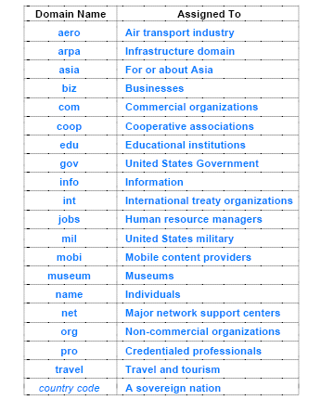
Figure 4.16 Example top-level domains and the group to which each is assigned

Slide 51
Domain Names That Begin with www
Many organizations assign domain names that reflect the service a computer provides
  For example, a computer that runs a server for FTP might be named:
  ftp.foobar.com
  Similarly, a computer that runs a web server might be named:
  www.foobar.com
Such names are mnemonic, but are not required
The use of www to name computers that run a web server is merely a convention
  an arbitrary computer can run a web server, even if the computer's domain name does not contain www
  a computer that has a domain name beginning with www is not required to run a web server

Slide 52
The DNS Hierarchy and Server Model
Each organization is free to choose the details of its servers
  For example, a small organization that only has a few computers can contract with an ISP to run a DNS server.
An organization that runs its own server can choose to place all names for the organization in a single physical server, or it can choose to divide its names among multiple servers
  For example, Figure 4.17 illustrates how the hypothetical Foobar Corporation might choose to structure servers if the corporation had a candy division and a soap division

Slide 53
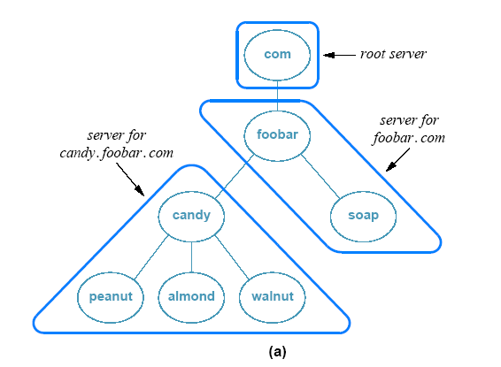
The DNS Hierarchy and Server Model

Slide 54
The DNS Hierarchy and Server Model
DNS is designed to allow each organization to assign names to computers or to change those names without informing a central authority
  To achieve autonomy, each organization is permitted to operate DNS servers for its part of the hierarchy
    Purdue University operates a server for names ending in purdue.edu
    IBM Corporation operates a server for names ending in ibm.com
Each DNS server contains information that links the server to other domain name servers up and down the hierarchy
  a given server can be replicated, such that multiple physical copies of the server exist
Replication is useful for heavily used servers, such as root servers that provide information about top-level domains
  administrators must guarantee that all copies are coordinated so they provide exactly the same information

Slide 55
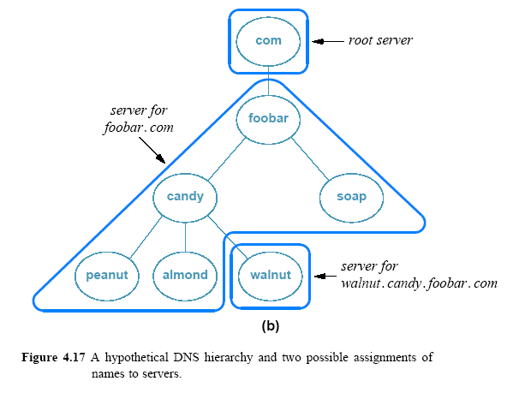
The DNS Hierarchy and Server Model

Slide 56
Name Resolution
The translation of a domain name into an address is called name resolution
  and the name is said to be resolved to an address
  Software to perform the translation is known as a name resolver (or simply resolver)
In the socket API, for example, the resolver is invoked by calling function gethostbyname
The resolver becomes a client by contacting a DNS server
  DNS server returns an answer to the caller
Each resolver is configured with the address of one or more local domain name servers
The resolver forms a DNS request message
  sends the message to the local server
  waits for the server to send a DNS reply message for the answer

Slide 57
Name Resolution
A resolver can choose to use either the stream or message paradigm when communicating with a DNS server
  most resolvers are configured to use a message paradigm because it imposes less overhead for a small request
Figure 4.17a illustrates, and assume a computer in the soap division generates a request for name
chocolate.candy.foobar.com
The resolver will be configured to send the request to the local DNS server (i.e., the server for foobar.com)
  Although it cannot answer the request
    the server knows to contact the server for candy.foobar.com, which can generate an answer

Slide 58
Caching in DNS Servers
The locality of reference principle that forms the basis for caching applies to the Domain Name System in two ways:
  Spatial: A user tends to look up the names of local computers more often than the names of remote computers
  Temporal: A user tends to look up the same set of domain names repeatedly
DNS exploits spatial locality
  a name resolver contacts a local server first
To exploit temporal locality
  a DNS server caches all lookups
Algorithm 4.4 summarizes the process

Slide 59
Caching in DNS Servers
According to the algorithm, when a request arrives for a name outside the set for which the server is an authority
  further client-server interaction results
The server temporarily becomes a client of another name server
When the other server returns an answer
  the original server caches the answer and sends a copy of the answer back to the resolver from which the request arrived
In addition to knowing the address of all servers down the hierarchy
  each DNS server must know the address of a root server
How long should items be cached?
  if an item is cached too long, the item will become stale
  DNS specify a cache timeout for each item

Slide 60
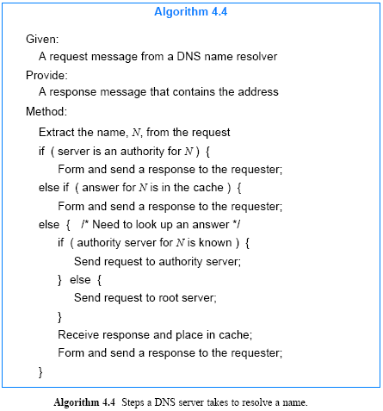

Slide 61
Types of DNS Entries
Each entry in a DNS database consists of three items:
  a domain name
  a record type
    The record type specifies how the value is to be interpreted
  a value
A query sent to a DNS server specifies both a domain name and a type
  the server only returns a binding that matches the type of the query
The principal type maps a domain name to an IP address
  DNS classifies such bindings as type A
    type A lookup is used by applications such as FTP, ping, or a browser
  DNS supports several other types, including type MX
    that specifies a Mail eXchanger
    when it looks up the name in an email address, SMTP uses type MX

Slide 62
Types of DNS Entries
Each entry in a DNS server has a type
When a resolver looks up a name
  the resolver specifies the type that is desired
  the DNS server returns only entries that match the specified type
The DNS type system can produce unexpected results
  because the address returned can depend on the type
  For example, a corporation may decide to use the name corporation.com for both web and email services
It is possible for the corporation to divide the workload between separate computers
  by mapping type A lookups to one computer and type MX lookups to another

Slide 63
Aliases and CNAME Resource Records
The DNS offers a CNAME
  it is analogous to a symbolic link in a file system; the entry provides an alias for another DNS entry
  aliases can be useful; suppose Foobar Corporation has two computers, named as:
  hobbes.foobar.com and calvin.foobar.com
Suppose that foobar decides to run a web server on computer hobbes, and wants to follow the convention of using the name www
Organization could choose to rename computer hobbes
A much easier solution exists:
  the organization can create a CNAME entry for www.foobar.com that points to hobbes
Whenever a resolver sends a request for www.foobar.com, the server returns the address of computer hobbes

Slide 64
Aliases and CNAME Resource Records
The use of aliases is especially convenient
  it permits an organization to change the computer used for a particular service without changing the names or addresses:
    For example, Foobar Corporation can move its web service from hobbes → calvin
    changing the CNAME record in the DNS server, the two computers retain their original names and IP addresses
The use of aliases also allows an organization to associate multiple aliases with a single computer
  Thus, Foobar Corporation can run an FTP server and a web server on the same computer, and can create CNAME records:
  www.foobar.com
  ftp.foobar.com

Slide 65
Abbreviations and the DNS
DNS does not incorporate abbreviations - a server only responds to a full name
Most resolvers can be configured with a set of suffixes that allow a user to abbreviate names
  For example, each resolver at Foobar Corporation might be programmed to look up a name twice:
    once with no change and once with the suffix foobar.com appended
If a user enters a full domain name
  the local server will return the address, and processing will proceed
If a user enters an abbreviated name
  it will first try to resolve the name
  and will receive an error because no such name exists
  then it will try appending a suffix and looking up the resulting name

Slide 66
Internationalized Domain Names
DNS uses the ASCII character set
Languages such as Russian, Greek, Chinese, and Japanese each contain characters for which no ASCII representation exists
  Many European languages use diacritical marks that cannot be represented in ASCII
IETF debated modifications and extensions of the DNS to accommodate international domain names
  After considering many proposals, the IETF chose an approach known as Internationalizing Domain Names in Applications (IDNA)
IDNA uses ASCII to store all names
If a domain name contains a non-ASCII character
  IDNA translates the name into a sequence of ASCII characters
  and stores the result in the DNS

Slide 67
Internationalized Domain Names
IDNA relies on applications to translate between the international character set and the internal ASCII form used
The rules for translating international domain names are complex and use Unicode
The latest versions of the widely-used browsers, such as Firefox and Internet Explorer, can accept and display non-ASCII domain names because they each implement IDNA

Slide 68
Extensible Representations (XML)
The traditional application protocols covered in this chapter each employ a fixed representation
Application protocol specifies an exact set of messages
The chief disadvantage of a fixed approach arises from the difficulty involved in making changes
  For example, because email standards restrict message content to text, a major change was needed to add MIME extensions
The alternative to a fixed representation is an extensible system that allows a sender to specify the format of data
One standard for extensible representation has become widely accepted: the Extensible Markup Language (XML)
XML resembles HTML in the sense that both languages embed tags into a text document

Slide 69
Extensible Representations (XML)
Unlike HTML, the tags in XML are not specified a priori and do not correspond to formatting commands
XML describes the structure of data and provides names for each field
Tags in XML are well-balanced; each occurrence of a tag <X> must be followed by an occurrence of </X>
XML does not assign any meaning to tags
  tag names can be created as needed
  tag names can be selected to make data easy to parse or access

Slide 70
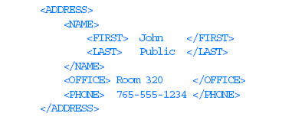
Extensible Representations (XML)
For example, if two companies agree to exchange corporate telephone directories
  they can define an XML format that has data items
    such as an employee's name, phone number, and office
  they can choose to further divide a name into a last and a first name

