Slide 1
Data Communications
Overview of Data Communications

Slide 2
Overview
Essence of Data Communications
Motivation and Scope of the Subject
The Conceptual Pieces of a Communication System
The Subtopics of Data Communications

Slide 3
Data Communications
What does data communications entail?
Combination of ideas and approaches from three disciplines
Involves the transmission of information over physical media
The subject draws on ideas about electric current, light, and other forms of electromagnetic radiation
Information is digitized and digital data is transmitted
Data communications uses mathematics and includes various forms of analysis
  Goal is to develop practical ways to design and build transmission systems

Slide 4
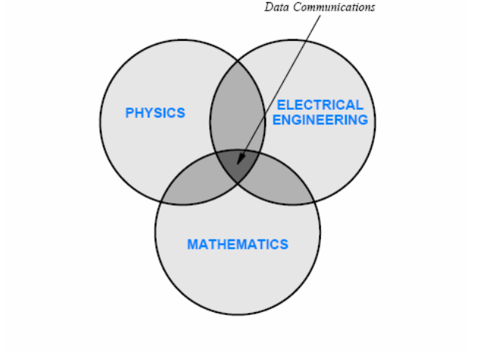
Data Communications

Slide 5
Motivation & Scope
Three main ideas provide much of the motivation for data communications and help define the scope
  The sources of information can be of arbitrary types
  Transmission uses a physical system
  Multiple sources of information can share the underlying medium
The first point is relevant considering the popularity of multimedia applications:
  Information is not restricted to bits that have been stored in a computer
  Information can also be derived from the physical world, including audio and video
  Various sources and forms of information available and one form can be transformed into another

Slide 6
Motivation & Scope
The second point suggests that we must use natural phenomena
  Electricity and electromagnetic radiation, to transmit information
It is important to understand the following issues:
  Types of media that are available
  Properties of each media
  How physical phenomena can be used to transmit information over each medium
  The relationship between data communications and the underlying transmission
  Limits of physical systems
  Problems that can arise during transmission
  Techniques that can be used to detect or solve the problems

Slide 7
Motivation & Scope
The third point suggests that sharing is fundamental
Sharing plays a fundamental role in most computer networks
  A network usually permits multiple pairs of communicating entities to communicate over a given physical medium
  There are possible ways underlying facilities can be shared
  We should understand advantages and disadvantages of each and the resulting modes of communication

Slide 8
Conceptual Pieces of a Communication System
A communication system has multiple sources of information and allows each source to send to a separate destination
How does such a system work?
  Each source needs a mechanism to gather the information
  Prepare the information for transmission and transmit the information across the shared physical medium
  Similarly, a mechanism is needed that extracts the information for the destination and delivers the information

Slide 9
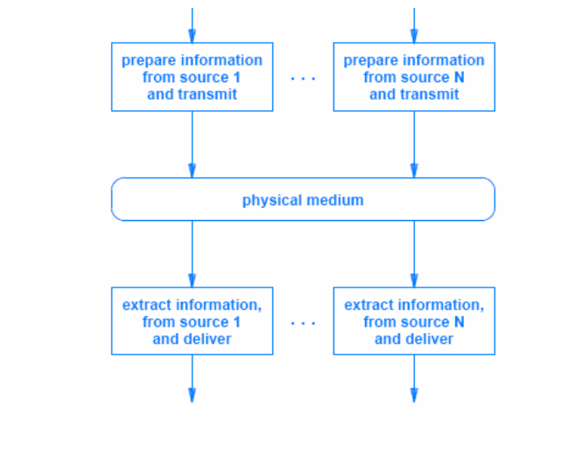
Conceptual Pieces of a Communication System

Slide 10
Conceptual Pieces of a Communication System
Data communications is complex
  Information can arrive from many types of sources
    the techniques used to handle multiple sources vary
  Before it can be sent, information must be digitized
  Extra data must be added to protect against channel errors
  If privacy is a concern, the information may need to be encrypted
  To send multiple streams of information across a shared media
    the information from each source must be identified
    and data from all the sources must be intermixed for transmission

Slide 11
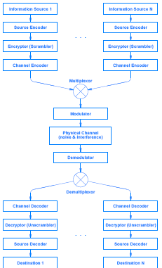
Conceptual Framework
Data Communication System
A conceptual framework for a data communications system
Multiple sources send to multiple destinations through an underlying physical channel

Slide 12
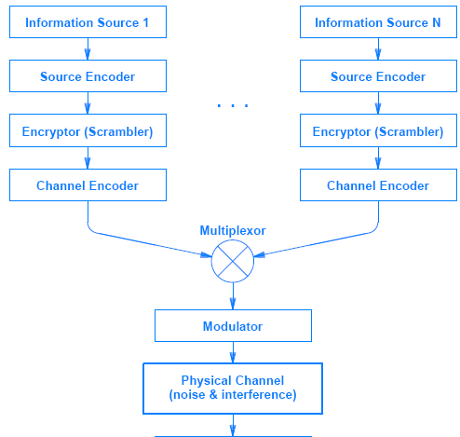
Conceptual Framework
Data Communication System
Processing at the transmitter/sender end

Slide 13
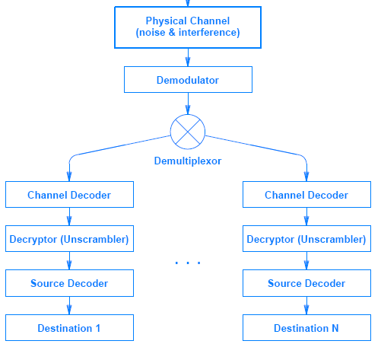
Conceptual Framework
Data Communication System
Processing at the receiver end

Slide 14
Subtopics of Data Communications
Each of the boxes in Figure corresponds to one subtopic of data communications
Information Sources
  The source of information can be either analog or digital
  Important concepts include characteristics of signals, such as amplitude, frequency, and phase, and classification as either periodic or aperiodic
  The subtopic focuses on the conversion between analog and digital representations of information
Source Encoder and Decoder
  Once information has been digitized, digital representations can be transformed and converted
  Concepts include data compression and consequences for communications

Slide 15
Subtopics of Data Communications
Encryptor and Decryptor
  To protect information and keep it private, the information can be encrypted (i.e., scrambled) before transmission and decrypted upon reception
  Concepts include cryptographic techniques and algorithms
Channel Encoder and Decoder
  Channel coding is used to detect and correct transmission errors
  Topics include methods to detect and limit errors
  Practical techniques like parity checking, checksums, and cyclic redundancy codes that are employed in computer networks
Multiplexor and Demultiplexor
  Multiplexing refers to the way information from multiple sources is combined for transmission across a shared medium
  Concepts include techniques for simultaneous sharing as well as techniques that allow sources to take turns when using the medium

Slide 16
Subtopics of Data Communications
Modulator and Demodulator
  Modulation refers to the way electromagnetic radiation is used to send information
  Concepts include both analog and digital modulation schemes
  Devices known as modems that perform the modulation and demodulation
Physical Channel and Transmission
  transmission media
  transmission modes, such as serial and parallel
  channel bandwidth
  electrical noise and interference
  channel capacity

