Slide 1
Data Transmission
Transmission Modes

Slide 2
Overview
A Taxonomy of Transmission Modes
Parallel Transmission
Serial Transmission
Transmission Order: Bits and Bytes
Timing of Serial Transmission
Asynchronous Transmission
RS-232 Asynchronous Character Transmission
Synchronous Transmission
Bytes, Blocks, and Frames
Isochronous Transmission
Simplex, Half-Duplex, and Full-Duplex Transmission
DCE and DTE Equipment

Slide 3
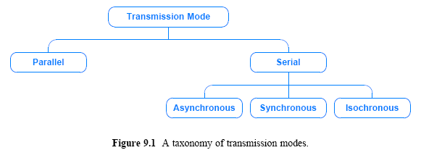
Taxonomy of Transmission Modes
We use the term transmission mode to refer to the manner in which data is sent over the underlying medium
Transmission modes can be divided into two fundamental categories:
Serial — one bit is sent at a time
  Serial transmission is further categorized according to timing of transmissions
Parallel — multiple bits are sent at the same time

Slide 4
Parallel Transmission
Parallel transmission allows transfers of multiple data bits at the same time over separate media
In general, parallel transmission is used with a wired medium that uses multiple, independent wires
Furthermore, the signals on all wires are synchronized so that a bit travels across each of the wires at precisely the same time
Figure 9.2 illustrates the concept, and shows why engineers use the term parallel to characterize the wiring

Slide 5
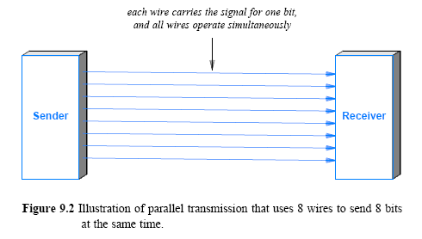
Parallel Transmission

Slide 6
Parallel Transmission
The figure omits two important details:
  First, in addition to the parallel wires that each carry data
    a parallel interface usually contains other wires that allow the sender and receiver to coordinate
  Second, to make installation and troubleshooting easy
    the wires for a parallel transmission system are placed in a single physical cable
A parallel mode of transmission has two chief advantages:
  High speed: it can send N bits at the same time
    a parallel interface can operate N times faster than an equivalent serial interface
  Match to underlying hardware: Internally, computer and communication hardware uses parallel circuitry
    a parallel interface matches the internal hardware well

Slide 7
Serial Transmission
Serial transmission
  sends one bit at a time
It may seem that anyone would choose parallel transmission for high speeds
  However, most communication systems use serial mode
There are two main reasons
  First, serial networks can be extended over long distances at much less cost
  Second, using only one physical wire means that there is never a timing problem caused by one wire being slightly longer than another
Sender and receiver must contain a hardware that converts data from the parallel form used in the device to the serial form used on the wire

Slide 8
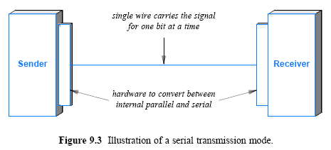
Serial Transmission

Slide 9
Serial Transmission
The hardware needed to convert data between an internal parallel form and a serial form can be straightforward or complex
  depending on the type of serial communication mechanism
In the simplest case, a single chip that is known as a Universal Asynchronous Receiver and Transmitter (UART) performs the conversion
A related chip, Universal Synchronous-Asynchronous Receiver and Transmitter (USART) handles conversion for synchronous networks

Slide 10
Transmission Order: Bits and Bytes
In serial mode, when sending bits, which bit should be sent across the medium first?
Consider an integer: Should a sender transmit
  the Most Significant Bit (MSB)
  or the Least Significant Bit (LSB) first?
We use the term little-endian to describe a system that sends the LSB first
We use the term big-endian to describe a system that sends the MSB first
Either form can be used, but the sender and receiver must agree

Slide 11
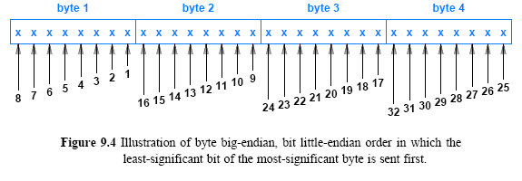
Transmission Order: Bits and Bytes
The order in which bits are transmitted does not settle the entire question of transmission order
  Data in a computer is divided into bytes, and each byte is further divided into bits (typically 8 bits per byte)
  Thus, it is possible to choose a byte order and a bit order independently
  For example, Ethernet technology specifies that data is sent byte big-endian and bit little-endian

Slide 12
Timing of Serial Transmission
Serial transmission mechanisms can be divided into three broad categories (depending on how transmissions are spaced in time):
Asynchronous transmission can occur at any time
  with an arbitrary delay between the transmission of two data items
Synchronous transmission occurs continuously
  with no gap between the transmission of two data items
Isochronous transmission occurs at regular intervals
  with a fixed gap between the transmission of two data items

Slide 13
Asynchronous Transmission
It is asynchronous if the system allows the physical medium to be idle for an arbitrary time between two transmissions
The asynchronous style of communication is well-suited to applications that generate data at random
  (e.g., a user typing on a keyboard or a user that clicks on a link)
The disadvantage of asynchrony arises from the lack of coordination between sender and receiver
  While the medium is idle, a receiver cannot know how long the medium will remain idle before more data arrives
Asynchronous technologies usually arrange for a sender to transmit a few extra bits before each data item
  to inform the receiver that a data transfer is starting
  extra bits allow the receiver to synchronize with the incoming signal
  the extra bits are known as a preamble or start bits

Slide 14
RS-232 Asynchronous Character Transmission
Consider the transfer of characters across copper wires between a computer and a device such as a keyboard
  each data item represents one character
It is standardized by the Electronic Industries Alliance (EIA)
    It has become the most widely used for character communication
    Known as RS-232-C, and commonly abbreviated RS-232
EIA standard specifies the details, such as
  physical connection size (max cable length 50 feet long)
  electrical details (range between -15v +15v) the line coding being used
  It can be configured to control the exact number of bits per second
  It can be configured to send 7-bit or 8-bit characters

Slide 15
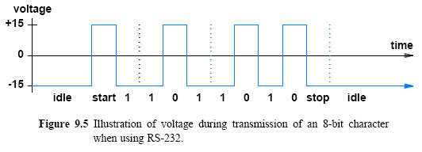
RS-232 Asynchronous Character Transmission

Slide 16
Synchronous Transmission
A synchronous mechanism transmits bits of data continually
  with no idle time between bits
  after transmitting the final bit of one data byte, the sender transmits a bit of the next data byte
The sender and receiver constantly remain synchronized
  which means less synchronization overhead
Compare the 8-bit characters on
  an asynchronous system as illustrated in Figure 9.5
  and a synchronous system as illustrated in Figure 9.6
Each character sent using RS-232 requires an extra start bit and stop bit
  meaning that each 8-bit character requires a minimum of 10 bit times, even if no idle time is inserted
On a synchronous system
  each character is sent without start or stop bits

Slide 17
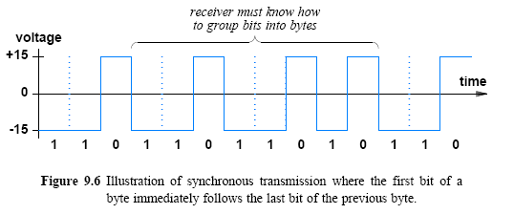
Synchronous Transmission

Slide 18
Bytes, Blocks, and Frames
If the underlying synchronous mechanism must send bits continually
  What happens if a sender does not have data ready to send at all times?
  The answer lies in a technique known as framing:
    an interface is added to a synchronous mechanism that accepts and delivers a block of bytes known as a frame
  To insure that the sender and receiver stay synchronized
    a frame starts with a special sequence of bits
  Most synchronous systems include an idle sequence (or idle byte)
    that is transmitted when the sender has no data to send

Slide 19
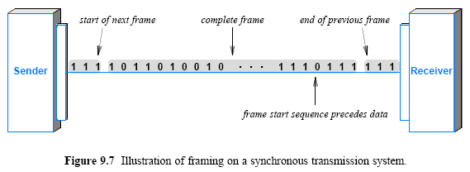
Bytes, Blocks, and Frames

Slide 20
Isochronous Transmission
Isochronous transmission
  is designed to provide steady bit flow for multimedia applications
Delivering such data at a steady rate is essential
  because variations in delay known as jitter can disrupt reception (cause pops or clicks in audio/make video freeze for a short time)
Isochronous network is designed to accept and send data at a fixed rate, R
  Network interface is such that data must be handed to the network for transmission at exactly R bits per second
For example, an isochronous mechanism designed to transfer voice operates at a rate of 64,000 bits per second
  A sender must generate digitized audio continuously
  A receiver must be able to accept and play the stream

Slide 21
Simplex, Half-Duplex, and Full-Duplex Transmission
A communications channel is classified as one of three types:
  (depending on the direction of transfer)
  Simplex
  Full-Duplex
  Half-Duplex
Simplex: a simplex mechanism can only transfer data in a single direction
  It is analogous to broadcast radio or television
  Figure 9.8a illustrates simplex communication
Full-Duplex: allows transmission in two directions simultaneously
  It is analogous to a voice telephone conversation
    in which a participant can speak even if they are able to hear background music at the other end

Slide 22
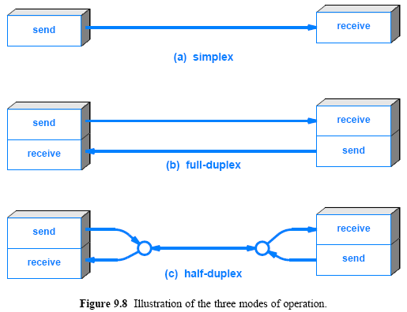
Simplex, Half-Duplex, and Full-Duplex Transmission

Slide 23
Simplex, Half-Duplex, and Full-Duplex Transmission
Half-Duplex: A half-duplex mechanism involves a shared transmission medium
  The shared medium can be used for communication in each direction
  But the communication cannot proceed simultaneously
  It is analogous to using walkie-talkies where only one side can transmit at a time
An additional mechanism is needed at each end of a half-duplex communication that coordinates transmission
  to insure that only one side transmits at a given time

Slide 24
DCE and DTE Equipment
Terms Data Communications Equipment (DCE) and Data Terminal Equipment (DTE) were originally created by AT&T
  To distinguish between the communications equipment owned by the phone company and the terminal equipment owned by a subscriber
The terminology persists: if a business leases a data circuit from a phone company
  the phone company installs DCE equipment at the business
  and the business purchases DTE equipment that attaches to the phone company’s equipment

Slide 25
DCE and DTE Equipment
From an academic point of view, the concept behind the DCE-DTE distinction is not ownership of the equipment
  Instead, it lies in the ability to define an arbitrary interface for a user
If the underlying network uses synchronous transmission
  the DCE equipment can provide either a synchronous or isochronous interface to the user’s equipment
Figure 9.9 illustrates the conceptual organization
Several standards exist that specify a possible interface between DCE and DTE
  The RS-232 standard described in this chapter and the RS-449 standard proposed as a replacement can each be used
  In addition, a standard known as X.21 is also available

Slide 26
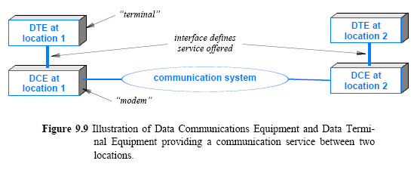
DCE and DTE Equipment

