Slide 1
Data Communications
Modulation & Modems

Slide 2
Topics Covered
Carriers, Frequency, and Propagation
Analog Modulation Schemes
Amplitude Modulation
Frequency Modulation
Phase Shift Modulation
Amplitude Modulation and Shannon's Theorem
Modulation, Digital Input, and Shift Keying
Phase Shift Keying
Phase Shift and a Constellation Diagram
Quadrature Amplitude Modulation
Modem Hardware for Modulation and Demodulation
Optical and Radio Frequency Modems
Dialup Modems
QAM Applied to Dialup
V.32 and V.32bis Dialup Modems

Slide 3
Carriers, Frequency, and Propagation
Many long-distance communication systems use an oscillating electromagnetic wave called a carrier
The system makes small changes to the carrier that represent information being sent
The frequency of electromagnetic energy determines how the energy propagates
One motivation for the use of carriers arises from the desire to select a frequency that will propagate well
  independent of the rate that data is being sent

Slide 4
Analog Modulation Schemes
We use the term modulation to refer to changes made in a carrier
  according to the information being sent
Modulation takes two inputs
  a carrier
  and a signal
Then it generates a modulated carrier as output, as in Figure 10.1
In essence, a sender must change one of the fundamental characteristics of the wave
There are three primary techniques that modulate an electromagnetic carrier according to a signal:
  Amplitude modulation
  Frequency modulation
  Phase shift modulation
The first two methods of modulation are the most familiar and have been used extensively

Slide 5
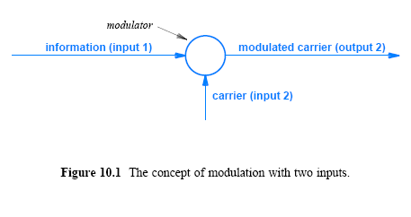
Analog Modulation Schemes

Slide 6
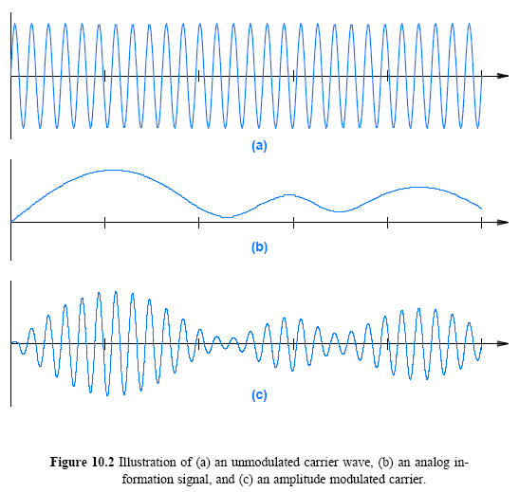
Amplitude Modulation (AM)
AM varies the amplitude of a carrier in proportion to the information being sent (i.e., according to a signal)
  The carrier continues oscillating at a fixed frequency, but the amplitude of the wave varies

Slide 7
Frequency Modulation (FM)
In FM, the amplitude of the carrier remains fixed
In FM, frequency changes according to the signal:
  when the signal is stronger, the carrier frequency increases slightly,
  and when the signal is weaker, the carrier frequency decreases slightly
Figure 10.3 illustrates an example of FM for an info signal
FM is more difficult to visualize
  because slight changes in frequency are not as clearly visible
  however, one can notice that the modulated wave has higher frequencies when the signal used for modulation is stronger

Slide 8
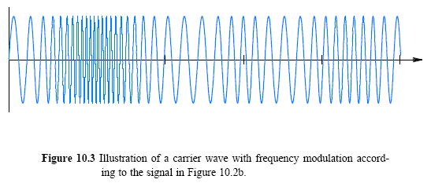
Frequency Modulation

Slide 9
Phase Modulation (PM)
One of the properties of a sine wave is its phase, the offset from a reference time at which the sine wave begins
It is possible to use changes in phase to represent a signal
We use the term phase shift to characterize such changes
If phase changes after cycle k, the next sine wave will start slightly later than the time at which cycle k completes
  A slight delay resembles a change in frequency
PM can be thought of as a special form of frequency modulation
  However, phase shifts are important when a digital signal is used to modulate a carrier

Slide 10
Amplitude Modulation and Shannon's Theorem
Figure 10.2c shows the amplitude varying from a maximum to almost zero
The figure is slightly misleading
  in practice, modulation only changes the amplitude of a carrier slightly, depending on a constant known as the modulation index
Practical systems do not allow for a modulated signal to approach zero
Consider Shannon's Theorem
  assuming the amount of noise is constant
    the signal-to-noise ratio will approach zero as the signal approaches zero
Keeping the carrier wave near maximum insures that the signal-to-noise ratio remains as large as possible
  this permits the transfer of more bits per second

Slide 11
Modulation, Digital Input, and Shift Keying
How can digital input be used in modulation?
Modifications to the modulation schemes described above are needed:
  instead of modulation that is proportional to a continuous signal, digital schemes use discrete values
To distinguish between analog and digital modulation
  we use the term shift keying rather than modulation
Shift keying operates similar to analog modulation
  instead of a continuum of possible values, digital shift keying has a fixed set
  for example, AM allows the amplitude of a carrier to vary by arbitrarily small amounts in response to a change in the signal
    in contrast, amplitude shift keying uses a fixed set of possible amplitudes
Figure 10.4 illustrates concept for ASK and FSK

Slide 12
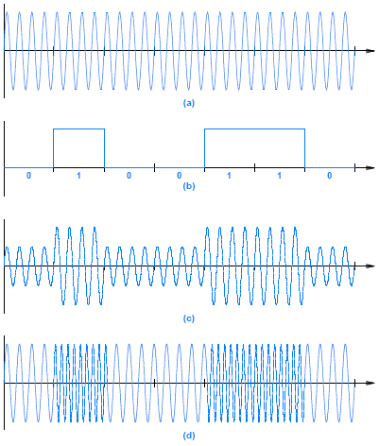
Figure 10.4 Illustration of
a carrier wave
a digital input signal
amplitude shift keying
frequency shift keying

Slide 13
Phase Shift Keying (PSK)
Amplitude and frequency modulations require at least one cycle of a carrier wave to send a single bit
  unless a special encoding scheme is used
The number of bits sent per unit time can be increased
  if the encoding scheme permits multiple bits to be encoded in a single cycle of the carrier
Data communications systems often use techniques that can send more bits
PSK changes the phase of the carrier wave abruptly
  each such change is called a phase shift

Slide 14
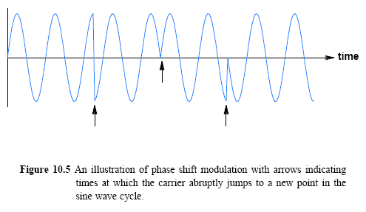
Phase Shift Keying (PSK)
Figure 10.5 illustrates how phase shifts affects a sine wave
  There are three (abrupt) phase changes
  A phase shift is measured by the angle of the change
  The left most portion of sine wave changes its phase by π/2 radians or 180
  The second phase change corresponds to a 180 shift

Slide 15
Phase Shift and a Constellation Diagram
How can data be encoded using phase shifts?
  A sender and receiver can agree on the number of bits per second
  It can use no phase shift to denote logical 0, and the presence of a phase shift to denote a logical 1
  For example, a system might use a 180 phase shift
A constellation diagram is used to express the exact assignment of data bits to specific phase changes
Figure 10.6 illustrates the concept
Many variations of PSK exist
  A phase shift mechanism such as the one illustrated in Figure 10.6 permits a sender to transfer one bit at a time
    It is called Binary Phase Shift Keying (BPSK) or 2-PSK
  Notation of 2-PSK is also used to denote the two possible values

Slide 16
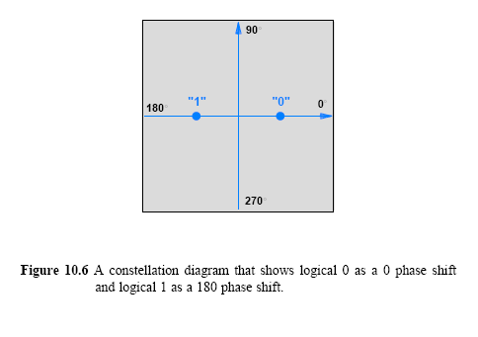
Phase Shift and a Constellation Diagram

Slide 17
Phase Shift and a Constellation Diagram
We can do more than detect the presence of a phase shift!
  A receiver can measure the amount a carrier shifted during a phase change
  It is possible to devise a system that recognizes a set of phase shifts
    and use each particular phase shift to represent specific values of data
Systems are designed to use a power of 2 possible shifts
  which means a sender can use bits of data to select among the shifts
Figure 10.7 shows the constellation diagram for a system that uses 4 possible phase shifts
  At each stage of transmission, a sender uses 2-bits of data to select among the 4-possible shift values
  This is known as 4-PSK mechanism

Slide 18
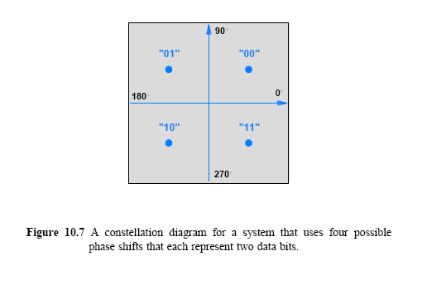
Phase Shift and a Constellation Diagram

Slide 19
Phase Shift and a Constellation Diagram
In theory, it is possible to increase the data rate by increasing the range of phase shifts
Thus, a 16-PSK mechanism can send twice as many bits per second as a 4-PSK mechanism
In practice, noise and distortion limit the ability of hardware to distinguish among minor differences in phase shifts

Slide 20
Quadrature Amplitude Modulation
How can the data rate be increased further?
A combination of modulation techniques that change two characteristics of a carrier at the same time
The most sophisticated technology combines ASK and PSK
One is known as Quadrature Amplitude Modulation (QAM) or Quadrature Amplitude Shift Keying (QASK)
  the approach uses both change in phase and in amplitude
To represent QAM on a constellation diagram
  We use distance from the origin as a measure of amplitude
  Figure 10.8 shows the constellation diagram for a variant known as 16QAM with dark gray areas indicating the amplitudes

Slide 21
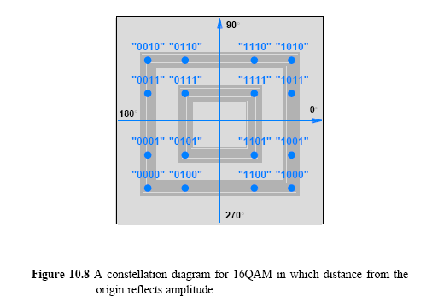
Quadrature Amplitude Modulation

Slide 22
Modem Hardware for Modulation and Demodulation
A mechanism that accepts a sequence of data bits and applies modulation to a carrier wave according to the bits is called a modulator
A mechanism that accepts a modulated carrier wave and recreates the sequence of data bits that was used to modulate the carrier is called a demodulator
Transmission of data requires a modulator at one end of the transmission medium and a demodulator at the other
Most communication systems are full duplex
  which means each location needs both a modulator to send data and a demodulator to receive data

Slide 23
Modem Hardware for Modulation and Demodulation
Users would like to keep cost low and make the pair of devices easy to install and operate
Manufacturers combine modulation and demodulation mechanisms into a single device
  called a modem (modulator and demodulator)
Figure 10.9 illustrates how a pair of modems use a 4-wire connection to communicate
Modems are designed to provide communication over long distances

Slide 24
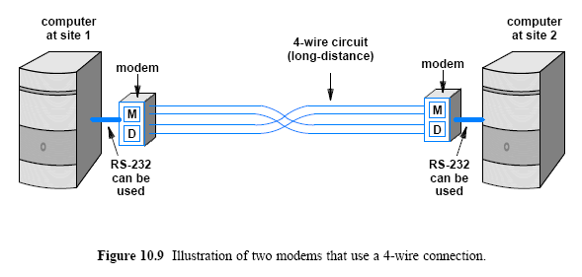
Modem Hardware for Modulation and Demodulation

Slide 25
Optical and Radio Frequency Modems
Modems are also used with other media
  including Radio Frequency (RF) transmission and optical fibers
A pair of RF modems can be used to send data via radio
A pair of optical modems can be used to send data across a pair of optical fibers
Modems can use entirely different media, but the principle remains the same:
  at the sending end, a modem modulates a carrier
  at the receiving end, data is extracted from the modulated carrier

Slide 26
Dialup Modems
A dialup modem uses an audio tone
  as with conventional modems, the carrier is modulated at the sending end and demodulated at the receiving end
A dialup modem uses data to modulate an audible carrier
  which is transmitted to the phone system
The chief difference between dialup and conventional modems arises from the lower bandwidth of audible dialup modems
Interior of a modern telephone system used today is digital
  The phone system digitizes the incoming audio
  Transports a digital form internally
  Converts the digitized version back to analog audio for delivery
  The receiving modem demodulates the analog carrier
  Extracts the original digital data

Slide 27
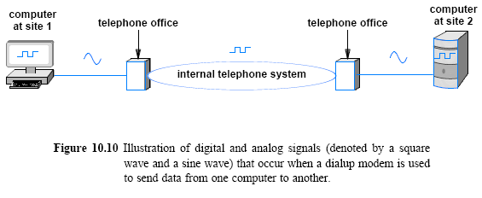
Dialup Modems
Figure 10.10 illustrates the ironic use of analog and digital signals by dialup modems
  a dialup modem is usually embedded in a computer
Term internal modem to denote an embedded device
Term external modem to denote a separate physical device

