Slide 1
Data Communications
Multiplexing & Demultiplexing (Channelization)

Slide 2
Topics Covered
The Concept of Multiplexing
The Basic Types of Multiplexing
Frequency Division Multiplexing (FDM)
Using a Range of Frequencies Per Channel
Hierarchical FDM
Wavelength Division Multiplexing (WDM)
Time Division Multiplexing (TDM)
Synchronous TDM
Framing Used in the Telephone System Version of TDM
Hierarchical TDM
The Problem with Synchronous TDM: Unfilled Slots
Statistical TDM
Inverse Multiplexing
Code Division Multiplexing

Slide 3
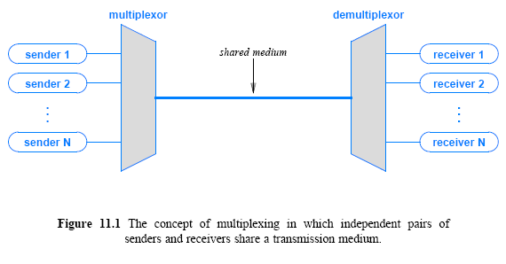
The Concept of Multiplexing
Multiplexing to refer to the combination of information streams from multiple sources for transmission over a shared medium
  Multiplexor is a mechanism that implements the concept
Demultiplexing to refer to the separation of a combination back into separate information streams
  Demultiplexor to refer to a mechanism that implements the concept

Slide 4
The Basic Types of Multiplexing
There are four basic approaches to multiplexing that each have a set of variations and implementations
  Frequency Division Multiplexing (FDM)
  Wavelength Division Multiplexing (WDM)
  Time Division Multiplexing (TDM)
  Code Division Multiplexing (CDM)
TDM and FDM are widely used
WDM is a form of FDM used for optical fiber
CDM is a mathematical approach used in cell phone mechanisms

Slide 5
Frequency Division Multiplexing
A set of radio stations can transmit electromagnetic signals simultaneously
  without interference provided, they each use a separate channel (i.e., carrier frequency)
It is possible to send simultaneously multiple carrier waves over a single copper wire
A demultiplexor applies a set of filters that each extract a small range of frequencies near one of the carrier frequencies
Figure 11.2 illustrates the organization
  A key idea is that the filters used in FDM only examine frequencies
  If a sender/receiver pair is assigned a particular carrier frequency
FDM mechanism will separate the frequency from others without otherwise modifying the signal

Slide 6
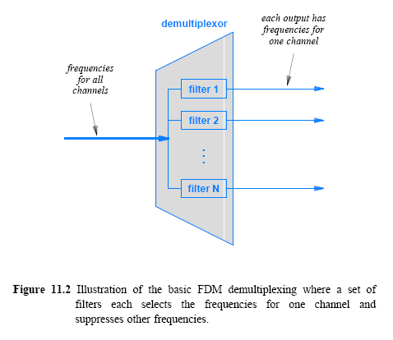
Frequency Division Multiplexing

Slide 7
Frequency Division Multiplexing
Advantage of FDM arises from the simultaneous use of a transmission medium by multiple pairs of entities
We imagine FDM as providing each pair with a private transmission path
  as if the pair had a separate physical transmission medium
  Figure 11.3 illustrates the concept
Practical FDM systems - there are some limitations
  If the frequencies of two channels are too close, interference can occur
  Furthermore, demultiplexing hardware that receives a combined signal must be able to divide the signal into separate carriers
  FCC in USA regulates stations to insure adequate spacing occurs between the carriers
  Designers choosing a set of carrier frequencies with a gap between them known as a guard band
Figures 11.4 and 11.5 show an example
  that allocates 200 KHz to each of 6 channels with a guard band of 20 KHz between each

Slide 8
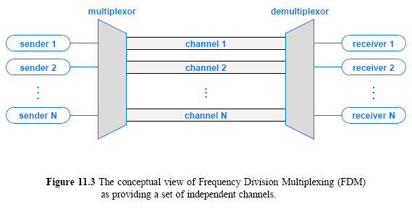
Frequency Division Multiplexing

Slide 9
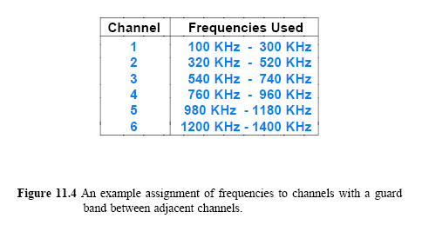
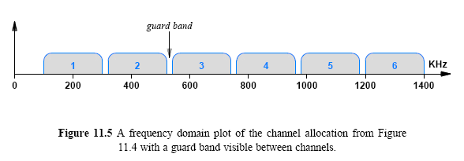
Frequency Division Multiplexing

Slide 10
Using a Range of
Frequencies Per Channel
Why does the example allocate blocks of frequencies?
Consider the following characteristics of FDM:
  Long-lived: FDM, the idea of dividing the electromagnetic spectrum into channels, arose in early experiments in radio
  Widely used: FDM is used in broadcast radio and television, cable television, and the AMPS cellular telephone
  Analog: FDM multiplexing and demultiplexing hardware accepts and delivers analog signals
    Even if a carrier has been modulated to contain digital information, FDM hardware treats the carrier as an analog wave
  Versatile: Because it filters on ranges of frequency without examining other aspects of signals, FDM is versatile

Slide 11
Using a Range of Frequencies Per Channel
The analog characteristic has the disadvantage of making FDM susceptible to noise and distortion
Most FDM systems assign each sender and receiver pair a range of frequencies
FDM has the ability to choose how the frequencies can be used
There are two primary ways that systems use a range of frequencies
  Increase the data rate
  Increase immunity to interference
To increase the overall data rate
  a sender divides the frequency range of the channel into K carriers
  and sends 1/K of the data over each carrier

Slide 12
Using a Range of Frequencies Per Channel
A sender can perform FDM within an allocated channel
  Sometimes, the term subchannel allocation refers to the subdivision
To increase immunity to interference
  a sender uses a technique known as spread spectrum
Various forms are suggested, but basic idea is
  divide the range of the channel into K carriers
  transmit the same data over multiple channels
  allow a receiver to use a copy of the data that arrives with fewest errors
The scheme works well in cases where noise is likely to interfere with some frequencies at a given time

Slide 13
Hierarchical FDM
Flexibility in FDM arises from the ability of hardware to shift frequencies
If a set of incoming signals all use the frequency range between 0 and 4 KHz
  multiplexing hardware can leave the first stage as is
  map the second onto the range 4 KHz to 8 KHz
  map the third onto the range 8 KHz to 12 KHz, and so on
Hierarchy in FDM multiplexors is that each maps its inputs to a larger, continuous band of frequencies
Figure 11.6 illustrates the concept of hierarchical FDM
© 2009 Pearson Education Inc., Upper Saddle River, NJ. All rights reserved.

Slide 14
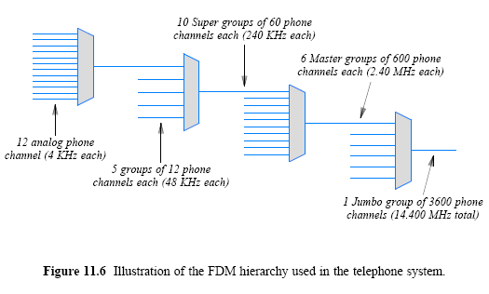
Hierarchical FDM

Slide 15
Wavelength Division Multiplexing (WDM)
WDM refers to the application of FDM to optical fiber
  some sources use the term Dense WDM (DWDM) to emphasize that many wavelengths of light can be employed
The inputs and outputs of such multiplexing are wavelengths of light
  denoted by the Greek letter λ, and informally called colors
When white light passes through a prism
  colors of the spectrum are spread out
If a set of colored light beams are each directed into a prism at the correct angle
  the prism will combine the beams to form a single beam of white light

Slide 16
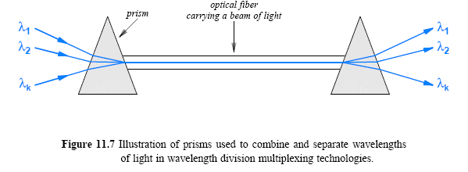
Wavelength Division Multiplexing
Prisms form the basis of optical multiplexing and demultiplexing
  a multiplexor accepts beams of light of various wavelengths and uses a prism to combine them into a single beam
  a demultiplexor uses a prism to separate the wavelengths.

Slide 17
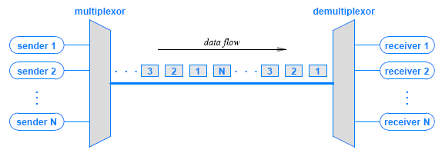
Time Division Multiplexing (TDM)
TDM is less esoteric than FDM and does not rely on special properties of electromagnetic energy
  multiplexing in time simply means transmitting an item from one source, then transmitting an item from another source, and so on
Figure 11.8 (below) illustrates the concept

Slide 18
Synchronous TDM
TDM is a broad concept that appears in many forms
  It is widely used throughout the Internet
Figure 11.8 is a conceptual view, and the details may vary
Figure shows items being sent in a round-robin fashion
  Most TDMs work this way, but some others do not
Figure shows a slight gap between items
  Recall from Chapter 9 that no gap occurs between bits if a communication system uses synchronous transmission
  When TDM is applied to synchronous networks, no gap occurs between items; the result is known as Synchronous TDM
Figure 11.9 illustrates how synchronous TDM works for a system of four senders

Slide 19
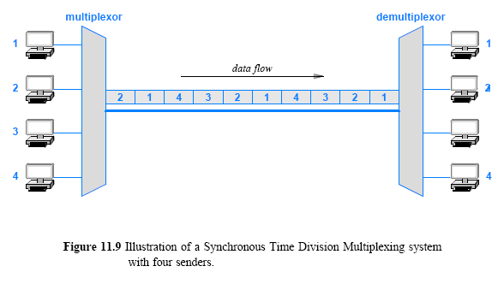
Synchronous TDM

Slide 20
Framing Used in the Telephone System Version of TDM
Telephone systems use synchronous TDM to multiplex digital streams from multiple phone calls
  they use the acronym TDM to refer to the specific form of TDM used to multiplex digital telephone calls
The phone system TDM includes an interesting technique
  to insure that a demultiplexor stays synchronized with the multiplexor
Why is synchronization needed?
  observe that a synchronous TDM sends one slot after another without any indication of the output to which a given slot occurs
A demultiplexor cannot tell where a slot begins
  a slight difference in the clocks used to time bits can cause a demultiplexor to misinterpret the bit stream

Slide 21
Framing Used in the Telephone System Version of TDM
To prevent misinterpretation, the version of TDM used in the phone system includes an extra framing channel as input
Instead of taking a complete slot, framing inserts a single bit in the stream on each round
A demultiplexor extracts data from the framing channel and checks for alternating 0 and 1 bits
If an error causes a demultiplexor to lose a bit
  it is highly likely that the framing check will detect the error and allow the transmission to be restarted
Figure 11.10 illustrates the use of framing bits

Slide 22
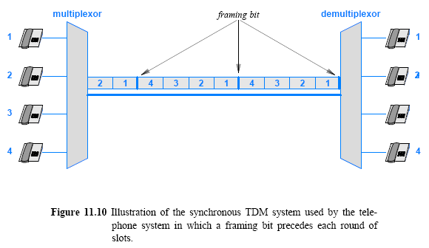
Framing Used in the Telephone System Version of TDM

Slide 23
Hierarchical TDM
Like FDM, TDM can be arranged in a hierarchy
The difference is that each successive stage of a TDM hierarchy uses N times the bit rate
  In FDM, each successive stage uses N times the frequencies
Additional framing bits are added to the data
  means that the bit rate of each successive layer of hierarchy is slightly greater than the aggregate voice traffic
Compare the example TDM hierarchy
  in Figure 11.11 with the FDM example in Figure 11.6

Slide 24
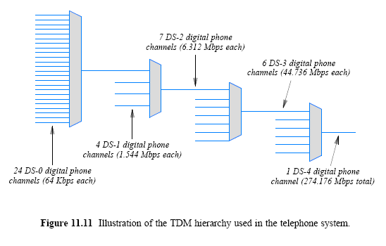
Hierarchical TDM

Slide 25
The Problem with Synchronous TDM: Unfilled Slots
Synchronous TDM works well if each source produces data at a uniform, fixed rate equal to 1/N of the capacity of the shared medium
Many sources generate data in bursts, with idle time between bursts
To understand why, consider the example in Figure 11.12
  sources on the left produce data items at random
  the synchronous multiplexor leaves a slot unfilled
    if the corresponding source has not produced an item by the time the slot must be sent
In practice, a slot cannot be empty because the underlying system must continue to transmit data
  the slot is assigned a value (such as zero)
  and an extra bit is set to indicate that the value is invalid

Slide 26
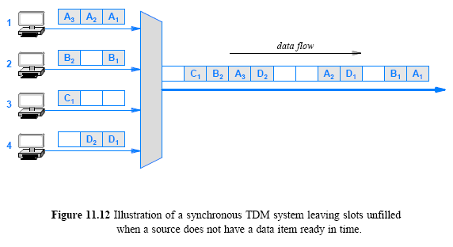
The Problem with Synchronous TDM: Unfilled Slots
© 2009 Pearson Education Inc., Upper Saddle River, NJ. All rights reserved.

Slide 27
Statistical TDM
How can a multiplexing system make better use of a shared medium?
One technique to increase the overall data rate is known as statistical TDM or statistical multiplexing
  some literature uses the term asynchronous TDM
The technique is straightforward:
  select items for transmission in a round-robin fashion
  but instead of leaving a slot unfilled, skip any source that does not have data ready
By eliminating unused slots
  statistical TDM takes less time to send the same amount of data
Figure 11.13 illustrates how a statistical TDM system sends the data from Figure 11.12 in only 8 slots instead of 12

Slide 28
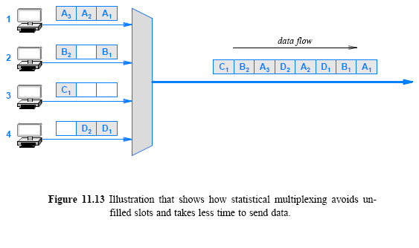
Statistical TDM

Slide 29
Statistical TDM
Statistical multiplexing incurs extra overhead
Consider demultiplexing:
  In a synchronous TDM system a demultiplexor knows that every N slot corresponds to a given receiver
  In a statistical multiplexing system, the data in a given slot can correspond to any receiver
Each slot must contain the identification of the receiver to which the data is being sent
Later chapters discuss identification mechanisms
  that are used with statistical multiplexing in packet switching networks and the Internet

Slide 30
Code Division Multiplexing (CDM)
CDM used in parts of the cellular telephone system and for some satellite communication
  The specific version of CDM used in cell phones is known as Code Division Multi-Access (CDMA)
CDM does not rely on physical properties
  such as frequency or time
CDM relies on an interesting mathematical idea
  values from orthogonal vector spaces can be combined and separated without interference
Each sender is assigned a unique binary code C_{i}
  that is known as a chip sequence
  chip sequences are selected to be orthogonal vectors
  (i.e., the dot product of any two chip sequences is zero)

Slide 31
Code Division Multiplexing
At any point in time, each sender has a value to transmit, V_{i}
  The senders each multiply C_{i} x V_{i} and transmit the results
The senders transmit at the same time
  and the values are added together
To extract value V_{i}, a receiver multiplies the sum by C_{i}
Consider an example
  to keep the example easy to understand, use a chip sequence that is only two bits long and data values that are four bits long
  think of the chip sequence as a vector
Figure 11.15 lists the values

Slide 32
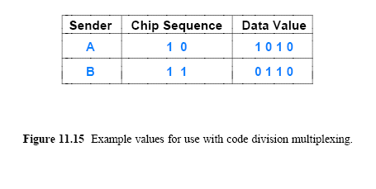
Code Division Multiplexing

Slide 33
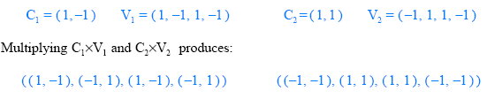
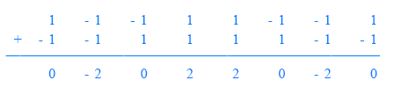
Code Division Multiplexing
The first step consists of converting the binary values into vectors that use -1 to represent 0:
If we think of the resulting values as a sequence of signal strengths to be transmitted at the same time
  the resulting signal will be the sum of the two signals

Slide 34
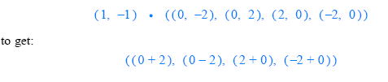
Code Division Multiplexing
A receiver treats the sequence as a vector
  computes the product of the vector and the chip sequence
  treats the result as a sequence, and converts the result to binary by interpreting positive values as binary 1 and negative values as 0
Thus, receiver number 1 computes:
Interpreting the result as a sequence produces: (2 -2 2 -2)
  which becomes the binary value: (1 0 1 0)
  note that 1010 is the correct value of V₁
  receiver 2 will extract V₂ from the same transmission

