Slide 1
Data Communications
Data Link Protocols

Slide 2
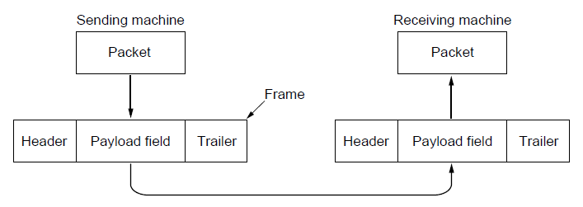
Packets & Frames
Relationship between packets and frames.

Slide 3
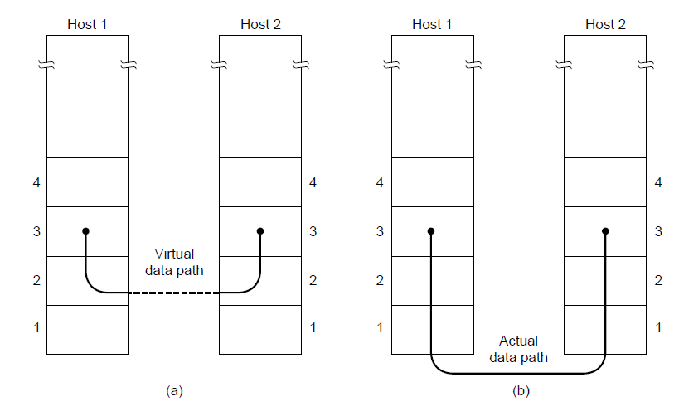
Network Layer Services
(a) Virtual communication. (b) Actual communication.

Slide 4
Possible Services Offered
Unacknowledged connectionless service.
Acknowledged connectionless service.
Acknowledged connection-oriented service.

Slide 5
Framing Methods
Byte count.
Flag bytes with byte stuffing.
Flag bits with bit stuffing.
Physical layer coding violations

Slide 6
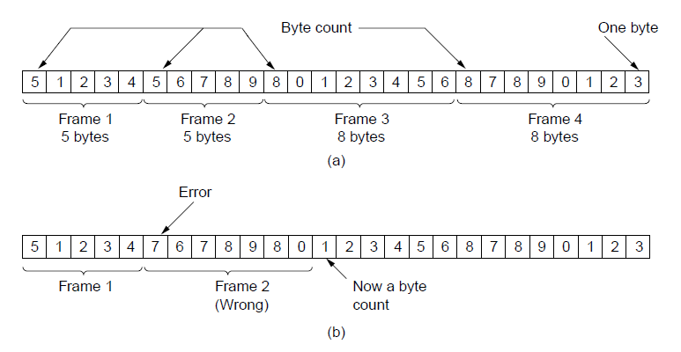
Byte Count Framing
A byte stream. (a) Without errors. (b) With one error.

Slide 7
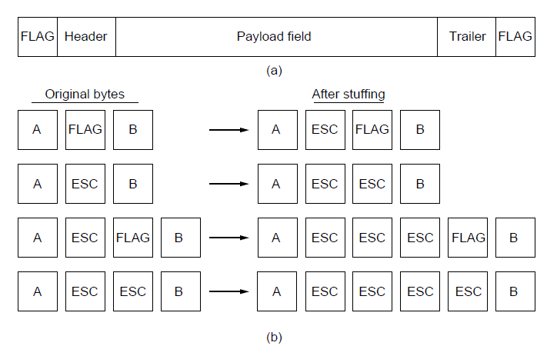
Framing with Flag Bytes
A frame delimited by flag bytes.
Four examples of byte sequences before and after byte stuffing.

Slide 8
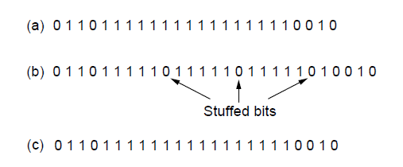
Framing with Bit Stuffing
Bit stuffing. (a) The original data. (b) The data as they appear on
the line. (c) The data as they are stored in the receiver’s memory after de-stuffing.

Slide 9
Elementary Data Link Protocols
Utopian Simplex Protocol
Simplex Stop-and-Wait Protocol
  Error-Free Channel
Simplex Stop-and-Wait Protocol
  Noisy Channel

Slide 10
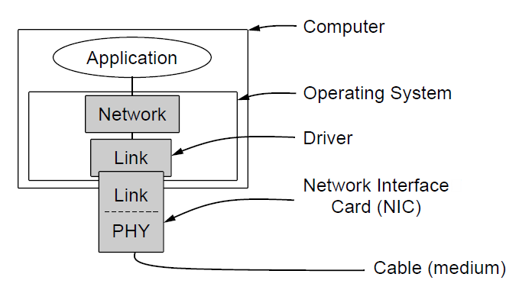
Elementary Data Link Protocols
Implementation of the physical, data link, and network layers.

Slide 11
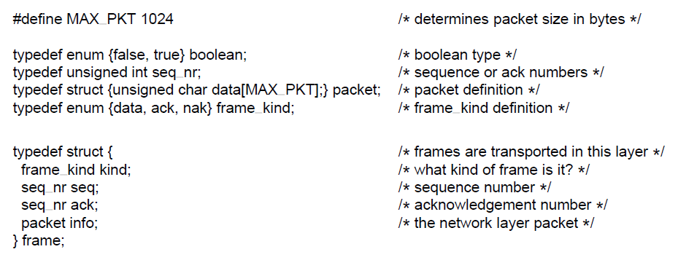
Elementary Data Link Protocols
Some definitions needed in the protocols to follow.

Slide 12
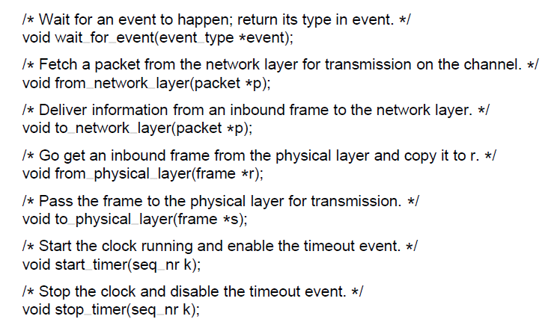
Elementary Data Link Protocols
Some definitions needed in the protocols to follow.

Slide 13
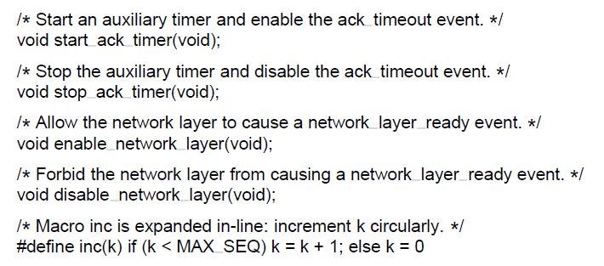
Elementary Data Link Protocols
Some definitions needed in the protocols to follow.

Slide 14
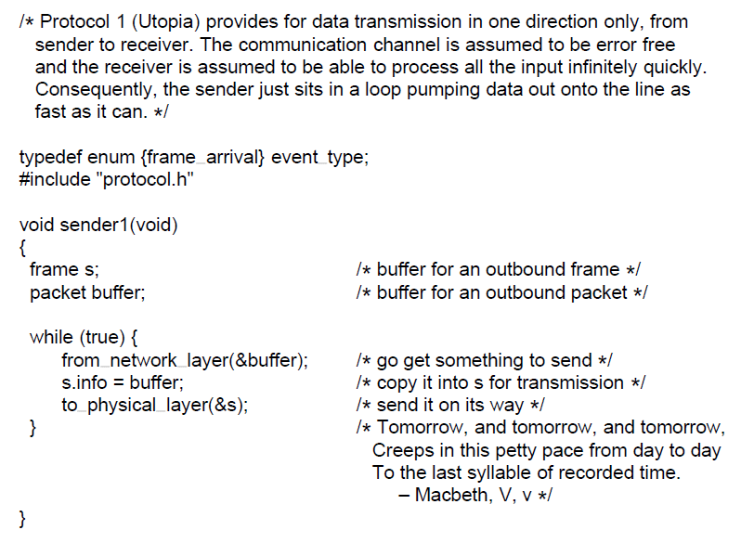
Simplex Protocol (Sender)

Slide 15
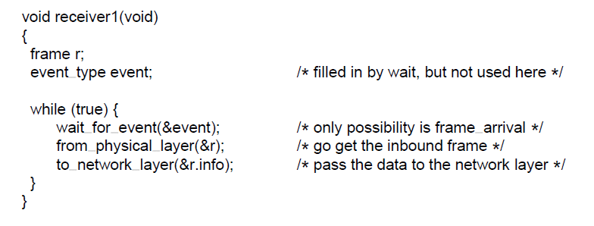
Simplex Protocol (Receiver)

Slide 16
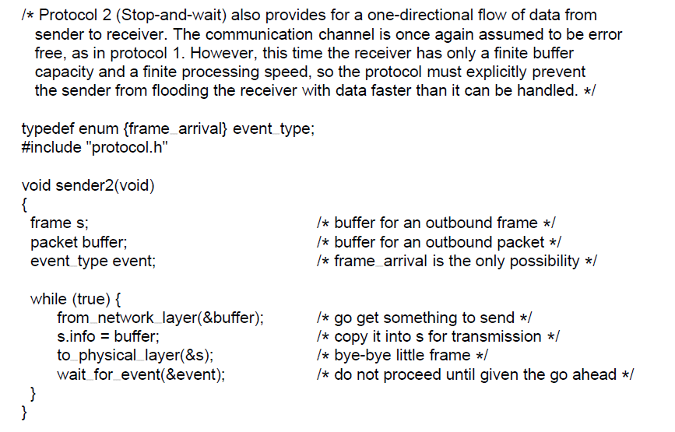
Simplex Stop-and-Wait Protocol for a Noisy Channel (Sender)

Slide 17
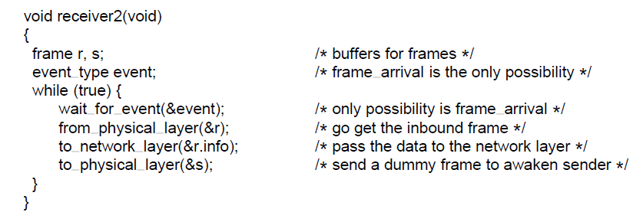
Simplex Stop-and-Wait Protocol for a Noisy Channel (Receiver)

Slide 18
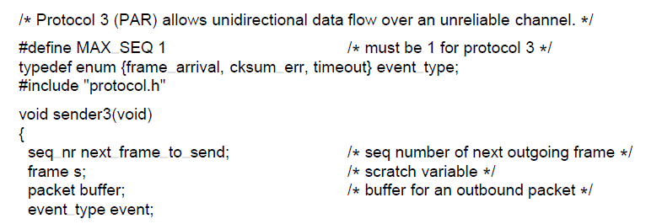
Sliding Window Protocols (Sender)
A positive acknowledgement with retransmission protocol.

Slide 19
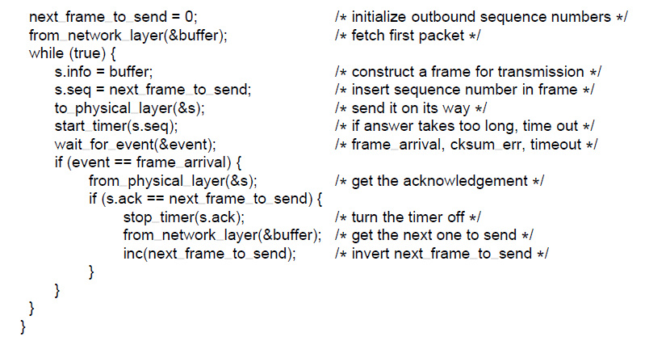
Sliding Window Protocols (Sender)
A positive acknowledgement with retransmission protocol.

Slide 20
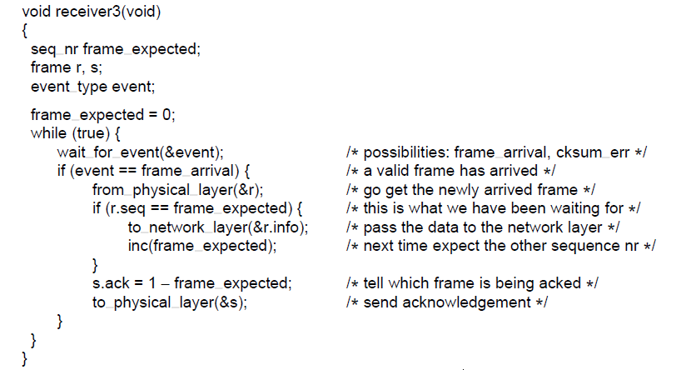
Sliding Window Protocols (Receiver)
A positive acknowledgement with retransmission protocol.

