Slide 1
Packet Switching and Network Technologies
Local Area Networks, Frames and Topologies

Slide 2
Topics Covered
Introduction
Circuit Switching
Packet Switching
Local and Wide Area Packet Networks
Standards for Packet Format and Identification
IEEE 802 Model and Standards
Point-to-Point and Multi-Access Networks
LAN Topologies
Packet Identification, Demultiplexing, MAC Addresses
Unicast, Broadcast, and Multicast Addresses
Broadcast, Multicast, and Efficient Multi-Point Delivery
Frames and Framing
Byte and Bit Stuffing

Slide 3
Circuit Switching
Circuit switching refers to a communication mechanism that establishes a path between a sender and receiver
  with guaranteed isolation from paths used by other pairs of senders and receivers
Circuit switching is usually associated with telephone technology
  because a telephone system provides a dedicated connection between two telephones
Figure 13.1 illustrates the concept
  Circuit switching networks use electronic devices to establish circuits
  Instead of having each circuit correspond to a physical path
    multiple circuits are multiplexed over shared media
    and the result is known as a virtual circuit

Slide 4
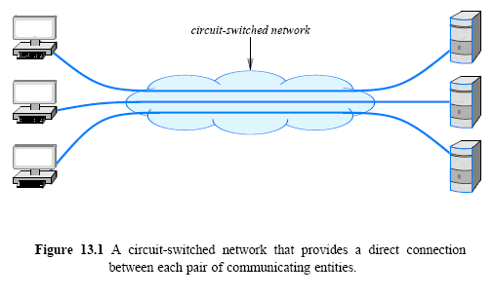
Circuit Switching

Slide 5
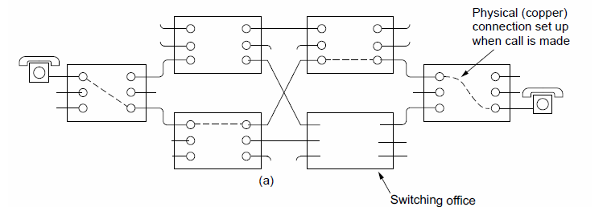
Circuit Switching

Slide 6
Circuit Switching
Three general properties define a circuit switched paradigm:
  Point-to-point communication
    means that a circuit is formed between exactly two endpoints
  Separate steps for circuit creation, use, and termination
    distinguishes circuits that are switched (i.e., established when needed) from circuits that are permanent
  Performance equivalent to an isolated physical path
    communication between two parties is not affected in any way by communication among other parties
    circuit switching must provide the illusion of an isolated path for each pair of communicating entities
Switched circuits use a three-step process analogous to placing a phone call
  a circuit is established between two parties
  the two parties use the circuit to communicate
  the two parties terminate use

Slide 7
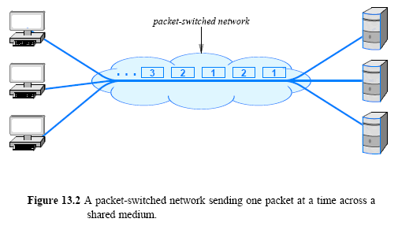
Packet Switching
A packet switching system uses statistical multiplexing
  multiple sources compete for the use of shared media

Slide 8
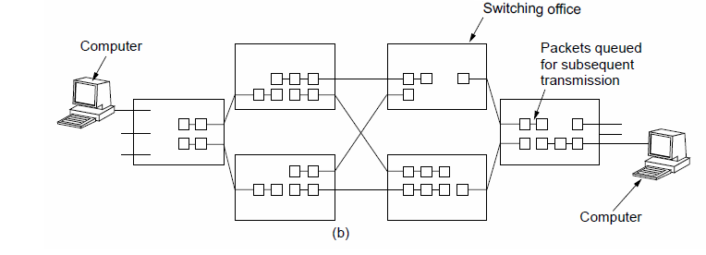
Packet Switching

Slide 9
Packet Switching
A packet switching system requires a sender to divide each message into blocks of data that are known as packets
  the size of a packet varies
  each packet switching technology defines a maximum packet size
Three general properties define packet switching
  Arbitrary, asynchronous communication
    allows a sender to communicate with one recipient or multiple recipients
      a given recipient can receive messages from one sender or multiple senders
    communication can occur at any time
      and a sender can delay arbitrarily long between successive communications
  No set-up required before communication begins
    system remains ready to deliver a packet to any destination at any time
      a sender does not need to perform initialization before communicating
    system does not need to notify the underlying system when communication terminates
  Performance varies due to statistical multiplexing among packets
    multiplexing occurs among packets rather than among bits or bytes

Slide 10
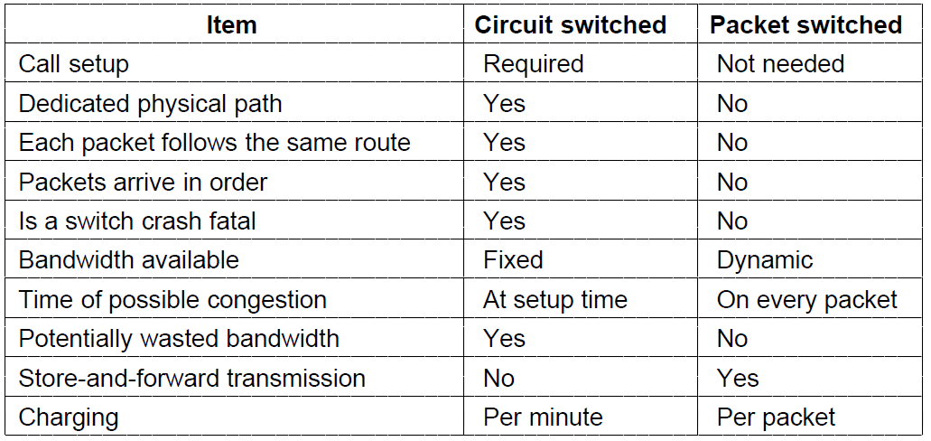
Circuit Switching/Packet Switching
A comparison of circuit-switched and packet-switched networks

Slide 11
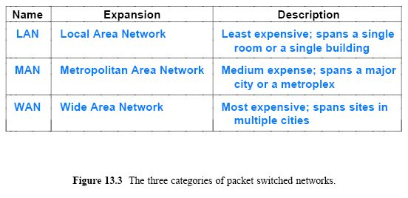
Local and Wide Area Packet Networks
Packet switching technologies are commonly classified according to the distance they span
  The least expensive networks use technologies that span a short distance (e.g., inside a single building)
  The most expensive span long distances (e.g., across several cities)

Slide 12
Standards for Packet Format and Identification
Each packet sent across such a network must contain the identification of the intended recipient
All senders must agree on the exact details of how to identify a recipient and where to place the identification in a packet
Standards organizations create protocol documents that specify all details
Standards have been created by various organizations
  Institute for Electrical and Electronic Engineers (IEEE) is most famous
In 1980, IEEE organized the Project 802 LAN/MAN Standards Committee to produce standards for networking

Slide 13
Standards for Packet Format and Identification
IEEE is mostly composed of engineers who focus on the lower two layers of the protocol
In fact, if one reads the IEEE documents
  it may seem that all other aspects of networking are unimportant
However, other standards organizations exist
  and each emphasizes particular layers of the stack
Figure 13.4 gives a humorous illustration of a protocol as viewed by various standards organizations, such as
  Institute for Electrical and Electronic Engineers (IEEE)
  World Wide Web Consortium (W3C)
  Internet Engineering Task Force (IETF)
Each standards organization focuses on particular layers of the protocol stack

Slide 14
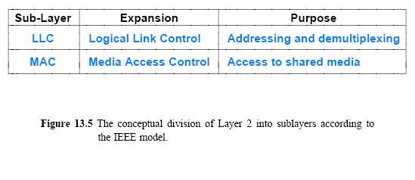
IEEE 802 Model and Standards
IEEE divides Layer 2 of the protocol stack into two conceptual sub-layers, as Figure 13.5 (below) illustrates
  The Logical Link Control (LLC)
    sublayer specifies addressing and the use of addresses for demultiplexing as described later in the chapter
  The Media Access Control (MAC)
    sublayer specifies how multiple computers share underlying medium

Slide 15
IEEE 802 Model and Standards
IEEE assigns a multi-part identifier of the form XXX.YYY.ZZZ
  XXX denotes the category of the standard
  YYY denotes a subcategory
  If a subcategory is large enough, a third level can be added
IEEE has created many working groups that are each intended to standardize one type of network technology
  Each working group consists of representatives from the industrial and academic communities; meets regularly to discuss approaches and devise standards
  IEEE allows a working group to remain active provided the group makes progress and the technology is still deemed important
  If a working group decides that the technology under investigation is no longer relevant, the group can decide to disband

Slide 16
Point-to-Point and Multi-Access Networks
LAN technologies allow multiple computers to share
  a medium in such a way that any computer on the LAN can communicate with any other
  we use the term multi-access to describe this and we say that a LAN is a multi-access network
In general, LAN technologies provide direct connection among communicating entities
Professionals say that LANs connect computers
  with the understanding that a device such as a printer can also connect to a multi-access LAN

Slide 17
LAN Topologies
Many LAN technologies have been invented
  How specific technologies are similar and how they differ?
Each network is classified into a category according to its topology or general shape
This section describes four basic topologies that are used to construct
  13.8.1 Bus Topology
  13.8.2 Ring Topology
  13.8.3 Mesh Topology
  13.8.4 Star Topology

Slide 18
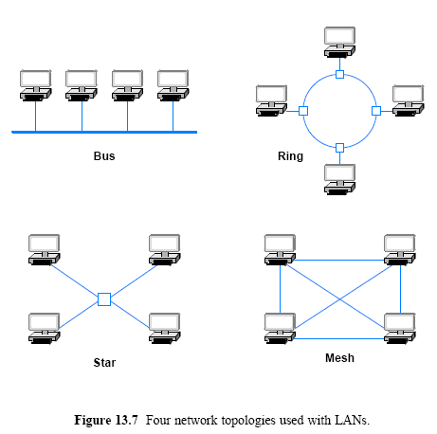
LAN Topologies

Slide 19
LAN Topologies
Bus topology usually consists of a single cable to which computers attach
The ends of a bus network must be terminated
  to prevent electrical signals from reflecting back along the bus
Any computer attached to a bus can send on the cable
  and all computers receive the signal
Because all computers attach directly to the cable
  any computer can send data to any other computer
The computers attached to a bus network must coordinate
  to ensure that only one computer sends a signal at any time

Slide 20
LAN Topologies
Ring topology arranges for computers to be connected in a closed loop
  a cable connects the first computer to a second computer, another cable connects the second computer to a third, and so on, until a cable connects the final computer back to the first
  name ring arises because one can imagine the computers and the cables connecting them arranged in a circle as Figure 13.7 illustrates
    In practice, the cables in a ring network do not form a circle
    Instead, they run along hallways or rise vertically from one floor of a building to another
Ring topology requires a computer to connect to a small device that forms the ring
  this is needed for the ring to continue operation even if some of the computers are disconnected

Slide 21

LAN Topologies
A network that uses a mesh topology provides a direct connection between each pair of computers
The chief disadvantage of a mesh arises from the cost:
  A mesh network connecting n computers requires:
  The important point is that the number of connections needed for a mesh network grows faster than the number of computers
Because connections are expensive
  few LANs employ a mesh topology in special circumstances

Slide 22
LAN Topologies
In star topology, all computers attach to a central point
The center of a star network is often called a hub
A typical hub consists of an electronic device
  that accepts data from a sending computer and delivers it to the appropriate destination
In practice, star networks seldom have a symmetric shape (hub is located an equal distance from all computers)
  Instead, a hub often resides in a location separate from the computers attached to it
For example, computers can reside in individual offices, while the hub resides in a location accessible to an organization's networking staff

Slide 23
LAN Topologies
Each topology has advantages and disadvantages
A ring makes it easy for computers to coordinate access and to detect whether the network is operating correctly
  However, an entire ring network is disabled if one of the cables is cut
A star helps protect the network from damage to a single cable because each cable connects only one machine
A bus but has the same disadvantage as a ring
  a network is disabled if someone accidentally cuts the main cable

Slide 24
Packet Identification, Demultiplexing, MAC Addresses

Slide 25
Packet Identification, Demultiplexing, MAC Addresses
Each packet that travels across the shared medium is intended for a specific recipient
  and only the intended recipient should process the packet
Demultiplexing uses an identifier known as an address
Each computer is assigned a unique address
  and each packet contains the address of the intended recipient
In the IEEE addressing scheme, each address consists of 48 bits; IEEE uses the term Media Access Control address (or simply MAC address)
  networking professionals often use the term Ethernet address
IEEE allocates a unique address for each piece of interface
  Each Network Interface Card (NIC) contains a unique IEEE address assigned when the device was manufactured

Slide 26
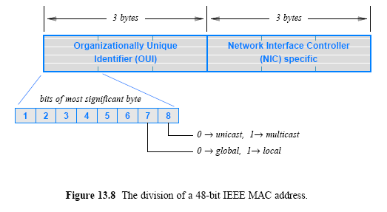
Packet Identification, Demultiplexing, MAC Addresses
IEEE assigns a block of addresses to each vendor
  and allows the vendor to assign a unique value to each device
  there is a 3-byte Organizationally Unique ID (OUI)
    OUI identifies the equipment vendor
    a 3-byte block that identifies a particular NIC

Slide 27
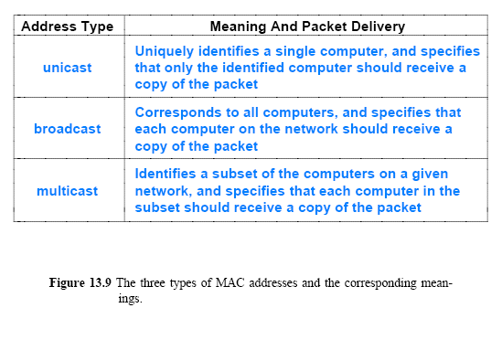
Unicast, Broadcast, and Multicast Addresses

Slide 28
Unicast, Broadcast, and Multicast Addresses
It may seem odd that the IEEE address format reserves a bit to distinguish between unicast and multicast
  but does not provide a way to designate a broadcast address
The standard specifies that a broadcast address consists of 48 bits that are all 1s
  Thus, a broadcast address has the multicast bit set
Broadcast can be viewed as a special form of multicast
  Each multicast address corresponds to a group of computers
  Broadcast address corresponds to a group that includes all computers on the network
© 2009 Pearson Education Inc., Upper Saddle River, NJ. All rights reserved.

Slide 29
Broadcast, Multicast, and Efficient Multi-Point Delivery
Broadcast and multicast addresses are useful in LANs
  because they permit efficient delivery to many computers
To understand the efficiency
  recall that a LAN transmits packets over a shared medium
In a typical LAN
  each computer on the LAN monitors the shared medium
  extracts a copy of each packet
  and then examines the address in the packet
  determine whether the packet should be processed or ignored

Slide 30
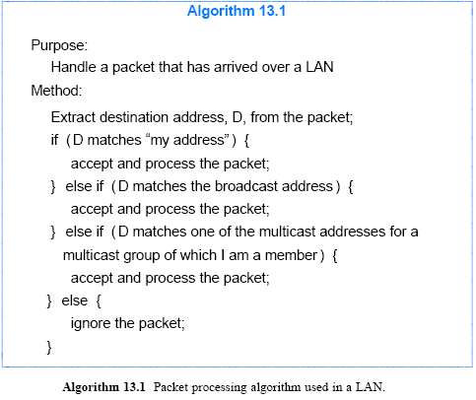
Broadcast, Multicast, and Efficient Multi-Point Delivery

Slide 31
Frames and Framing
In more general terms, framing refers to the structure added to a sequence of bits or bytes that allows a sender and receiver to agree on the exact format of the message
In a packet-switched network, each frame corresponds to a packet
A frame consists of two conceptual parts:
  Header that contains metadata, such as an address
    contains information used to process the frame
  Payload that contains the data being sent
    contains the message being sent
    and is usually much larger than the frame header

Slide 32
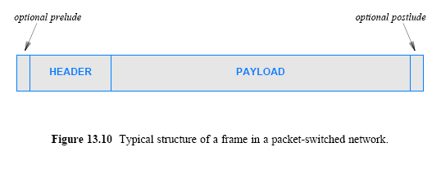
Frames and Framing
A message is opaque
  in the sense that the network only examines the frame header
  the payload can contain an arbitrary sequence of bytes that are only meaningful to the sender and receiver
Some technologies delineate each frame by sending a short prelude before the frame and a short postlude after it

Slide 33
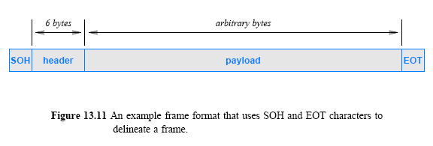
Frames and Framing
Assume that a packet header consists of 6 bytes
  the payload consists of an arbitrary number of bytes
We can use ASCII character set
  the Start Of Header (SOH) character marks the beginning of a frame
  and the End Of Transmission (EOT) character marks the end

Slide 34
Byte and Bit Stuffing
In the ASCII character set
  SOH has hexadecimal value 201
  EOT has the hexadecimal value 204
An important question arises
  what happens if the payload of a frame includes one or more bytes with value 201 or 204?
The answer lies in a technique known as byte stuffing
  that allows transmission of arbitrary data without confusion

Slide 35
Byte and Bit Stuffing
To distinguish between data and control information, such as frame delimiters
  Sender changes a data to replace each control byte with a sequence
  The receiver replaces the sequence with the original one
  As a result, a frame can transfer arbitrary data and the underlying system never confuses data with control information
The technique is known as byte stuffing
  the terms data stuffing and character stuffing are sometimes used
A related technique used with systems that transfer a bit stream is known as bit stuffing

Slide 36
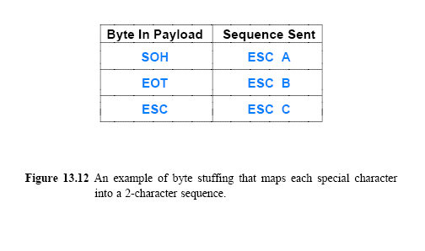
Byte and Bit Stuffing
Because SOH and EOT are used to delimit the frame
  those two bytes must not appear in the payload
Byte stuffing reserves a third character to mark occurrences of reserved characters in the data
  For example, suppose the ASCII character ESC (hex value 1B) has been selected as the third character
  When any of the three special characters occur in the data
    the sender replaces the character with a two-character sequence

Slide 37
Byte and Bit Stuffing
As the figure specifies
  the sender replaces each occurrence of SOH by the two characters ESC + A
  each occurrence of EOT by the characters ESC + B
  and each occurrence of ESC by the two characters ESC + C
A receiver reverses the mapping
  by looking for ESC followed by one of A, B, or C and replacing the 2-character combination with the appropriate single character
Figure 13.13 shows an example payload and the same payload after byte stuffing has occurred
  Note that once byte stuffing has been performed, neither SOH nor EOT appears anywhere in the payload

Slide 38
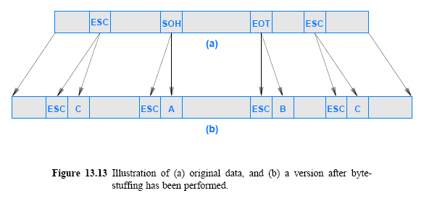
Byte and Bit Stuffing

