Slide 1
Introduction and Internet Applications
Internet Applications & Network Programming

Slide 2
Overview
Introduction
Two Basic Internet Communication Paradigms
Connection-Oriented Communication
The Client-Server Model of Interaction
Characteristics of Clients and Servers
Server Programs and Server-Class Computers
Requests, Responses, and Direction of Data Flow
Multiple Clients and Multiple Servers
Server Identification and Demultiplexing
Concurrent Servers
Circular Dependencies Among Servers
Peer-to-Peer Interactions
Network Programming and the Socket API
Sockets, Descriptors, and Network I/O
Parameters and the Socket API
Socket Calls in a Client and Server
Socket Functions Used by Both Client and Server
The Connection Function Used Only by a Client
Socket Functions Used Only by a Server
Socket Functions Used with the Message Paradigm
Other Socket Functions
Sockets, Threads, and Inheritance

Slide 3
Introduction
The Internet offers users a wide range of services
  None of theses services are built-in
The Internet provides a general purpose mechanism
  Services are supplied by application programs that run on computers attached to the Internet
Develop new services without changing the Internet
Two key concepts of Internet applications:
  Conceptual paradigm that applications follow when they communicate over the Internet
  The socket Application Programming Interface (socket API) that Internet applications use
Internet application programmers can get started easily
It is possible to create Internet applications without knowing how networks operate
  However, understanding network protocols and technologies allows them to write efficient and reliable code that enables applications to scale across many sites

Slide 4
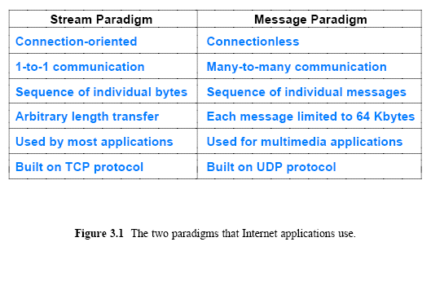
Two Basic Internet Communication Paradigms
The Internet supports two basic communication paradigms:
  Stream-based Transport
  Message-based Transport

Slide 5
Stream Transport
Stream denotes a paradigm in which a sequence of bytes flows from one application program to another
Internet's mechanism arranges two streams between a pair of communicating applications, one in each direction
The network accepts input from either application, and delivers the data to the other application
The stream mechanism transfers a sequence of bytes without attaching meaning to the bytes and without inserting boundaries
A sending application can choose to generate one byte at a time, or can generate blocks of bytes
The network chooses the number of bytes to deliver at any time
  The network can choose to combine smaller blocks into one large block or can divide a large block into smaller blocks

Slide 6
Message Transport
In a message paradigm, the network accepts and delivers messages
Each message delivered to a receiver corresponds to a message that was transmitted by a sender
  The network never delivers part of a message, nor does it join multiple messages together
  If a sender places exactly n bytes in an outgoing message, the receiver will find exactly n bytes in the incoming message
The message paradigm allows delivery in different forms:
  Unicast
    Message can be sent from an application on one computer directly to an application on another, 1-to-1
  Multicast
    Message can be multicast to some of the computers on a network, 1-to-many
  Broadcast
    Message can be broadcast to all computers on a given network, 1-to-all

Slide 7
Message Transport
Message service does not make any guarantees
So messages may be
  Lost (i.e., never delivered)
  Duplicated (more than one copy arrives)
  Delivered out-of-order
A programmer who uses the message paradigm must insure that the application operates correctly
  Even if packets are lost or reordered
Most applications require delivery guarantees
Programmers tend to use the stream service except in special situations
  Such as video, where multicast is needed and the application provides support to handle packet reordering and loss

Slide 8
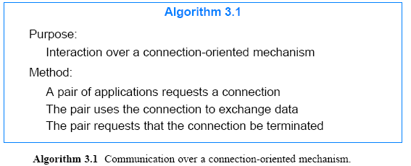
Connection-Oriented Communication
The Internet stream service is connection-oriented
It operates analogous to a telephone call:

Slide 9
Client-Server Model
How is the connection hand-shaking protocol handled?
The answer lies in a form of interaction known as the client-server model
  A server starts first and awaits contact
  A client starts second and initiates the connection
Application programs known as clients and servers handle all services in the Internet

Slide 10
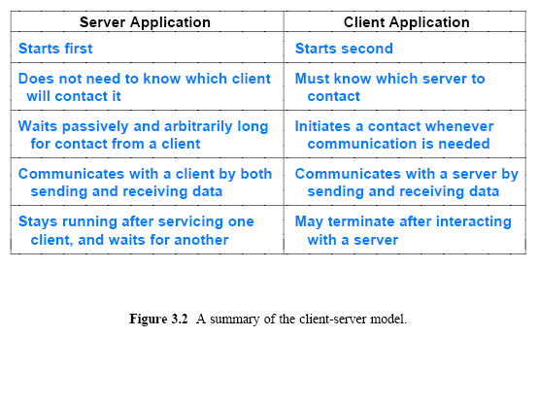
Client-Server Model

Slide 11
Characteristics of Clients and Servers
Most instances of client-server interaction have the same general characteristics
Client software:
  Application program that becomes a client temporarily when remote access is needed, but also performs other computation
  Invoked directly by a user, and executes only for one session
  Runs locally
  Actively initiates contact with a server
  Can access multiple services as needed, but usually contacts one remote server at a time
  Does not require especially powerful computer hardware

Slide 12
Characteristics of Clients and Servers
A server software:
  Is a special-purpose, privileged program
  Is dedicated to providing one service that can handle multiple remote clients at the same time
  Is invoked automatically when a system boots, and continues to execute through many sessions
  Runs on a large, powerful computer
  Waits passively for contact from arbitrary remote clients
  Accepts contact from arbitrary clients, but offers a single service
  Requires powerful hardware and a sophisticated operating system (OS)

Slide 13
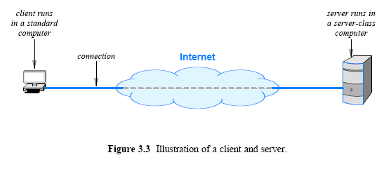
Server Programs and Server-Class Computers
Term server refers to a program that waits passively for communication
  Not to the computer on which it executes
However, when a computer is dedicated to running one or more server programs,
  The computer itself is sometimes called a server
Hardware vendors contribute to the confusion
  They classify computers that have fast CPUs, large memories, and powerful operating systems as server machines

Slide 14
Requests, Responses, and Direction of Data Flow
Client and server?
Which side initiates contact?
Once contact has been established, two-way communication is possible (i.e., data can flow from a client to a server or from a server to a client)
In some cases, a client sends a series of requests and the server issues a series of responses

Slide 15
Multiple Clients and Multiple Servers
Allowing a given computer to operate multiple servers is useful because
  Hardware can be shared
  A single computer has lower system administration overhead than multiple computer systems
  Research has shown that the demand for a server is often sporadic
    A server can remain idle for long periods of time
If demand for services is low, consolidating servers on a single computer can dramatically reduce cost
  Without significantly reducing performance

Slide 16
Multiple Clients and Multiple Servers
A computer can run:
  A single client
  A single server
  Multiple copies of a client that contact a given server
  Multiple clients that each contact a particular server
  Multiple servers, each for a particular service
Allowing a computer to operate multiple clients is useful
  Services can be accessed simultaneously
For example, a user can have three (3) windows open simultaneously running three (3) applications:
  Retrieve and display email
  Connect to a chat service
  Run a web browser

Slide 17
Server Identification and Demultiplexing
How does a client identify a server?
The Internet protocols divide identification into two pieces:
  An identifier for the computer on which a server runs
  An identifier for a service on the computer
Identifying a computer?
  Each computer in the Internet is assigned a unique 32-bit identifier known as an Internet Protocol address (IP address)
  A client must specify the server’s IP address
  To make server identification easy for humans, each computer is also assigned a name, and the Domain Name System (DNS)
    described in Chapter 4 is used to translate a name into an address
  Thus, a user specifies a name such as www.cisco.com rather than an integer address

Slide 18
Server Identification and Demultiplexing
Identifying a service?
  Each service available in the Internet is assigned a unique 16-bit identifier known as a protocol port number (or port number)
    Examples, email → port number 25, and the web → port number 80
  When a server begins execution
    it registers with its local OS by specifying the port number for its service
  When a client contacts a remote server to request service
    the request contains a port number
  When a request arrives at a server
    software on the server uses the port number in the request to determine which application on the server computer should handle the request

Slide 19
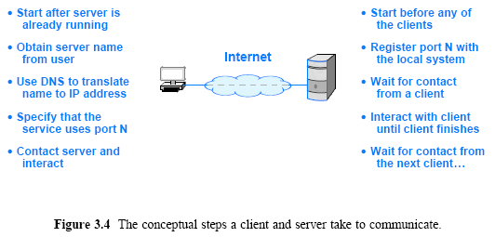
Server Identification and Demultiplexing

Slide 20
Concurrent Servers
Although a serial approach works in a few trivial cases, most servers are concurrent
  That is, a server uses more than one thread of control
Concurrent execution depends on the OS being used
Concurrent server code is divided into two pieces
  a main program (thread)
  a handler
The main thread accepts contact from a client and creates a thread of control for the client
Each thread of control interacts with a single client and runs the handler code

Slide 21
Concurrent Servers
After handling one client the thread terminates
The main thread keeps the server alive after creating a thread to handle a request
  the main thread waits for another request to arrive
If N clients are simultaneously using a concurrent server, N+1 threads will be running:
  the main thread (1) is waiting for additional requests
  and N threads are each interacting with a single client

Slide 22
Circular Dependencies Among Servers
In practice, the distinction blurs because a server for one service can act as a client for another
  For example, before it can fill in a web page, a web server may need to become a client of a database
  A server may also become the client of a security service (e.g., to verify that a client is allowed to access the service).
Programmers must be careful to avoid circular dependencies among servers
  For example, consider what can happen if a server for service X becomes a client of service X, which becomes a client of service X, which becomes a client of X
  The chain of requests can continue indefinitely until all three servers exhaust resources
The potential for circularity is especially high when services are designed independently
  because no single programmer controls all servers

Slide 23
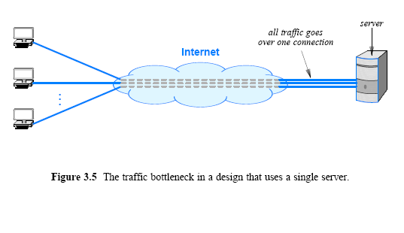
Peer-to-Peer Interactions
If a single server provides a given service
  the network connection between the server and the Internet can become a bottleneck

Slide 24
Peer-to-Peer Interactions
Can Internet services be provided without creating a central bottleneck?
  One way to avoid a bottleneck forms the basis of file sharing known as a peer-to-peer (P2P) architecture
The scheme avoids placing data on a central server
  data is distributed equally among a set of N servers
  and each client request is sent to the appropriate server
  a given server only provides 1/N of the data
    the amount of traffic between a server and the Internet is 1/N as much as in the single-server architecture
Server software can run on the same computers as clients

Slide 25
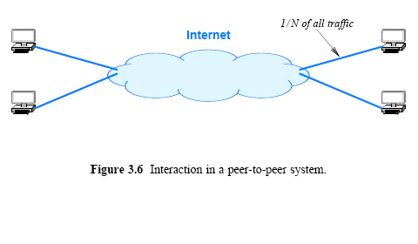
Peer-to-Peer Interactions

Slide 26
Network Programming
& Socket API
The interface an application uses to specify communication is known as an Application Program Interface (API)
  Appendix 1 contains a simplified API (with only seven functions)
    example code that demonstrates how such an API can be used to create Internet applications, including a working web server
Details of an API depend on the OS
One particular API has emerged as the de facto standard for software that communicates over the Internet
  known as the socket API, and commonly abbreviated sockets
The socket API is available for many OS
  such as Microsoft's Windows systems
  as well as various UNIX systems, including Linux

Slide 27
Sockets, Descriptors, and Network I/O
Because it was originally developed as part of the UNIX OS, the socket API is integrated with I/O
When an application creates a socket to use for Internet
  OS returns a small integer descriptor that identifies the socket
The application then passes the descriptor as an argument
  when it calls functions to perform an operation on the socket (e.g., to transfer data across the network or to receive data)
In many OS, socket descriptors are integrated with other I/O descriptors
  as a result, an application can use the read and write operations for socket I/O or I/O to a file

Slide 28
Parameters and the Socket API
Socket programming differs from conventional I/O
An application must specify many details, such as
  the address of a remote computer
  the protocol port number
  and whether the application will act as a client or as a server
To avoid having a single socket function with many parameters, designers of the socket API chose to define many functions
An application creates a socket, and then invokes functions for details
The advantage of the socket approach is that most functions have three or fewer parameters
The disadvantage is that a programmer must remember to call multiple functions when using sockets

Slide 29
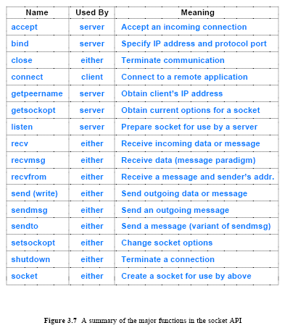
Socket API

Slide 30
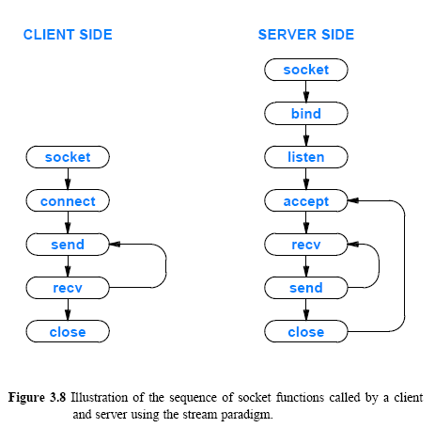
Socket Calls in a Client and Server

Slide 31
Socket Functions Used by Both Client and Server
Readers are encouraged to check the book for the details of these functions
  3.17.1 The Socket Function
  3.17.2 The Send Function
  3.17.3 The Recv Function
  3.17.4 Read and Write with Sockets
  3.17.5 The Close Function

Slide 32
The Connection Function Used Only by a Client
Clients call connect to establish a connection with a specific server. The form is:
connect (socket, saddress, saddresslen)
Argument socket is the descriptor of a socket to use for the connection

Slide 33
Socket Functions Used Only by a Server
Readers are encouraged to check the book for the details of these functions
  The Bind Function
  The Listen Function
  The Accept Function

Slide 34
Socket Functions Used with the Message Paradigm
The socket functions used to send and receive messages are more complicated than those used with the stream paradigm because many options are available
  For example, a sender can choose whether to store the recipient’s address in the socket and merely send data or to specify the recipient’s address each time a message is transmitted
  Furthermore, one function allows a sender to place the address and message in a structure and pass the address of the structure as an argument, and another function allows a sender to pass the address and message as separate arguments
Readers are encouraged to check the book for the details
  Sendto and Sendmsg Socket Functions
  Recvfrom and Recvmsg Functions

Slide 35
Other Socket Functions
The socket API contains a variety of support functions
  getpeername
  gethostname
  setsockopt
  getsockopt g
  gethostbyname
  gethostbyaddr

Slide 36
Sockets, Threads, and Inheritance
The socket API works well with concurrent servers
Implementations of the socket API adhere to the following inheritance principle:
  Each new thread that is created inherits a copy of all open sockets from the thread that created it
  The socket implementation uses a reference count mechanism to control each socket
  When a socket is first created
    the system sets the socket’s reference count to 1
    and the socket exists as long as the reference count remains positive.
  When a program creates an additional thread
    the thread inherits a pointer to each open socket the program owns
    and the system increments the reference count of each socket by 1
  When a thread calls close
    the system decrements the reference count for the socket
    if the reference count has reached zero, the socket is removed

