Slide 1
Data Communications
Information Sources
& Signals

Slide 2
Overview
Information Sources
Analog and Digital Signals
Periodic and Aperiodic Signals
Sine Waves and Signal Characteristics
Composite Signals
The Importance of Composite Signals and Sine Functions
Time and Frequency Domain Representations
Bandwidth of an Analog Signal
Digital Signals and Signal Levels
Baud and Bits Per Second
Converting a Digital Signal to Analog
The Bandwidth of a Digital Signal
Synchronization and Agreement About Signals
Line Coding
Manchester Encoding Used in Computer Networks
Converting an Analog Signal to Digital
The Nyquist Theorem and Sampling Rate
Nyquist Theorem and Telephone System Transmission
Encoding and Data Compression

Slide 3
Information Sources
Communication system accepts input from one or more sources and delivers to a specified destination
For the Internet, the source and destination of information are a pair of application programs
  that generate and consume data
Data communications theory concentrates on low-level communications systems
  it applies to arbitrary sources of information
  conventional computer peripherals such as keyboards and mice
  information sources can include microphones, sensors, and measuring devices, such as thermometers and scales
  destinations can include audio output devices such as earphones and loud speakers as well as devices such as LEDs that emit light

Slide 4
Analog and Digital Signals
Data communications deals with two types of information:
  analog
  digital
An analog signal is characterized by a continuous mathematical function
  when the input changes from one value to the next, it does so by moving through all possible intermediate values
A digital signal has a fixed set of valid levels
  each change consists of an instantaneous move from one valid level to another

Slide 5
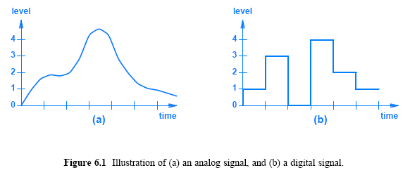
Analog and Digital Signals

Slide 6
Periodic and Aperiodic Signals
Signals are broadly classified as
  periodic
  aperiodic (sometimes called nonperiodic)
  classification depends on whether they repeat
For example:
  Figure 6.1a is aperiodic over the time interval shown because the signal does not repeat
  Figure 6.2 illustrates a signal that is periodic (i.e., repeating) - periodic signal repeats

Slide 7
Sine Waves and
Signal Characteristics
Much of the analysis in data communications involves the use of sinusoidal trigonometric functions
  especially sine, which is usually abbreviated sin
Sine waves are especially important in information sources
  because natural phenomena produce sine waves
  when a microphone picks up an audible tone, the output is a sine
  electromagnetic radiation can be represented as a sine wave
We are interested in sine waves that correspond to a signal that oscillates in time

Slide 8
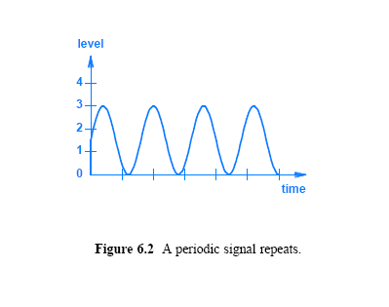
Sine Waves and Signal Characteristics

Slide 9
Sine Waves and
Signal Characteristics
Important characteristics of signals that relate to sine waves:
Frequency:
  the number of oscillations per unit time (usually seconds)
Amplitude:
  the difference between the maximum and minimum signal heights
Phase:
  how far the start of the sine wave is shifted from a reference time
Wavelength:
  the length of a cycle as a signal propagates across a medium
  is determined by the speed with which a signal propagates

Slide 10
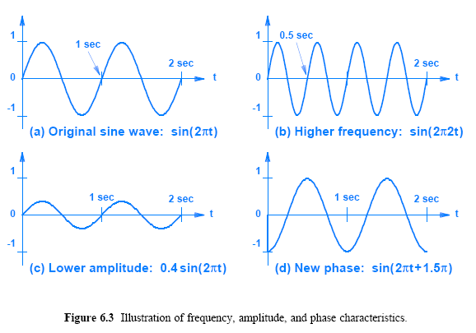
Sine Waves and
Signal Characteristics

Slide 11
Sine Waves and
Signal Characteristics
The frequency can be calculated as the inverse of the time required for one cycle, which is known as the period
The example sine wave in Figure 6.3a has
  a period T = 1 seconds
  and a frequency of 1 / T or 1 Hertz
The example in Figure 6.3b has
  a period of T = 0.5 seconds
  its frequency is 2 Hertz
Both examples are considered extremely low frequencies
Typical communication systems use high frequencies
  often measured in millions of cycles per second
To clarify high frequencies, engineers express time in fractions of a second or express frequency in units such as megahertz (MHz)

Slide 12
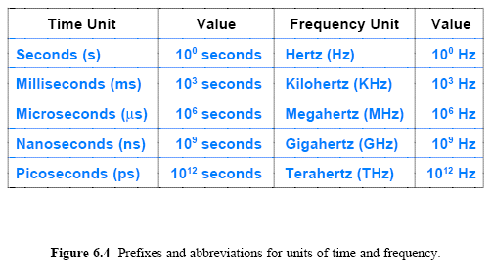
Sine Waves and
Signal Characteristics

Slide 13
Composite Signals
Signals like the ones illustrated in Figure 6.3 are classified as simple
  because they consist of a single sine wave that cannot be decomposed further
Most signals are classified as composite
  the signal can be decomposed into a set of simple sine waves

Slide 14
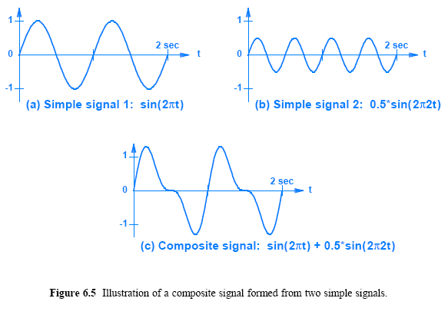
Composite Signals

Slide 15
Importance of Composite Signals and Sine Functions
Why does data communications seem obsessed with sine functions and composite signals?
When we discuss modulation and demodulation, we will understand one of the primary reasons:
  the signals that result from modulation are usually composite signals
A mathematician named Fourier discovered that
  it is possible to decompose a composite signal into its constituent parts
    a set of sine functions, each with a frequency, amplitude, and phase
The analysis by Fourier shows that if the composite signal is periodic, the constituent parts will also be periodic
  most systems use composite signals to carry information
  a composite signal is created at the sending end
  and the receiver decomposes the signal into the simple components

Slide 16
Time and Frequency Domain Representations
Several methods have been invented to represent composite signals
A graph of a signal as a function of time is known as time domain representation
The other representation is known as a frequency domain
  A frequency domain graph shows a set of simple sine waves that constitute a composite function
  The y-axis gives the amplitude, and the x-axis gives the frequency
The function Asin(2pt) is represented by a single line of height A that is positioned at x = t
The frequency domain graph in Figure 6.6 represents a composite from Figure 6.5c
  The figure shows a set of simple periodic signals

Slide 17
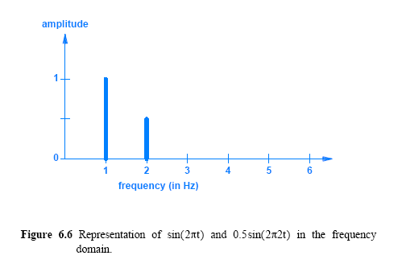
Time and Frequency Domain Representations

Slide 18
Time and Frequency Domain Representations
A frequency domain representation can also be used with nonperiodic signals
  but aperiodic representation is not essential to an understanding of the subject
One of the advantages of the frequency domain representation arises from its compactness
  a frequency domain representation is both small and easy to read because each sine wave occupies a single point along the x-axis
  the advantage becomes clear when a composite signal contains many simple signals

Slide 19
Bandwidth of an Analog Signal
What is network bandwidth?
In networking and communication, the definition of bandwidth varies; here we describe analog bandwidth
  We define the bandwidth of an analog signal to be the difference between the highest and lowest frequencies of the constituent parts (the highest and the lowest frequencies obtained by Fourier analysis)
Figure 6.7 shows a frequency domain plot with frequencies measured in Kilohertz (KHz)
  Such frequencies are in the range audible to a human ear
  In the figure, the bandwidth is the difference between the highest and lowest frequency (5 KHz - 1 KHz = 4 KHz)

Slide 20
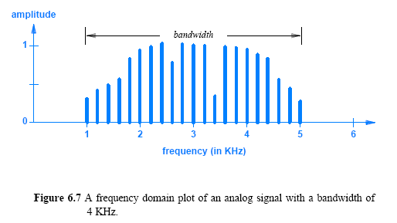
Bandwidth of an Analog Signal

Slide 21
Digital Signals and Signal Levels
Some systems use voltage to represent digital values
  by making a positive voltage correspond to a logical one
  and zero voltage correspond to a logical zero
For example, +5 volts can be used for a logical one and 0 volts for a logical zero
If only two levels of voltage are used
  each level corresponds to one data bit (0 or 1).
Some physical transmission mechanisms can support more than two signal levels
When multiple digital levels are available
  each level can represent multiple bits
For example, consider a system that uses four levels of voltage:
-5 volts, -2 volts, +2 volts, and +5 volts
  Each level can correspond to two bits of data as Figure 6.8 illustrates

Slide 22
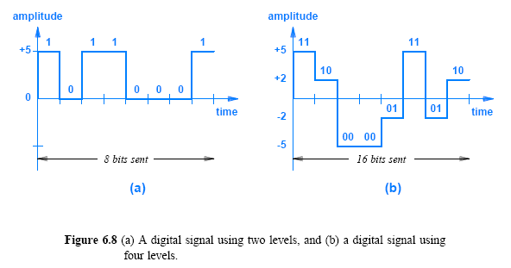
Digital Signals and Signal Levels

Slide 23
Digital Signals and Signal Levels
The relationship between the number of levels required and the number of bits to be sent is straightforward
There must be a signal level for each possible combination of bits
There are 2^{n} combinations possible with n bits
  a communication system must use 2^{n} levels to represent n bits
One could achieve arbitrary numbers of levels by dividing voltage into arbitrarily small increments
  Mathematically, one could create a million levels between 0 and 1 volts merely by using 0.0000001 volts for one level, 0.0000002 for the next level, and so on
Practical electronic systems cannot distinguish between signals that differ by arbitrarily small amounts
  Thus, practical systems are restricted to a few signal levels

Slide 24
Baud and Bits Per Second
How much data can be sent in a given time?
  The answer depends on two aspects of the communication system.
The rate at which data can be sent depends on
  the number of signal levels
  the amount of time the system remains at a given level before moving to the next
If the communication system is modified to use half as much time for a given bit
  twice as many bits will be sent in the same amount of time

Slide 25
Baud and Bits Per Second
As with signal levels, the hardware in a practical system places limits on how short the time can be
  if the signal does not remain at a given level long enough, the receiving hardware will fail to detect it
The accepted measure of a communication system does not specify a length of time
  how many times the signal can change per second, which is defined as the baud
  for example, if a system requires the signal to remain at a given level for .001 seconds, we say that the system operates at 1000 baud
Both baud and number of signal levels control bit rate

Slide 26

Baud and Bits Per Second
If a system with two signal levels operates at 1000 baud
  the system can transfer exactly 1000 bits per second
If a system that operates at 1000 baud has four signal levels
  the system can transfer 2000 bits per second (because four signal levels can represent two bits)
Equation 6.1 expresses the relationship between baud, signal levels, and bit rate

Slide 27
Converting a Digital Signal to Analog
How can a digital signal be converted into an equivalent analog signal?
According to Fourier, an arbitrary curve can be represented as a composite of sine waves
  where each sine wave in the set has a specific amplitude, frequency, and phase
Fourier's theorem also applies to a digital signal
  however, accurate representation of a digital signal requires an infinite set of sine waves
Engineers adopt a compromise:
  conversion of a signal from digital to analog is approximate
  generate analog waves that closely approximate the digital signal
  approximation involves building a composite signal from only a few sine waves
  Figure 6.9 illustrates the approximation

Slide 28
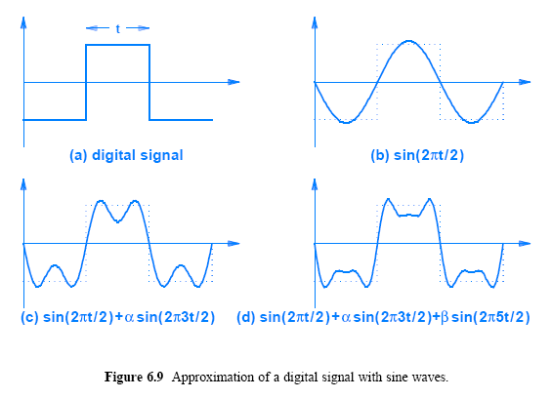
Converting a Digital Signal to Analog

Slide 29
The Bandwidth of a Digital Signal
What is the bandwidth of a digital signal?
If Fourier analysis is applied to a square wave?
A digital signal has infinite bandwidth
  Fourier analysis of a digital signal produces an infinite set of sine waves with frequencies that grow to infinity

Slide 30
Synchronization and Agreement About Signals
The electronics at both ends of a physical medium must have circuitry to measure time precisely
  if one end transmits a signal with 10 elements per second, the other end must expect exactly 10 elements per second
At slow speeds, making both ends agree is trivial
Building electronic systems that agree at the high speeds used in modern networks is extremely difficult
A fundamental problem that arises from the way data is represented concerns synchronization of sender/receiver
Suppose a receiver misses the first bit that arrives, and starts interpreting data starting at the second bit
  Figure 6.10 illustrates how a mismatch in interpretation can produce errors

Slide 31
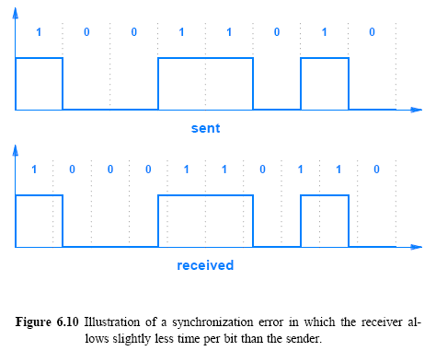
Synchronization and Agreement
About Signals

Slide 32
Line Coding
Several techniques have been invented that can help avoid synchronization errors
In general, there are two broad approaches:
  Before transmitting, the sender transmits a known pattern of bits, typically a set of alternating 0s and 1s, for receiver to synchronize
  Data is represented by the signal in such a way that there can be no confusion about the meaning
We use the term line coding to describe the way data is encoded in a signal
As an example of line coding that eliminates ambiguity
How one can use a transmission mechanism that supports three discrete signal levels?
  Consider Figure 6.11

Slide 33
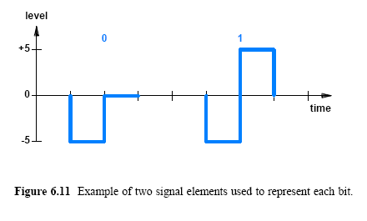
Line Coding

Slide 34
Line Coding
Using multiple signal elements to represent a single bit means fewer bits can be transmitted per unit time
Figure 6.12 lists the names of line coding techniques in common use and groups them into related categories
  choice depends on the specific needs of a given system
A variety of line coding techniques are available that differ in
  how they handle synchronization
  as well as other properties such as the bandwidth used

Slide 35
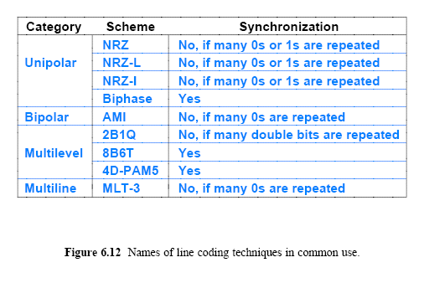
Line Coding

Slide 36
Manchester Encoding Used in Computer Networks
In addition to the list in Figure 6.12, one particular standard for line coding is especially important for networks:
  Manchester Encoding used with Ethernet
Detecting a transition in signal level is easier than measuring the signal level
This fact explains why Manchester Encoding uses transitions rather than levels to define bits
In Manchester Encoding, a 1 corresponds to a transition from negative voltage level to a positive voltage level
  Correspondingly, a 0 corresponds to a transition from a positive voltage level to a negative level
  The transitions occur in the “middle” of the time slot of a bit

Slide 37
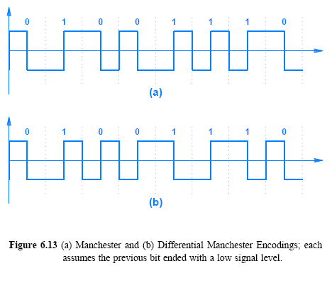
Manchester Encoding Used in Computer Networks

Slide 38
Manchester Encoding Used in Computer Networks
A variation known as a Differential Manchester Encoding (also called a Conditional DePhase Encoding) uses relative transitions rather than absolute
  the representation of a bit depends on the previous bit
Each bit time slot contains one or two transitions
A transition always occurs in the middle of the bit time
The logical value of the bit is represented by the presence or absence of a transition at the beginning of a bit time:
  logical 0 is represented by a transition
  and logical 1 is represented by no transition

Slide 39
Converting an Analog
Signal to Digital
Many sources of information are analog
  which means they must be converted to digital form for further processing (e.g., before they can be encrypted)
There are two basic approaches:
  pulse code modulation (PCM)
  delta modulation (DM)
In PCM, the level of an analog signal is measured repeatedly at fixed time intervals and converted to digital form
The acronym PCM is ambiguous
  because it can refer to the general idea or to a specific form of pulse code modulation used by the telephone system

Slide 40
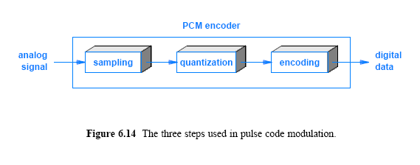
Converting an Analog
Signal to Digital

Slide 41
Converting an Analog
Signal to Digital
First stage is known as sampling
  each measurement is known as a sample
A sample is quantized
  by converting it into a small integer value
  the quantized value is not a measure of voltage or any other property of the signal
  the range of the signal from the minimum to maximum levels is divided into a set of slots, typically a power of 2
Then encoded into a specific format
Figure 6.15 illustrates the concept by showing a signal quantized into eight slots

Slide 42
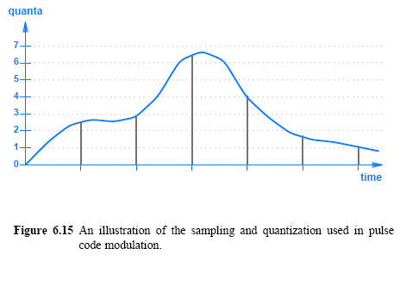
Converting an Analog
Signal to Digital

Slide 43
Converting an Analog
Signal to Digital
In the Figure 6.15
  The six samples are represented by vertical gray lines
  each sample is quantized by choosing the closest quantum interval
  for example, the third sample, taken near the peak of the curve, is assigned a quantized value of 6
In practice, slight variations in sampling have been invented
For example, to avoid inaccuracy caused by a brief spike or a dip in the signal, averaging can be used
  instead of relying on a single measurement for each sample, three measurements can be taken close together and an arithmetic mean can be computed

Slide 44
Converting an Analog
Signal to Digital
Delta modulation (DM) also takes samples like PCM
  however, does not do a quantization for each sample
  DM sends one quantization value followed by a string of values that give the difference between the previous value and the current value
Transmitting differences requires fewer bits than sending full values, especially if the signal does not vary rapidly
The main tradeoff with DM arises from the effect of an error
  if any item in the sequence is lost or damaged, all successive values will be misinterpreted
  communication systems that expect data values to be lost or changed during transmission usually use PCM

Slide 45
Nyquist Theorem and
Sampling Rate
An analog signal must be sampled in PCM or DM
How frequently should an analog signal be sampled?
  Taking too few samples (undersampling) means that the digital values only give a crude approximation of the original signal
  Taking too many samples (oversampling) means that more digital data will be generated, which uses extra bandwidth
A mathematician named Nyquist discovered the answer to the question of how much sampling is required:
  where f_{max} is the highest frequency in the composite signal
Nyquist Theorem provides a practical solution to the problem:
  sample a signal at least twice as fast as the highest frequency that must be preserved

Slide 46
Nyquist Theorem and Telephone System Transmission
Consider the telephone system that was originally designed to transfer voice as an example
  Measurements of human speech have shown that preserving frequencies between 0 - 4000 Hz provides acceptable audio quality
When converting a voice signal from analog to digital
  the signal should be sampled at a rate of 8000 samples per second
The PCM standard used by the phone system quantifies each sample into an 8 bit value for quality
  the range of input is divided into 256 possible levels so that each sample has a value between 0 and 255
The rate generated for a single telephone call is:

Slide 47
Encoding and Data Compression
Data compression refers to a technique that reduces the number of bits required to represent data
Data compression is relevant to a communication system
  because reducing the number of bits used to represent data reduces the time required for transmission
  a communication system can be optimized by compressing data
Chapter 29 discusses compression in multimedia applications
There are two types of compression:
  Lossy - some information is lost during compression
  Lossless - all information is retained in the compressed version

Slide 48
Encoding and Data Compression
Lossy compression is generally used with data that a human consumes, such as an image, video/audio
The key idea is that the compression only needs to preserve details to the level of human perception
  a change is acceptable if humans cannot detect the change
  JPEG (used for images) compression or MPEG-3 (abbreviated MP3 and used for audio recordings) employ lossy compression
Lossless compression preserves the original data without any change
  lossless compression can be used for documents or in any situation where data must be preserved exactly
  when used for communication, a sender compresses the data before transmission and the receiver decompresses the result
  arbitrary data can be compressed by a sender and decompressed by a receiver to recover an exact copy of the original

