Slide 1
Data Transmission
Transmission Media

Slide 2
Overview
Guided and Unguided Transmission
A Taxonomy by Forms of Energy
Background Radiation and Electrical Noise
Twisted Pair Copper Wiring
Shielding: Coaxial Cable and Shielded Twisted Pair
Categories of Twisted Pair Cable
Media Using Light Energy and Optical Fibers
Types of Fiber and Light Transmission
Optical Fiber Compared to Copper Wiring
Infrared Communication Technologies
Point-to-Point Laser Communication
Electromagnetic (Radio) Communication
Signal Propagation
Types of Satellites
GEO Communication Satellites
GEO Coverage of the Earth
Low Earth Orbit (LEO) Satellites and Clusters
Tradeoffs Among Media Types
Measuring Transmission Media
The Effect of Noise on Communication
The Significance of Channel Capacity

Slide 3
Guided and Unguided Transmission
How should transmission media be divided into classes?
There are two broad approaches:
  By type of path: communication can follow an exact path such as a wire, or can have no specific path, such as a radio transmission
  By form of energy: electrical energy is used on wires, radio transmission is used for wireless, and light is used for optical fiber
We use the terms guided (wired) and unguided (wireless) transmission to distinguish between physical media
  Copper wiring or optical fibers provide a specific path and a radio transmission that travels in all directions through free space
Term wired is used even when the physical medium is an optical fiber

Slide 4
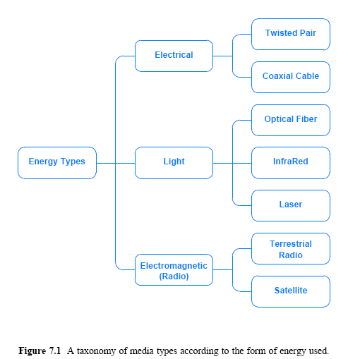
A Taxonomy by Forms of Energy

Slide 5
Background Radiation and Electrical Noise
Electrical current flows along a complete circuit
  All transmissions of electrical energy need two wires to form a circuit; a wire to the receiver and a wire back to the sender
The simplest form of wiring consists of a cable that contains two copper wires
Each wire is wrapped in a plastic coating
  Insulates the wires electrically
The outer coating on the cable holds related wires together to make it easier for humans who connect equipment

Slide 6
Background Radiation and Electrical Noise
Computer networks use an alternative form of wiring
Why ?
  Random electromagnetic radiation, called noise, permeates the environment
    Communication systems generate minor amounts of electrical noise as a side-effect of normal operation
  When it hits metal, electromagnetic radiation induces a small signal
    Random noise can interfere with signals used for communication
  Because it absorbs radiation, metal acts as a shield
    Thus, placing enough metal between a source of noise and a communication medium can prevent noise from interfering

Slide 7
Twisted Pair Copper Wiring
The third fact in the previous section explains the wiring used with communication systems
There are three forms of wiring that help reduce interference from electrical noise
  Unshielded Twisted Pair (UTP)
    Known as twisted pair wiring
  Coaxial Cable
  Shielded Twisted Pair (STP)
Twisting two wires makes them less susceptible to electrical noise than leaving them parallel

Slide 8
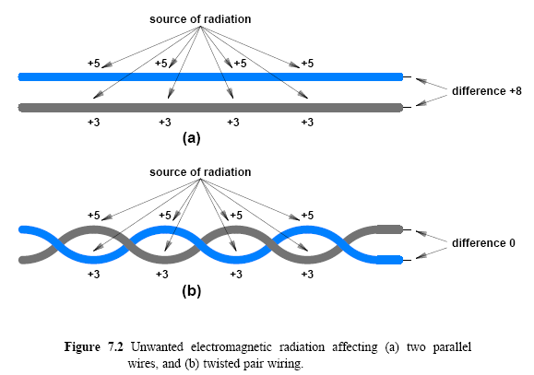
Twisted Pair Copper Wiring

Slide 9
Shielding: Coaxial Cable and Shielded Twisted Pair
Although it is immune to most background radiation, twisted pair wiring does not solve all problems
Twisted pair tends to have problems with:
  Strong electrical noise, close physical proximity to the source of noise
  High frequencies used for communication
If the intensity is high or cables run close to the source of electrical noise, even twisted pair may not be sufficient
Sometimes, it is difficult to build equipment that can distinguish between valid signals and noise
  Means that even a small amount of noise can cause interference when high frequencies are used

Slide 10
Shielding: Coaxial Cable and Shielded Twisted Pair
Forms of wiring are available that have extra metal shielding
The most familiar form is the wiring used for cable television
  Known as coaxial cable (coax)
  Wiring has a thick metal shield formed from braided wires that completely surround a center (inner) wire that carries the signal
Figure 7.3 illustrates the concept
  The shield in a coaxial cable forms a flexible cylinder around the inner wire
    Provides a barrier to electromagnetic radiation from any direction
  The barrier also prevents signals on the inner wire from radiating electromagnetic energy
A coaxial cable can be placed adjacent to sources of electrical noise and other cables, and can be used for high frequencies

Slide 11
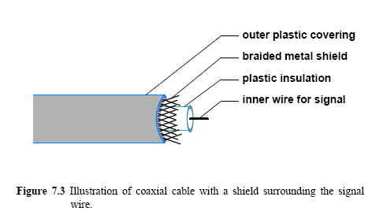
Shielding: Coaxial Cable and Shielded Twisted Pair

Slide 12
Shielding: Coaxial Cable and Shielded Twisted Pair
Using braided wire instead of a solid metal shield keeps coaxial cable flexible
  Heavy shield does make coaxial cable less flexible than twisted pair wiring
Variations of shielding have been invented that provide a compromise
  Cable is more flexible, but has slightly less immunity to electrical noise
One popular variation is known as shielded twisted pair (STP)
  The cable has a thinner, more flexible metal shield surrounding one or more twisted pairs of wires
  In most versions of STP cable, the shield consists of metal foil, similar to the aluminum foil used in a kitchen

Slide 13
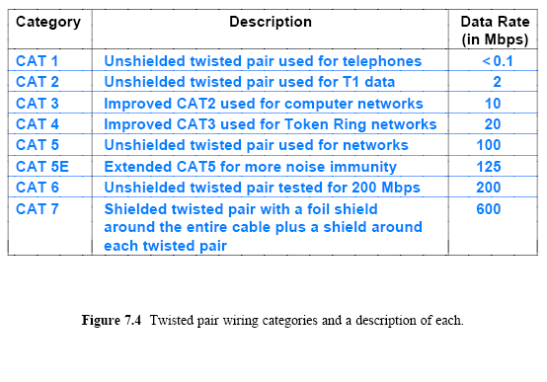
Categories of Twisted Pair Cable

Slide 14
Media Using Light Energy and Optical Fibers
According to the taxonomy figure, three forms of media use light energy to carry information:
  Optical fibers
  Infrared transmission
  Point-to-point lasers
The most important and widely used type is optical fiber
Each fiber consists of a thin strand of glass or transparent plastic encased in a plastic cover
  An optical fiber is used for communication in a single direction
  One end of the fiber connects to a laser or LED used to transmit light
  The other end of the fiber connects to a photosensitive device used to detect incoming light
To provide two-way communication
  Two fibers are used; one to carry information in each direction

Slide 15
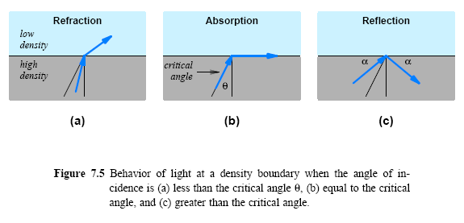
Media Using Light Energy and Optical Fibers

Slide 16
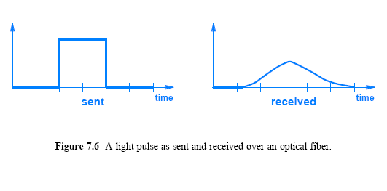
Media Using Light Energy and Optical Fibers
Reflection in an optical fiber is not perfect
  Reflection absorbs a small amount of energy
  If a photon takes a zigzag path that reflects from the walls of the fiber many times the photon will travel a slightly longer distance than a photon that takes a straight path
  The result is that a pulse of light sent at one end of a fiber emerges with less energy and is dispersed (i.e., stretched) over time
  Dispersion is a serious problem for long optical fibers

Slide 17
Types of Fiber and Light Transmission
Three forms of optical fibers have been invented that provide a choice between performance and cost:
  Multimode, Step Index
    Least expensive and used when performance is unimportant
    Boundary between the fiber and the cladding is abrupt, which causes light to reflect frequently
    Dispersion is high
  Multimode, Graded Index
    Fiber is slightly more expensive than the step index fiber
    Advantage of making the density of the fiber increase near the edge, which reduces reflection and lowers dispersion
  Single Mode
    Fiber is the most expensive, and provides the least dispersion
    Fiber has a smaller diameter and other properties that help reduce reflection. Single mode is used for long distances and higher bit rates

Slide 18
Types of Fiber and Light Transmission
How is light sent and received on a fiber?
  The key is that the devices used for transmission must match the fiber
Transmission: LED or Injection Laser Diode (ILD)
Reception: photo-sensitive cell or photodiode
  LEDs and photo-sensitive cells are used for short distances and slower bit rates common with multimode fiber;
  Single mode fiber, used over long distance with high bit rates, generally requires ILDs and photodiodes

Slide 19
Optical Fiber vs.
Copper Wiring
Optical fiber has several properties that make it more desirable than copper wiring
  Optical fiber
    Immune to electrical noise
    Higher bandwidth
    Light traveling across a fiber does not attenuate as much as electrical signals traveling across copper
  Copper wiring is less expensive
  Ends of an optical fiber must be polished before they can be used
  Installation of copper wiring does not require as much special equipment or expertise as optical fiber
  Copper wires are less likely to break if accidentally pulled or bent

Slide 20
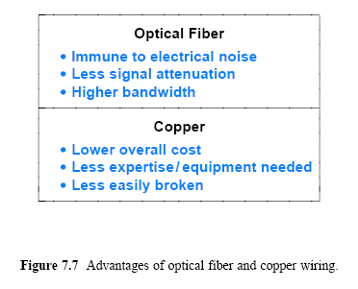
Optical Fiber vs.
Copper Wiring

Slide 21
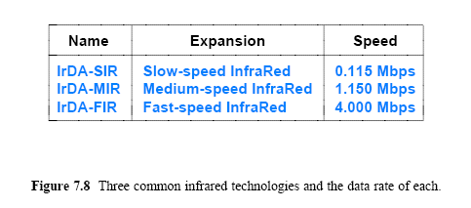
Infrared (IR) Communication Technologies
IR uses the same type of energy as a TV remote control:
  A form of electromagnetic radiation that behaves like visible light but falls outside the range that is visible to a human eye
Like visible light, infrared disperses quickly
Infrared signals can reflect from a smooth, hard surface
An opaque object as thin as a sheet of paper can block the signal, as does moisture in the atmosphere
IR commonly used to connect to a nearby peripheral
The wireless aspect of infrared can be attractive for laptop computers

Slide 22
Point-to-Point Laser Communication
A pair of devices with a beam that follows the line-of-sight
IR is classified as providing point-to-point communication
Other point-to-point communication technologies also exist
  One form of point-to-point communication uses a beam of coherent light produced by a laser
Laser communication follows line-of-sight, and requires a clear, unobstructed path between the communicating sites
  Unlike an infrared transmitter, however, a laser beam does not cover a broad area; the beam is only a few centimeters wide
  The sending and receiving equipment must be aligned precisely to insure that the sender's beam hits the sensor in the receiver
  They are suitable for use outdoors, and can span great distances
  As a result, laser technology is especially useful in cities to transmit from building to building

Slide 23
Electromagnetic (Radio) Communication
Most common form of unguided communication consists of wireless networking technologies
  Use electromagnetic energy in the Radio Frequency (RF) range
RF transmission has a distinct advantage over light
  RF energy can traverse long distances and penetrate objects such as the walls of a building
The exact properties of electromagnetic energy depend on the frequency
  The term spectrum refers to the range of possible frequencies
Organizations allocate frequencies for specific purposes
  In the U.S., the Federal Communications Commission (FCC) sets rules for how frequencies are allocated
    It sets limits on the amount of power that communication equipment can emit at each frequency

Slide 24
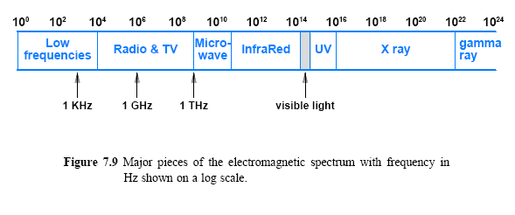
Electromagnetic (Radio) Communication

Slide 25
Signal Propagation
Amount of information an electromagnetic wave can represent depends on the wave's frequency
The frequency of an electromagnetic wave also determines how the wave propagates
Figure 7.10 describes the three broad types of propagation
  lowest frequencies
    Electromagnetic radiation follows the earth's surface, which means if the terrain is relatively flat
    It will be possible to place a receiver beyond the horizon from a transmitter
  medium frequencies
    A transmitter and receiver can be farther apart, because the signal can bounce off the ionosphere to travel between them
  highest frequencies
    Radio transmission behaves like light; the signal propagates in a straight line from the transmitter to the receiver and the path must be free from obstructions

Slide 26
Signal Propagation
Wireless technologies are classified into two broad categories as follows:
Terrestrial
  Communication uses equipment such as radio or microwave transmitters that is relatively close to the earth's surface
  Typical locations for antennas or other equipment include the tops of hills, man-made towers, and tall buildings
Non-terrestrial
  Some of the equipment used in communication is outside the earth's atmosphere (e.g., a satellite in orbit around the earth)
Frequency and amount of power used can affect:
  The speed at which data can be sent
  The maximum distance over which communication can occur
  Characteristics, such as if signal can penetrate a solid object

Slide 27
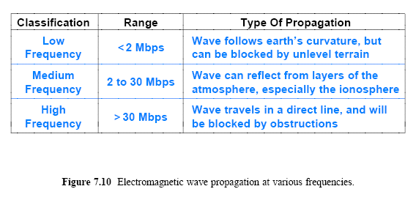
Signal Propagation

Slide 28
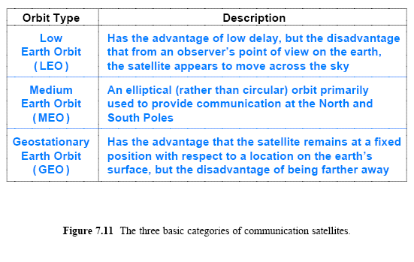
Types of Satellites
The laws of physics (specifically Kepler's Law) govern the motion of an object, such as a satellite, that orbits the earth
In particular, the period (i.e., time required for a complete orbit) depends on the distance from the earth
Communication satellites are classified into three broad categories
  Depending on their distance from the earth

Slide 29
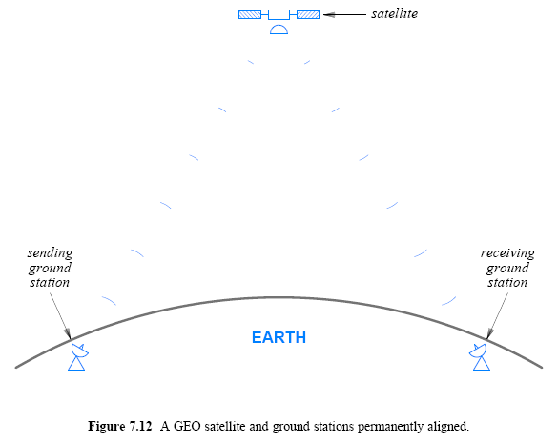
GEO Communication Satellites
Advantage of a satellite in Geostationary Earth Orbit (GEO) is that the orbital period is exactly the same as the rate at which the earth rotates
If positioned above the equator, a GEO satellite remains in exactly the same location over the earth's surface at all times
A stationary satellite position means that once a ground station has been aligned with the satellite
  the equipment never needs to move

Slide 30

GEO Communication Satellites
The distance required for a geostationary orbit is 35,785 kilometers or 22,236 miles
  which is approximately one tenth the distance to the moon
What does such a distance mean for communication?
  consider a radio wave traveling to a GEO satellite and back
  at the speed of light, 3¹⁰ meters per second, the trip takes:
A delay of approximately 0.2 seconds can be significant for some applications
  For electronic transactions such as a stock exchange offering a limited set of bonds, delaying an offer by 0.2 seconds may mean the difference between a successful and unsuccessful offer

Slide 31
GEO Coverage of the Earth
How many GEO communication satellites are possible?
There is a limited amount of “space” available in the geosynchronous orbit above the equator
  Because communication satellites using a given frequency must be separated from one another to avoid interference
  the minimum separation depends on the power of the transmitters
    but may require an angular separation of between 4 and 8 degrees
However, as technology is evolving it’s possible to allocate more satellites in orbit

Slide 32
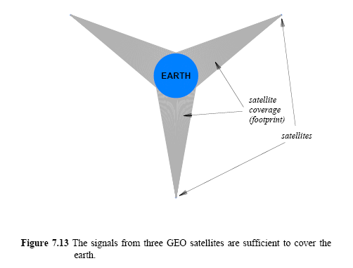
GEO Coverage of the Earth
What is the minimum number of satellites needed to cover the earth?
Consider Figure 7.13, which illustrates three GEO satellites
  They are positioned around the equator with 120 degree separation
  In the figure, the size of the earth and the distance of the satellites are drawn to scale

Slide 33
Low Earth Orbit (LEO)
Satellites and Clusters
Low Earth Orbit (LEO) is defined as altitudes up to 2000 Km
  As a practical matter, a satellite must be placed above the fringe of the atmosphere to avoid the drag produced by encountering gases
  Thus, LEO satellites are typically placed at altitudes of 500-600 kilometers or higher
  LEO offers the advantage of short delays (typically 1 to 4 ms)
The disadvantage of LEO is that the orbit of a satellite does not match the rotation of the earth
From an observer's point of view on the earth
  an LEO satellite appears to move across the sky
    means that a ground station must have an antenna that can rotate to track the satellite
  Tracking is difficult because satellites move rapidly
  The lowest altitude LEO satellites orbit the earth in approximately 90 minutes
    higher LEO satellites require several hours

Slide 34
Low Earth Orbit (LEO) Satellites and Clusters
LEO satellites used in clustering or in array deployment
  A large group of LEO satellites are designed to work together
A satellite in the group can also communicate with other satellites in the group
  Members of the group stay in communication, and agree to forward messages, as needed
For example,
  Consider what happens when a user in Europe sends a message to a user in USA
  A ground station in Europe transmits the message to the satellite currently overhead (above it)
  The cluster of satellites communicate to forward the message to the satellite in the cluster that is currently over a ground station in USA
  Finally, the satellite currently over USA transmits the message to a ground station

Slide 35
Tradeoffs Among Media Types
The choice of medium is complex
Choice involves the evaluation of multiple factors, such as:
  Cost
    Materials, installation, operation, and maintenance
  Data rate
    Number of bits per second that can be sent
  Delay
    Time required for signal propagation or processing
  Affect on signal
    Attenuation and distortion
  Environment
    Susceptibility to interference and electrical noise
  Security
    Susceptibility to eavesdropping

Slide 36
Measuring Transmission Media
The two most important measures of performance used to assess a transmission medium:
  Propagation delay
    the time required for a signal to traverse the medium
  Channel capacity
    the maximum data rate that the medium can support
Nyquist discovered a fundamental relationship between the bandwidth of a transmission system and its capacity to transfer data known as Nyquist Theorem
  It provides a theoretical bound on the maximum rate at which data can be sent without considering the effect of noise
  If a transmission system uses K possible signal levels and has an analog bandwidth B, the maximum data rate in bits per second, D, is

Slide 37
Effect of Noise on Communication
Nyquist's Theorem provides an absolute maximum that cannot be achieved in practice
  a real system is subject to small amounts of electrical noise
  such noise makes it impossible to achieve the theoretical maximum transmission rate
Claude Shannon extended Nyquist's work to specify the maximum data rate that could be achieved over a transmission system that experiences noise
  The result, called Shannon's Theorem
  where
    C is the effective limit on the channel capacity in bits per second
    B is the hardware bandwidth
    S/N is the signal-to-noise ratio, the ratio of the average signal power divided by the average noise power

Slide 38
Effect of Noise on Communication
As an example of Shannon's Theorem
Consider a transmission medium that has the following:
  a bandwidth of 1 KHz
  an average signal power of 70 units
  an average noise power of 10 units
The channel capacity is:
The signal-to-noise ratio is often given in decibels (abbreviated dB), where a decibel is defined as a measure of the difference between two power levels

Slide 39

Effect of Noise on Communication
Once two power levels have been measured, the difference is expressed in decibels, defined as follows:
Using dB as a measure has two interesting advantages:
  First, it can give us a quick idea about outcome of an operations:
    a negative dB value means that the signal has been attenuated
    a positive dB value means the signal has been amplified
  Second, if a communication system has multiple parts arranged in a sequence
    The dB measures of the parts can be summed to produce a measure of the overall system

Slide 40
Effect of Noise on Communication
Example:
  The voice telephone system has a signal-to-noise ratio of approximately 30 dB and an analog bandwidth of approximately 3000 Hz
  To convert signal-to-noise ratio dB into a simple fraction
    divide by 10 and use the result as a power of 10
    (i.e., 30/10 = 3, and 10³ = 1000, so the signal-to-noise ratio is 1000)
  Shannon's Theorem can be applied to determine the maximum number of bits per second that can be transmitted across the telephone network:
  or approximately 30,000 bps
Engineers recognize this as a fundamental limit; faster transmission speeds will only be possible if the signal-to-noise ratio can be improved

Slide 41
The Significance of Channel Capacity
Nyquist and Shannon Theorems have consequences for engineers who design data communication networks:
Nyquist's work has provided an incentive to explore complex ways to encode bits on signals:
  Encourages engineers to explore ways to encode bits on a signal
  Because a clever encoding allows more bits to be transmitted per unit time
Shannon's Theorem is more fundamental because it represents an absolute limit derived from the laws of physics
  No amount of clever encoding can overcome the laws of physics
  It places a fundamental limit on the number of bits per second that can be transmitted in a real communication system

