Slide 1
Data Transmission
Reliability
and
Channel Coding

Slide 2
Overview
The Three Main Sources of Transmission Errors
Effect of Transmission Errors on Data
Two Strategies for Handling Channel Errors
Block and Convolutional Error Codes
An Example Block Error Code: Single Parity Checking
The Mathematics of Block Error Codes and (n, k) Notation
Hamming Distance: A Measure of a Code's Strength
The Hamming Distance Among Strings in a Codebook
The Tradeoff Between Error Detection and Overhead
Error Correction with Row and Column (RAC) Parity
The 16-Bit Checksum Used in the Internet
Cyclic Redundancy Codes (CRCs)
An Efficient Hardware Implementation of CRC
Automatic Repeat reQuest (ARQ) Mechanisms

Slide 3
Three Main Sources of Transmission Errors
All data communications systems are susceptible to errors
  some of the problems are inherent in the physics of the universe
  and some result either from devices that fail or from equipment that does not meet the engineering standards
Small errors that occur during transmission are more difficult to detect than complete failures
  We need ways/mechanisms to control and recover from such errors
There are three main categories of transmission errors:
Interference
  Electromagnetic radiation emitted from devices such as electric motors and background cosmic radiation can cause noise that can disturb radio transmissions and signals traveling across wires

Slide 4
Three Main Sources of Transmission Errors
Distortion
  All physical systems distort signals
  As a pulse travels along an optical fiber, the pulse disperses
  Wires have properties of capacitance and inductance
    Block signals at some frequencies while admitting signals at other frequencies
  Placing a wire near a large metal object can change the set of frequencies that can pass through the wire
  Metal objects can block some frequencies of radio waves, while passing others
Attenuation
  As a signal passes across a medium, the signal becomes weaker
    Signals on wires or optical fibers become weaker over long distances, just as a radio signal becomes weaker with distance

Slide 5
Three Main Sources of Transmission Errors
Shannon's Theorem suggests one way to reduce errors:
  Increase the signal-to-noise ratio (either by increasing the signal or lowering noise if possible)
Mechanisms like shielded wiring can help lower noise
Physical transmission system is always susceptible to errors
  May not be possible to change the signal-to-noise ratio
Noise/interference cannot be eliminated completely
  Many transmission errors can be detected
  In some cases, errors can be corrected automatically
Error detection adds overhead
Error handling is a tradeoff
  A system designer must decide whether a given error is likely to occur, and if so, what the consequences will be

Slide 6
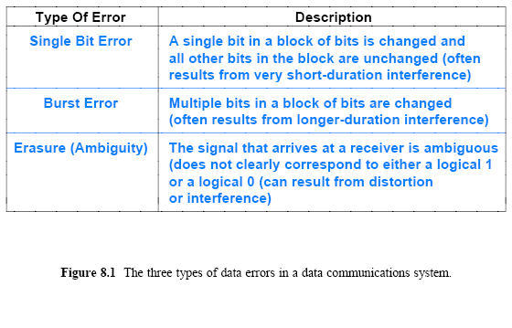
Effect of Transmission
Errors on Data

Slide 7
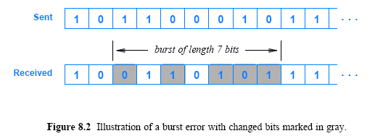
Effect of Transmission Errors on Data
For a burst error, the burst size, or length, is defined as the number of bits from the start of the corruption to the end of the corruption

Slide 8
Two Strategies for
Handling Channel Errors
A variety of mathematical techniques have been developed that overcome errors during transmission and increase reliability
  Known collectively as channel coding
The techniques can be divided into two broad categories:
  Forward Error Correction (FEC) mechanisms
  Automatic Repeat reQuest (ARQ) mechanisms
The basic idea of FEC is straightforward:
  add additional information to data that allows a receiver to verify that data arrives correctly and to correct errors (if possible)

Slide 9
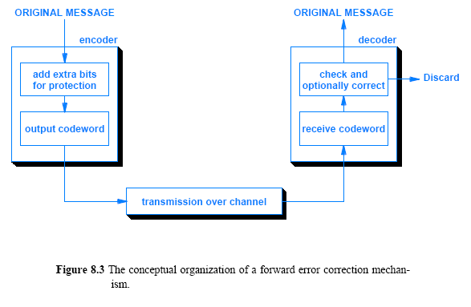
Two Strategies for
Handling Channel Errors

Slide 10
Two Strategies for
Handling Channel Errors
Basic error detection mechanisms allow a receiver to detect when an error has occurred
FEC mechanisms allow a receiver to determine
  Exactly which bits have been changed and to compute correct values
The second approach to channel coding, known as an ARQ,
  Requires the cooperation of a sender
    Sender and receiver exchange messages to insure that all data arrives correctly

Slide 11
Block and Convolutional Error Codes
The two types of FEC techniques satisfy separate needs:
Block Error Codes
  It divides the data to be sent into a set of blocks
  It attaches extra information known as redundancy to each block
  The encoding for a given block of bits depends only on the bits themselves, not on bits that were sent earlier
  They are memory less in the sense that the encoding mechanism does not carry state information from one block of data to the next
Convolutional Error Codes
  It treats data as a series of bits, and computes a code over a continuous series
  Thus, the code computed for a set of bits depends on the current input and some of the previous bits in the stream
  Convolutional codes are said to be codes with memory

Slide 12
An Example Block Error Code:
Single Parity Checking
How can additional information be used to detect errors?
  Consider a single parity checking (SPC) mechanism
One form of SPC defines a block to be an 8-bit unit of data (i.e., a single byte)
  On the sending side, an encoder adds an extra bit, called a parity bit, to each byte before transmission
  A receiver uses parity bit to check whether bits in the byte are correct
  Before parity can be used, the sender and receiver must be configured for either even parity or odd parity

Slide 13
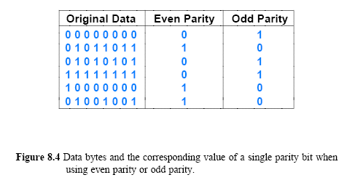
An Example Block Error Code:
Single Parity Checking

Slide 14
An Example Block Error Code:
Single Parity Checking
SPC is a weak form of channel coding that can detect errors
  but cannot correct errors
An even parity mechanism can only handle errors where an odd number of bits are changed
  If one of the nine bits (including the parity bit) is changed during transmission, the receiver will declare that the incoming byte is invalid
  However, if a burst error occurs in which two, four, six, or eight bits change value, the receiver will incorrectly classify the incoming byte as valid

Slide 15
The Mathematics of Block Error Codes and (n, k) Notation
Mathematically
  Define the set of all possible messages to be a set of datawords
  Define the set of all possible encoded versions to be a set of codewords
If a dataword contains k bits and r additional bits are added to form a codeword, we say that the result is an
(n, k) encoding scheme
  where n = k + r
The key to successful error detection lies in choosing a subset of the 2 possible combinations that are valid codewords
  The valid subset is known as a codebook

Slide 16
The Mathematics of Block Error Codes and (n, k) Notation
As an example, consider SPC
The set of datawords consists of any possible combination of 8-bits
  Thus, k = 8 and there are 2⁸ or 256 possible data words
  The set of n = 9 bits, so there are 2⁹ or 512 possibilities
    However, only half of the 512 values form valid codewords
Think of the set of all possible n-bit values and the valid subset that forms the codebook
If an error occurs during transmission
  One or more of the bits in a codeword will be changed, which will either produce another valid codeword or an invalid combination
For the example discussed above
  Change to a single bit of a valid codeword produces an invalid combination, but changing two bits produces another valid codeword

Slide 17
Hamming Distance:
A Measure of a Code's Strength
No channel coding scheme is ideal!
  Changing enough bits will always transform to a valid codeword
What is the minimum number of bits of a valid codeword that must be changed to produce another valid codeword?
  To answer the question, engineers use a measure known as the Hamming distance, named after a theorist at Bell Laboratories who was a pioneer in the field of information theory and channel coding
Given two strings of n bits each, the Hamming distance is defined as the number of differences

Slide 18
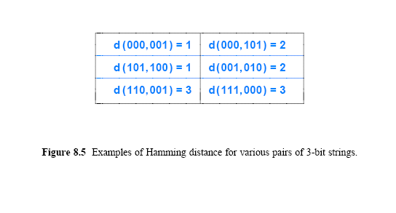
Hamming Distance:
A Measure of a Code's Strength

Slide 19
Hamming Distance:
A Measure of a Code's Strength
One way to compute the Hamming distance consists of
  taking the exclusive or (xor) between two strings
  and counting the number of 1 bits in the answer
For example, consider the Hamming distance between strings 110 and 011
  The xor of the two strings is:
  which contains two 1 bits
  Therefore, the Hamming distance between 011 and 101 is 2

Slide 20
The Hamming Distance Among
Strings in a Codebook
Errors can transform a valid codeword into another valid codeword
  To measure such transformations, we compute the Hamming distance between all pairs of codewords in a given codebook
Consider odd parity applied to 2-bit datawords
Figure 8.6 lists the four (4) possible datawords
  4-possible codewords that result from appending a parity bit
  and the Hamming distances for pairs of codewords
We use to denote the minimum Hamming distance, d_{min} among pairs in a codebook
  The concept gives an answer to the question above
  How many bit errors can cause a transformation from one valid codeword into another valid codeword?

Slide 21
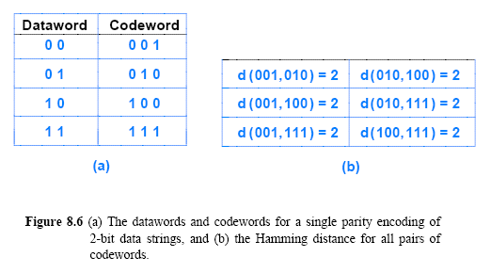
The Hamming Distance Among
Strings in a Codebook

Slide 22

The Tradeoff Between Error
Detection and Overhead
A large value of d_{min} is desirable
  Code is immune to more bit errors, if fewer than d_{min} bits are changed, the code can detect that error(s) occurred
Equation specifies the relationship between d_{min} and e, the maximum number of bit errors that can be detected:
A code with a higher value of d_{min} sends more redundant information than an error code with a lower value of d_{min}

Slide 23
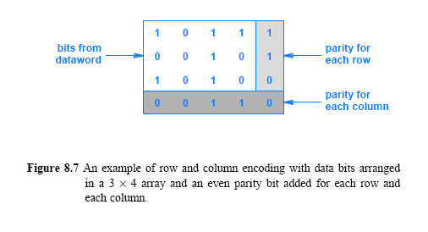
Error Correction with Row and Column (RAC) Parity
Imagine an array of 3-rows and 4-columns, with a parity bit added for each row and for each column
  Figure 8.7 illustrates the arrangement, which is known as a Row and Column (RAC) code
    Example RAC has n= 20, which means that it is a (20, 12) code

Slide 24
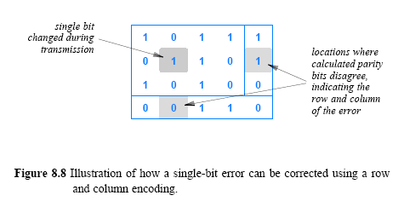
Error Correction with Row and Column (RAC) Parity
How error correction works? Assume that one of the bits in Figure 8.7 (below) is changed during transmission:
  When the receiver arranges the bits into an array and parity bits are recalculated
    two of the calculations will disagree with the parity bits received, as Figure 8.8 illustrates
    a single bit error will cause two calculated parity bits to disagree with the parity bit received

Slide 25
Error Correction with
Row and Column (RAC) Parity
The two disagreements correspond to the row and column position of the error
A receiver uses the calculated parity bits to determine exactly which bit is in error, and then corrects the bit
  Thus, an RAC can correct any error that changes a single data bit
What happens to an RAC code if an error changes more than one bit in a given block?
RAC can only correct single-bit errors
In cases where two or three bits are changed
  RAC encoding will be able to detect an odd number of errors

Slide 26
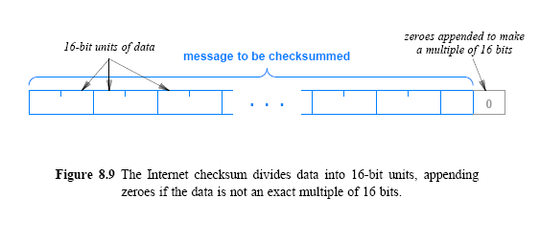
The 16-Bit Checksum
Used in the Internet
A particular coding scheme plays a key role in the Internet
  Known as the Internet checksum, the code consists of a 16-bit 1s complement checksum
The Internet checksum does not impose a fixed size on a dataword
  the algorithm allows a message to be arbitrarily long
  and computes a checksum over the entire message
The Internet checksum treats data in a message as a series of 16-bit integers, as Figure 8.9 below illustrates

Slide 27
The 16-Bit Checksum
Used in the Internet
To compute a checksum, a sender
  adds the numeric values of the 16-bit integers
  and it transmits the result
To validate the message, a receiver performs the same computation
Algorithm 8.1 gives the details of the computation
  The checksum is computed in 1s complement arithmetic
  and uses 16 bit integers instead of 32 or 64 bit integers
During the for loop, the addition may overflow
  Thus, following the loop, the algorithm adds the overflow (the high-order bits) back into the sum
Why is a checksum computed as the arithmetic inverse of the sum instead of the sum?

Slide 28
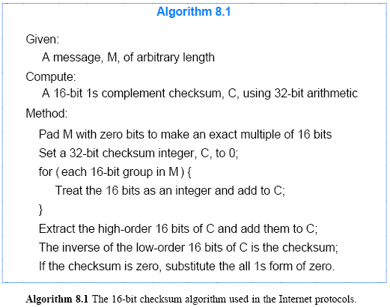
The 16-Bit Checksum
Used in the Internet

Slide 29
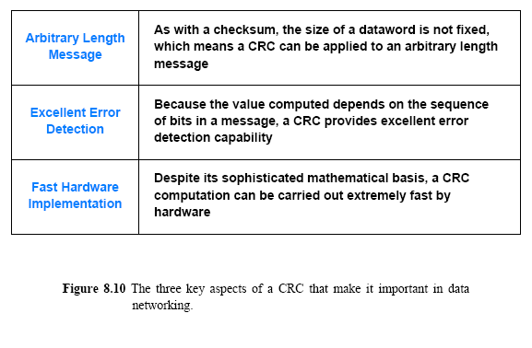
Cyclic Redundancy Codes (CRC)
A form of channel coding known as a Cyclic Redundancy Code (CRC) is used in high-speed data networks
Key properties of CRC are summarized below

Slide 30
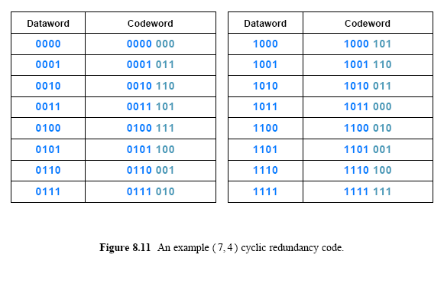
Cyclic Redundancy Codes (CRC)
Term cyclic is derived from a property of the codewords:
  A circular shift of the bits of any codeword produces another one
Figure 8.11 (below) show a (7, 4) CRC by Hamming

Slide 31
Cyclic Redundancy Codes (CRC)
CRC codes have been studied extensively
  A variety of mathematical explanations and computational techniques have been produced
  The descriptions seem so disparate that it is difficult to understand how they can all refer to the same concept
Principal views include:
Mathematicians
  explain a CRC computation as the remainder from a division of two polynomials with binary coefficients
    one representing the message and another representing a fixed divisor
Theoretical Computer Scientists
  explain a CRC computation as the remainder from a division of two binary numbers
    one representing the message and the other representing a fixed divisor

Slide 32
Cyclic Redundancy Codes (CRC)
Cryptographers
  Explain a CRC computation as a mathematical operation in a Galois field of order 2, written GF(2)
Computer programmers
  explain a CRC computation as an algorithm that iterates through a message
  and uses table lookup to obtain an additive value for each step
Hardware architects
  explain a CRC computation as a small hardware pipeline unit that takes as input a sequence of bits from a message
  and produces a CRC without using division or iteration

Slide 33
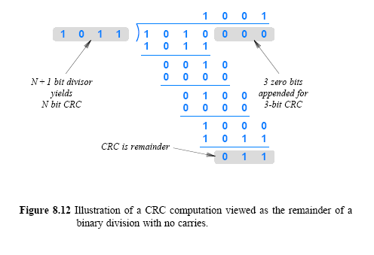
Cyclic Redundancy Codes (CRC)

Slide 34
Cyclic Redundancy Codes (CRC)
How can mathematicians view the above process as a polynomial division?
  think of each bit in a binary number as the coefficient of a term in a polynomial
For example, we can think of the divisor in Figure 8.12, 1011, as coefficients in the following polynomial:
  Similarly, the dividend in Figure 8.12, 1010000, represents the polynomial:

Slide 35
Cyclic Redundancy Codes (CRC)
Term generator polynomial to describe a polynomial that corresponds to a divisor
  The selection of a generator polynomial is key to creating a CRC with good error detection properties
An ideal polynomial is irreducible (i.e., can only be divided evenly by itself and 1)
A polynomial with more than one non-zero coefficient can detect all single-bit errors

Slide 36
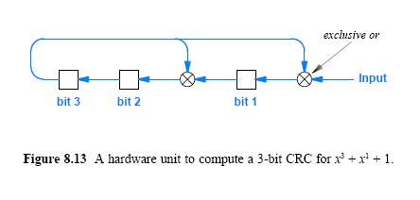
An Efficient Hardware
Implementation of CRC
CRC hardware is arranged as a shift register with exclusive or (xor) gates between some of the bits

Slide 37
Automatic Repeat reQuest (ARQ) Mechanisms
Whenever one side sends a message to another, the other side sends a short acknowledgement (ACK) message back
  For example, if A sends a message to B, B sends an ACK back to A
  Once it receives an ACK, A knows that the message arrived correctly
  If no ACK is received after T time units, A assumes the message was lost and retransmits a copy
ARQ is especially useful in cases of dealing with detecting errors
  but not in cases for error correction
  many computer networks use a CRC to detect transmission errors
An ARQ scheme can be added to guarantee delivery if a transmission error occurs
  the receiver discards the message if an error occurs
  and the sender retransmits another copy

