Slide 2
Five Components of a Computer
Computer
Keyboard,
Mouse
Processor
Memory
(passive)
(where
programs,
data live
when
running)
Devices
Disk
(where
programs,
data live when not running)
Input
Control
Output
Datapath
Display,
Printer

Slide 3
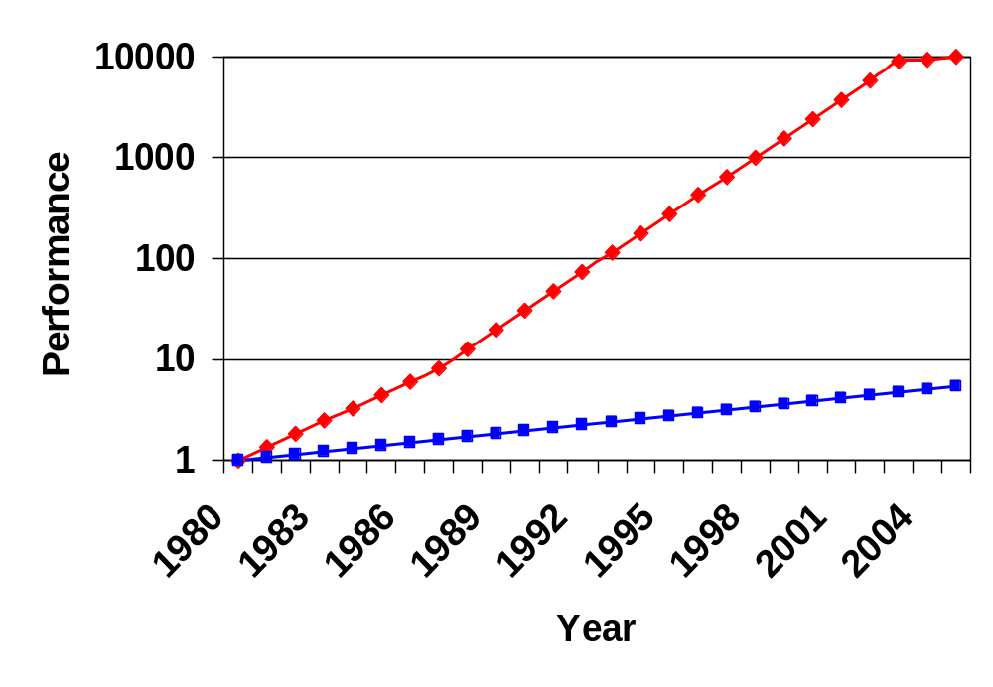
Processor-Memory Performance Gap
µProc
55%/year
(2X/1.5yr)
“Moore’s Law”
Processor-Memory
Performance Gap
(grows 50%/year)
DRAM
7%/year
(2X/10yrs)
Notes:
HIDDEN SLIDE – KEEP?
Memory baseline is a 64KB DRAM in 1980, with three years to the next generation until 1996 and then two years thereafter with a 7% per year performance improvement in latency.
Processor assumes a 35% improvement per year until 1986, then a 55% until 2003, then 5%
Need to supply an instruction and a data every clock cycle
In 1980 there were no caches (and no need for them), by 1995 most systems had 2 level caches (e.g., 60% of the transistors on the Alpha 21164 were in the cache)

Slide 4
The Memory Hierarchy Goal
Fact: Large memories are slow and fast memories are small
How do we create a memory that gives the illusion of being large, cheap and fast (most of the time)?
  With hierarchy
  With parallelism

Slide 5
Memory Caching
Mismatch between processor and memory speeds leads us to add a new level: a memory cache
Implemented with same IC processing technology as the CPU (usually integrated on same chip): faster but more expensive than DRAM memory
Cache is a copy of a subset of main memory
Most processors have separate caches for instructions and data

Slide 6
Memory Technology
Static RAM (SRAM)
  0.5ns – 2.5ns, $2000 – $5000 per GB
Dynamic RAM (DRAM)
  50ns – 70ns, $20 – $75 per GB
Magnetic disk
  5ms – 20ms, $0.20 – $2 per GB
Ideal memory
  Access time of SRAM
  Capacity and cost/GB of disk

Slide 7
Principle of Locality
Programs access a small proportion of their address space at any time
Temporal locality
  Items accessed recently are likely to be accessed again soon
  e.g., instructions in a loop
Spatial locality
  Items near those accessed recently are likely to be accessed soon
  E.g., sequential instruction access, array data

Slide 8
Taking Advantage of Locality
Memory hierarchy
Store everything on disk
Copy recently accessed (and nearby) items from disk to smaller DRAM memory
  Main memory
Copy more recently accessed (and nearby) items from DRAM to smaller SRAM memory
  Cache memory attached to CPU

Slide 9
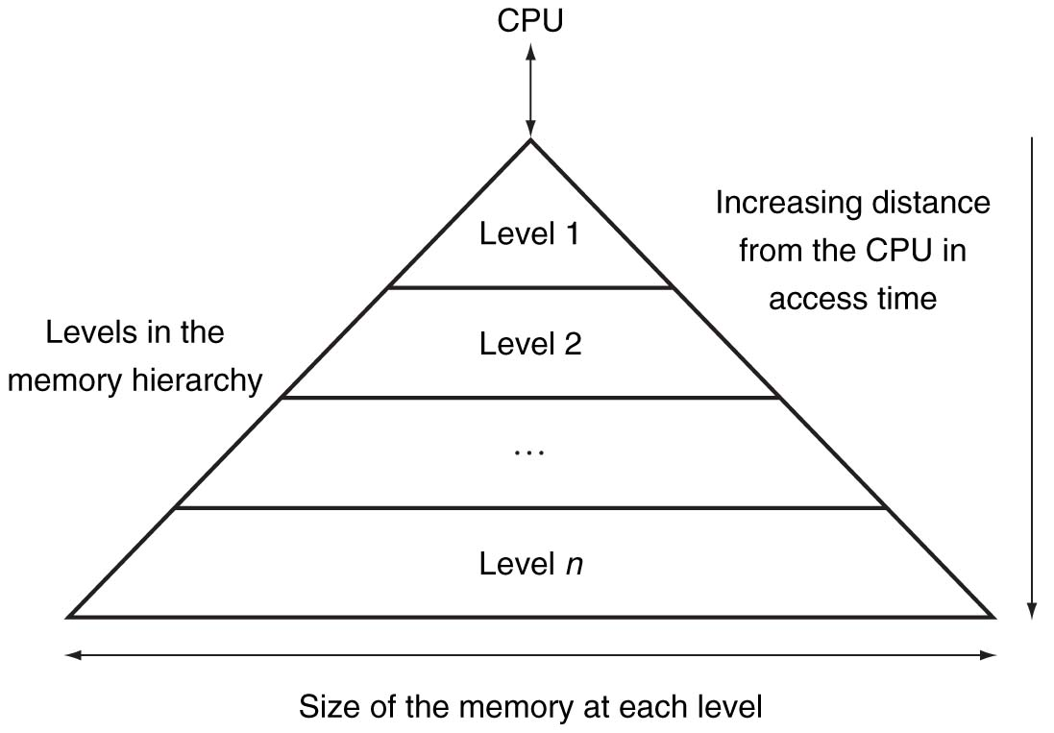
Memory Hierarchy Levels

Slide 10
Memory Hierarchy Analogy: Library
You’re writing a term paper (Processor) at a table in the library
Library is equivalent to disk
  essentially limitless capacity
  very slow to retrieve a book
Table is main memory
  smaller capacity: means you must return book when table fills up
  easier and faster to find a book there once you’ve already retrieved it

Slide 11
Memory Hierarchy Analogy
Open books on table are cache
  smaller capacity: can have very few open books fit on table; again, when table fills up, you must close a book
  much, much faster to retrieve data
Illusion created: whole library open on the tabletop
  Keep as many recently used books open on table as possible since likely to use again
  Also keep as many books on table as possible, since faster than going to library

Slide 12

Memory Hierarchy Levels
Block (aka line): unit of copying
  May be multiple words
If accessed data is present in upper level
  Hit: access satisfied by upper level
    Hit ratio: hits/accesses
If accessed data is absent
  Miss: block copied from lower level
    Time taken: miss penalty
    Miss ratio: misses/accesses
    = 1 – hit ratio
  Then accessed data supplied from upper level

Slide 13

Cache Memory
Cache memory
  The level of the memory hierarchy closest to the CPU
Given accesses X₁, …, X_{n–1}, X_{n}
How do we know if the data is present?
Where do we look?

Slide 14

Direct Mapped Cache
Location determined by address
Direct mapped: only one choice
  (Block address) modulo (#Blocks in cache)
#Blocks is a power of 2
Use low-order address bits

Slide 15
Tags and Valid Bits
How do we know which particular block is stored in a cache location?
  Store block address as well as the data
  Actually, only need the high-order bits
  Called the tag
What if there is no data in a location?
  Valid bit: 1 = present, 0 = not present
  Initially 0

Slide 16
Cache Example
8-blocks, 1 word/block, direct mapped
Initial state
Index | V | Tag | Data
000 | N
001 | N
010 | N
011 | N
100 | N
101 | N
110 | N
111 | N

Slide 17
Cache Example
Word addr | Binary addr | Hit/miss | Cache block
22 | 10 110 | Miss | 110
Index | V | Tag | Data
000 | N
001 | N
010 | N
011 | N
100 | N
101 | N
110 | Y | 10 | Mem[10110]
111 | N

Slide 18
Cache Example
Word addr | Binary addr | Hit/miss | Cache block
26 | 11 010 | Miss | 010
Index | V | Tag | Data
000 | N
001 | N
010 | Y | 11 | Mem[11010]
011 | N
100 | N
101 | N
110 | Y | 10 | Mem[10110]
111 | N

Slide 19
Cache Example
Word addr | Binary addr | Hit/miss | Cache block
22 | 10 110 | Hit | 110
26 | 11 010 | Hit | 010
Index | V | Tag | Data
000 | N
001 | N
010 | Y | 11 | Mem[11010]
011 | N
100 | N
101 | N
110 | Y | 10 | Mem[10110]
111 | N

Slide 20
Cache Example
Word addr | Binary addr | Hit/miss | Cache block
16 | 10 000 | Miss | 000
3 | 00 011 | Miss | 011
16 | 10 000 | Hit | 000
Index | V | Tag | Data
000 | Y | 10 | Mem[10000]
001 | N
010 | Y | 11 | Mem[11010]
011 | Y | 00 | Mem[00011]
100 | N
101 | N
110 | Y | 10 | Mem[10110]
111 | N

Slide 21
Cache Example
Word addr | Binary addr | Hit/miss | Cache block
18 | 10 010 | Miss | 010
Index | V | Tag | Data
000 | Y | 10 | Mem[10000]
001 | N
010 | Y | 10 | Mem[10010]
011 | Y | 00 | Mem[00011]
100 | N
101 | N
110 | Y | 10 | Mem[10110]
111 | N

Slide 22

Address Subdivision

Slide 23
Bits in a Cache
Example: How many total bits are required for a direct-mapped cache with 16 KB of data and 4-word blocks, assuming a 32-bit address?
(DONE IN CLASS)
32-bit address, cache size 2^{n} blocks, cache block size is 2^{m} words.
The size of tag is? The total bit in cache is?

Slide 24
Problem1
For a direct-mapped cache design with 32-bit address, the following bits of the address are used to access the cache
Tag Index Offset
31-10 9-4 3-0
What is the cache line size (in words)?
How many entries does the cache have ?
How big the data in cache is?
(DONE IN CLASS)

Slide 25
Problem2
Below is a list of 32-bit memory address, given as WORD addresses:
1, 134, 212,1, 135, 213, 162, 161, 2, 44, 41, 221
For each of these references, identify the binary address, the tag, the index given a direct-mapped cache with 16 one-word blocks. Also list if each reference is a hit or miss.
For each of these references, identify the binary address, the tag, the index given a direct-mapped cache with two-word blocks and a total size of 8 blocks. Also list if each reference is a hit or miss.
(DONE IN CLASS)

Slide 26
Problem 3
Below is a list of 32-bit memory address, given as BYTE addresses:
1, 134, 212,1, 135, 213, 162, 161, 2, 44, 41, 221
For each of these references, identify the binary address, the tag, the index given a direct-mapped cache with 16 one-word blocks. Also list if each reference is a hit or miss.
For each of these references, identify the binary address, the tag, the index given a direct-mapped cache with two-word blocks and a total size of 8 blocks. Also list if each reference is a hit or miss.
(DONE IN CLASS)

Slide 27
Associative Caches
Fully associative
  Allow a given block to go in any cache entry
  Requires all entries to be searched at once
  Comparator per entry (expensive)
n-way set associative
  Each set contains n entries
  Block number determines which set
    (Block number) modulo (#Sets in cache)
  Search all entries in a given set at once
  n comparators (less expensive)

Slide 28

Associative Cache Example

Slide 29
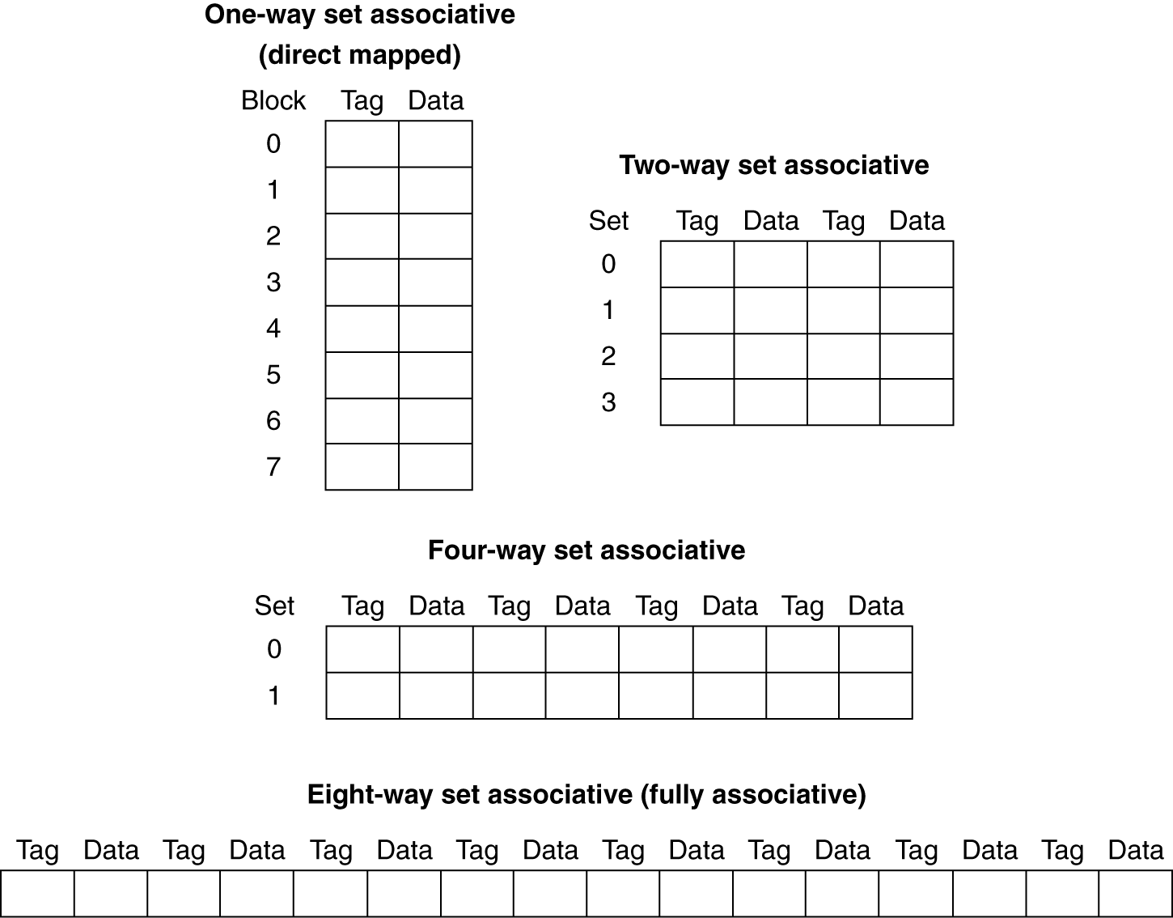
Spectrum of Associativity
For a cache with 8 entries

Slide 30
Misses and Associativity in Caches
Example: Assume there are 3 small caches (direct mapped, two-way set associative, fully associative), each consisting of 4 one-word blocks. Find the number of misses for each cache organization given the following sequence of block addresses: 0, 8, 0, 6, 8
(DONE IN CLASS)

Slide 31
Associativity Example
Compare 4-block caches
  Direct mapped, 2-way set associative,
  fully associative
  Block access sequence: 0, 8, 0, 6, 8
Direct mapped
Block address | Cache index | Hit/miss | Cache content after access
 |  |  | 0 | 1 | 2 | 3
0 | 0 | miss | Mem[0]
8 | 0 | miss | Mem[8]
0 | 0 | miss | Mem[0]
6 | 2 | miss | Mem[0] |  | Mem[6]
8 | 0 | miss | Mem[8] |  | Mem[6]
Notes:
Morgan Kaufmann Publishers
Chapter 5 — Large and Fast: Exploiting Memory Hierarchy

Slide 32
Associativity Example
2-way set associative
Block address | Cache index | Hit/miss | Cache content after access
 |  |  | Set 0 |  | Set 1
0 | 0 | miss | Mem[0]
8 | 0 | miss | Mem[0] | Mem[8]
0 | 0 | hit | Mem[0] | Mem[8]
6 | 0 | miss | Mem[0] | Mem[6]
8 | 0 | miss | Mem[8] | Mem[6]
Fully associative
Block address |  | Hit/miss | Cache content after access
0 |  | miss | Mem[0]
8 |  | miss | Mem[0] | Mem[8]
0 |  | hit | Mem[0] | Mem[8]
6 |  | miss | Mem[0] | Mem[8] | Mem[6]
8 |  | hit | Mem[0] | Mem[8] | Mem[6]
Notes:
Morgan Kaufmann Publishers
Chapter 5 — Large and Fast: Exploiting Memory Hierarchy

Slide 33
Replacement Policy
Direct mapped: no choice
Set associative
  Prefer non-valid entry, if there is one
  Otherwise, choose among entries in the set
Least-recently used (LRU)
  Choose the one unused for the longest time
    Simple for 2-way, manageable for 4-way, too hard beyond that
Most-recently used (MRU)
Random
  Gives approximately the same performance as LRU for high associativity

Slide 34

Set Associative Cache Organization

Slide 35
Problem 4
Identify the index bits, the tag bits and block offset bits for a cache of 3-way set associative cache with 2-word blocks and a total size of 24 words.
How about cache block size 8 bytes with a total size of 96 bytes, 3-way set associative?
(DONE IN CLASS)

Slide 36
Problem 5
Identify the index bits, the tag bits and block offset bits for a cache of 3-way set associative cache with 4-word blocks and a total size of 24 words.
How about 3-way set associative, cache block size 16bytes with 2 sets.
How about a full associative cache with 1-word blocks and a total size of 8 words?
How about a full associative cache with 2-word blocks and a total size of 8 words?
(DONE IN CLASS)

Slide 37
Problem 6
Identify the index bits, the tag bits and block offset bits for a cache of 3-way set associative cache with 4-word blocks and a total size of 24 words.
How about 3-way set associative, cache block size 16bytes with 2 sets.
(DONE IN CLASS)

Slide 38
Problem 7
Below is a list of 32-bit memory address, given as WORD addresses:
1, 134, 212,1, 135, 213, 162, 161, 2, 44, 41, 221
For each of these references, identify the index bits, the tag bits and block offset bits for a cache of 3-way set associative cache with 2-word blocks and a total size of 24 words. Show if a hit or a miss, assuming using LRU replacement? Show final cache contents.
How about a full associative cache with 1-word blocks and a total size of 8 words?
(DONE IN CLASS)

Slide 39
Problem 8
Below is a list of 32-bit memory address, given as WORD addresses:
1, 134, 212,1, 135, 213, 162, 161, 2, 44, 41, 221
What is the miss rate of a fully associative cache with 2-word blocks and a total size of 8 words, using LRU replacement.
What is the miss rate using MRU replacement?
(DONE IN CLASS)

Slide 40
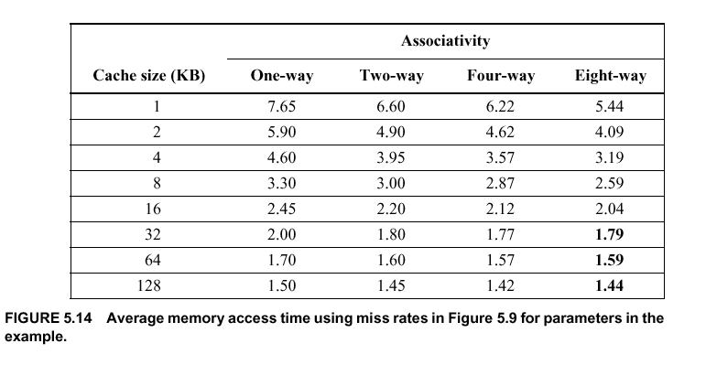

Slide 41
Replacement Algorithms (1)
Direct mapping
No choice
Each block only maps to one line
Replace that line

Slide 42
Replacement Algorithms (2)
Associative & Set Associative
Hardware implemented algorithm (speed)
Least Recently used (LRU)
e.g. in 2 way set associative
  Which of the 2 block is lru?
First in first out (FIFO)
  replace block that has been in cache longest
Least frequently used
  replace block which has had fewest hits
Random

Slide 43
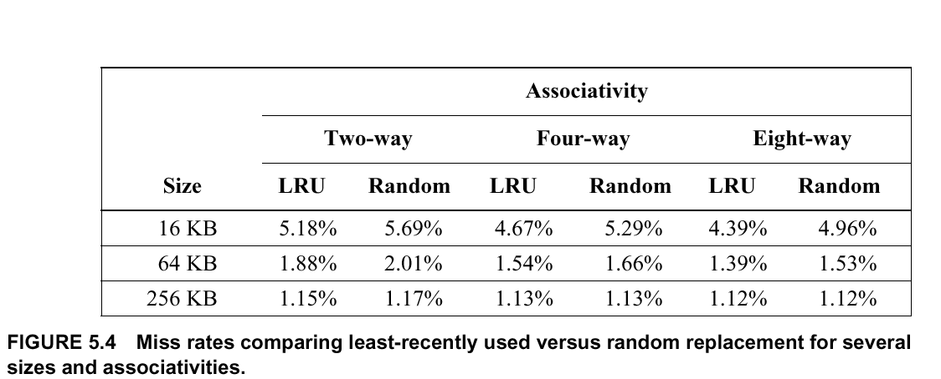

Slide 44
Write Policy
Must not overwrite a cache block unless main memory is up to date
Multiple CPUs may have individual caches
I/O may address main memory directly

Slide 45
Write through
All writes go to main memory as well as cache
Multiple CPUs can monitor main memory traffic to keep local (to CPU) cache up to date
Lots of traffic
Slows down writes

Slide 46
Write back
Updates initially made in cache only
Update bit for cache slot is set when update occurs
If block is to be replaced, write to main memory only if update bit is set
Other caches get out of sync
I/O must access main memory through cache
N.B. 15% of memory references are writes

Slide 47
Block / line sizes
How much data should be transferred from main memory to the cache in a single memory reference
Complex relationship between block size and hit ratio as well as the operation of the system bus itself
As block size increases,
  Locality of reference predicts that the additional information transferred will likely be used and thus increases the hit ratio (good)

Slide 48
  Number of blocks in cache goes down, limiting the total number of blocks in the cache (bad)
  As the block size gets big, the probability of referencing all the data in it goes down (hit ratio goes down) (bad)
  Size of 4-8 addressable units seems about right for current systems

Slide 49
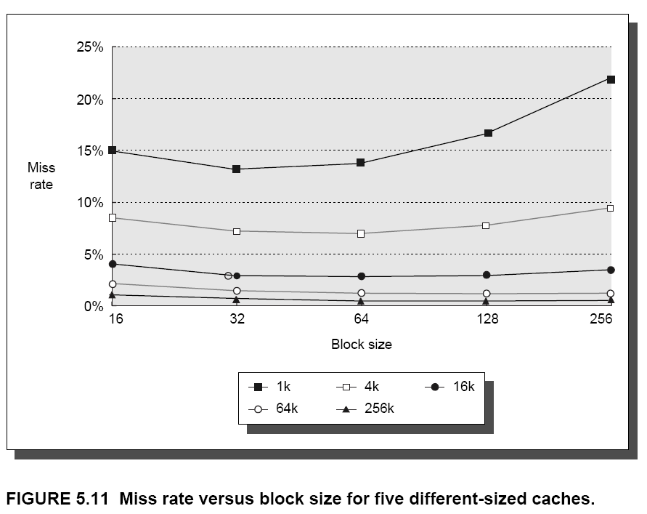

Slide 50
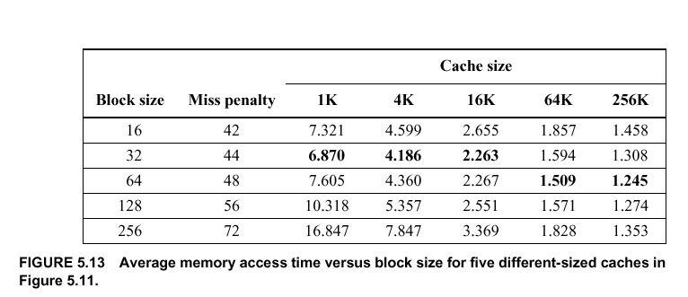

Slide 51
Number of Caches (Single vs. 2-Level)
Modern CPU chips have on-board cache (L1, Internal cache)
  80486 -- 8KB
  Pentium -- 16 KB
  Power PC -- up to 64 KB
  L1 provides best performance gains
Secondary, off-chip cache (L2) provides higher speed access to main memory
  L2 is generally 512KB or less -- more than this is not cost-effective

Slide 52
Unified Cache
Unified cache stores data and instructions in 1 cache
Only 1 cache to design and operate
Cache is flexible and can balance “allocation” of space to instructions or data to best fit the execution of the program -- higher hit ratio

Slide 53
Split Cache
Split cache uses 2 caches -- 1 for instructions and 1 for data
Must build and manage 2 caches
Static allocation of cache sizes
Can out perform unified cache in systems that support parallel execution and pipelining (reduces cache contention)

Slide 54
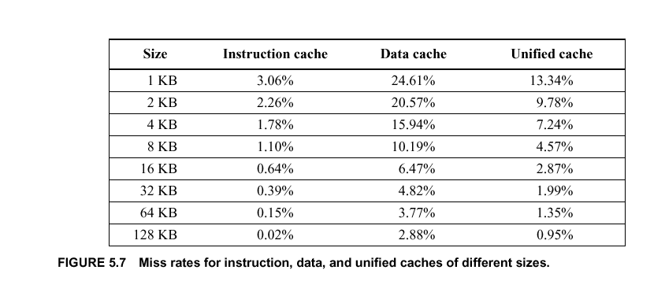

Slide 55
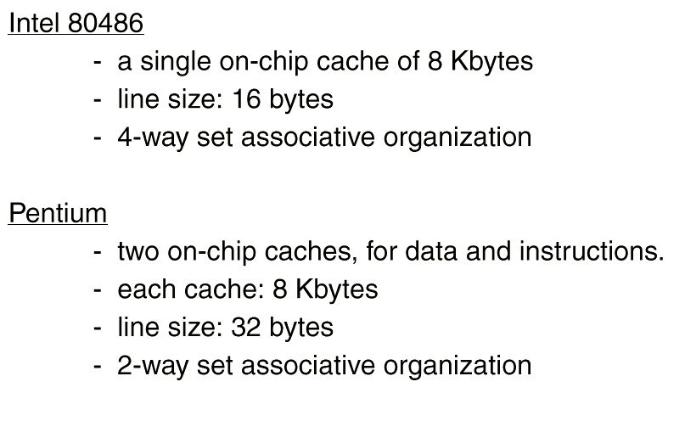
Some Cache Architectures

Slide 56
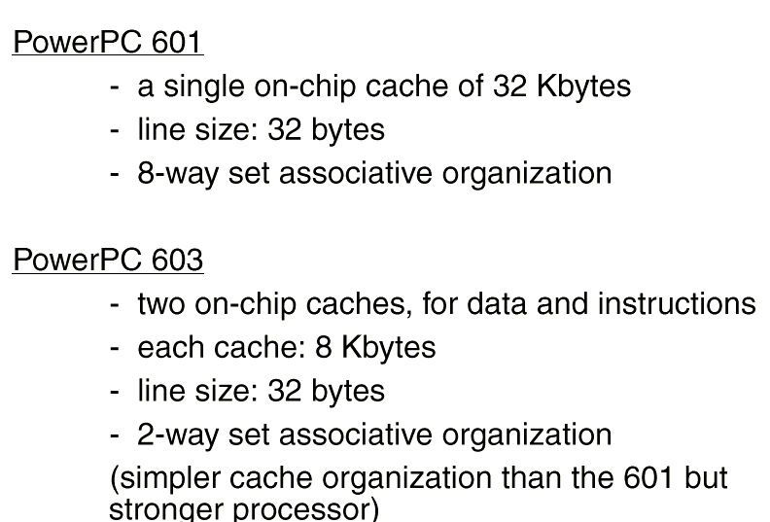
Some Cache Architectures

Slide 57
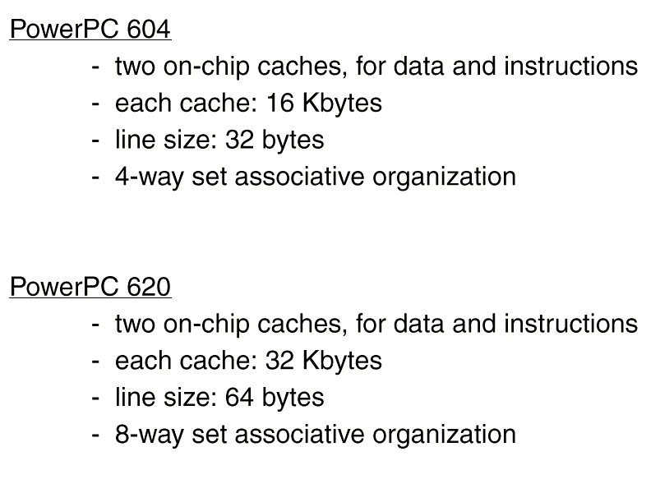
Some Cache Architectures

