Slide 1
Asynchronous Counters

Slide 2
Lecture Overview
Classifications of Counters
Definitions
Asynchronous Counter…
  J – K Flip Flops
  D Flip Flops
  Up Counters
  Down Counters
  Truncated Counters
Design Example

Slide 3
Classifications of Counters
Asynchronous Counters
  Only the first flip-flop is clocked by an external clock. All subsequent flip-flops are clocked by the output of the preceding flip-flop.
  Asynchronous counters are slower than synchronous counters because of the delay in the transmission of the pulses from flip-flop to flip-flop.
  Asynchronous counters are also called ripple-counters because of the way the clock pulse ripples it way through the flip-flops.

Slide 4
Classifications of Counters
Synchronous Counters
  All flip-flops are clocked simultaneously by an external clock.
  Synchronous counters are faster than asynchronous counters because of the simultaneous clocking.
  Synchronous counters are an example of state machine design because they have a set of states and a set of transition rules for moving between those states after each clocked event.

Slide 5
States / Modulus / Flip-Flops
The number of flip-flops determines the count limit or number of states.
    (STATES = 2 ^{# of flip flops})
The number of states used is called the MODULUS.
For example, a Modulus-12 counter would count from 0 (0000) to 11 (1011) and requires four flip-flops (16 states - 12 used).

Slide 6
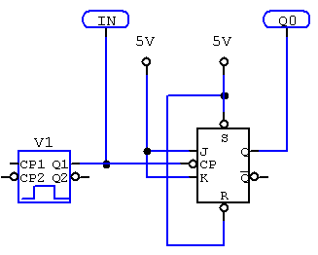
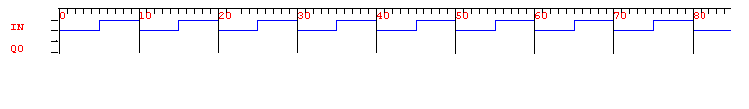
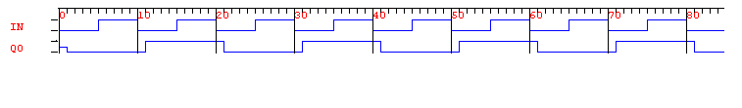
1 Bit Asynch-Counter / Modulus 2

Slide 7
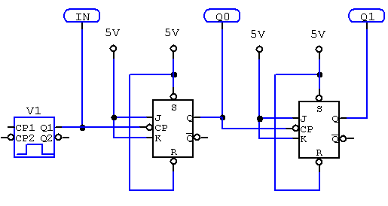
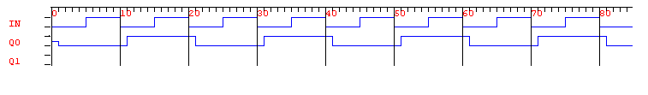
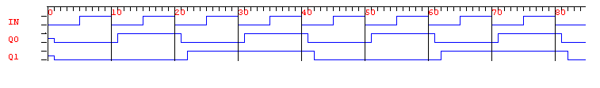
2 Bit Asynch-Counter / Modulus 4

Slide 8
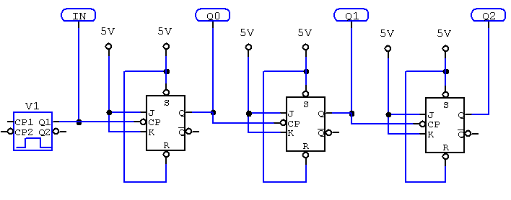
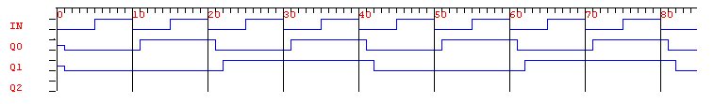
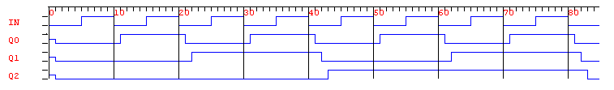
3 Bit Asynch-Counter / Modulus 8

Slide 9
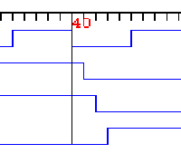
The Ripple Effect…
Q0
Q1
Q2

Slide 10
Ripple Effect…The Problem
Q0
Q1
Q2
3
4
2
0

Slide 11
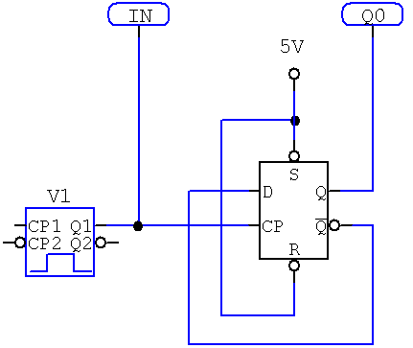

D Flip-Flop… Nothing Special About J-K

Slide 12
Six Examples
Modulus 4 Up Counter with Negative Edge Triggered Flip-Flops
Modulus 4 Down Counter with Negative Edge Triggered Flip-Flops
Modulus 4 Up Counter with Positive Edge Triggered Flip-Flops
Modulus 4 Down Counter with Positive Edge Triggered Flip-Flops
Truncated Counter
Counter Design

Slide 13
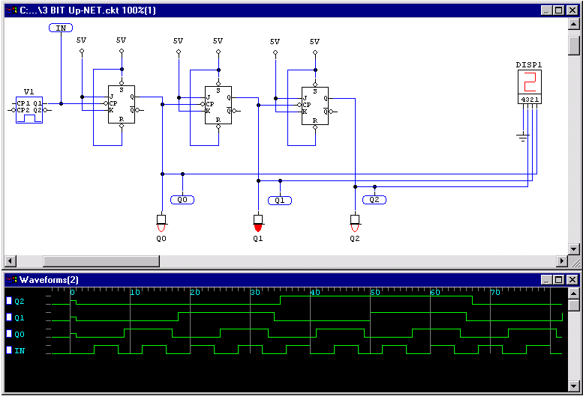
Up Counter w/ Negative Edge Flip-Flops

Slide 14
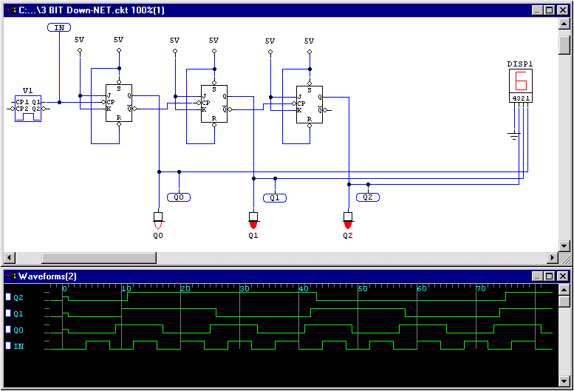
Down Counter w/ Negative Edge Flip-Flops

Slide 15
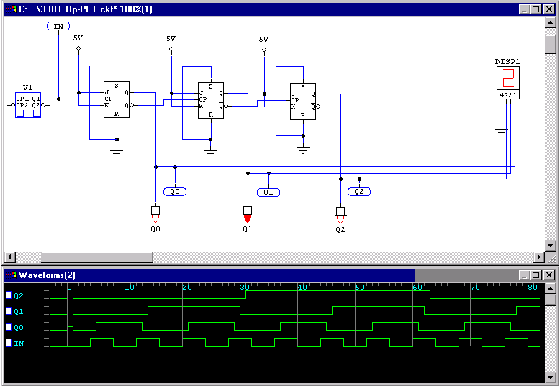
Up Counter w/ Positive Edge Flip-Flops

Slide 16
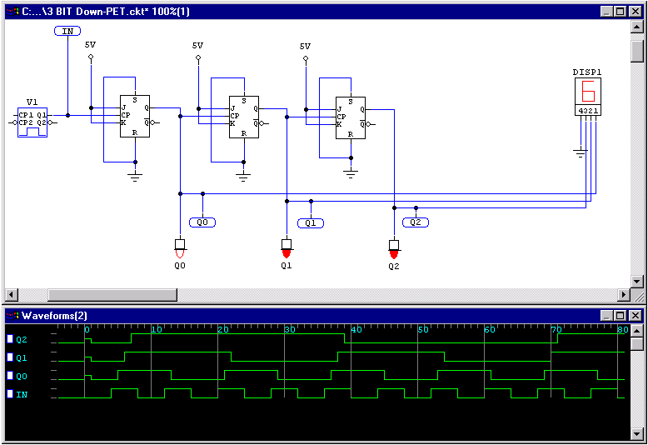
Down Counter w/ Positive Edge Flip-Flops

Slide 17
Truncating the Count… Modulus 6

Slide 18
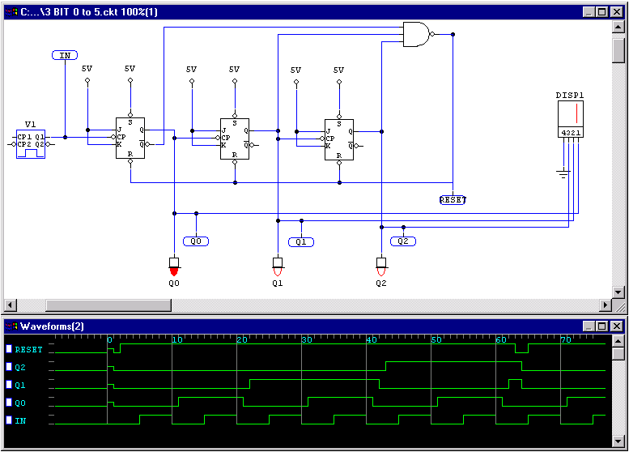
Modulus-6 Counter

Slide 19
Asynchronous Counter Design Steps
Select Type
    Up or Down
    Modules
Select Flip-Flop Type
    J-K or D
    Positive Edge Trigger (PET) or Negative Edge Trigger (NET)
Determine Number of Flip-Flops
    (2^{# Flip-Flop} ≥ Modules)

Slide 20


Asynchronous Counter Design Steps
Design Basic Counters
    Same polarity for down counters:
    Opposite polarity for up counters:
Design Limits Logic
    Input to logic is count that is one past the end of sequence.

Slide 21
Design Example
Select Type
    Up or Down
    Modules
Select Flip-Flop Type
    J-K or D
    Positive Edge Trigger (PET) or Negative Edge Trigger (NET)
Determine Number of Flip-Flops
    (2^{# Flip-Flop} ≥ Modules)
MOD – 14 (0..13)
2^{4 Flip-Flop} ≥ 16

Slide 22
Design Example
Design Basic Counters
    Same polarity for down counters:
    Opposite polarity for up counters:
Design Limits Logic
    Input to logic is count that is one past the end of sequence.
Limit 13+1 = 14 (1110)

Slide 23
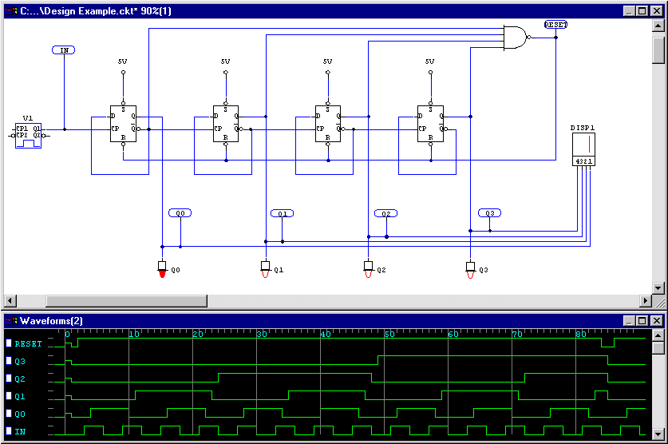
Design Example…Solution

