Slide 1

On-Chip Context Save and Restore of Hardware Tasks on Partially Reconfigurable FPGAs
Aurelio Morales-Villanueva and Ann Gordon-Ross⁺
Department of Electrical and Computer Engineering
University of Florida, Gainesville, Florida, USA
⁺ Also Affiliated with NSF Center for High-Performance Reconfigurable Computing
This work was supported by National Science Foundation (NSF) grants EEC-0642422 and IIP-1161022, and Programa de Ciencia y Tecnología (FINCyT) under contract 121-2009-FINCyT-BDE

Slide 2
Motivations
Partially reconfigurable (PR) FPGAs enhance hardware multitasking of shared resources
Hardware tasks (PR modules (PRMs)) share PR regions (PRRs)
Only reconfigured PRR halts execution
PRM preemption: saves PRM’s execution state (i.e., context)
PRM resumption: restores previous PRM’s saved context
Prior works only provide partial solutions
Contributions
On-chip context save and restore (CSR) software
Application/system independent (i.e., portable)
On-chip CSR software benefits
No external/custom hardware required for operation
No tool flow changes required
Autonomuous
Maximizes task throughput, no re-execution time for PRM upon resumption

Slide 3
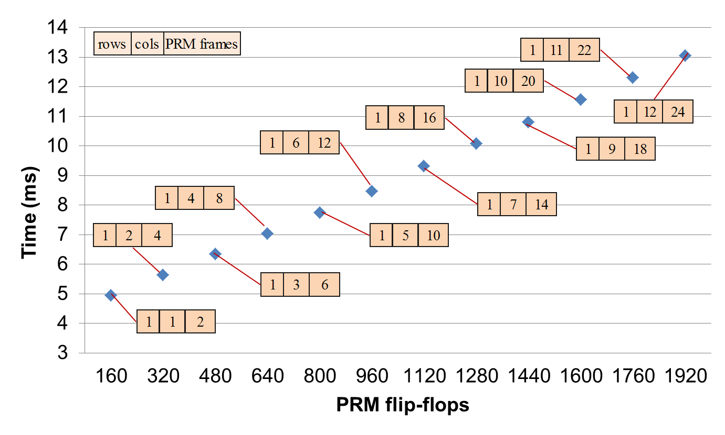
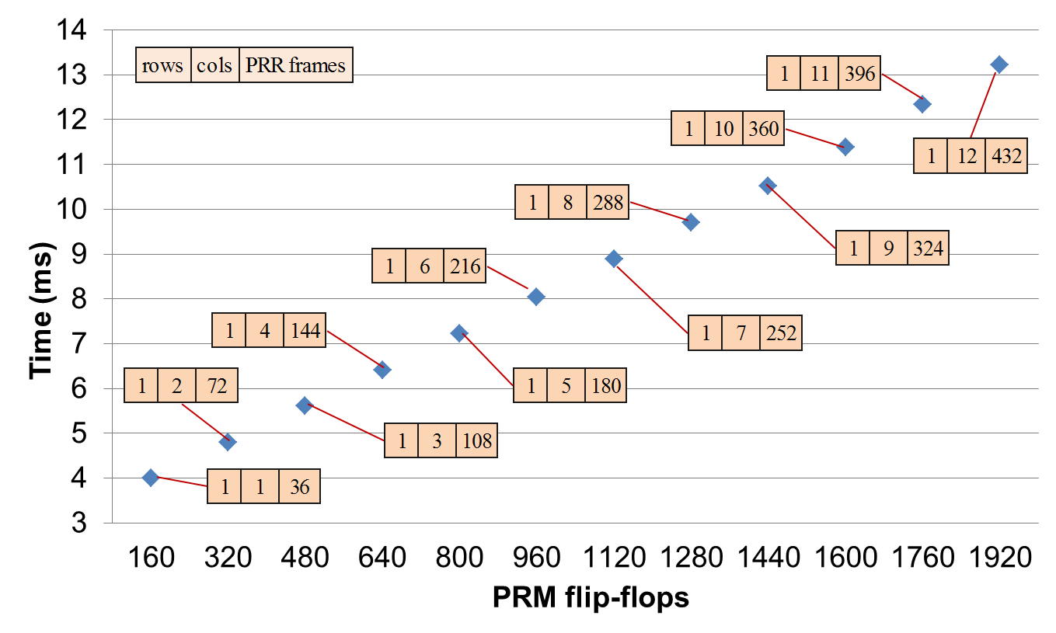
Context save (T_{CS}) execution time
Results
Context restore (T_{CR}) execution time
All execution times show linear growth rate
Facilitates predictability of CSR times for different PRR sizes
On-chip CSR software benefits for system designers
Portability across different FPGA architectures
Allows to trade off PRR size and CSR times based on application requirements
Notes:
Number of FFs per column

