Slide 1

Partial Region and Bitstream Cost Models for Hardware Multitasking on Partially Reconfigurable FPGAs
Aurelio Morales-Villanueva and Ann Gordon-Ross⁺
Department of Electrical and Computer Engineering
University of Florida, Gainesville, Florida, USA
⁺ Also Affiliated with NSF Center for High-Performance Reconfigurable Computing
This work was supported by National Science Foundation (NSF) grants EEC-0642422 and IIP-1161022, and Programa de Ciencia y Tecnología (FINCyT) under contract 121-2009-FINCyT-BDE

Slide 2
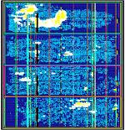
Introduction
Field-programmable gate arrays (FPGAs)
Programmable devices with large amount of resources
Resources connected with a complex, configurable routing network
Logic resources: CLBs (LUTs, flip-flops)
Special resources: BRAMs, DSPs, hardcore μP
Reconfiguration on FPGAs
Benefits system designers and functionality
Run-time hardware adaptation via resource time multiplexing
Reduced area/power requirements
Two types of reconfiguration: full and partial reconfiguration

Slide 3
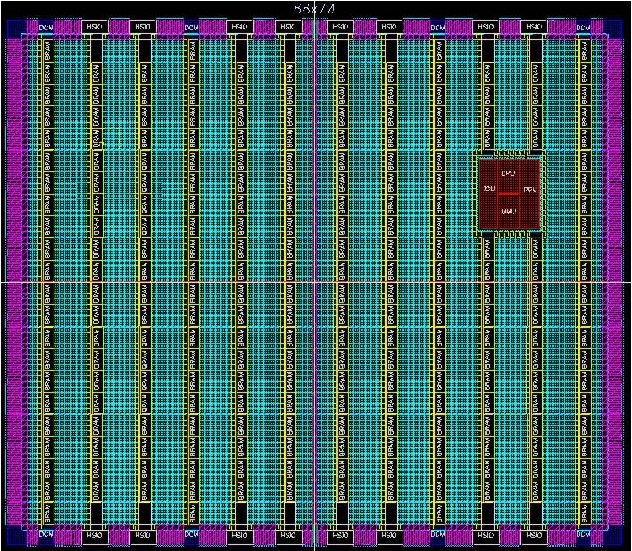
Full Reconfiguration
Used for initializing the entire FPGA
Entire FPGA configured with full bitstream and fixed hardware task set
Reconfiguration halts all tasks (i.e., the entire system)
Lengthy switching time if task set changes
HW task C1
HW task B1
HW task A1
HW task C2
HW task B2
HW task A2
Full bitstream 1
Configuration Port
Full bitstream 2
Execution and state of all tasks is lost during full reconfiguration!

Slide 4
Partial Reconfiguration (PR)
PR divides the FPGA fabric into two regions
Static region: fixed functionality, never reconfigured after initial configuration at startup
Reconfigurable region: multiple PR regions (PRRs)
PRRs execute PR modules (PRMs) (hardware tasks)
ICAP
Module A
Module B
Embedded
processor
Module C
Mem Controller
Module D
Static region
Reconfig. region
Current FPGAs support PR
Enables efficient hardware multitasking
FPGA area and power reduction, faster configuration, etc.
Effectively leveraging PR on FPGAs
Challenging for system designers
Early design decisions affect overall PR system performance
Inappropriate decisions severely degrade PR system performance
Potentially worse than non-PR system

Slide 5
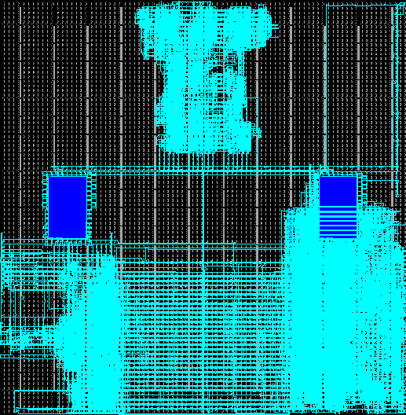
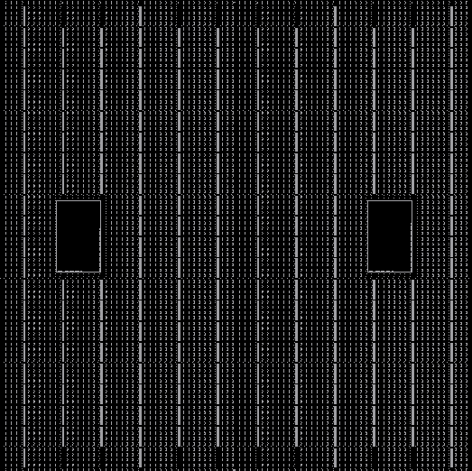
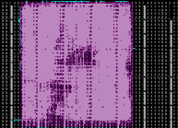
Partial vs. Full Reconfiguration
Dynamic, on-the-fly PR of individual PRRs
No execution interruption of static region or other PRRs!
Uses partial bitstreams
Smaller than full bitstream ➔ faster reconfiguration time
*May* require bitstream for each PRM-to-PRR mapping
Increased flexibility
Increased task throughput/performance
Reduced FPGA area requirements
Reduced power consumption
Configuration
Overhead
Reconfiguration
Overhead
Function
Static region operation
Power On
Time

Slide 6
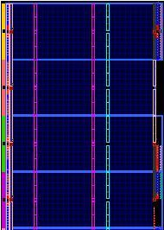
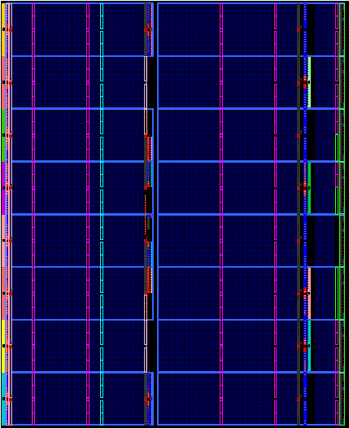


System Designer Challenges
Critical design decisions done in early system design
PRR size/organization?
Design partitioning?
PRM-to-PRR mapping?
PRR size? How big?
PRR 1
PRR 1
PRR 1
PRR
1
PRR 1
Static
region
PRM2
PRM3
OR
PRM1
PRR 2
PRR 2
PRR 2
PRM4
Resource utilization vs. PRR size/organization
PR partitioning design space is exponentially large
Fine-grained to coarse-grained partitioning
Simple operations to entire application as a single PRM
Designers can only evaluate a subset of these designs
Need analytical or simulated cost models
Evaluate design decisions’ impact on PRR size/organization and partial bitstream sizes
Cost models avoid lengthy PR design flow

Slide 7
Motivations
Prior works in PR cost models
Only provided partial methods for evaluating design tradeoffs
Manual PRR floorplanning process in the PR design flow
Avoid oversized PRRs
Avoid ill-suited PRR organizations
Goal: high resource utilization per PRR
Benefits:
Smaller partial bitstreams
Faster reconfiguration times
Efficent area utilization in the FPGA
GOAL: High-level cost models for system designers
Evaluation of design decisions early in the design process
The cost models must provide sufficiently accurate evaluations
Reduces design space exploration time
As compared to full system implementation to attain same information
PRR
change to
PRR
PRR
PRR

Slide 8
Contributions
Two high-level cost models for design decision evaluation
Based on synthesis report results generated by Xilinx tools
PRR size/organization cost model
Compares PRRs with different resources and FPGA fabric locations
Partial bitstream size cost model
Partial bitstream size derivation based on PRR size/organization
Benefits of our cost models
Early estimation of PRR size/organization and partial bitstream size
Increases the resource utilization in PRRs
Generally portable across different Xilinx FPGA families
Device-specific characteristics’ values used in cost model formulas
Does not require executing the entire PR design flow
Significantly decreases the design exploration time
Increasing system designer productivity

Slide 9
PRR Size/Organization Cost Model

Slide 10
PRR Size/Organization Cost Model Parameters
Parameter | Description
LUT_FF_{req} | LUT FF pairs required in PRM
LUT_{req} | Slice LUTs required in PRM
LUT_CLB | LUTs per CLB
FF_CLB | FFs per CLB
CLB_{req} | CLBs required in PRM
FF_{req} | FFs required in PRM
W_{CLB} | CLB columns in PRR
H_{CLB} | CLB rows in PRR
CLB_{col} | CLBs in a column (per row)
DSP_{req} | DSPs required in PRM
W_{DSP} | DSP columns in PRR
H_{DSP} | DSP rows in PRR
Parameter | Description
DSP_{col} | DSPs in a column (per row)
BRAM_{req} | BRAMs required in PRM
W_{BRAM} | BRAM columns in PRR
H_{BRAM} | BRAM rows in PRR
BRAM_{col} | BRAMs in a column (per row)
CLB_{avail} | CLBs available in PRR
FF_{avail} | FFs available in PRR
DSP_{avail} | DSPs available in PRR
BRAM_{avail} | BRAMs available in PRR
H | Number of rows in the PRR
W | Number of columns in the PRR
PRR_{size} | Size of PRR
Parameter | Virtex-4 | Virtex-5 | Virtex-6
CLB_{col} | 16 | 20 | 40
DSP_{col} | 4 | 8 | 16
BRAM_{col} | 4 | 4 | 8
LUT_CLB | 8 | 8 | 8
FF_CLB | 8 | 8 | 16
Based on Xilinx synthesis report results
Specific values in PRR size/organization cost model for Virtex-4, -5, and -6 device families

Slide 11

Derivation of the PRR Size/Organization
Extract resources required for PRMs that map to same PRR
Selected Device : 5vlx110tff1136-1
Slice Logic Utilization:
# of Slice Registers: 1592 of 69120 2%
# of Slice LUTs: 1527 of 69120 2%
# used as Logic: 1527 of 69120 2%
Slice Logic Distribution:
# of LUT Flip Flop pairs used: 2619
# with an unused Flip Flop: 1027 of 2619 39%
# with an unused LUT: 1092 of 2619 41%
# of fully used LUT-FF pairs: 500 of 2619 19%
# of unique control sets: 45
IO Utilization:
# of IOs: 38
# of bonded IOBs: 38 of 640 5%
Specific Feature Utilization:
# of Block RAM/FIFO: 4 of 148 2%
# using Block RAM only: 4
# of BUFG/BUFGCTRLs: 3 of 32 9%
# of DSP48Es: 4 of 64 6%
Flip-Flops
DSPs
BRAMs
Derive PRRs resources
Maximum resource util.
CLB columns (W_{CLB})
DSP columns (W_{DSP})
BRAM columns (W_{BRAM})
Select an FPGA
for the PR system
Generate
synthesis
report for
each PRM
PRR height (number of rows)
PRR Width (number of columns)
Total PRR size
H = H_{CLB} = H_{DSP} = H_{BRAM}
W = W_{CLB} + W_{DSP} + W_{BRAM}
PRR_{SIZE} = H x W
PRR size/organization depends on the specific FPGA selected

Slide 12
Partial Bitstream Size Cost Model

Slide 13
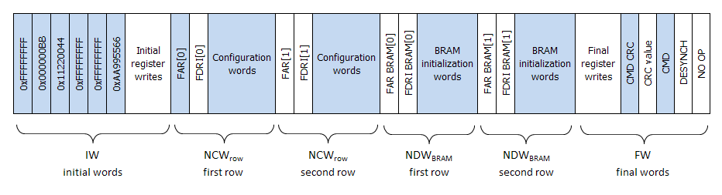
Partial Bitstream Structure
Partial bitstream structure is similar across device families
Initial words (IW)
Synchronization of bitstream with configuration port (e.g., ICAP)
Configuration words per PRR row (NCW_{row})
Access to CLBs, DSPs, BRAMs, and CLB flip-flops initialization
BRAM data words per PRR row (NDW_{BRAM})
BRAM initialization
Final words (FW)
Releases the ICAP, allowing other PRRs to be configured

Slide 14
Partial Bitstream Size Cost Model Parameters
Parameter | Description
IW | Number of initial words
FW | Number of final words
FAR_FDRI | FAR/FDRI initialization words per row
NCW_{row} | Configuration words in a PRR row
NDW_{BRAM} | BRAM initialization words in a PRR row
NCF_{CLB} | CLB configuration frames in a PRR row
NCF_{DSP} | DSP configuration frames in a PRR row
NCF_{BRAM} | BRAM configuration frames in a PRR row
CF_{CLB} | Configuration frames per CLB column
CF_{DSP} | Configuration frames per DSP column
CF_{BRAM} | Configuration frames per BRAM col.
DF_{BRAM} | Initialization frames per BRAM col.
FR_{size} | Frame size in words
Bytes_{word} | Number of bytes per word
H | Number of rows in the PRR
S_{bitstream} | Size of partial bitstream in bytes
Parameter | Virtex-4 | Virtex-5 | Virtex-6
CF_{CLB} | 22 | 36 | 36
CF_{DSP} | 21 | 28 | 28
CF_{BRAM} | 20 | 30 | 28
DF_{BRAM} | 64 | 128 | 128
FR_{size} | 41 | 41 | 81
IW | 12 | 16 | 20
FW | 108 | 114 | 113
FAR_FDRI | 5 | 5 | 5
Bytes_{word} | 4 | 4 | 4
Specific values in partial bitstream size cost model for Virtex-4, -5, and -6 device families

Slide 15
Partial Bitstream Size Derivation
Partial bitstream size in bytes
PRR rows
S_{bitstream} = {IW + H x (NCW_{row} + NDW_{BRAM}) + FW} x Bytes_{words}
Configuration words per PRR row
frame size
NCW_{row} = FAR_FDRI + (NCF_{CLB} + NCF_{DSP}+ NCF_{BRAM} + 1) x FR_{size}
CLB configuration frames per PRR row
NCF_{CLB} = W_{CLB} x CF_{CLB}
DSP configuration frames per PRR row
NCF_{DSP} = W_{DSP} x CF_{DSP}
BRAM configuration frames per PRR row
NCF_{BRAM} = W_{BRAM} x CF_{BRAM}
BRAM initialization words per PRR row
NDW_{BRAM} = FAR_FDRI + (W_{BRAM} x DF_{BRAM} + 1) x FR_{size}

Slide 16
Experimental Results

Slide 17
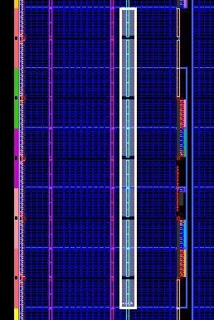
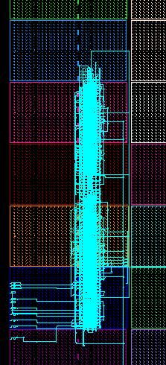
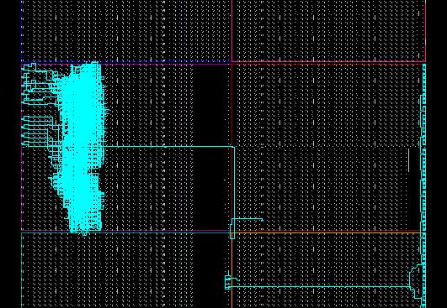
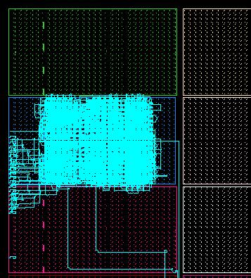
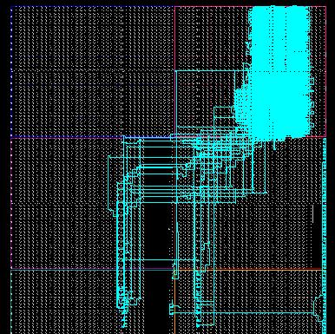
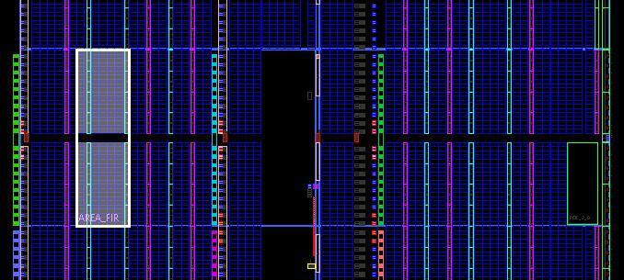
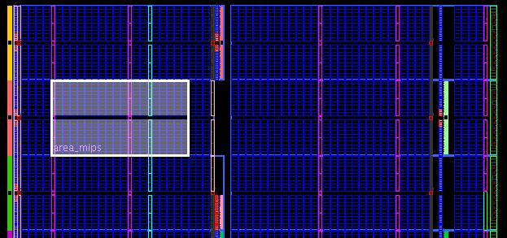
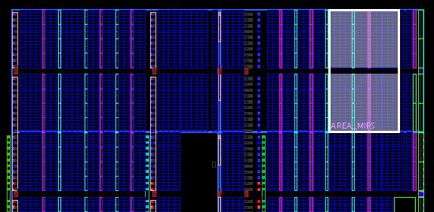
PRR Size/Organization Cost Model Evaluation
FPGA devices -- Virtex-5 LX110T and Virtex-6 LX75T
Different sizes/architectures to evaluate different resource organizations
Experimental PRMs -- MIPS, FIR, and SDRAM
PRM complexity and resource usage similar to prior works
PRM MIPS (Virtex-5)
PRM FIR (Virtex-6)
PRM FIR (Virtex-5)
PRM MIPS (Virtex-6)
Resource
Utilization
RU_{CLB} = 92%
RU_{DSP} = 25%
RU_{BRAM} =75%
Resource
Utilization
RU_{CLB} = 82%
RU_{DSP} = 80%
RU_{BRAM} = 0%
Resource
Utilization (RU)
RU_{CLB} = 97%
RU_{DSP} = 50%
RU_{BRAM} =75%
H = 1, W_{CLB} = 17, W_{DSP} = 1, W_{BRAM} = 2
H = 1, W_{CLB} = 11, W_{DSP} = 1, W_{BRAM} = 1
RU_{CLB} = 92%, RU_{DSP} = 84%, RU_{BRAM} = 0%
H = 1, W_{CLB} = 5, W_{DSP} = 2, W_{BRAM} = 0
H = 5, W_{CLB} = 2, W_{DSP} = 1, W_{BRAM} = 0
Executing the entire flow vs. using our cost model
Average RU_{CLB} is 15% higher (due to tool optimizations)
RU_{DSP} and RU_{BRAM} are the same
Synthesis report results using Xilinx ISE 12.4 tools
Resource utilizations (RUs) per resource type are maximum for the selected PRR size/organization

Slide 18
Partial Bitstream Sizes
PRM | Virtex-5 LX110T | Virtex-6 LX75T
FIR | 83,440 | 77,340
MIPS | 157,672 | 189,140
SDRAM | 18,416 | 24,204
Bitstream sizes (in bytes) based on PRR sizes/organizations per PRM
Without executing the entire PR design flow
Bitstream sizes are 9% larger on average vs. executing the entire flow
Execution times: minutes (m) and seconds (s)
Includes derivation of PRR size/organization and bitstream size
(cost model = 1m 30s on avg., which is 35% of synthesis time)
 | Virtex-5 LX110T |  |  | Virtex-6 LX75T
Process | FIR | MIPS | SDRAM | FIR | MIPS | SDRAM
Synthesis | 4m 25s | 4m 15s | 3m 20s | 4m | 4m 50s | 4m 23s
Implementation | 5m 35s | 5m 15s | 2m 55s | 4m 15s | 5m 50s | 4m 30s
Place and Route execution times

Slide 19
Conclusions
Introduced two high-level cost models
Early design estimation tradeoffs for PR system design space exploration
PRR size/organization cost model
Smallest PRRs that maximize shared PRM resource utilization
Partial bitstream size cost model
Bitstream size derivation based on PRR size/organization
Cost models generally portable across FPGA device families
Improved system designer productivity
Use of cost models without executing the entire PR design flow
Future work
Introduce cost models as part of the PR design flow
Integration with Xilinx tools in the PRR floorplanning process

Slide 20

Questions?

