Slide 1


Configuration Prefetching and Reuse for Preemptive Hardware Multitasking on Partially Reconfigurable FPGAs
Aurelio Morales-Villanueva, Rohit Kumar, and Ann Gordon-Ross⁺ Department of Electrical and Computer Engineering
University of Florida, Gainesville, Florida, USA
⁺ Also affiliated with NSF Center for High-Performance Reconfigurable Computing
This work was supported by National Science Foundation (NSF) grants EEC-0642422 and IIP-1161022, NSF CHREC membership support of Draper Laboratory, and Fondo para la Innovación, la Ciencia y la Tecnología (FINCyT) under contract 121-2009-FINCyT-BDE

Slide 2
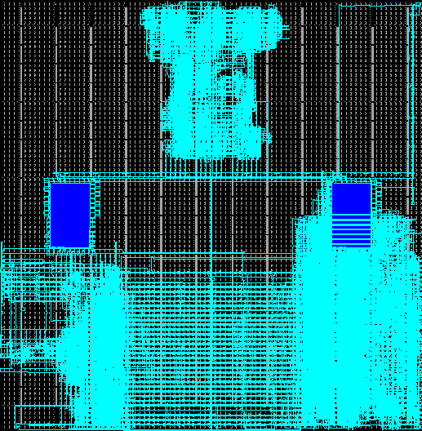

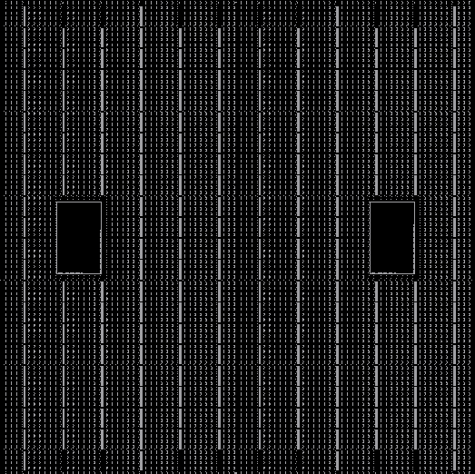
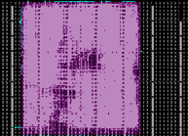
Motivations
Partially reconfigurable (PR) FPGAs enhance hardware (HW) multitasking of shared resources
HW tasks share PR regions (PRRs)
Time to reconfigure a PRR delays HW task execution
Reconfiguration time can be reduced/hidden using:
Configuration prefetching and configuration reuse
Prior works only provide partial solutions, and no physical implementation
Contributions
First physical implementation of configuration prefetching and configuration reuse for PR FPGAs
Leverage ICAP and bitstream manipulations
Prefetching: PRR reconfiguration overlaps HW task execution over the same PRR w/o affecting execution of current HW task
Reuse: No PRR reconfiguration needed
Experimental results on Virtex-5 FPGA
Fundamentals can be extended to newer device families (Series-7, Zynq 7000)
Function
Configuration
Overhead
Reconfiguration overhead
Prefetching
Static region operation
Power On
PRR operation
Time

