Slide 1
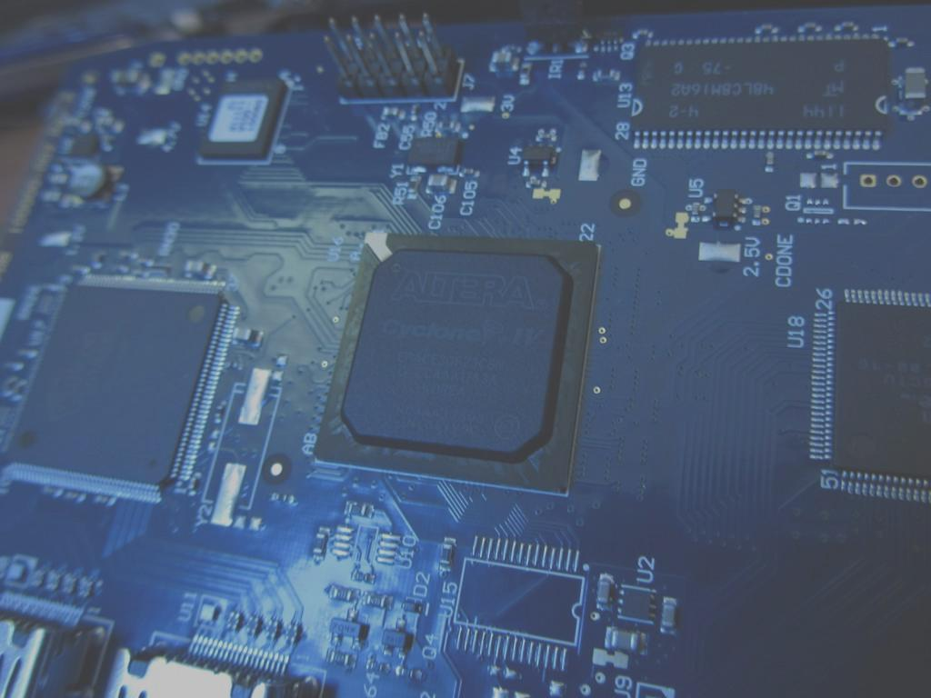


Relocation of Hardware Tasks across Networked Partially Reconfigurable FPGAs
Aurelio Morales Villanueva, PhD
Universidad Nacional de Ingeniería
E-CON UNI 2017 - Lima, November 24th, 2017

Slide 2
Overview
Introduction and background
Multitasking systems
Field-Programmable Gate Array (FPGA)
On-Chip Context Save and Restore (CSR)
On-Chip Hardware Task Relocation (HTR)
Remote HTR across networked FPGAs
Conclusions
Future Work

Slide 3
Task Switching Analogy
Processor SW task switching
FPGA HW task switching
μP
FPGA
Software task 1
Region 1
Hardware task 1
Stack
OS
+
MMU
Software task 2
μP or
custom HW
Region 2
Hardware task 2
Region 3
Hardware task N
Software task N
Multiple tasks execute concurrently
Each task ≡ one bitstream
Multiple regions time multiplex tasks
Use context save (CS) and context restore (CR) for task switching
CS: saves flip-flops’ values
CR: restores flip-flops’ values
Task relocation
Tasks may run on different regions
Challenging!
One task executes at a time
Each task ≡ piece of binary code
Time multiplex tasks
One stack for all tasks
Stack saves context for task restore
No task relocation
No reconfiguration of μP
μP – Microprocessor
FPGA – Field Programmable Gate Array
OS – Operating System
MMU – Memory Management Unit

Slide 4
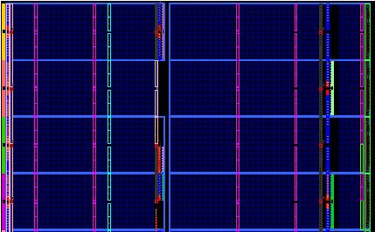
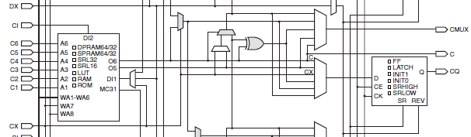
What is an FPGA?
BRAM
BRAM
CLK
BRAM
BRAM
BRAM
IOB
DSP
IOB
IOB
FPGAs are programmable devices with large amount of resources connected with a complex, configurable routing network
Logic resources: CLBs (LUTs, flip-flops)
Special resources: BRAMs, DSPs, hardcore μP
Routing resources: connection/switch boxes
Benefits of a FPGA over a traditional μP
Application-specific hardware enables efficient processing at high frequency and low power
Large logic fabric enables massive algorithm parallelism
Flexibility: from combinational/sequential circuits up to system on chip (SoC)
Allows time multiplexing of multiple designs (task switching)
Simplest hardware tasks: implemented in CLBs
Occupy a portion of the FPGA = region
Defined by a bitstream: size = depends on region size
Task’s execution state (context) = flip-flops’ values
region
CLBs
CLBs
CLBs
CLBs
CLBs
CLBs
CLBs
Floorplanning of a Xilinx FPGA
flip-flop
Lookup Table (LUT)
Xilinx CLB Architecture (partial)
μP – Microprocessor
CLB – Configurable Logic Block
BRAM – Embedded RAM Block
DSP – Digital Signal Processing Block
IOB – Input and Output Block

Slide 5
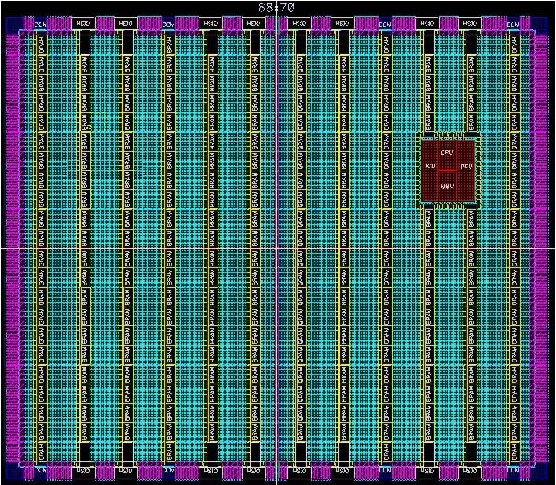
Reconfiguration on FPGAs
Benefits to system designers and functionality
Run-time hardware adaptation via time multiplexing of resources
Reduced area/power requirements
Two types of reconfiguration: Full and partial reconfiguration
Full reconfiguration:
Entire FPGA configured with full bitstream with fixed hardware task set
Reconfiguration halts all tasks --- lengthy task switching time
No context save/restore of hardware tasks --- tasks restart execution
HW task C1
HW task B1
HW task A1
HW task C2
HW task B2
HW task A2
Full bitstream 1
Configuration Port
Full bitstream 2
Execution and state of all tasks are lost during full reconfiguration!

Slide 6
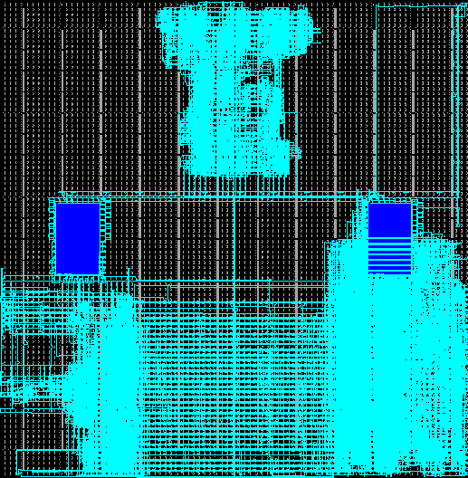
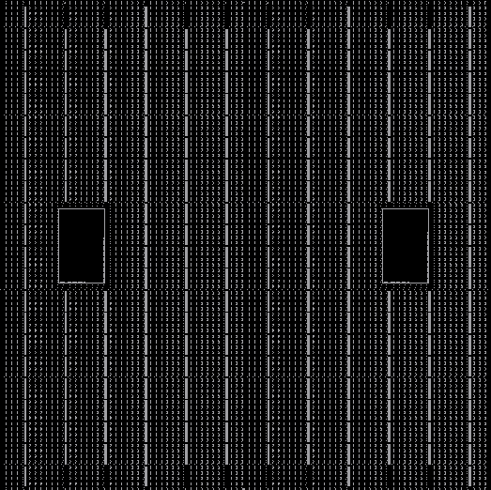
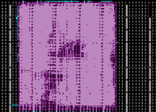
Partial Reconfiguration (PR)
PR divides the FPGA fabric into two regions
Static region: fixed functionality, never reconfigured after initial configuration at startup
Reconfigurable region: multiple PR regions (PRRs)
PRRs execute PR modules (PRMs) (hardware tasks)
ICAP
Module A
Module B
Embedded
processor
Module C
Mem Controller
Module D
PR compared to full reconfiguration
Dynamic, on-the-fly reconfiguration of individual PRRs
No interruption of static region or other PRRs!
Uses partial bitstreams --- smaller than full bitstreams
Faster reconfiguration time
*May* require a bitstream for each PRM-to-PRR mapping
Static region
Reconfig. region
Increased flexibility
Increased task throughput/performance
Enhances hardware multitasking
Requires context save and context restore for effective task switching
PR plays a key role in our research
Configuration
Overhead
Reconfiguration
Overhead
Function
Static region operation
Power On
Time

Slide 7
On-Chip Context Save and Restore

Slide 8
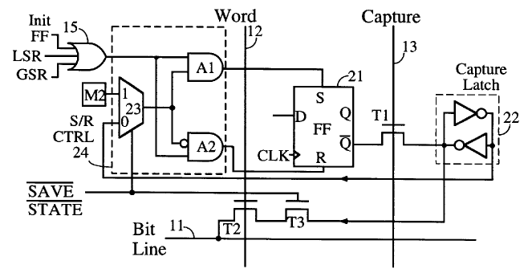
On-chip Context Save and Restore (CSR)
Purpose
Save and restore the task execution state (flip-flops’ values)
CSR in Xilinx FPGAs
Comprises two steps: context save and context restore
Context Save (CS)
Capture and save the flip-flops’ values in off-chip file
Context Restore (CR)
Restore previously captured flip-flops’ values
LSR – Local Set/Reset
GSR – Global Set/Reset
S/R CTRL – Set/Reset Control Logic
M2 – Configuration Memory bit

Slide 9
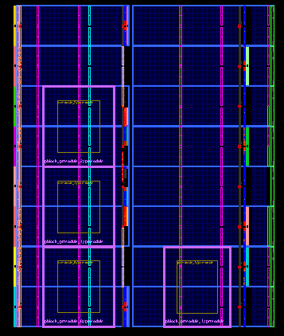



On-chip CSR Operation
M1
PRR1
M2
PRR1
Context
Restore
M3
PRR2
M4
PRR2
Context
Save
Context
Save
M5
PRR3
M6
PRR3
M7
PRR4
M8
PRR4
Resume
Execution
Execute
now
Reconfigure
PRR4
Execute

Slide 10
On-Chip Hardware Task Relocation

Slide 11
On-chip Hardware Task Relocation (HTR)
On-chip CSR enables hardware multitasking on the same PRR
May not maximize PRR utilization
PRRs may be busy (tasks cannot be preempted)
PRRs may be idle (pending tasks cannot execute on other PRRs)
Solution: on-chip HTR
Extend on-chip CSR functionality
Allow context restore (CR) on idle/different PRRs
Maximize PRR utilization (more candidate PRRs for task execution)
HTR requires more complex bitstream manipulations than CSR
Different PRR sizes and row and/or column locations
PRRs with heterogeneous resources
PRRs with different resource organization

Slide 12
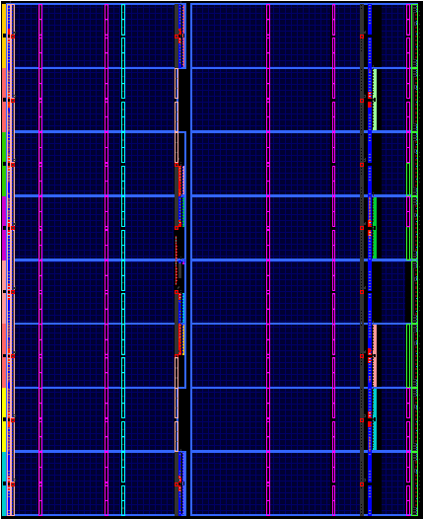

On-Chip HTR Operation
Example system
Enable FPGA protection
T_{protect_FPGA}
PRM
1
PRM
2
Initialization
Reconfiguration of PRR1 with PRM1
T_{reconfig_PRR}
Initial conditions
Executing PMR3
Execute PRM2
N
PRR1
PRR2
Context save and restore (CSR)
Y
Hardware task relocation (HTR) of PRM2 on PRR2
Y
N
PRR1 free or ⬇priority PRM
PRM2 executed in PRR1
and saved the context
T_{CS1}
Context save of PRM1
Context save of PRM3
T_{CS2}
T_{merge}
Merge saved context of PRM2 with initial bitstream of PRM2
Saved context relocation of PRM2 in PRR2
T_{relocate}
T_{CR1}
Context restore of
PRM2 on PRR1
Context restore of PRM2 on PRR2
T_{CR2}
Merged PRM2
PRM2
PRM3
Execute PRM2 on PRR1
Execute PRM2 on PRR2

Slide 13
Remote HTR (rHTR) across Networked Partially Reconfigurable FPGAs

Slide 14

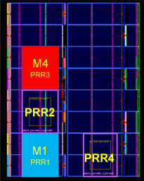
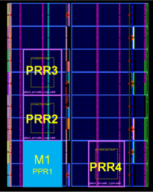
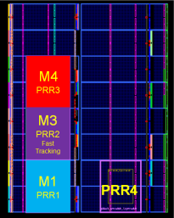
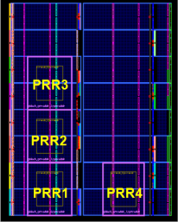


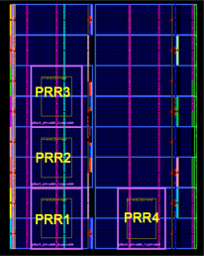
Remote HTR (rHTR) across Networked PR FPGAs
rHTR implements a distributed context relocation of PRMs in a network of PR-capable FPGAs
Each FPGA in the network = node
Transfer PRMs’ context via node switching
rHTR leverages CSR and HTR
Prevent losing execution state of PRMs during node switching
Maximize PRR utilization among all nodes in the network
Example systems
Dynamic load balancing of hardware tasks, sensor networks, continuous adaptive target tracking, distributed fault tolerant systems, distributed/parallel processing of hardware tasks
Example: load balancing in a network of FPGAs
M4
PRR2
M3
PRR1
M3
PRR3
PRR3
PRR3
M2
PRR2
PRR2
PRR2
M1
PRR1
M4
PRR4
PRR1
PRR4
PRR1
PRR4
FPGA Node 1
FPGA Node 2
DDRM
DDRM
DDRM
M4
PRR1
PRR3
M4
PRR3
PRR3
M2
PRR2
Slow Tracking
M3
PRR2
Fast Tracking
PRR2
PRR2
M1
PRR1
PRR1
PRR1
PRR4
PRR4
Example: Continuous adaptive target tracking

Slide 15
Motivations and Challenges
Motivations
Maximize resource utilization in a network of PR-FPGAs
Leverage CSR and HTR across nodes
Maximize task throughput
Improve task scheduling in a network of PR-FPGAs
Task relocation between nodes
No previous work in this direction!
Challenges
Preserve task’s execution state on node switching
Maintain node status consistency across all nodes
Remote execution of PRMs across nodes
Node switching latency

Slide 16
Node Consistency in rHTR
Due to rHTR’s distributed nature, inconsistencies in the network of FPGAs must be avoided
Global Table (GT) and Local Table (LT) on each node
GT: Local and remote PRM-to-PRR mappings on all nodes
LT: Node´s current PRM-to-PRR mappings
Remote Procedure Call (RPC)
Programs in a local node remotely execute code in a remote node
Propagate/check PRMs/PRRs’ status across nodes
node 0
node 1
M9 mapped in
node 1, PRR4
remote
relocation
resume
execution
No broadcast of M8’s new status
start
execution
M10
PRR1
schedule
later
M10 mapped in
node 0, PRR4
M9
PRR1
M1
PRR1
wired or
wireless
network
M5
PRR1
X
X
M8 abruptly ends
execution w/o
saving the context
context
save M4
M2
PRR2
M6
PRR2
X
M3
PRR3
M4
PRR4
M7
PRR3
M9’
PRR4
M8
PRR4
context restore
M8
No broadcast of M4’s new status

Slide 17








On-chip rHTR Operation
node 0
node 1
start
execution
P4
preempt M04
start
execution
M14
PRR1
resume
M15
M14
PRR4
S2
PRR1
PRR2
PRR3 PRR4
PRR1
PRR2
PRR3 PRR4
S2
X
M01
PRR1
S2
P1
M11
PRR1
context
save M12
P1
P2
M02
PRR2
P3
M12
PRR2
S2
S2
S2
S2
S2
S2
S2
S2
context
save M04
S2
context restore M15
S1
S1
S1
P3
M03
PRR3
M05
PRR4
M13
PRR3
P4
M04
PRR4
wired or
wireless
network
P4
P2
M15
PRR2
S1
S1
S1
resume
M25
node 2
node 3
context
save M22
PRR1
PRR2
PRR3 PRR4
P1
PRR1
PRR2
PRR3 PRR4
resume
M35
local
relocation
P1
M21
PRR1
M31
PRR1
M25
PRR2
X
M22
PRR2
P3
M32
PRR2
X
P2
M25
PRR1
P4
remote
relocation
S2
S2
S2
P3
M23
PRR3
M24
PRR4
P2
M33
PRR3
P2
M34
PRR4
X
M35
PRR1
S1
S1
S1
P3
P4
priority
execution
levels
P1
Critical
High
Medium
Low
PRR
free
PRR
busy
MXY
PRR Z
Module Y
Node X
PRR Z
P2
S1
PRR
locked
PRR
unlocked
P3
PRM
status
Preempted
Executing
P4
S2

Slide 18
rHTR Flow: remote relocation of PRM
Start/resume execution of PRM in remote free candidate PRR
Remote PRR is unlocked
Purple box contains the remote HTR (rHTR) steps
Start/resume execution of PRM in remote busy candidate PRR
Lower remote priority PRM is preempted

Slide 19
Experimental results
Purpose
Evaluate how PRR resources/size affects rHTR execution times
Help system designers trade off PRR sizes, partial bitstream sizes, and rHTR times
Experimental setup
Four Xilinx Virtex-5 ML509 board (four FPGA nodes) running Linux
Gigabit Ethernet switch to interconnect the boards
Two reconfigurable regions (PRRs) per FPGA node
Three hardware tasks (PRMs) share the same PRR
Each PRM: CLBs (flip-flops and LUTRAM) and BRAM resources
Heterogeneous PRR sizes and FPGA fabric locations
Global and local tables on each FPGA node
Local and remote PRM-to-PRR mapping
Task relocation cases (local or remote)
Small-to-large PRR task relocation
Notes:
For the purpose of HTR, two PRRs have different locations in the FPGA fabric.
There are two cases for relocation: from small-to-large PRR or from large-to-small PRR
The third case is not interesting: same-size PRR relocation
Since there are so many combination (144 for consecutive CLB columns) to perform a task relocation (in terms of sizes between two PRRs), I reduced the experiments (went down to 12) by having the large PRR with double (2x) the number of columns of the small PRR.
Since we covered only CLBs, doubling the number of columns in the large PRR, also doubles the number of frames.

Slide 20
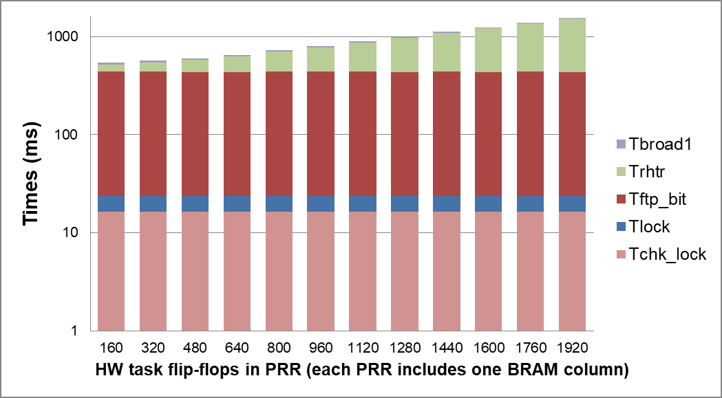
On-Chip rHTR results (1)
Start/resume execution of a PRM on a free and unlocked remote PRR (T_{exe1})
Remote destination PRR has twice as many CLB columns as compared to source local PRR
T_{exe1} shows non-linear growth rate
T_{rhtr} shows non-linear behavior as small-to-large PRR task relocation in HTR
T_{ftp_bit} = 412 ms
Independent of CS bitstream size (22 KB to 29 KB) in experiments

Slide 21
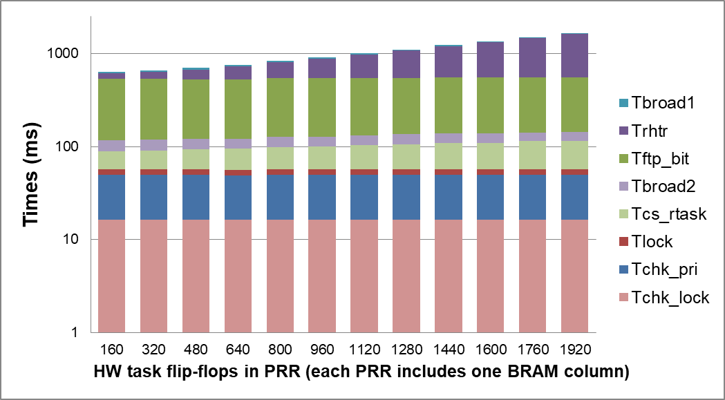
On-Chip rHTR results (2)
Start/resume execution of a PRM on a busy and unlocked remote PRR executing a lower priority PRM (T_{exe2})
Remote destination PRR has twice as many CLB columns as compared to source local PRR
T_{exe2} shows non-linear growth rate
T_{cs_rtask} depends on the LUTRAMS, BRAMs, and flip-flops of remote task
T_{rhtr} shows non-linear behavior as small-to-large PRR task relocation in HTR
T_{ftp_bit} = 412 ms as in T_{exe1}
Notes:
CS bitstreams for the preempted tasks range from 22 KB to 28.9 KB. Partial bitstreams range from 31.9 KB to 95.4 KB

Slide 22
Wrap-Up

Slide 23
Conclusions (1)
On-chip context save and restore (CSR) software effectively implements hardware multitasking over the same PRR
Autonomous, no design/system constraints
Extend on-chip CSR to implement on-chip hardware task relocation (HTR) software
Task relocation between 2-D heterogeneous PRRs
Maximize shared resource utilization on a single FPGA
Leverage CSR and HTR to implement on-chip remote HTR (rHTR) across networked PR FPGAs
Maximize PRR utilization in a network of PR-capable FPGAs
More candidate PRRs per hardware tasks

Slide 24
Conclusions (2)
CSR, HTR, and rHTR for newer FPGA architectures
CSR, HTR, and rHTR are valid for newer architectures
Portable across different FPGA architectures
rHTR application domains
Dynamic load balancing of hardware tasks across FPGAs
Distributed fault-tolerant systems
Distributed/parallel processing of HW tasks in a network of FPGAs
Experimental results on CSR, HTR, and rHTR
Most attractive for smaller PRRs
Enable system designers to determine application partitioning
Number of hardware tasks (PRMs)
PRM-to-PRR mappings (local or remote)

Slide 25
Future Work
Optimize CSR, HTR, and rHTR execution times
Use custom hardware to accelerate execution times
Replace/combine software with custom hardware
rHTR for a mixture of different FPGA architectures
Work with Zynq 7000 devices
Zedboard, Parallella boards
On line software (or hardware) scheduler for rHTR
Use configuration prefetching and reuse techniques
Hardware/software (HW/SW) migration
Execute/resume SW (or HW) task as a HW (or SW) task

Slide 26
Publications
Published (4 conference)
Morales-Villanueva, A., and Gordon-Ross, A., “On-Chip Context Save and Restore of Hardware Tasks on Partially Reconfigurable FPGAs”, 21st IEEE International Symposium on Field-Programmable Custom Computing Machines (FCCM’13), pp. 61-64.
Morales-Villanueva, A., and Gordon-Ross, A., “HTR: On-Chip Hardware Task Relocation for Partially Reconfigurable FPGAs”, 9th International Symposium on Applied Reconfigurable Computing (ARC’13), LNCS vol. 7806, 2013, pp. 185-196.
Morales-Villanueva, A., and Gordon-Ross, A., “Partial Region and Bitstream Cost Models for Hardware Multitasking on Partially Reconfigurable FPGAs”, 2015 IEEE International Parallel and Distributed Processing Symposium Workshop (IPDPSW’15), pp. 90-96.
Morales-Villanueva, A., Kumar, R., and Gordon-Ross, A., “Configuration Prefetching and Reuse for Preemptive Hardware Multitasking on Partially Reconfigurable FPGAs”, 2016 Design, Automation and Test in Europe Conference & Exhibition (DATE), pp. 1505-1508.

Slide 27

Questions?

Slide 29
Additional Slides

Slide 30
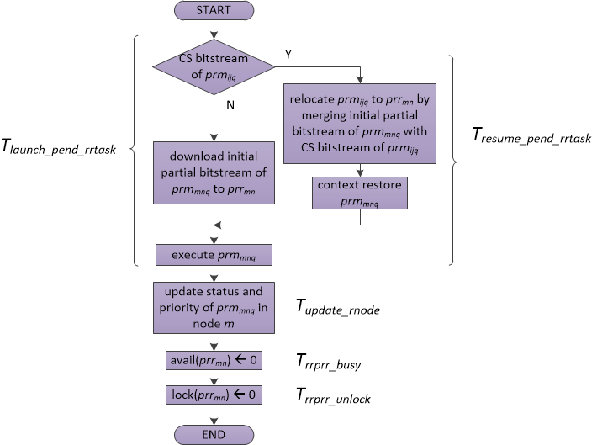
DDRM Flow: remote HTR (rHTR)
Resume execution of PRM in remote free candidate PRR
Merge CS bitstream of scheduled PRM with initial partial bitstream of PRM in remote candidate PRR
Execute CR by downloading the merged bitstream in the remote candidate PRR
Start execution of PRM for the first time in remote free candidate PRR
Download initial partial bitstream of scheduled PRM in remote candidate PRR

