Slide 1
Exploring Dynamic Partial Reconfiguration in a Tightly-coupled Coprocessor Attached to a RISC-V Soft-processor on a FPGA
Paper 150
Jairo Walber Abdala Castro and Aurelio Morales-Villanueva
College of Electrical and Electronics Engineering
Universidad Nacional de Ingeniería, Lima – Perú

Slide 2

CONTENT
Introduction
Dynamic Partial Reconfiguration in LowRISC-SoC
Reconfigurable Tightly-Coupled Coprocessor Interface
Experimental Results
Conclusions and Future Work

Slide 3

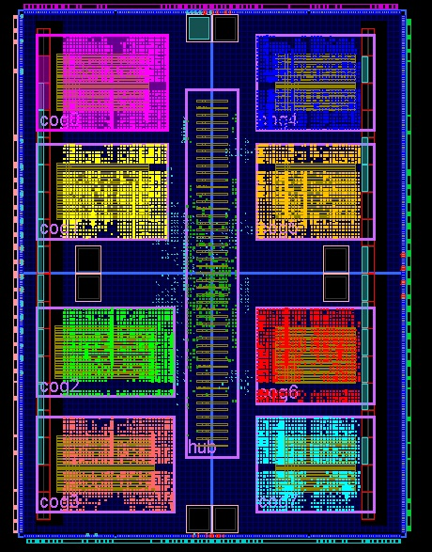
Introduction
General Purpose Processors and Reconfigurable Architectures
 | GENERAL PURPOSE PROCESSOR | RECONFIGURABLE ARCHITECTURE
PROS | Supported by a strong software layer High-level language programmability Hardware abstraction layer | Better energy efficiency, not as an ASIC Better computing efficiency, not as an ASIC Task-level parallelism
CONS | Weak hardware flexibility Low energy efficiency | Hardware level design using HDL EDA Tool required to define behavior of the HW
Dynamic Reconfigurable Processors (DRP)
Processor
Reconfigurable array
The DRP takes advantage of the hardware adaptation from:
The ease of programming of the GPP architecture.
The hardware adaptation from the reconfigurable section.
Instruction-based execution.
Reconfigurable accelerator/coprocessor to boost computing efficiency.
Control Unit
PU
PU
PU
INTERFACE
PU
PU
PU
ALU
PU
PU
PU
Fig.1.- Generic reconfigurable processor architecture

Slide 4
Dynamic Partial Reconfiguration in LowRISC-SoC
Paper Main Goals
Design and implement a Linux capable processor with a dynamic reconfigurable tightly-coupled coprocessor on a FPGA.
Main processor: based on the open-source RISC-V architecture
Adaptable to target different applications: embedded systems to high-performance computing.
Use dynamic partial reconfiguration (DPR) for the tightly coupled coprocessor
Main processor continue working while performing DPR on the coprocessor.
Coprocessor: to be used for accelerating the computations.
Challenging, since RISC-V is not supported for DPR on Xilinx FPGAs!
Complete system based in the open-source project LowRISC-SoC.

Slide 5
Dynamic Partial Reconfiguration in LowRISC-SoC (cont.)
LowRISC-SoC
Project from Cambridge University to offer an open implementation of a Linux capable system on a chip (SoC) executed in a RISC-V 64-bits core.
The complete system design is supported for different FPGA development boards.
Rocket-Chip
Project developed at the University of California, Berkeley under the open license Apache.
Implements a parameterizable RISC-V SoC generator.
The design is written in Chisel, an HDL based on the programming language Scala
Language characteristics: functional behavior, object-oriented, data inference and parameterization.
Rocket-Chip:
Core (RISC-V), L1 data and instruction caches, coprocessor, etc., organized in Tiles.
Tiles are interconnected through TileLink interfaces.

Slide 6
Dynamic Partial Reconfiguration in LowRISC-SoC (cont.)
Rocket-Chip Custom Coprocessor (RoCC)
Rocket-Tile
RoCC is a tightly-coupled coprocessor (i.e. an accelerator) added to the system, and communication between the RoCC and other elements in a Rocket-Tile is via RoCC interfaces.
Rocket: RISC-V Core
CSR: Control and Status Register
L1-I: L1 instruction cache memory
L1-D: L1 data cache memory
PTW: Page Table Walker (includes the TLB)
FPU: Floating-Point Unit
aUTL: Arbitrated Uncached TileLink
Rocket
CSR
RoCC
L1-I
L1-D
FPU
PTW
aUTL
Fig.2.- RoCC infrastructure communication

Slide 7
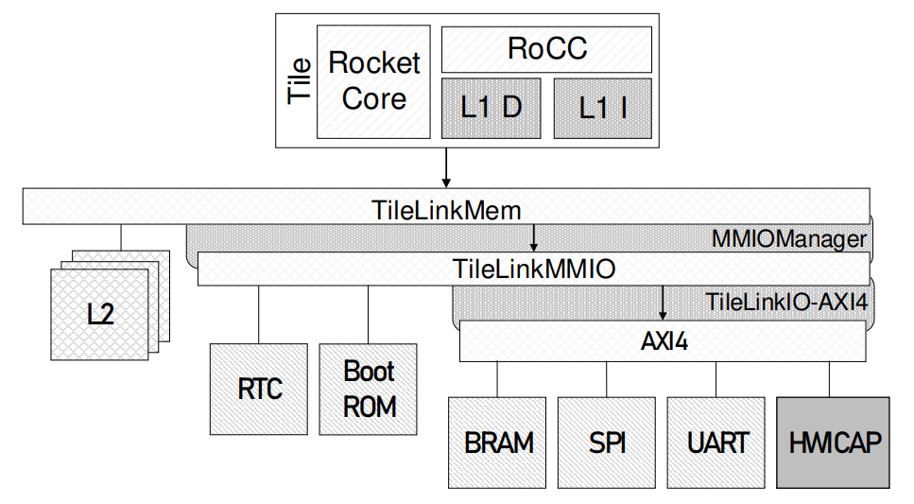
Dynamic Partial Reconfiguration in LowRISC-SoC (cont.)
Reconfiguration Controller
Used for DPR, controlled by a RISC-V SoC and implemented in a Xilinx FPGA.
Xilinx FPGAs require the Internal Configuration Access Port (ICAP) for DPR.
For SoC systems, the ICAP must be connected to AXI4 bus.
The AXI-HWICAP adds a hardware wrapper that enables a configurable data transfer system to the ICAP and compatible with the AXI interface.
Hardware
The LowRISC-SoC project includes adaptations to the AXI interface:
TileLinkMem, for cache-coherent memory access.
TileLinkMMIO, for communication to I/O memory mapped devices.
The HWICAP is generated and connected as an AXI4 Slave.
Fig.3.- AXI-HWICAP connection

Slide 8
Dynamic Partial Reconfiguration in LowRISC-SoC (cont.)
Reconfiguration Controller (cont.)
Software
In order to get access to the HWICAP in Linux, a mechanism to transfer the hardware information to the operating system has to be configured:
The HWICAP information is stored in the BootROM:
Role of the first-stage bootloader for transferring the hardware information.
Architectures other than MicroBlaze and ARM are not officially supported by Xilinx for DPR.
The HWICAP is only intended to work with MicroBlaze.
Official Linux driver is compatible with OPS HWICAP and the XPS HWICAP.
OPS HWICAP and XPS HWICAP: old interface IP cores.
The Linux driver for the HWICAP has to be adapted with changes in:
The internal FIFOs manipulation to control the data transfers.
The platform information to match the hardware name in the Configuration String (Device-tree).

Slide 9
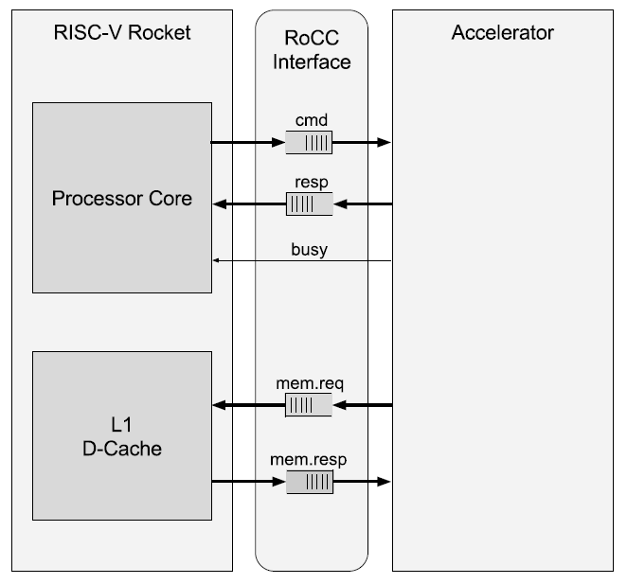
Tightly-Coupled Reconfigurable Coprocessor Interface
The reconfigurable coprocessor (i.e. accelerator) is attached to the Rocket Core via the RoCC Interface.
The data is transferred to/from the coprocessor using the custom instructions format in the RISC-V specification.
Linux custom instructions for RoCC
The RoCC accelerator starts working upon a RISC-V custom instruction execution.
To enable the custom instructions execution in the operating system, the XS field in the mstatus CSR has to be configured and reinitialized in every context switch.
The reconfigurable coprocessor lacks of a context-save system, so it is only suitable for mono core systems.
Fig.4.- Interaction between RISC-V and the custom accelerator

Slide 10
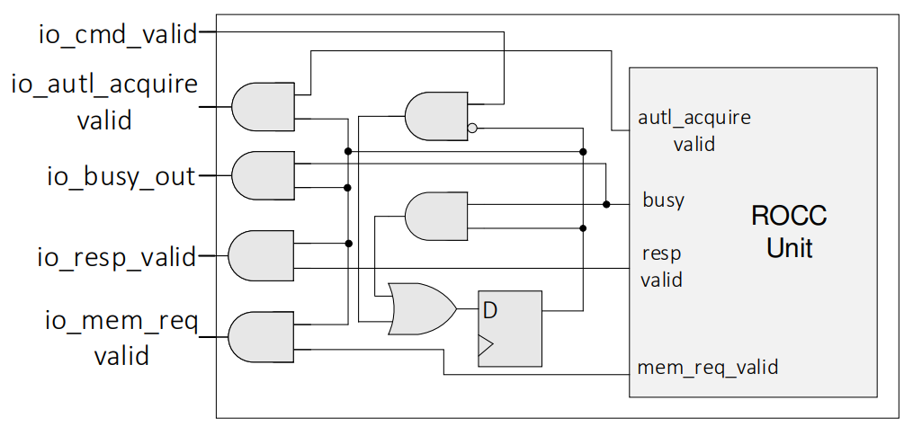
Tightly-Coupled Reconfigurable Coprocessor Interface (cont.)
Decoupling Stage
The accelerator is implemented in a partially reconfigurable region (PRR) on the FPGA.
During the reconfiguration time, the input/output signals of the PRR may get random levels.
Unpredictable behaviors in the system:
Caused by the valid signals asserted before time.
Can initiate a data transfer between the different elements of the processor and the RoCC Unit.
A decoupling stage is added to the PRR:
Valid signals can only be asserted after a custom RoCC instruction is issued from the processor.
Fig. 5.- Decoupling system
io_cmd_valid: from the core
io_busy_out: to the core
io_resp_valid: to the core
io_mem_req_valid: to the L1-Data cache memory
io_autl_acquire_valid: to the TileLink interface

Slide 11
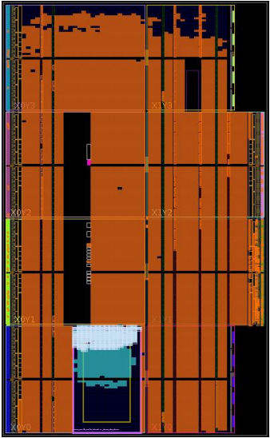
Experimental Results
Testing Setup
Nexys 4-DDR development board:
Xilinx XC7A100T-1CSG324C Artix-7 FPGA and 128 MB DDR2 RAM.
System clock frequency: 25 MHz
16 KB L1 Data cache, 16 KB L1 Instruction cache
Xilinx Vivado 2015.4
Linux kernel version 4.6.2
The system was tested with the following accelerators and adapted to the RoCC interface:
128-bit Advanced Encryption Standard (AES) – Encryption
128-bit Advanced Encryption Standard (AES) – Decryption
64-bit Data Encryption Standard (DES) – Encryption
64-bit Data Encryption Standard (DES) – Decryption
Fig. 6.- FPGA floorplanning with AES encryption accelerator

Slide 12
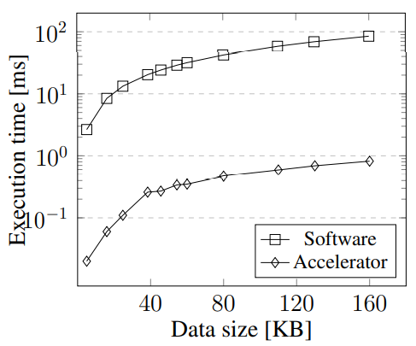
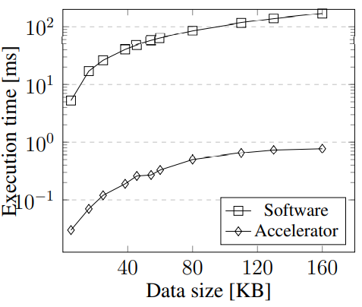
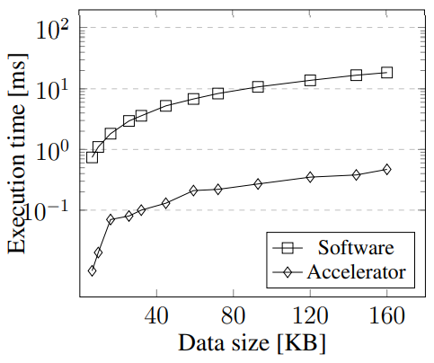
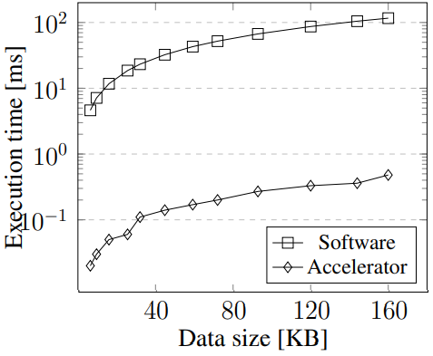
Experimental Results (cont.)
Resources, Execution Times and Speedup
ACCELERATORS | SLICE LUTs |  |  | SLICE REGISTERS
 | # | PRR | TOTAL | # | PRR | TOTAL
DES Encryption | 1574 | 26.23% | 2.48% | 196 | 1.63% | 0.15%
DES Decryption | 1765 | 29.41% | 2.78% | 198 | 1.65% | 0.15%
AES Encryption | 1649 | 27.48% | 2.60% | 196 | 1.63% | 0.15%
AES Decryption | 1769 | 29.48% | 2.79% | 679 | 5.66% | 0.53%
ACCELERATORS | AVERAGE SPEEDUP
DES Encryption | 102.56
DES Decryption | 200.27
AES Encryption | 41.67
AES Decryption | 249.91
Average reconfiguration time: 151ms
DES Encryption
DES Decryption
AES Encryption
AES Decryption

Slide 13
Conclusions and Future Work
Conclusions
Successful implementation of tightly-coupled accelerators for a RISC-V SoC using DPR on a FPGA.
First implementation (to the best of our knowledge) of DPR based on a RISC-V SoC in a Xilinx FPGA.
Reduced execution times of the encryption/decryption algorithms executed in the tightly-coupled accelerator, compared to pure software implementations.
DPR of the accelerator allows the system to use less FPGA resources in comparison to a full static design.
Future Work
Extend and improve the software and hardware support (BRAMs and DSPs) to manage the coprocessor switching process.
Reduce the reconfiguration time of PRR using techniques such as configuration prefetching and reuse.
Explore the use of multiple accelerators for a RISC-V Rocket Chip project.

