Slide 1

HTR: On-Chip Hardware Task Relocation for Partially Reconfigurable FPGAs
Aurelio Morales-Villanueva and Ann Gordon-Ross⁺
Department of Electrical and Computer Engineering
University of Florida, Gainesville, Florida, USA
⁺ Also Affiliated with NSF Center for High-Performance Reconfigurable Computing
This work was supported by National Science Foundation (NSF) grants EEC-0642422 and IIP-1161022, and Programa de Ciencia y Tecnología (FINCyT) under contract 121-2009-FINCyT-BDE

Slide 2


Introduction
Multitasking in modern systems
Software tasks: implemented in microprocessors
Hardware tasks: implemented in field-programmable gate arrays (FPGAs)
Task management requirements in any multitasking system
Task scheduling
Mechanism to begin task execution on a system resource
Task suspension
Preempt task and saving execution state --- context save (CS)
Task switching
Replacing preempted task with another task
Task restoration
Resume preempted task from saved state --- context restore (CR)
Task
Task
Task
A
B
C
A
B
C
A
B
time
time
time
T₁
T₂
T₃
T₄
T₅
T₆
T₁
T’₂
T₃
T’₄
T₅
T’₆
T₁
T’₂
T₃
T’₄
T₇

Slide 3
Context Switching Analogy
Processor Context Switch
FPGA Context Switch
uP
FPGA
Software task 1
Region 1
Stack
Hardware task 1
OS
+
MMU
Software task 2
uP or
custom HW
Region 2
Hardware task 2
Region 3
Hardware task N
Software task N
Multiple tasks execute concurrently
Multiple regions time multiplex tasks
Use context save and context restore for task switching
Task relocation
Challenging!
Leveraging partial reconfiguration can be advantageous…
One task executes at a time
Time multiplex tasks
One stack for all tasks
Stack saves context for task restore
No task relocation
No reconfiguration of uP

Slide 4
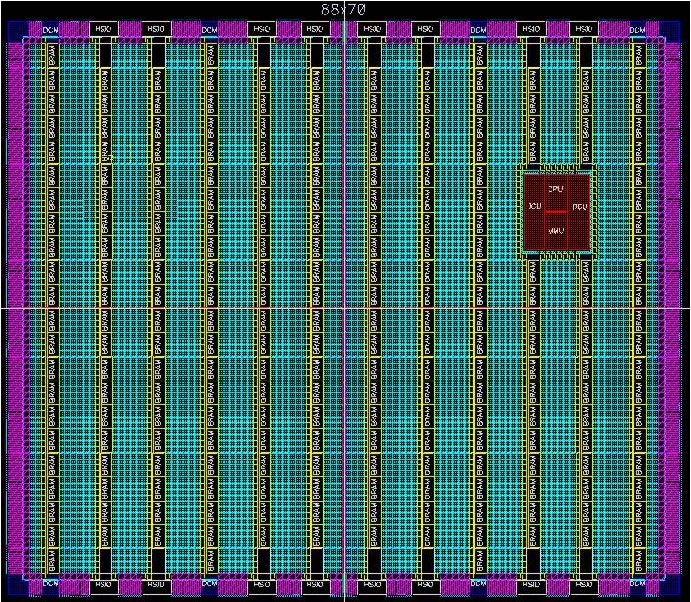
Reconfiguration on FPGAs
Benefits to system designers and functionality
Run-time hardware adaptation via time multiplexing of resources
Reduced area/power requirements
Two types of reconfiguration: Full and partial reconfiguration
Full reconfiguration:
Entire FPGA configured with full bitstream with fixed hardware task set
Reconfiguration halts all tasks --- lengthy task switching time
No context save/restore ofhardware tasks --- tasks restart execution
Unless state can be saved via checkpoint of data capture
HW task C1
HW task B1
HW task A1
HW task C2
HW task B2
HW task A2
Full bitstream 1
Configuration Port
Full bitstream 2
Execution and state of all tasks is lost during full reconfiguration!

Slide 5
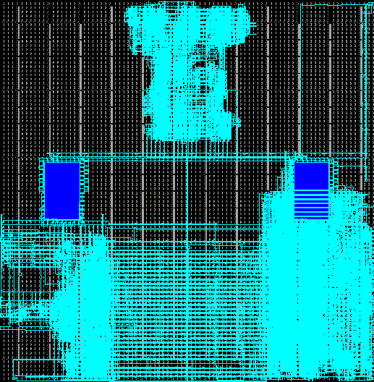
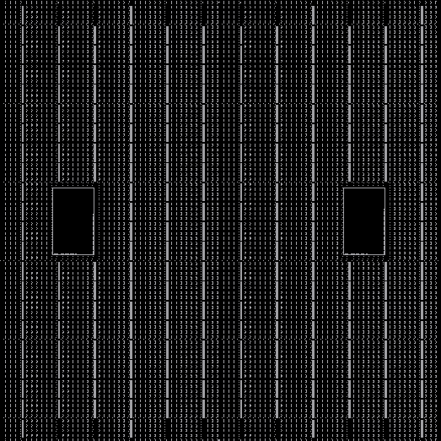
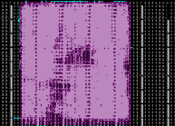
Partial Reconfiguration (PR)
PR divides the FPGA fabric into two regions
Static region: fixed functionality, never reconfigured after initial configuration at startup
Reconfigurable region: multiple PR regions (PRRs)
PRRs execute PR modules (PRMs) (hardware tasks)
ICAP
Module A
Module B
Embedded
processor
Module C
Mem Controller
Module D
PR compared to full reconfiguration
Dynamic, on-the-fly PR of individual PRRs
No interruption of static region or other PRRs!
Uses partial bitstreams --- smaller than full bitstreams
Faster reconfiguration time
*May* require a bitstream for each PRM-to-PRR mapping
Static region
Reconfig. region
Increased flexibility
Increased task throughput/performance
Enhances hardware multitasking
Requires context save and context restore for effective task switching
Configuration
Overhead
Reconfiguration
Overhead
Function
Static region operation
Power On
Time

Slide 6
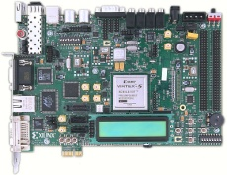

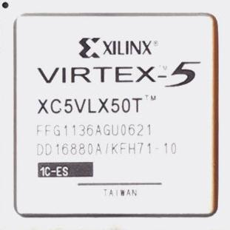
Previous Related Work
Context save and restore (CSR)
Over the same PRR using:
Off-chip CSR software
Requires external host (e.g., CPU)
Lengthy communication overhead
On-chip CSR hardware
Device overhead, limited portability
No task re-execution after context restore
Bitstream relocation (BR)
Eliminates per-PRR bitstream requirement
Off/on-chip BR over homogeneous PRRs
Same shape/resources, different FPGA fabric locations
Does not save/restore task’s context
Re-execution of relocated task required
No relocation over heterogeneous PRRs
reconfigure
reconfigure
context save
context save
context restore
task’s context
task’s context
custom
HW
custom
PRMs
homogeneous
PRRs
reconfigure
reconfigure
relocate +
reconfigure
PRMs

Slide 7
Motivations
Improvements over off-chip context save and restore (CSR) software
Eliminate external host requirement --- autonomous
Eliminate communication overhead between FPGA and external host
Improvements over on-chip context save and restore (CSR) hardware
Eliminate custom hardware requirement and area overhead
Eliminate portability limitations
Improvements over bitstream relocation (BR)
Enable task relocation over heterogeneous PRRs
Eliminate task re-execution requirement

Slide 8
Contributions
On-chip hardware task relocation (HTR) software
Relocation of hardware tasks over heterogeneous PRRs
PRRs with different shape, resources, locations on the FPGA fabric
Relocation of hardware task context
Task’s execution state is preserved --- no re-execution
HTR benefits
Maximizes shared resources utilization
Reduces idle PRRs --- PRMs can run in any available PRR*
Maximizes task throughput
Improves task scheduling performance
Preemption and resumption of tasks in different PRRs
Priority considerations
Eliminates lengthy re-execution time of relocated preempted tasks
* Some restrictions apply, but are addressed in our current/future work

Slide 9
Hardware Task Relocation (HTR)

Slide 10
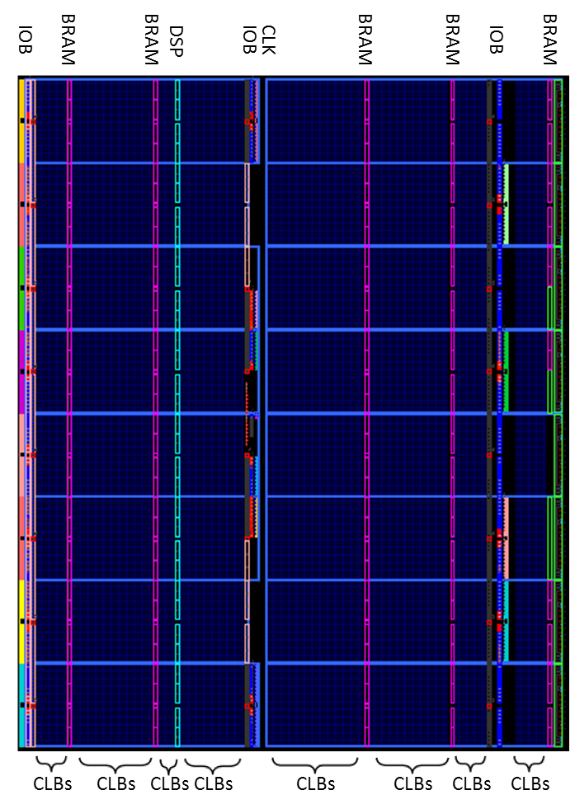


HTR Operation
Resume
Operation
Main HTR software steps
Initialize static region and PRRs
Initial configuration of tasks in all PRRs
Context save (CS)
Save the execution state of the preempted hardware task
Task relocation (TR)
Generation of a “merged bitstream” of relocated task
Context restore (CR)
Resume execution of preempted task in another PRR
M1
PRR1
M2
PRR1
Task
Relocation
Resume
Operation
M5
PRR2
Task
Relocation
Still Busy
M4
PRR2
Still Busy
Context
Save
Context
Save
M3
PRR3
M5
PRR3
Use initial
partial bitstream
Context
Restore
M2
PRR4
M6
PRR4
Use initial
partial bitstream
Context
Restore

Slide 11
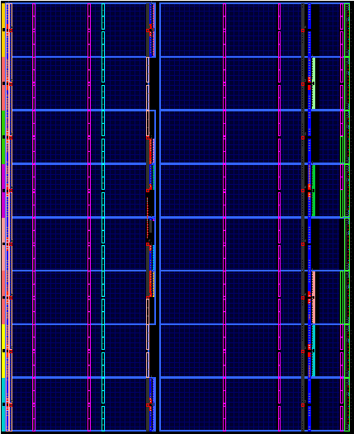

HTR Flow Chart
Example system
Reconfiguration of PRR1 with PRM1
T_{reconfig_PRR}
PRM
1
PRM
2
Initialization
Enable FPGA protection
T_{protect_FPGA}
Initial conditions
Executing PMR3
Execute PRM2
N
PRR1
PRR2
Context save and restore (CSR)
Y
Hardware task relocation (HTR) of PRM2 on PRR2
Y
N
PRR1 free or ⬇priority PRM
PRM2 executed in PRR1
and saved the context
T_{CS1}
Context save of PRM1
Context save of PRM3
T_{CS2}
T_{merge}
Merge saved context of PRM2 with initial bitstream of PRM2
Saved context relocation of PRM2 in PRR2
T_{relocate}
T_{CR1}
Context restore of
PRM2 on PRR1
Context restore of PRM2 on PRR2
T_{CR2}
Merged PRM2
PRM2
PRM3
Execute PRM2 on PRR1
Execute PRM2 on PRR2

Slide 12
Experimental Results

Slide 13
Experimental Setup
Virtex-5 LX110T on Xilinx ML509 board
Two reconfigurable regions (PRRs)
Contain configurable logic block (CLB) resources (flip-flops)
Heterogeneous sizes and FPGA fabric locations
Task relocation cases
Small-to-large PRR task relocation
Large-to-small PRR task relocation
Source PRR = PRR with task’s saved context
Destination PRR = PRR with task’s relocated context
Restrict test cases for tractability
Large PRR = 2x (number of columns and frames of small PRR)
Number of flip-flops used by the task are the same for all PRR sizes
Notes:
For the purpose of HTR, two PRRs have different locations in the FPGA fabric.
There are two cases for relocation: from small-to-large PRR or from large-to-small PRR
The third case is not interesting: same-size PRR relocation
Since there are so many combination (I think 144 for consecutive CLB columns) to perform a task relocation (in terms of sizes between two PRRs), I reduced the experiments (went down to 12) by having the large PRR with double (2x) the number of columns of the small PRR.
Since we covered only CLBs, doubling the number of columns in the large PRR, also doubles the number of frames.

Slide 14
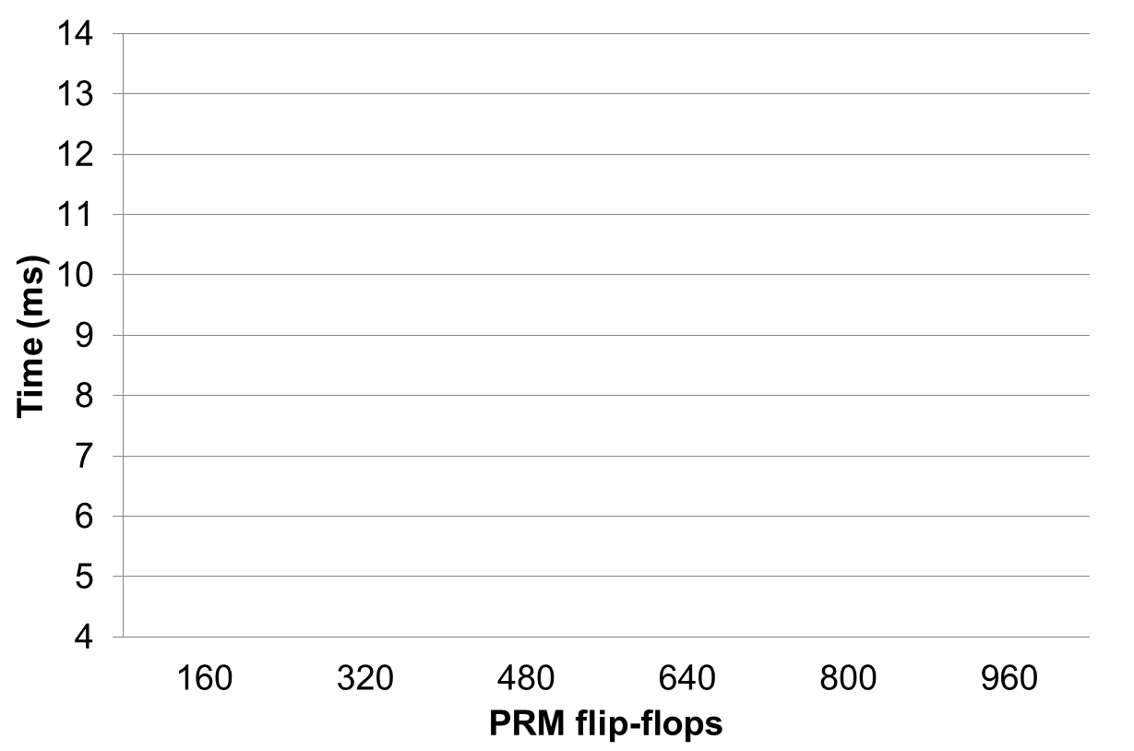
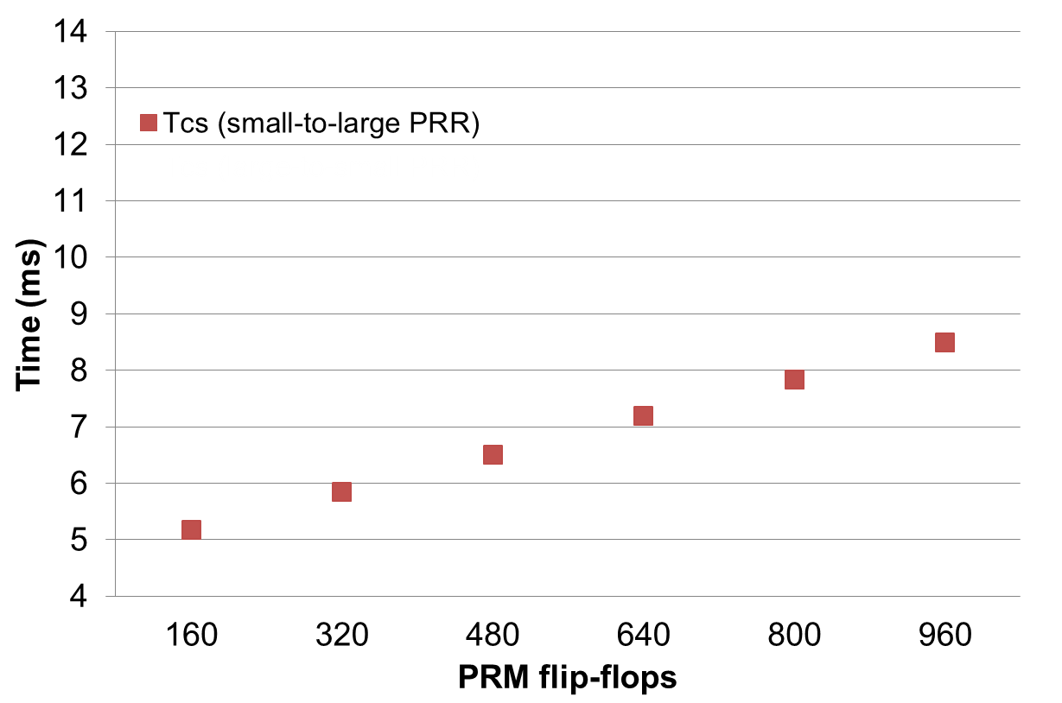
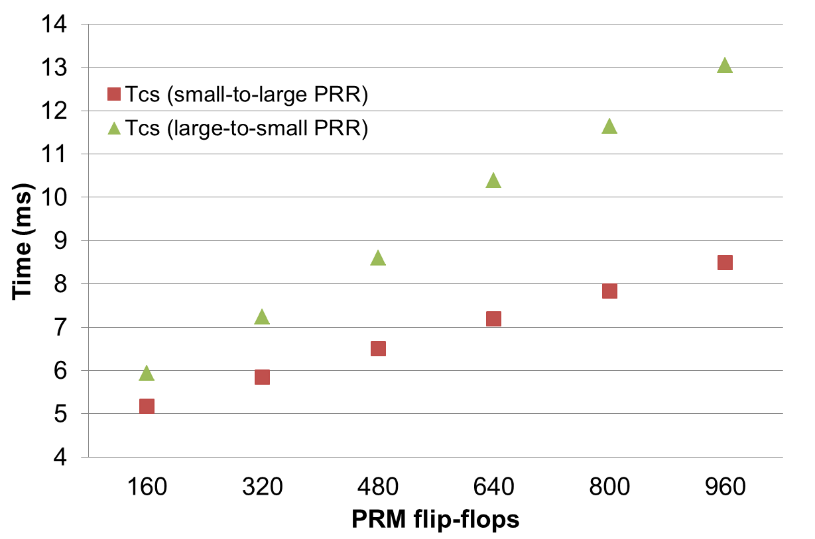
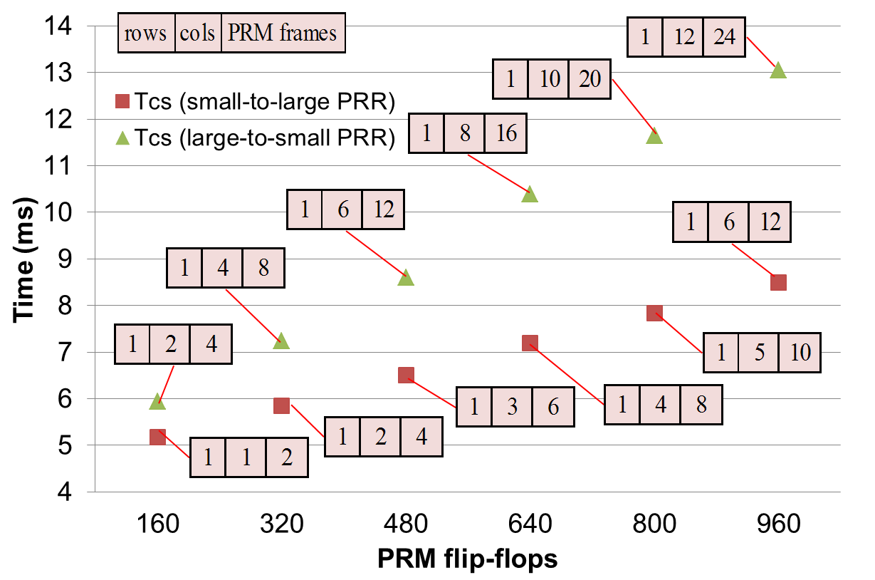
Results – Context Save (T_{CS})
(per column)
Context save time shows linear growth rate
Dependent on the number of PRM frames in the source PRR
Notes:
Number of FFs per column

Slide 15
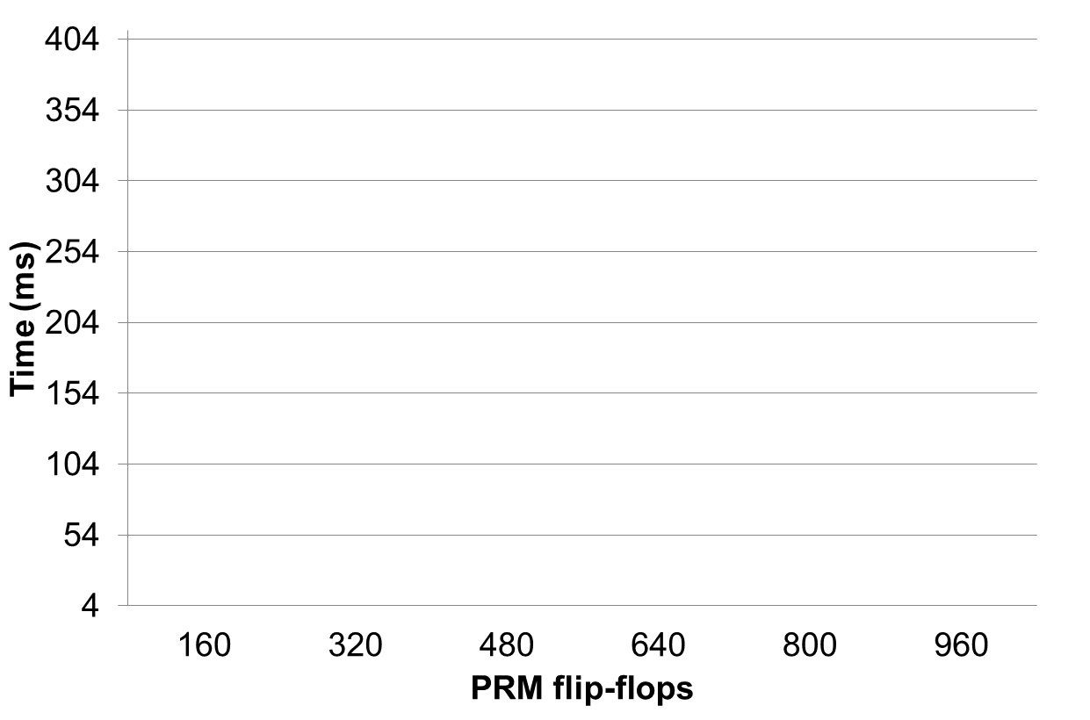
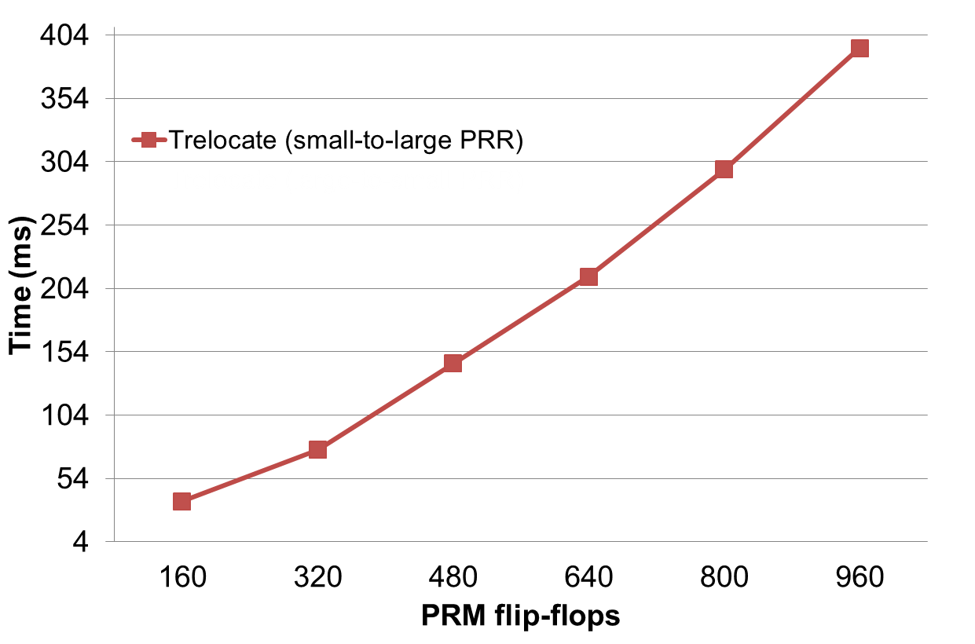
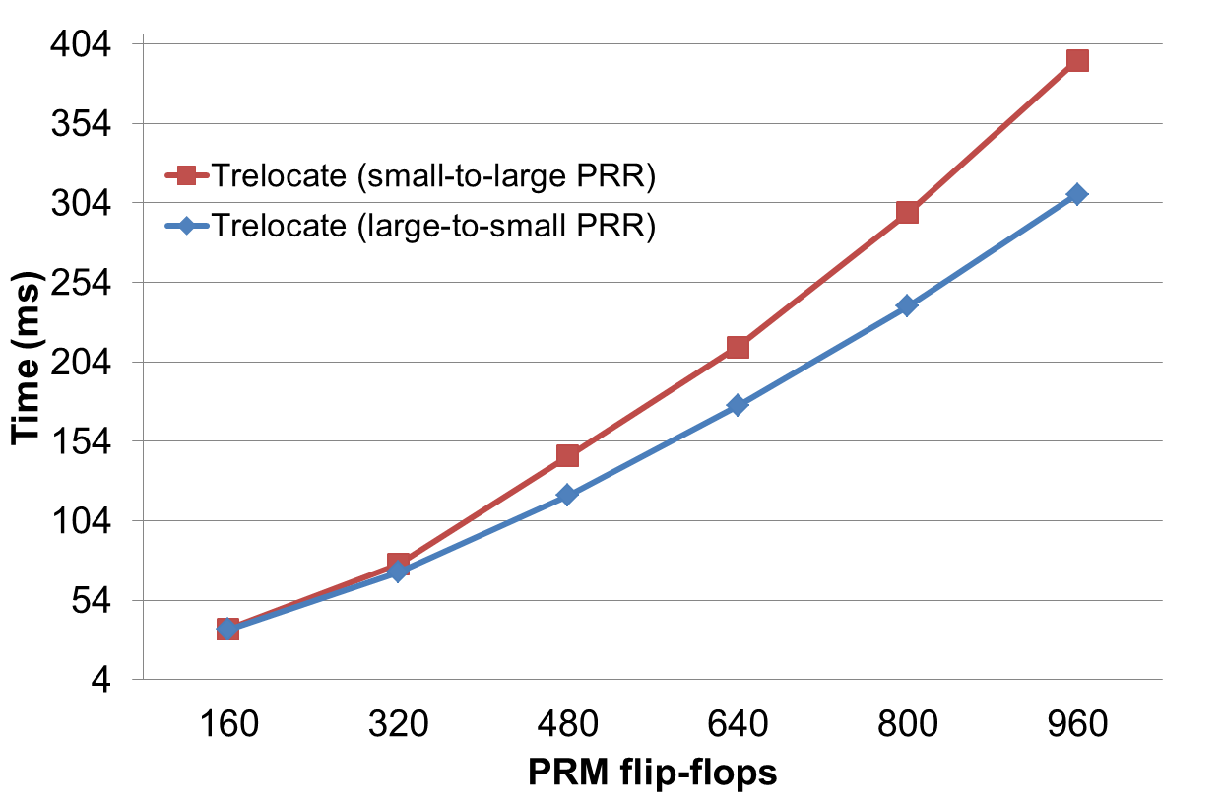
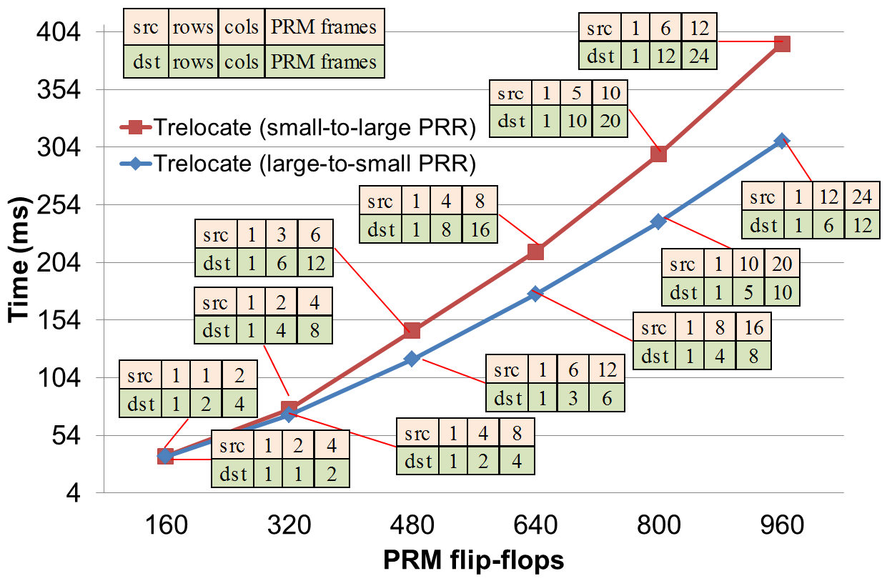
Results – Task Relocation (T_{relocate})
Task relocation time shows non-linear growth rate
Random access pattern to saved context and merged bitstreams
High data cache misses and overheads accessing data from SDRAM
Dependent on the number of PRM flip-flops to be relocated

Slide 16
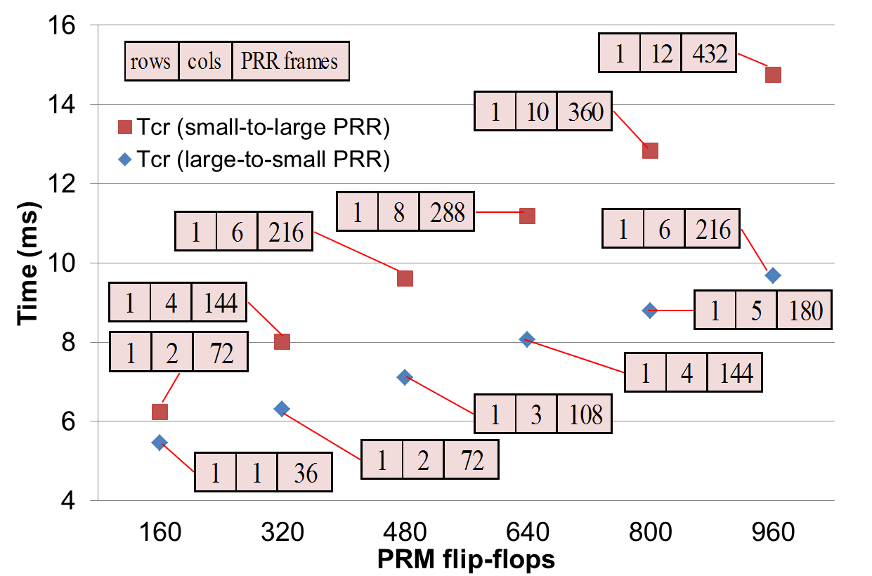
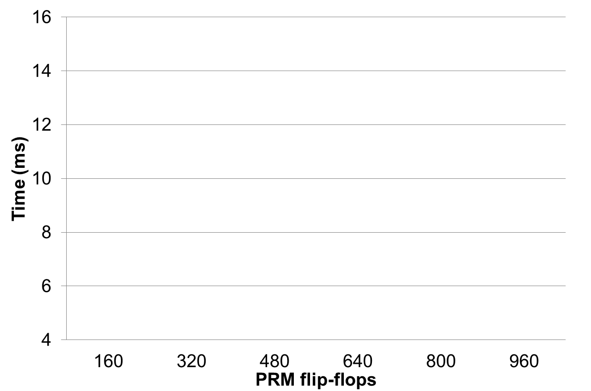
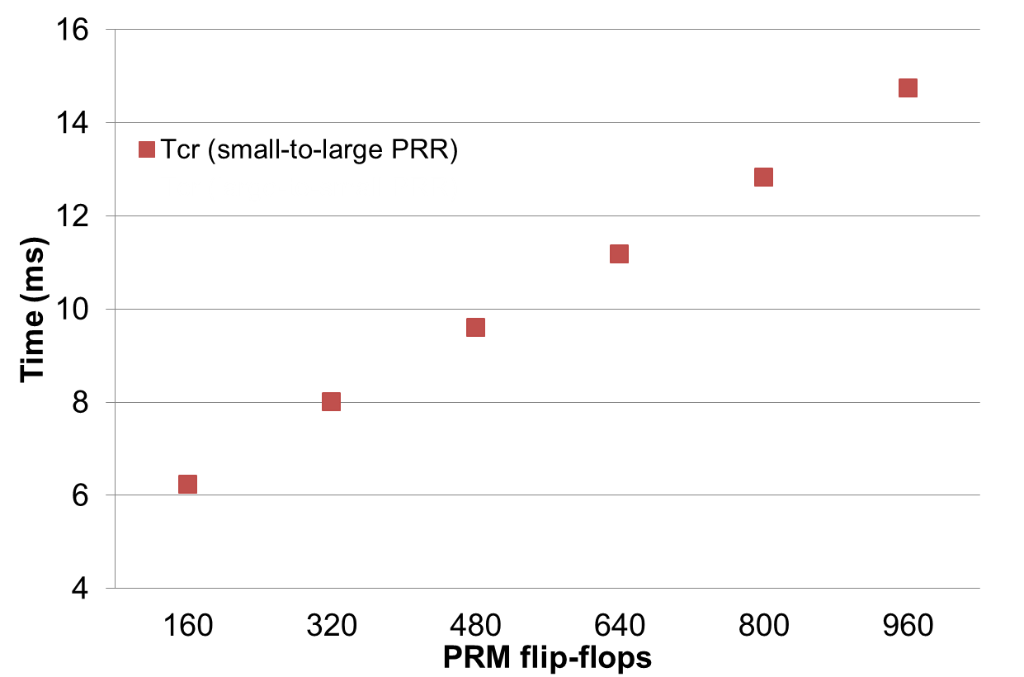
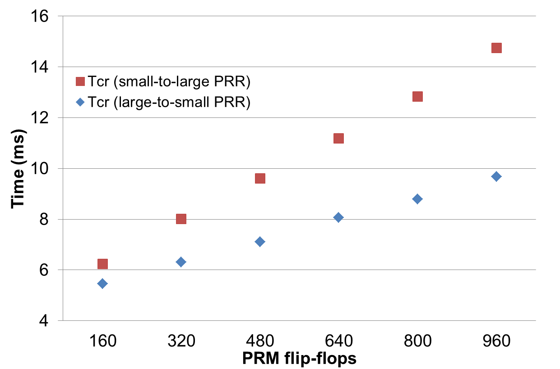
Results – Context Restore (T_{CR})
Context restore time shows nearly linear growth rate
Dependent on the number PRR frames in the merged bitstream (destination PRR)
Context restore time is larger than PRR reconfiguration time (T_{reconfig_PRR})
Unprotection and protection of destination PRR

Slide 17
Conclusions
Introduced on-chip hardware task relocation (HTR) software
Task relocation between heterogeneous PRRs
Maximizes shared resource utilization
No off-chip communication overhead
No design/system constraints
Application/system independent
Aids system design
Enables designers to tradeoff HTR execution times and task/PRR granularity
Future work
Extend HTR’s functionalities
Include DSP, BRAM, and IOB resources in PRRs

Slide 18

Questions?

