Slide 1
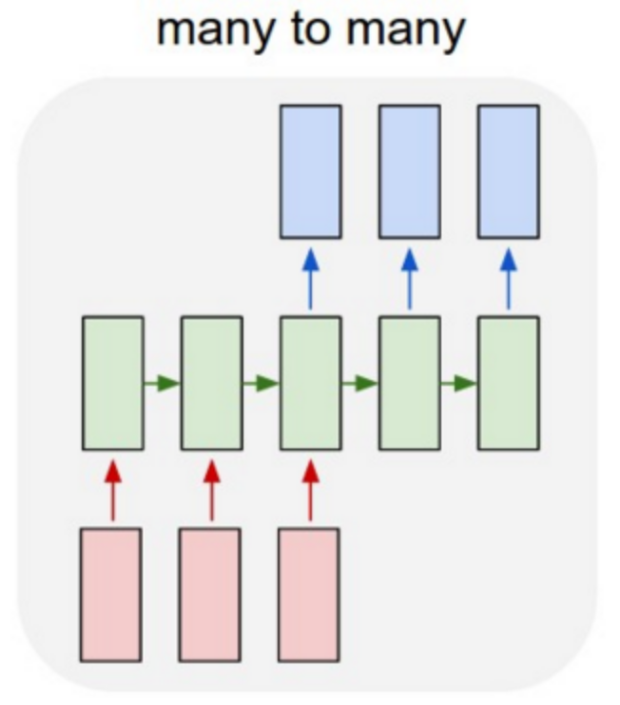
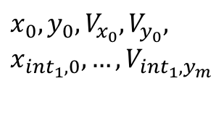

$$x_{10},y_{10},V_{x_{10}},V_{y_{10}}$$
hidden size= 128
Nb of layers = 2
$$x_{0},y_{0},V_{x_{0}},V_{y_{0}}, x_{{int}_{1},0},…,V_{{int}_{1},y_{m}}$$

