Slide 1
Dear participant,
You are about to participate in a study that was designed to examine your ability to evaluate the emotional response of faces expressing emotion.
You will first go through a short instructions session, then complete a short practice round, and then participate in the actual experiment.
Please follow the instructions carefully.

Slide 2
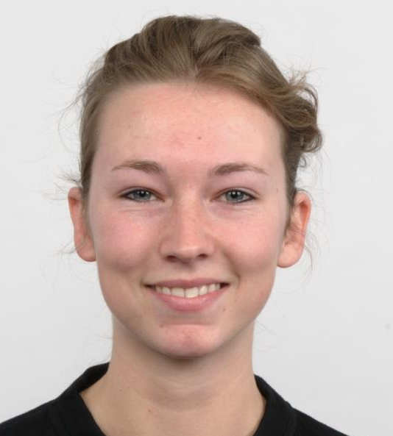
The goal of this study is to examine whether people can estimate the emotional expression of faces. In each trial, a face expressing various degrees of emotions will appear on the screen. The face may either be expressing positive or negative emotions. The face will be on the screen for a brief moment. In order to take all the ratings in, try to focus your attention on it as much as possible.

Slide 3
​Following the face, you will be asked to move the mouse left of the line to begin the rating phase
Move mouse left of the line to begin

Slide 4
​A face will then appear on the screen. When you move your mouse, the face will change from being neutral to expressing emotion By adjusting your mouse, you are asked to replicate the emotional response of the face you just saw.

Slide 5
Remember, the goal here is provide
YOUR ESTIMATION OF THE EMOTIONAL RESPONSE
of the face you just saw.

Slide 6
Once you make the choice, the page will switch to the next trial.

Slide 7
At the next stage, you will conduct a short practice run to make sure that the task is clear.
Remember – the goal is to ESTIMATE THE EMOTIONAL RESPONSE of the of the face you just saw.

Slide 8
Thank you for completing the practice stage.
Remember – the goal was to ESTIMATE THE EMOTIONAL RESPONSE of the face you just saw.
In the following section you will complete the actual study, which consists of 50 trials. The task should take 5 minutes, more or less.
Click ‘Continue’ to begin the actual task.

Slide 9
You've completed the task.
Thank you for your participation.
The next section is a short survey (up to 5 min).

