Slide 1

Taking FOSS
to the newsroom
Journalists collaborating with developers
Video: Internews Data Journalism program

Slide 2

Internews is a media development organisation.
Through trainings and mentorship we empower local media to give Kenyans the news and information they need.

Slide 3
Projects related to FOSS
Data journalism fellowship
Data Dredger: a data portal for Kenyan journalists and for mentoring aspiring data journalists

Slide 4
Why do journalist need developers help?
Journalists are good at mining data and finding story angles.
But they do not know how to visualize the data and make it interactive online.
Online news platforms readers want to explore the data of the stories through news apps.

Slide 5
Developers + Designers
Developers have the technical skills to build applications and platforms.
Designers have the visual mindset to transform data into visual representation and illustrate information and processes.
Together they can produce user friendly apps and platforms that are clear and communicative.

Slide 6
Case studies:
1.Change for Health - news app
2. Unsafe abortions - calculator
3. Landquest - portal

Slide 7
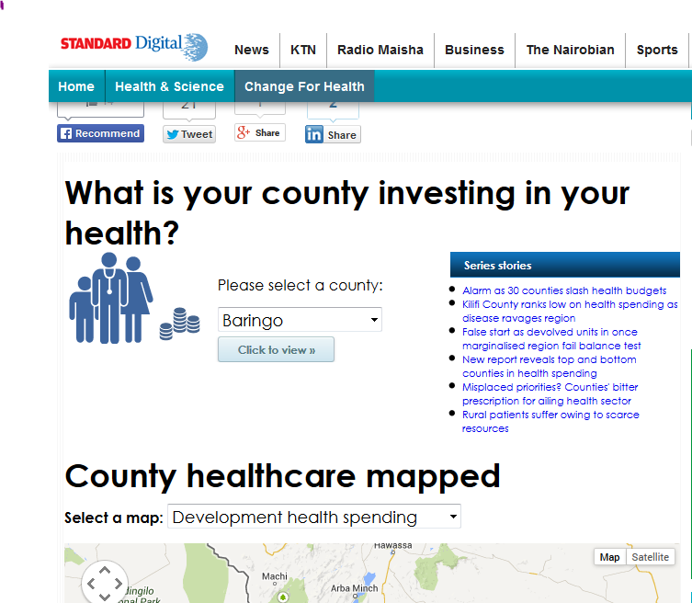
1.Change for Health -news app
Link to news app
This is an app that depicts the amount spent by each county on health.
Notes:
Just at a click, it helps county residents visualize the importance county leaders are giving to health.
-Shows how health care spending, access to healthcare professionals and facilities compare to other counties.

Slide 8
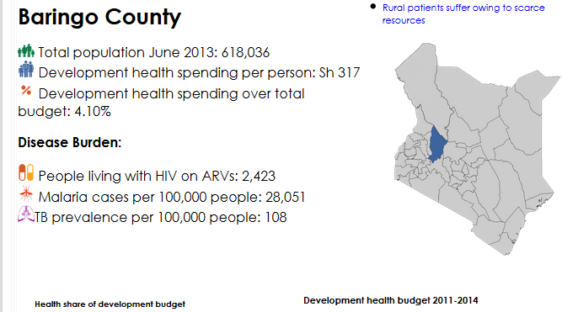
Just at a click,
it provides an overview of the county.
Residents can see if the county leaders are prioritising health.

Slide 9
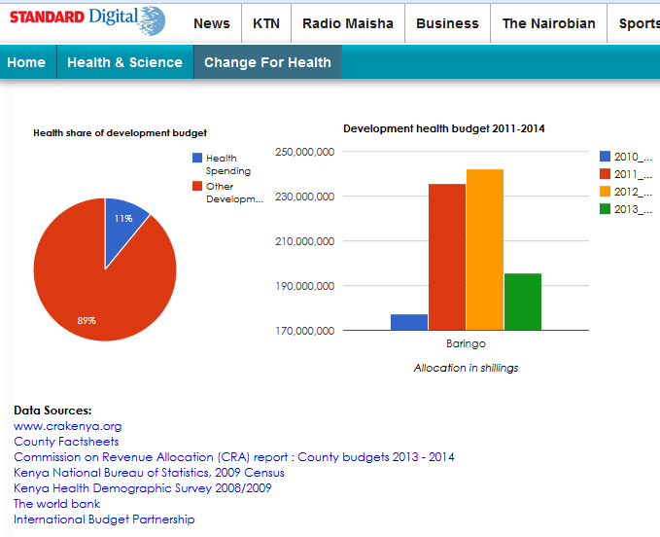
It visualize each county’s data in interactive pie and bar charts.
The application is planned to be updated annually as county budget data becomes available.

Slide 10
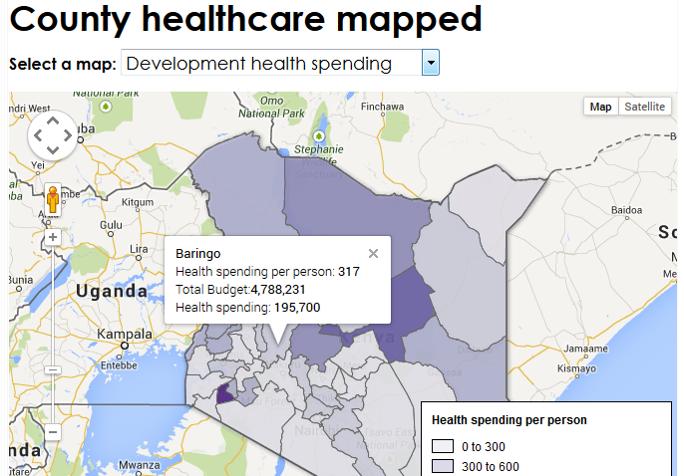
Several google maps provides a second way of viewing some of the data.

Slide 11
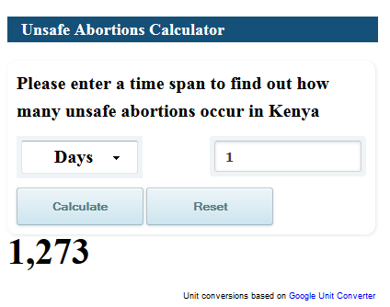
2. Unsafe Abortion Calculator
Link to calculator
Lets the reader explore the number of unsafe abortions procured in Kenya by seconds, minutes, hours or days.

Slide 12
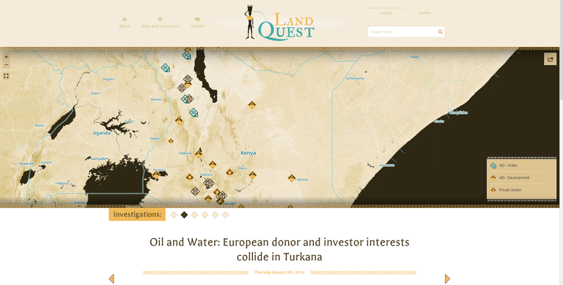
3. LandQuest - portal
Link to LandQuest
Open tools used
Languages: PHP + JS
Database engine: MySQL
Data cleaning: Open Refine/Excel
landquest.internewskenya.org
Source code: https://github.com/oeco/landquest-jeo-child

Slide 13
Thank you
James Ratemo | @kenyacurrent
Digital Media Trainer @InternewsKE
jratemo@internews.org
Aurelia Moser | @auremoser
Fellow @Ushahidi + @InternewsKE
aurelia@ushahidi.com

