Slide 1

Taking FOSS to the Newsroom
A Case Study of News Apps
James Raterno | Internews Kenya
Aurelia Moser | Open News Fellow
Notes:
Not partial to images, just put in ones that showed up on google for “Internews + Health”

Slide 2
Intro to Internews

Slide 3
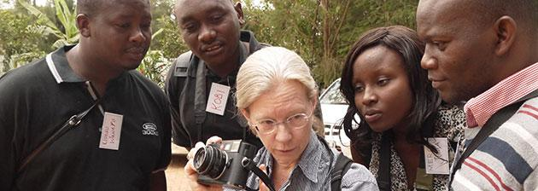
Internews
[:Misson:]
to empower local media worldwide to give people the news and information they need, the ability to connect and the means to make their voices heard
Notes:
Internews is an international non-profit organization whose mission is to empower local media worldwide to give people the news and information they need, the ability to connect, and the means to make their voices heard.

Slide 4
Internews
[:Serving:]
90 countries worldwide
[:Providing:]
training programs that will prepare journalists
to mine data
to identify patterns
to investigate trends
to highlight development needs in their countries
Notes:
We’ve worked in over 90 countries, so we have the local media knowledge to tailor training programs that will prepare journalists to mine data, identify patterns, and investigate the reasons behind these trends to cast a spotlight on development needs in their countries

Slide 5

Internews in Kenya
[:Projects:]
Data journalism fellowship
Data Dredger: a data portal for Kenyan journalists and for mentoring aspiring data journalists
Featured projects!
Notes:
Internews in Kenya has pioneered data journalism in Kenya through its data journalism fellowship, the Data Dredger, a data portal for Kenyan journalists and mentoring aspiring data journalists. These are some of our featured projects.

Slide 6

Focus on Health
Public health
Socio-economic development
Extractive industry and sustainability
Notes:
Our featured projects will focus on these thematic areas, all of which generally pertain to the “health,” economic or medical, of Kenya.

Slide 7
Featured Projects

Slide 8
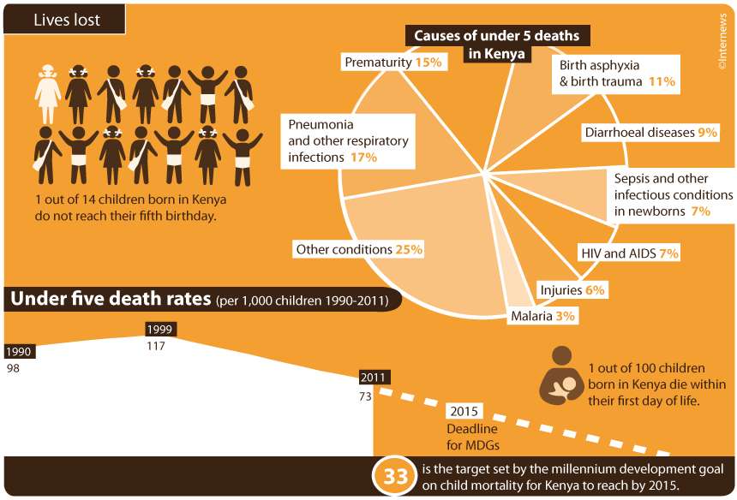
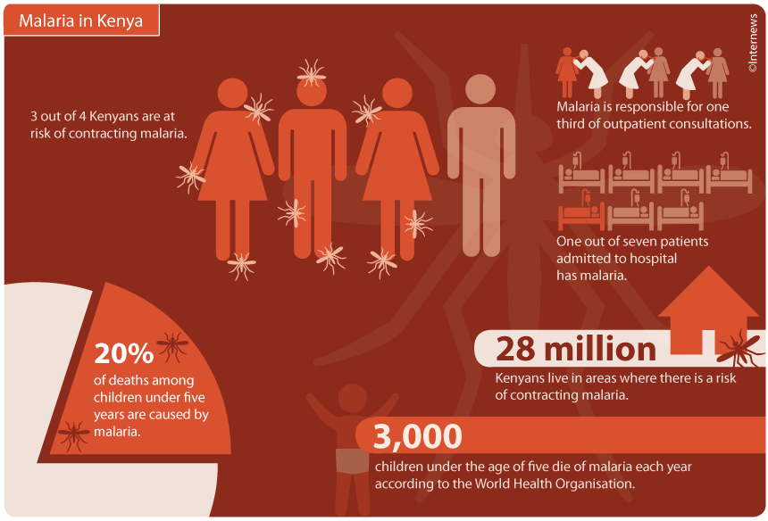
Change for Health
Notes:
Change for Health is an application that depicts the amount spent by each county on health. Just at a click, it helps county residents visualize the importance county leaders are giving to health and how healthcare spending, access to healthcare professionals and facilities compare to other counties.

Slide 9
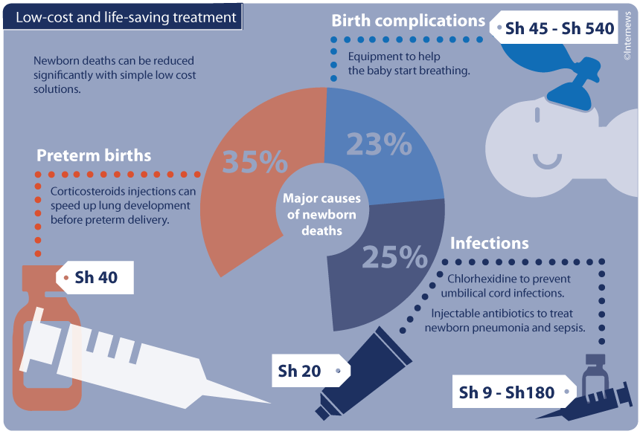
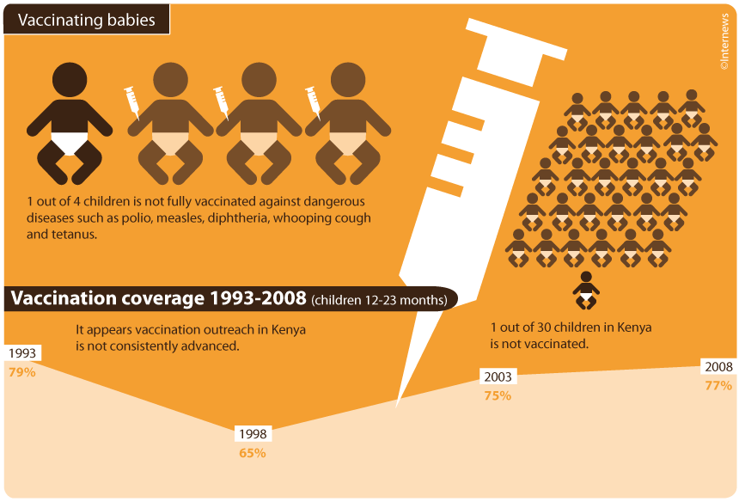
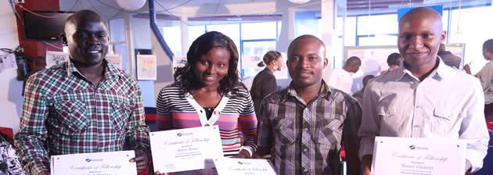

Slide 10
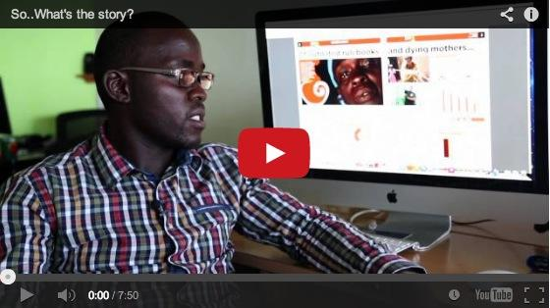
Link to video
Unsafe Abortions Calculator
Notes:
Unsafe Abortions Calculator shows the number of unsafe abortions procured in Kenya by second, minute, hour or day. The data from which the applications were derived was scraped and packaged using open source tools.

Slide 11
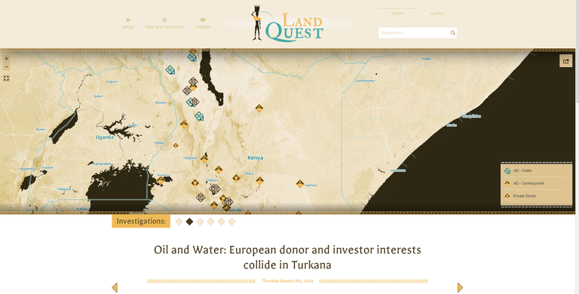
landquest.internewskenya.org
LandQuest
Notes:
Land Quest is an experiment in cross-border investigative journalism that uses geo-located data and stories to illustrate barriers to development in Kenya.
Mapping development and private sector stories and data help people visualize the interplay between capitalism and altruism and its impact on wealth and inequality. The geo-narratives mapped alongside development projects and private industry underscore the relationship between people, data and the politics of development.

Slide 12
Internews Onward

Slide 13
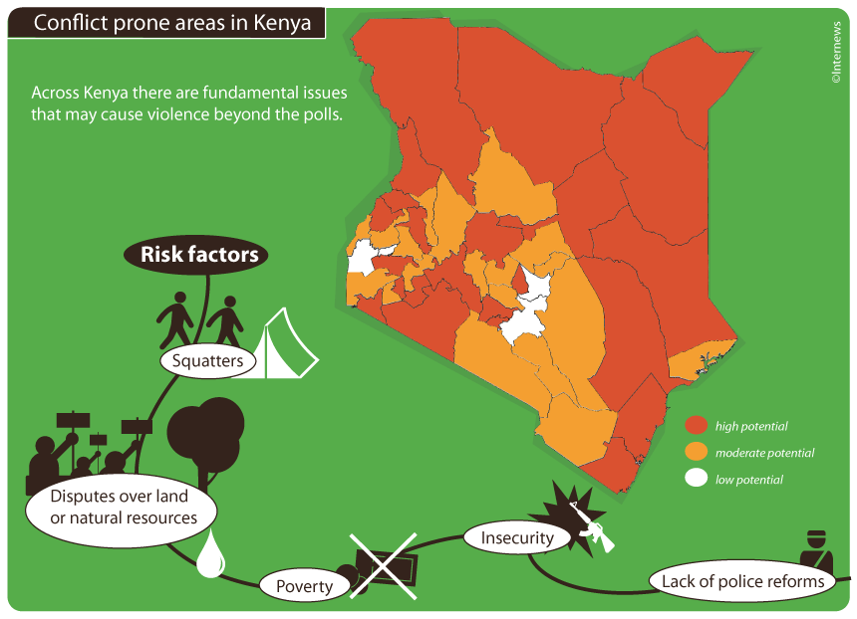
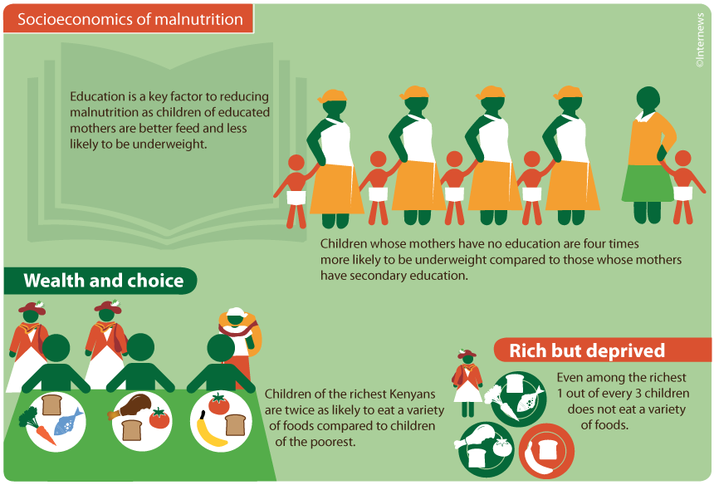
What’s next?
Upcoming Projects
Ways to contribute

Slide 14
Thank you!
James Raterno |
Online Trainer @ Internews
jraterno@internews.org
Aurelia Moser | @auremoser
Fellow @ Ushahidi + Internews KE
aurelia@ushahidi.com

