Slide 1
On Optimal and Efficient in Place Merging
Pok-Son Kim
Kookmin University, Department of Mathematics, Seoul 135-702, Korea
Arne Kutzner
Seokyeong University, Department of E-Business, Seoul 136-704, Korea

Slide 2
Merging
Make one sorted array out of two consecutive sorted arrays
4
91
3
92
3, 4
91, 92

Slide 3
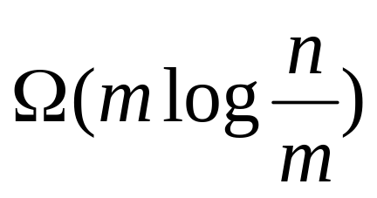
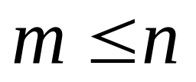

Lower Bounds for Merging
Number of comparisons
  Argumentation over the decision tree (see Knuth)
Number of assignments
  Each element can change its position in the final sequence
for

Slide 4
Notions
An algorithm merges two adjacent sequences “in place” when it needs
constant additional space.
Stability:
Merging algorithm preserves the initial ordering of elements with equal value.

Slide 5
We present .....
…a stable, asymptotically optimal, in place merging algorithm

Slide 6
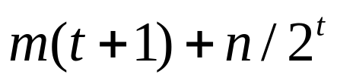
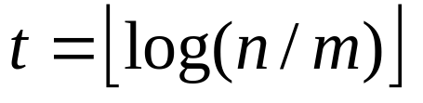

Foundation
Algorithm of Hwang and Lin [1972]
Merging algorithm with the following properties
  Asymptotically optimal regarding comparisons where
  Two variants
    External space of size m (not in place)
    2m + n assignments
    External space of size O(1)
    assignments (not asymptotically optimal)

Slide 7
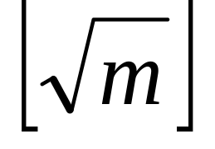
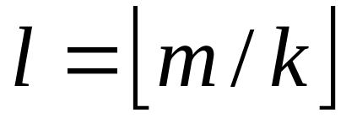
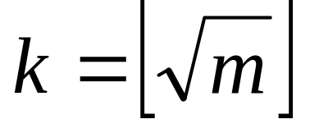
Step 1: Reducing the external space from m to
Granulation of shorter input sequence into blocks of equal size
size m-l*k
l blocks of size k
u₀
u₁
u₂
u_{l}
v
shorter input sequence u (size m)

Slide 8
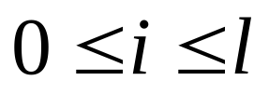
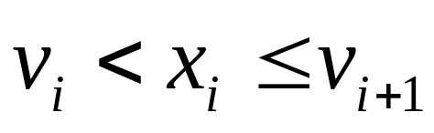
Reducing the external space from m to (cont.)
Spilt u_{i} into b_{i}x_{i}, so that x_{i} is the last element of u_{i} for
Granulation of v such that
(Technically l+1 binary searches)
u₀
u_{i}
u_{l}
b₀
x₀
b_{i}
x_{i}
b_{l}
x_{l}
v₀
v_{i}
v_{l}
v_{l+1}

Slide 9
Kernel Algorithm
b₀
x₀
b_{i}
x_{i}
b_{l}
x_{l}
v₀
v_{i}
v_{l}
v_{l+1}
Block Rearrangements
b₀
v₀
x₀
b_{i}
v_{i}
x_{i}
b_{l}
v_{l}
x_{l}
v_{l+1}
l+1 local merges using Hwang and Lin
(necessary external space )
Sorted Sequence

Slide 10
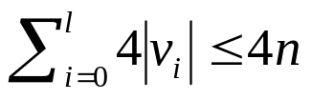
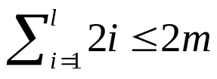
Block Rearrangements
“tricky” technique
  Kernel idea: result of Mannilla and Ukkonen [1984]
Main characteristics:
  Iterative processing, starting with the placement of u₀, v₀ continuing with u₁, v₁ and so on
  Altogether: assignments
  Nasty: “unplaced” u_{i} blocks can be interleaved
  Therefore repeated search of minimal block necessary. Additional costs:
  comparisons for repeated search
  l(7k) ≤ 7m assignments for minimal block extraction

Slide 11
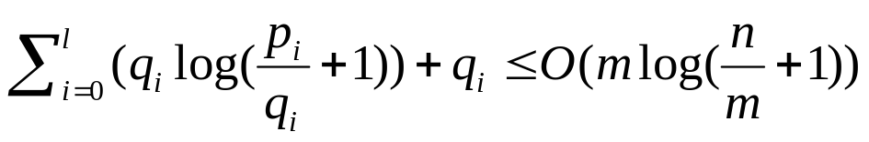
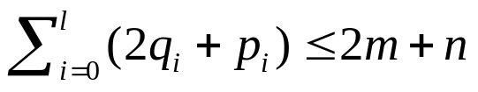
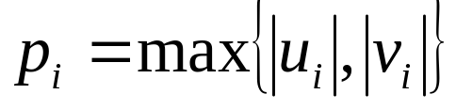
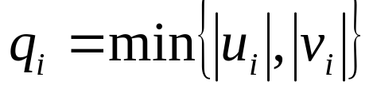
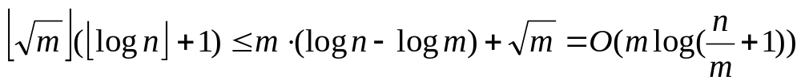
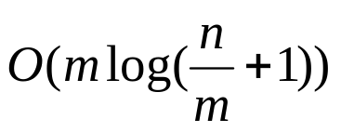
Overall Complexity of the Kernel Algorithm
l+1 calls of Hwang and Lin
comparisons
assignments
where and
l+1 binary searches
Block rearrangements (foregoing slide)
comparisons, O(m+n) assignments

Slide 12
Step 2: Reducing the external space from to O(1)
Kernel Idea: Creation of an “internal buffer” of size
  Technique first described by Kronrod [1968]
  Created by an initial splitting step
  Elements of the internal buffer can be disordered during merging
  Finally the elements of the internal buffer are sorted and merged

Slide 13
Unstable in Place Alg.
internal buffer (size )
Binary Search
u₁
u₂
v₁
v₂
Rotation
u₁
v₁
u₂
v₂
Kernel Alg. (u₁ is buffer)
u₁
v₁
Sorted Sequence
Sort/Hwang and Lin with external space O(1)
Sorted Sequence

Slide 14
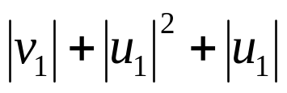
Complexity of Unstable in Place Algorithm
Lemma: Unstable In Place Alg. is asymptotically optimal regarding number of comparisons and assignments.
Proof: Simply count the additional operations
  Binary search and Hwang and Lin trivially doesn’t change the asymptotic number of comparisons
  Hwang and Lin’s call poses = O(m+n) additional assignments
  Insertion sort needs O(m) comparisons as well as assignments

Slide 15
Deriving a Stable Alg.
2 Reasons for lacking stability
  Internal buffer might contain equal elements
  (the initial order of equal elements can’t be restored by insertion sort)
  Two blocks u_{i} and u_{j} (0≤i,j≤l, i≠j) that contain equal elements can’t be distinguished during the search for the minimal block

Slide 16
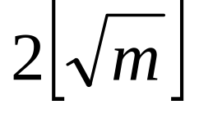

Deriving a Stable Alg. (cont)
Kernel Idea:
Extraction of distinct elements as buffer elements
  buffer elements for local merges
  buffer elements to keep track of the reordering of the u_{i}-blocks
  (movement imitation buffer)
  Reordering of the buffer elements now doesn't effect stability because all elements are different !

Slide 17
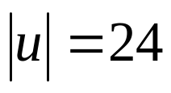
Partitioning Scheme
Buffer for Local Merges (size )
Movement Imitation Buf. (size )
u₁
e₁
e₂
e₃
e₄
u₃
u₄
u₅
u₆
v
Here for
Every rearrangement of the u_{i} is mirrored in movement imitation buffer
Additional counter variable for the number of “already placed” blocks necessary

Slide 18
Deriving a Stable Alg. (cont)
Application of the following modifications to the unstable Algorithm:
  Initial Buffer extraction
    (Technique described by Pardo [1977])
  Replacement of search for minimal block by management of Movement Imitation-Buffer
  Final merging of sorted buffers slightly different:
Sorted Buffer
Sorted Sequence
Hwang and Lin with external space O(1)
Sorted Sequence

Slide 19
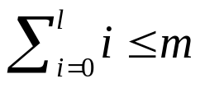

Complexity of Stable Algorithm
Lemma: Stable in Place Alg. is asymptotically optimal regarding comparisons and assignments.
Proof:
Check of all modifications applied to the unstable algorithm.
  Buffer extraction needs O(m) comparisons and O(m) assignments
  Repeated search of the minimal block:
  Management of the mi-buffer:
  Modified final merging has no impact
comparisons
assignments

Slide 20
Special Case
- Too few buffer elements -
We use a slightly modified version of Hwang and Lin’s Alg.
  Instead of directly inserting we first extract maximal segments of equal elements:
  (maximal segments are found by a linear search)
Hwang and Lin applied to single elements
A)
1
2
2
2
3
3
3
4
5
5
5
5
Hwang and Lin applied to groups of eq. elements
B)
1
2
2
2
3
3
3
4
5
5
5
5

Slide 21
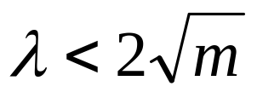

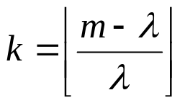
Special Case (cont.)
- Too few buffer elements -
Effect of modification:
We can express the number of assignments depending on the number of different elements in u
Modified stable algorithm:
Movement Imitation Buf. (size )
Blocks of (size )
u₁
u₂
v
  Modified Hwang and Lin is used for local merges

Slide 22
Special Case
- Complexity -
Lemma: Stable Alg. for the case of too few buffer elements is asymptotically optimal regarding assignments and comparisons
Proof:
Only significant modifications
  size of u blocks changed
  modified variant of Hwang and Lin.

Slide 23
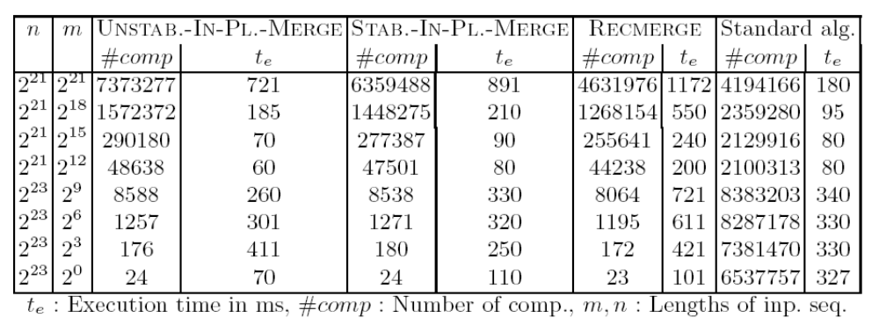
Experimental Results
#comparisons(-)
Time(+)
Unstable as well as stable Alg. ready for practice!
  Impact of time per comparison ! (Here we took integer comparisons)

Slide 24
Related Work
3 Papers that present similar results:
  Symvonis[1995]: Description of a “may be” algorithm design
  Geffert at all [2000]: Complex non-modular algorithm
    No remarks regarding implementation or benchmarking
  Chen [2003]: Slightly simplified version of Geffert’s Alg.
    No remarks regarding implementation or benchmarking
All papers rely on the work of Hwang and Lin, Kronrod as well as Mannilla and Ukkonen

Slide 25
Conclusion
Presentation of an unstable as well as stable merging algorithm
  In Place
  Asymptotically optimal regarding the number of comparisons as well as assignments
Highlights:
  Alg. has modular and transparent structure
  Alg. was implemented, Kernel part described in Pseudo-Code (in paper)
  Experimental Results - Benchmarking
  Several detail improvements, e.g. “leaving free” of m elements in Kernel Alg.
  Elegant handling (embedding) of the case of too few buffer elements
Question for further research:
Is there a simpler stable asymptotically optimal in-place merging algorithm?

Slide 26
Thank you very much for your attention

