Slide 1

select give

Slide 2

Go to

Slide 3
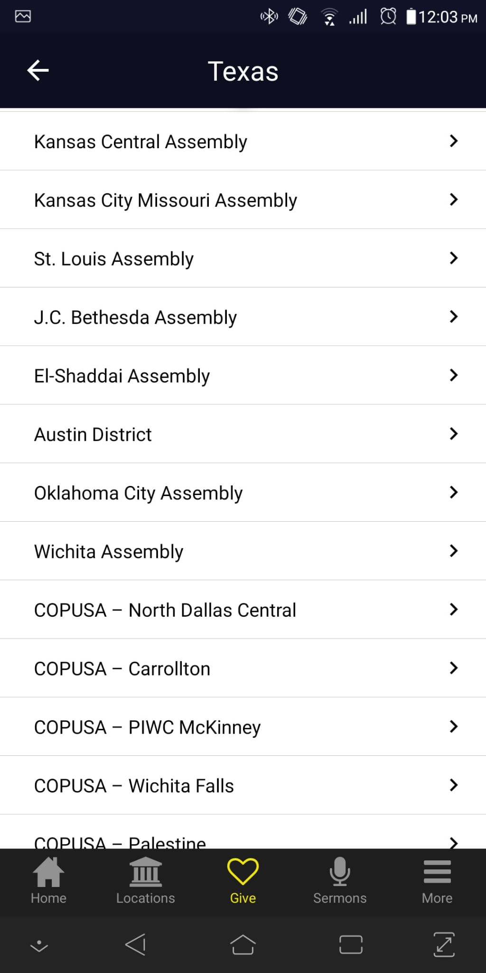
Go to

Slide 4
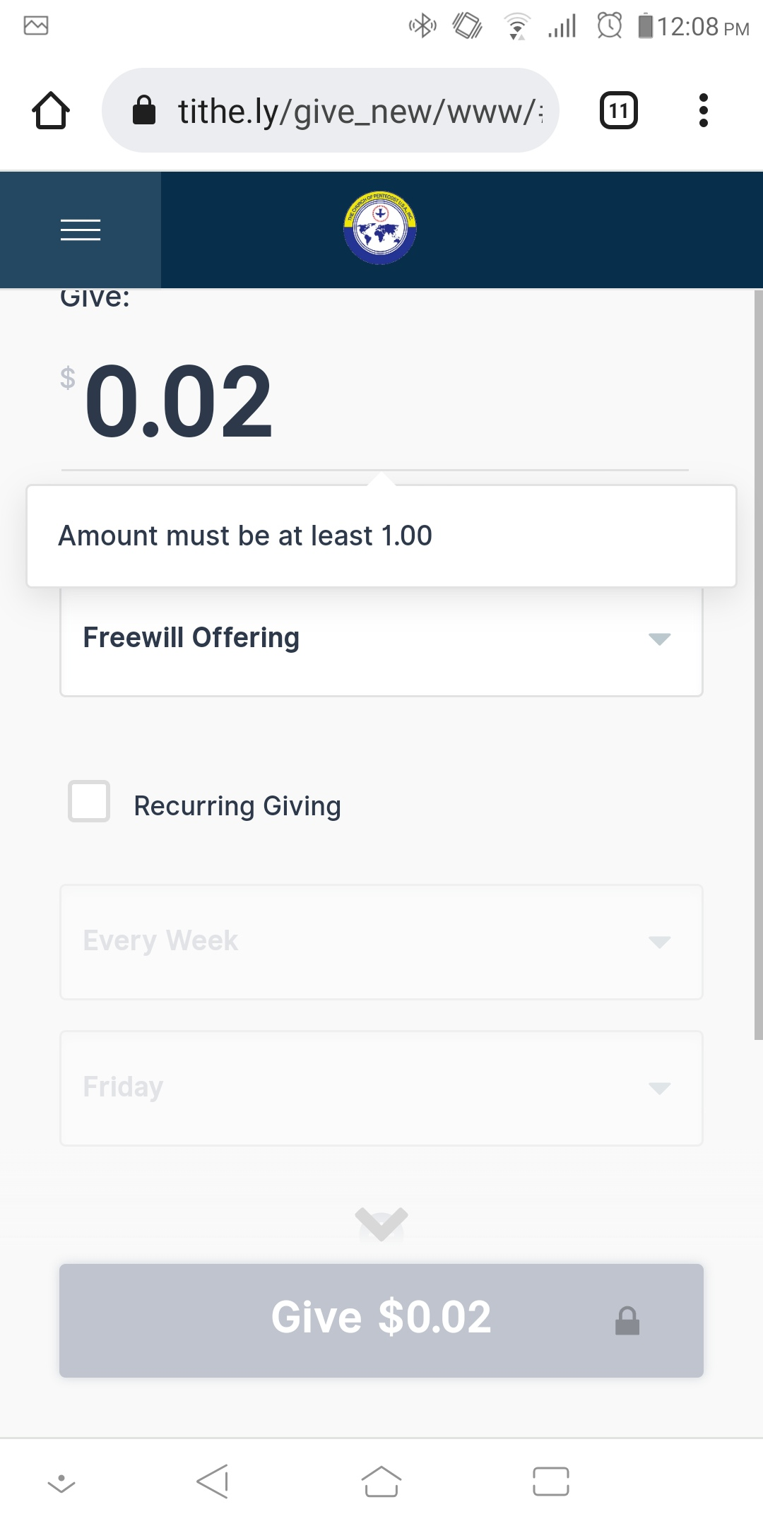
Type the amount you want to give

Slide 5
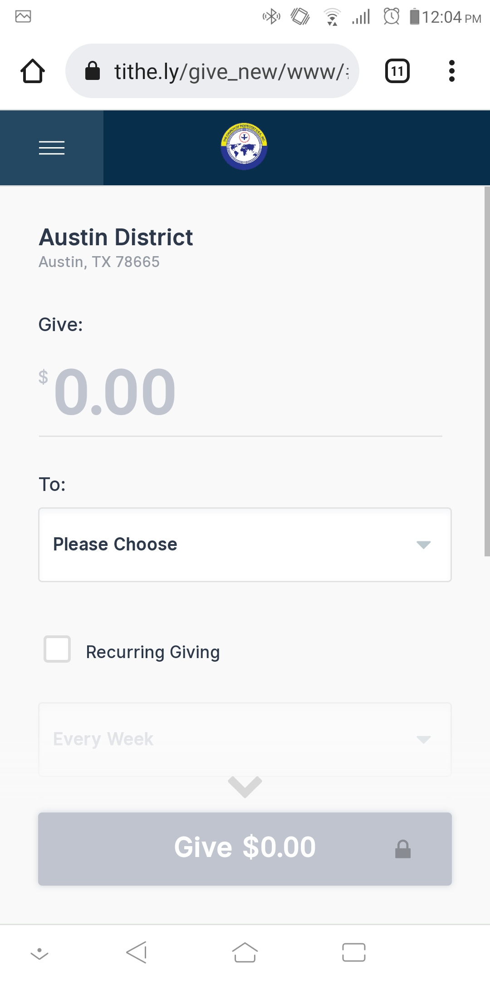
Choose from the dropdown

Slide 6
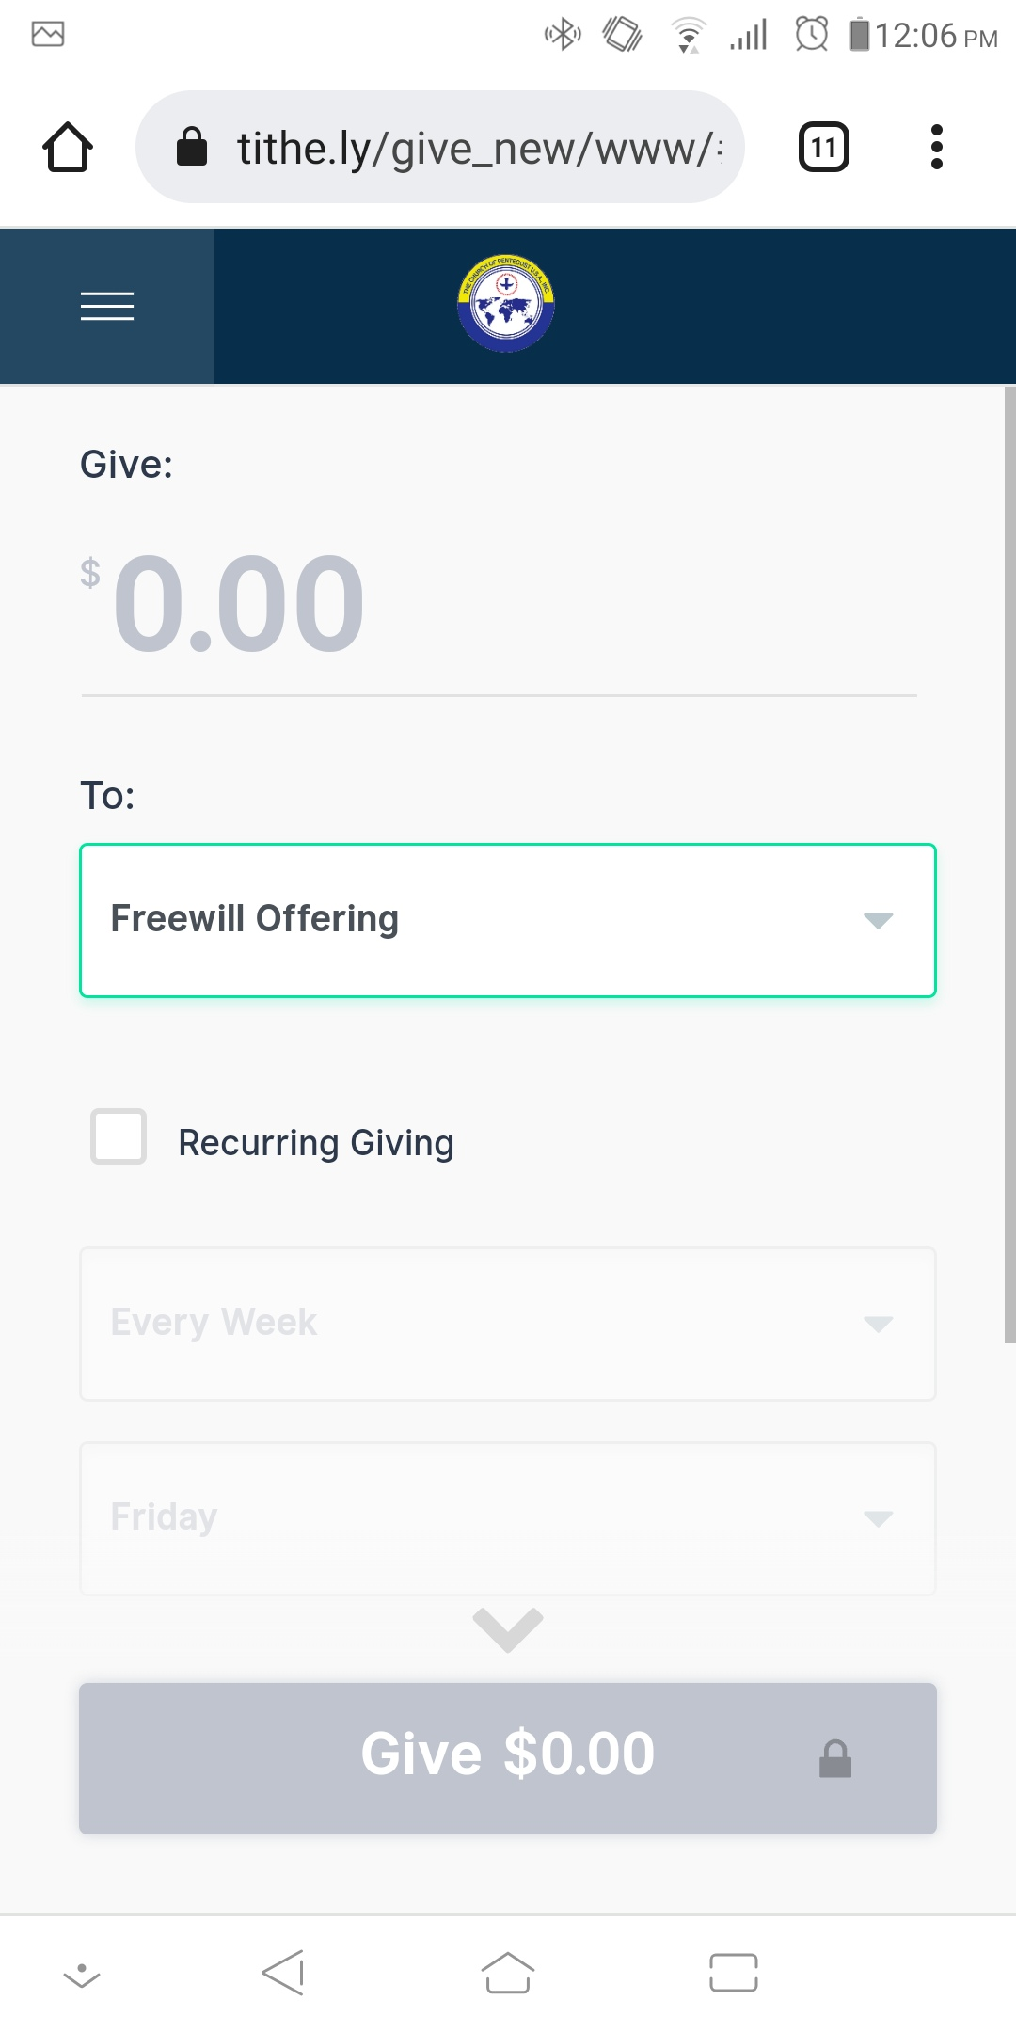
Select Freewill offering or your option

Slide 7
Click on Give to submit your donation

