Slide 1

NLP (CS60075)
Term Project
Named Entity Recognition in Biomedical Corpus
Team Name: NLP Term Project Team
Himanshu Mundhra(16CS10057)
Aurghya Maiti(16CS10059)
Swastika Dutta(16CS10060)
Omar Eqbal(16CS30043)

Slide 2
Problem Statement
In recent years, deep contextual embeddings such as (BERT, FLAIR, ELMO) have proved to be competent enough to detect the exact spans of named entities (both in general English Domain and Biomedical Domain).
In this task, we aim to address the gaps of detecting named entities using both context-independent word embeddings and context-dependent word embeddings on the NCBI Disease, BC5CDR and ChemProt Corpus.

Slide 3
Introduction
Textual Data, be it a structured database or an unstructured document, is always rich with information.
Named-Entity Recognition (NER) is used to extract entities and relationships in texts.
Biomedical NER (Bio-NER) is a pivotal yet challenging task.

Slide 4
Motivation
Biomedical texts are expensive, and have challenges:
Ambiguity, abbreviations, Multi-word NERs, etc
Various approaches exist, contextual word embeddings is new state-of-the-art. To compare and contrast the different approaches of Bio-NER; evaluate the relative efficiencies of these models.

Slide 5
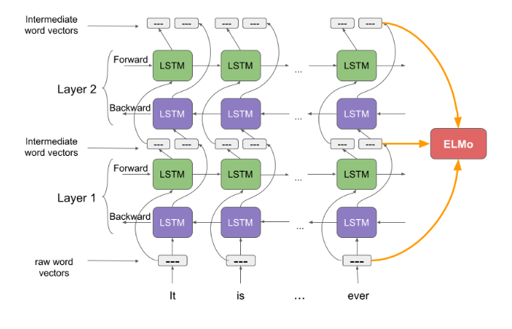
ELMO Model Architecture
Contains biLM model with two layers stacked together. Each layer has 2 passes — forward pass and backward pass.
Character-level convolutional neural network (CNN) to represent words of a text string into raw word vectors.
Final representation is the weighted sum of the raw word vectors and the 2 intermediate word vectors.

Slide 6
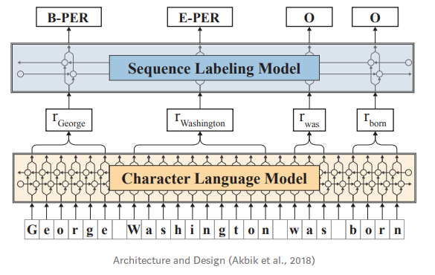
FLAIR Model Architecture
Leverages the internal states of a trained character language model to contextual string embeddings.
Model words as sequences of characters, and are contextualized by their surrounding text.
Utilizes trained Language Models to generate embeddings, but consider Language Models(LMs) at the character level.

Slide 7
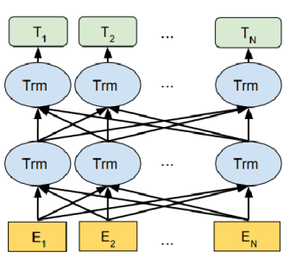
BERT Model Architecture
It has been pre-trained with Masked Language Modeling and Next Sentence Prediction Tasks on Wikipedia and BooksCorpus and requires task-specific fine-tuning.
There are two models of BERT:
BERT base – 12 layers, 12 attention heads, and 110 million parameters.
BERT Large – 24 layers, 16 attention heads and, 340 million parameters.

Slide 8
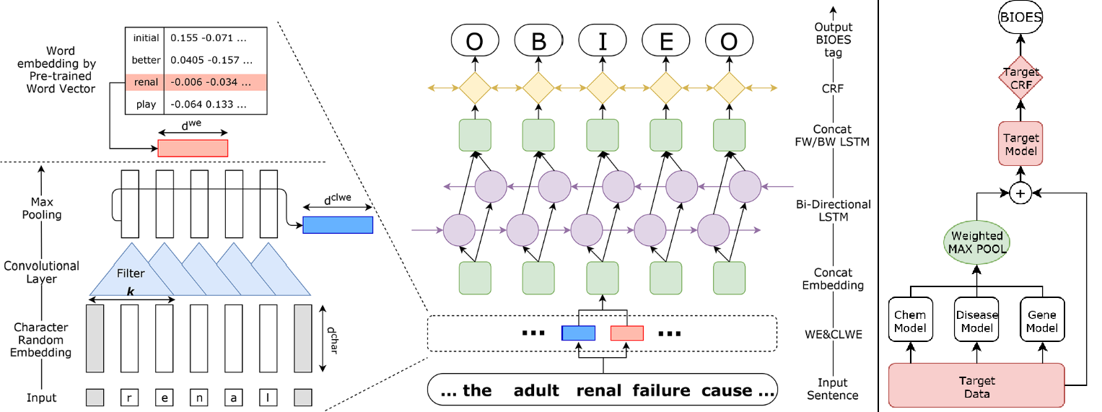
CollaboNet Model Architecture
Utilizes a combination of multiple NER models.
Models trained on a different dataset are connected to each other - target model obtains information from other collaborator models to reduce false positives.
Helps to tackle problems associated with lack of data and the entity type misclassification problem in BioNER tasks.

Slide 9
Results and Discussions
NCBI disease | F1 Score | Precision | Recall
Elmo | 0.7577 | 0.7514 | 0.7643
Bio-Elmo | 0.8758 | 0.8635 | 0.8816
Flair | 0.8253 | 0.8343 | 0.8165
Bio-Flair | 0.8791 | 0.8667 | 0.8845
Bert | 0.7373 | 0.7317 | 0.7431
Bio-Bert | 0.9058 | 0.8918 | 0.9127
Bio-Bert (Fine Tuning) | 0.9279 | 0.9123 | 0.9335
CollaboNet | 0.8481 | 0.8315 | 0.8653

Slide 10
Results and Discussions
BC5CDR chem | F1 Score | Precision | Recall
Elmo | 0.7826 | 0.8153 | 0.7524
Bio-Elmo | 0.9153 | 0.9058 | 0.9276
Flair | 0.8283 | 0.8106 | 0.8498
Bio-Flair | 0.9135 | 0.9215 | 0.9023
Bert | 0.7795 | 0.8251 | 0.7387
Bio-Bert | 0.9172 | 0.9074 | 0.9254
Bio-Bert (Fine Tuning) | 0.9388 | 0.9285 | 0.9492
CollaboNet | 0.9079 | 0.9205 | 0.8913

Slide 11
Results and Discussions
BC5CDR disease | F1 Score | Precision | Recall
Elmo | 0.7103 | 0.7517 | 0.6732
Bio-Elmo | 0.8712 | 0.8813 | 0.8416
Flair | 0.8291 | 0.8201 | 0.8461
Bio-Flair | 0.8585 | 0.8671 | 0.8501
Bert | 0.8263 | 0.8145 | 0.8327
Bio-Bert | 0.8759 | 0.8823 | 0.8656
Bio-Bert (Fine Tuning) | 0.9162 | 0.9071 | 0.9253
CollaboNet | 0.8322 | 0.8296 | 0.8349

Slide 12
Ablation Analysis
Ambiguity:
EGFR corresponds to epidermal growth factor receptor or estimated glomerular filtration rate.
For the first case, the entity is name of a protein, while the second one is not
Polysemy, i.e, a word refers to different entities.
Example: myc-c refers to the name of a gene or protein..

Slide 13
Ablation Analysis
Synonyms identification.
For example, CASP3, caspase-3, and CPP32 denote the same entity.
Out of vocabulary words :
Overwhelming growth of adding new names to dictionary.
Due to IUPAC nomenclature new proteins can be named, but they are not present in the vocabulary frequent enough to learn a proper embedding.

Slide 14
Ablation Analysis
Multi-word/Hyphenated BioNE’s : If the word is hyphenated then should we tokenize into multiple words or learn it.
“ . . . we demonstrate a high frequency of ATM mutations in T - PLL .”
Nested BioNEs, i.e., a BioNE may occur as part of longer BioNE as a proper string. For example, colorectal adenomas and carcinoma

Slide 15
Ablation Analysis
Let’s have a look at where BioBERT is having success:
BioBERT turns out to be very good with abbreviations:
In SCA3 , gaze - evoked nystagmus was often present as was saccade hypometria and smooth pursuit gain was markedly decreased
Because IVF causes cardiac rhythm disturbance , we investigated whether malfunction of ion channels could cause the disorder by studying mutations in the cardiac sodium channel gene SCN5A .

Slide 16
Ablation Analysis
Where is BERT failing?
BERT is often missing out some parts of the entity, in short instances or as a part of longer entity.
This mutation may be valuable for developing models of dominantly inherited neurodegeneration, as the early age of onset of symptoms suggests that this mutation may be particularly deleterious to the magnocellular neuron .
We have studied a set of 164 patients with multiple colorectal adenomas and / or carcinoma and analyzed codons 1263 - 1377 ( exon 15G ) of the APC gene for germ - line variants .

Slide 17
Ablation Analysis
When the entities are followed by OOV words or followed by other entities, BioBERT is often predicting I instead of O
Mucopolysaccharidosis IVA ( MPS IVA ) is an autosomal recessive lysosomal storage disorder caused by a genetic(B) defect(actual I) in N - acetylgalactosamine - 6 - sulfate(predicted I) sulfatase ( GALNS ) .
Sometimes if the word is commonly known to be a non-entity, then it will be predicted O instead I
Immunohistochemical staining of human breast specimens also revealed BRCA1 nuclear foci in benign breast , invasive lobular cancers and low - grade (marked as O actually I) ductal carcinomas .

Slide 18
Conclusion
Fully contextualized embeddings give higher exact-span match F1-score than context independent embeddings generated by CollaboNet
Contextual embeddings fine-tuned on bio-medical domain perform better than the embeddings trained on a general domain (fine-tuned Bio-BERT)

Slide 19
Thank You!

