Slide 1
Introduction to dplyr
auriane jobard

Slide 2
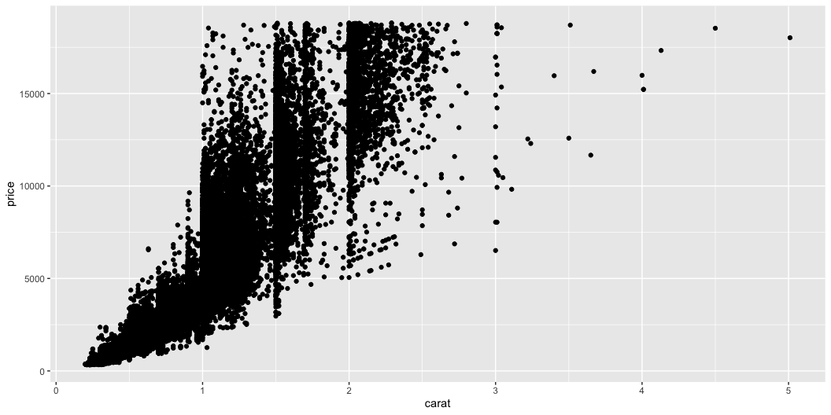
#diamond prices as function of their weight

Slide 3
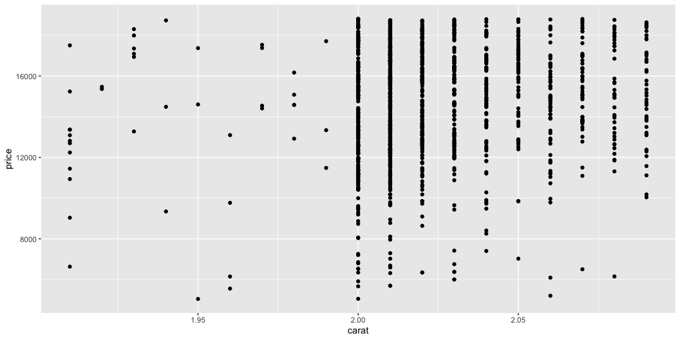
#Focus on the 2 carat diamonds
diamonds_2ct <- diamonds |>
filter(abs(carat-2)<=0.1)

Slide 4
Gap in the distribution
There are:
-42diamonds with weight between 1.9 and 1.99 carats -1353 diamonds with weight between 2 and 2.1 carats
There is a clear gap in the distribution of the weights, with a very small number of diamonds just before 2 carats compared to the number of them just after 2 carats

Slide 5
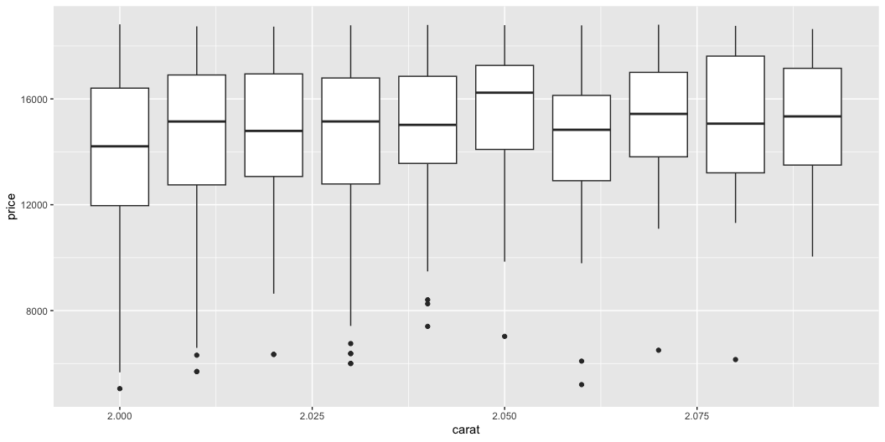
price distribution for 2 to 2.1 carats

