Slide 1
AGV’s
Best founds in the market

Slide 2
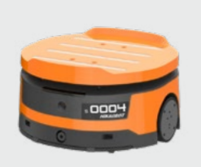
Q1-010CRL-A HIKROBOT
Features:
Dimension L*W*H(mm) 461*454*252
Weight(Kg) 18
Rated Load(10 Kg)
Navigation 2D code
Speed (3m/s)
Endurance(h) 8
https://www.hikrobotics.com/en/mobilerobot/LMR

Slide 3
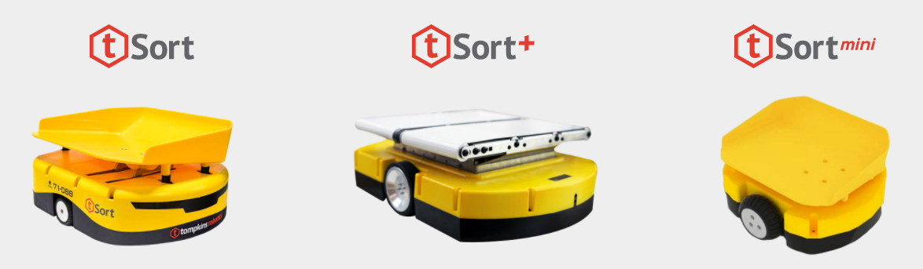
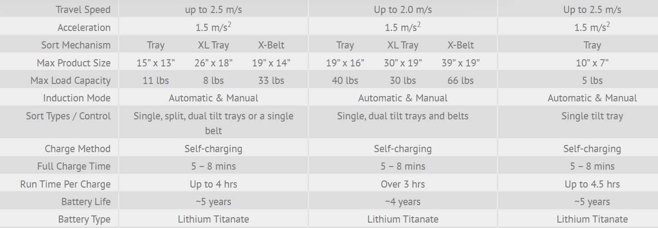
Tompkins Robotics Tsort
https://tompkinsrobotics.com/tsort-solutions/tompkins-robotics-t-sort-solution/

Slide 4
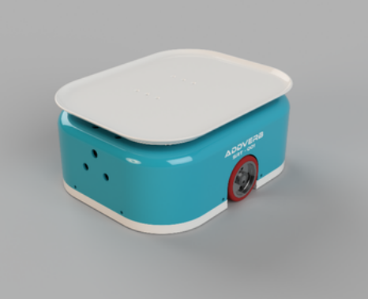
Zippy – Addverb Technologies
Features:
Payload: Upto 6Kg
Max speed: 3m/s
Powered by fleet management software
30min Fast charging
Runtime 4h
2D QR navigation
https://youtu.be/gDe-ErKLoks
https://www.indiamart.com/addverb-technologies/mobile-robotics.html#smart-sorting-robot-for-parcels

Slide 5
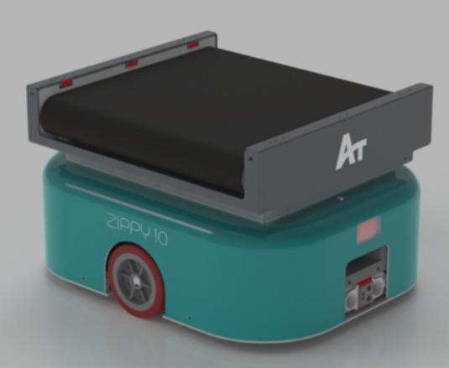
Zippy 10 – Addverb Technologies
Features:
Payload: 10Kg
Max speed: 2m/s
Powered by fleet management software
Dimensions: 470mm x 370mm x 200mm
Runtime 4h 20 min
2D QR code navigation
https://addverb.com/product/zippy-sorting-robot/?varient=2

Slide 6
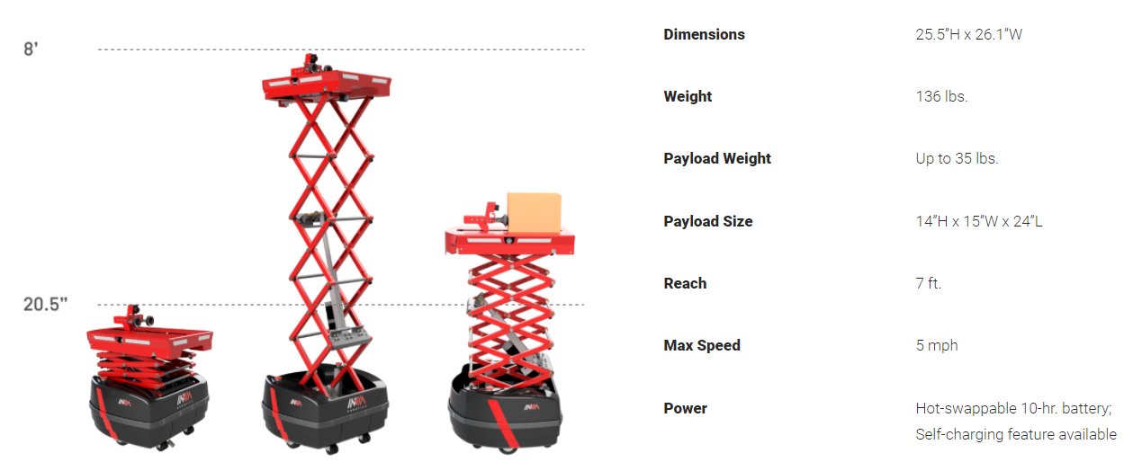
inVia Picker– Invia Robotics
https://www.inviarobotics.com/our-system/invia-picker-robots/

Slide 7
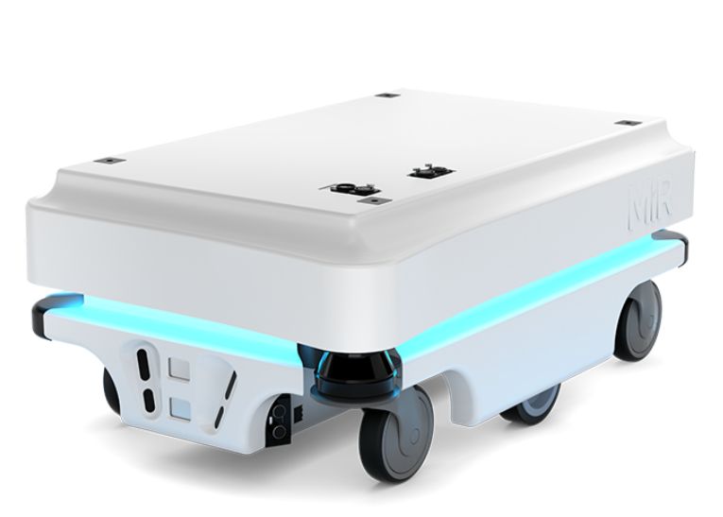
MIR100– mobile-industrial-robots
Features:
Vida del producto: 5 años o 20 000 horas
Dim(mm): 580*890*352
Peso: 70Kg
Capacidad de carga máxima 100 Kg
Velocidad máxima: 1.5 m/s
Sensores: Escanedres laser de seguridad SICK, Cámaras 3D, sensores de ultrasonidas
https://www.mobile-industrial-robots.com/es/solutions/robots/mir100/

Slide 8
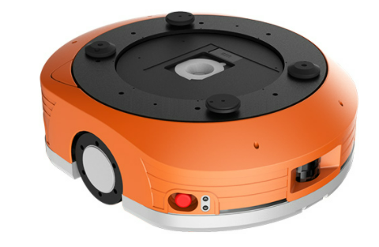
Zhuque M15A – quicktron
Features:
Size: 620 * 538 * 221mm
Weight: 78Kg
Load: 150Kg
Speed: 2.2m/s
Navigation: QR code
Battery life: 8h
http://www.flashhold.com/english.php/product-info/4/17

Slide 9
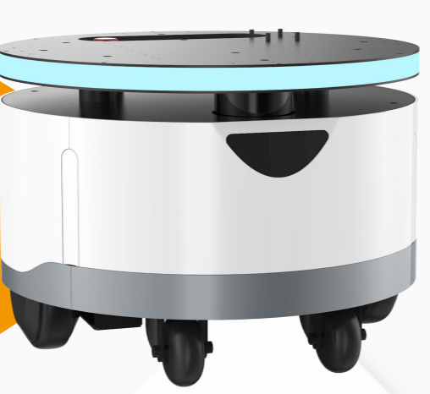
WBOT11B - Reeman (china)
Features:
Speed: 1m/s
Working time: 6-8h
Price per unit 2550USD
Dim : (450mm(L)*450mm(W)*317mm(H)
Bearing weight: 60KG
Sensors: lidars
https://www.alibaba.com/product-detail/Reeman-New-Roller-Auto-Robot-Chassis_1600249724540.html?spm=a2700.12243863.0.0.25443e5f1UEerG

Slide 10
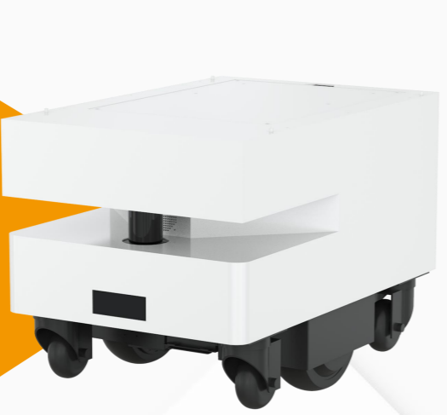
HBOT11B – Reeman (china)
Features:
Speed: 1m/s
Working time: 6-8h
Price per unit 2050USD
Dim : 540mm(L)*360mm(W)*367mm(H)
Bearing weight: 60KG
Sensors: lidars
https://www.alibaba.com/product-detail/Source-Manufacturer-Chassis-Equipment-Open-Sdk_1600210453476.html?spm=a2700.12243863.0.0.25443e5f1UEerG

