Slide 1
BACKEND PROJECT / 5C
Product Inventory
API
A clean REST API for managing shop products
NODE.JS
EXPRESS.JS
REST • JSON
API → PRODUCTS
BETECHIFIED BACKEND DEVELOPMENT
01 / 08

Slide 2

MEET THE TEAM / GROUP 5C
02 / 08

Slide 3
01 / PROJECT OVERVIEW
One API. Five product operations.
A lightweight backend that lets a shop manage its inventory through HTTP requests.
Product Inventory API
JS
Runtime
EX
Framework
</>
Node.js runs the server.
Express.js handles routes.
A REST API that accepts requests and returns product data as JSON.
RAM
Storage
+
○
↻
×
Products are held in memory — no database is connected.
ADD
VIEW
EDIT
DELETE
LIST is available through GET /products
Note: in-memory data resets when the server restarts.
03/ 08

Slide 4
02 / ROUTE MAP
Six endpoints. Clear responsibilities.
These routes are used to read, create, update, and remove products.
METHOD
ENDPOINT
PURPOSE
GET
/products
List all products
GET
/products/:id
View one product
GET
/products/low-stock
Find quantity below 10
POST
/products
Add a product
PUT
/products/:id
Edit a product
DELETE
/products/:id
Remove a product
Tip: use Postman to send requests and inspect JSON responses.
04 / 08

Slide 5
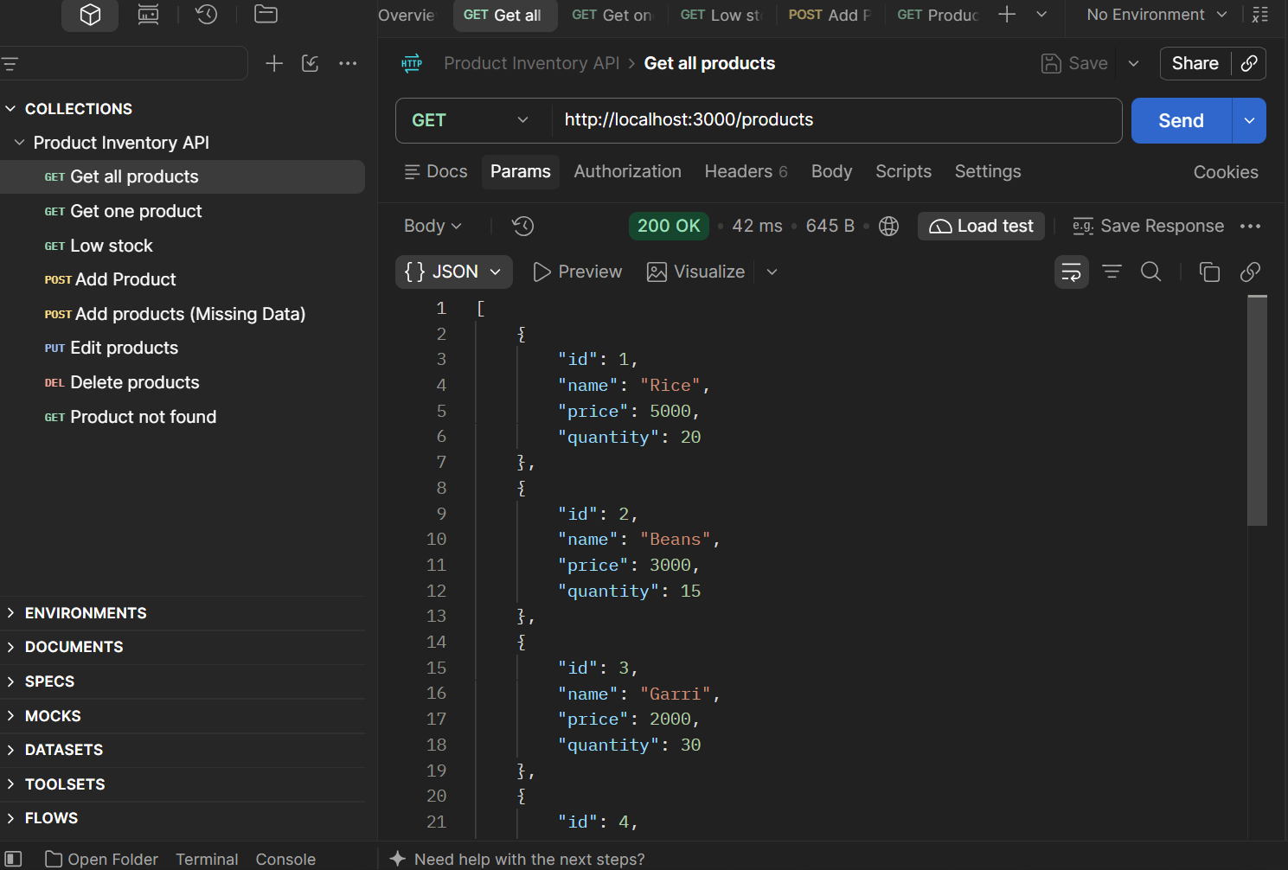
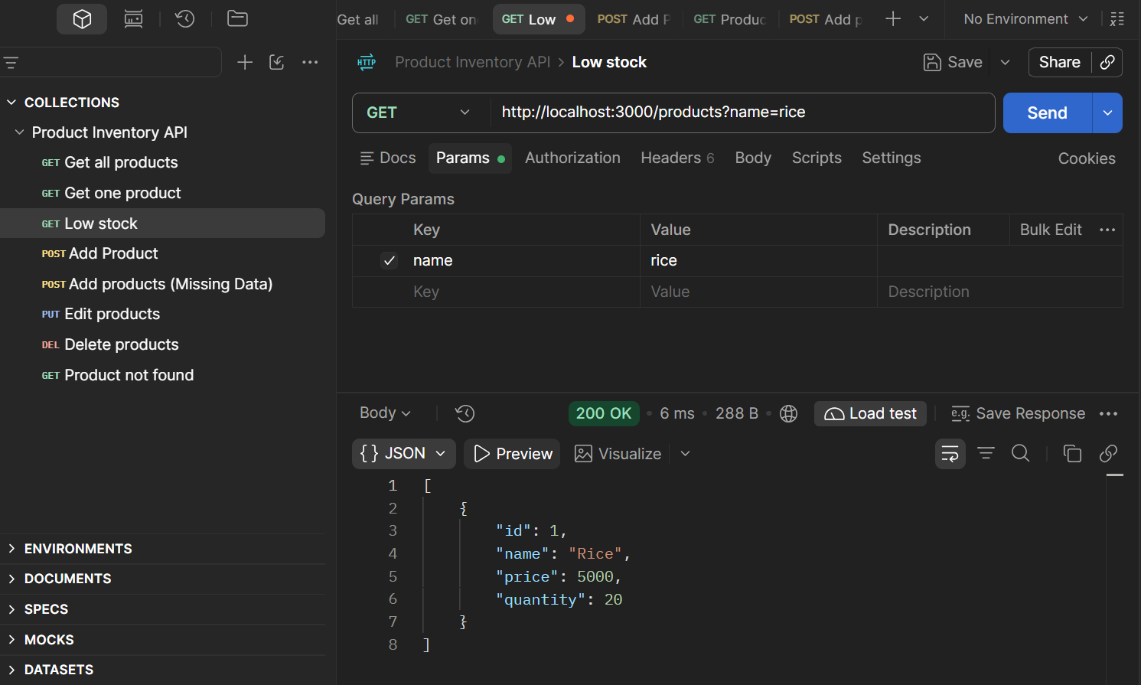
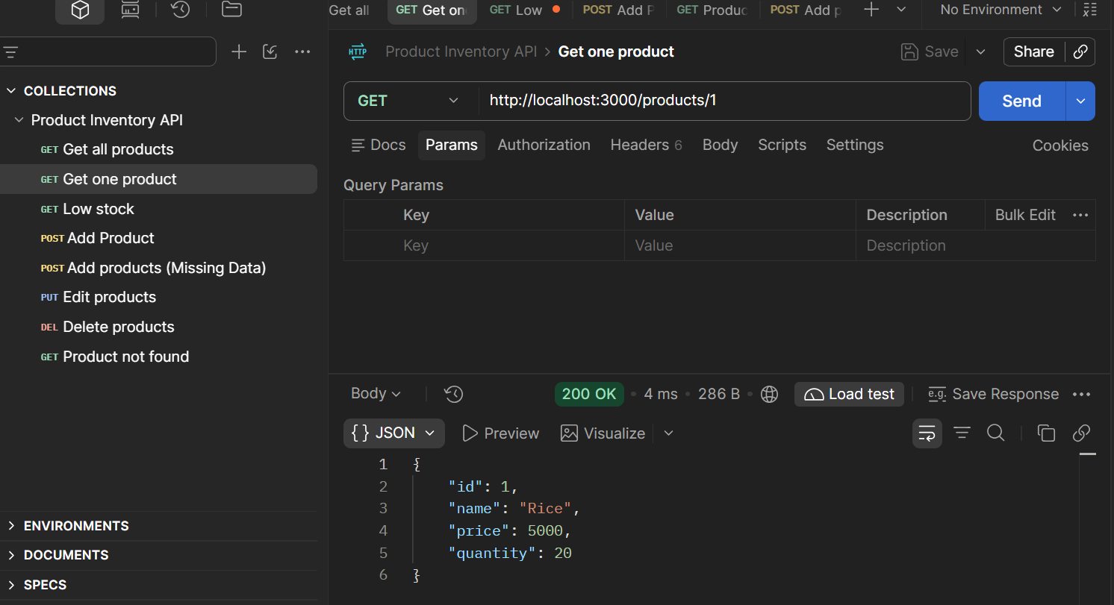
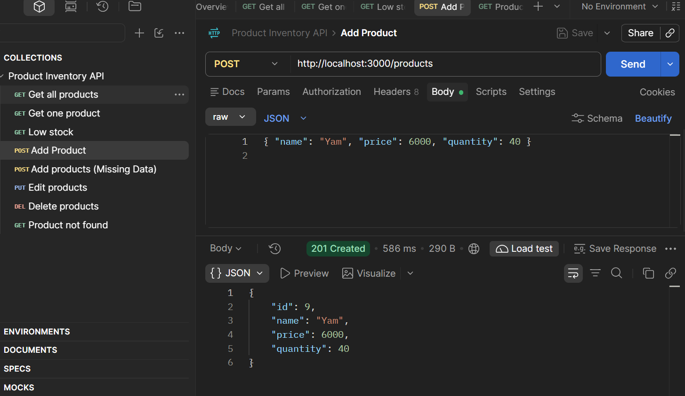
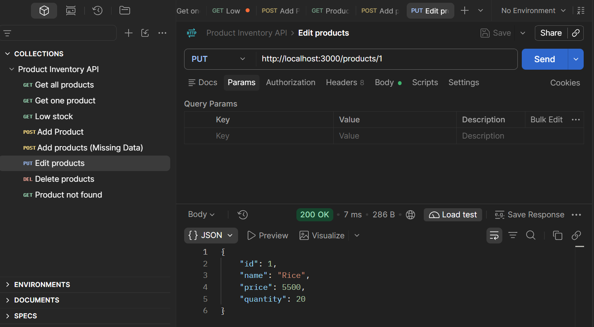
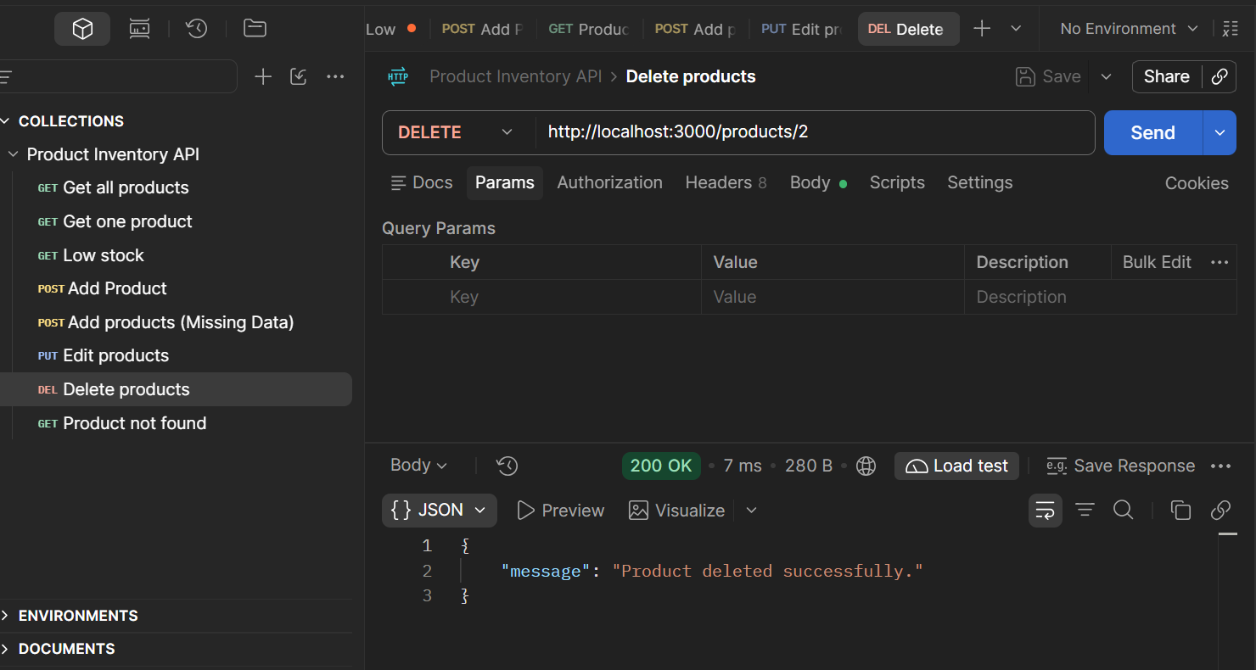
GET
02 / Code snippets
GET
GET
GET
POST
PUT
DELETE
05/ 08

Slide 6
03 / REQUEST LIFECYCLE
From request to JSON response.
The server routes each request to the product-handling logic.
↗
S
/
▤
{}
CLIENT
SERVER
ROUTES
PRODUCT DATA
RESPONSE
Postman / app
server.js
routes/products.js
In-memory array
JSON
!
400 • Bad Request
?
404 • Not Found
{}
Product fields
POST returns 400 when required product data is missing.
GET by ID, PUT, or DELETE returns 404 if the product is absent.
Each product has id, name, price, and quantity.
Key idea: HTTP method + route + JSON body (when needed) = a clear API action.
06 / 08

Slide 7
04 / DELIVERY & NEXT STEPS
Built collaboratively. Tested with Postman.
A working foundation for inventory management, ready for the next improvement.
GH
API
DB
TEAMWORK
TESTING
NEXT STEP
Individual GitHub commits show each member’s contribution.
Postman collection in the repository helps verify the endpoints.
Connect a real database so product data persists after restart.
Repository: github.com/auriela16/Product-Inventory-API
07/ 08

Slide 8
Thank you.
Questions & discussion
{ API }
08/ 08

