Slide 1
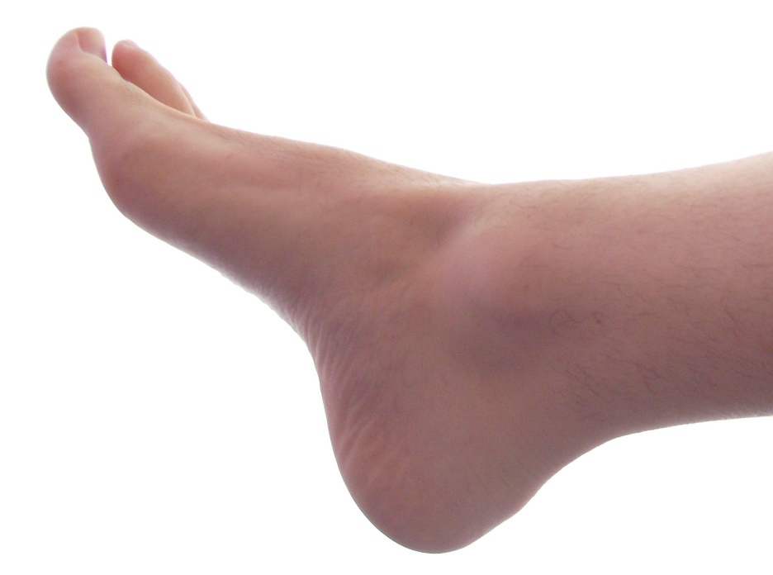
Climate change is scary! What can I do?
Know your own ‘carbon footprint’
What are things that contribute MOST to your carbon footprint?
Find out at…
www.footprintcalculator.org/

Slide 2

The world is scary! What can I do?
A little money can do a lot of good…
Which charities are most effective at improving lives?
Find out at…
www.givingwhatwecan.org
www.givewell.org

Slide 3

The world is scary! What can I do?
A lot of time can do a LOT of good…
How can we help people the most through our career?
Find out at…
www.80000hours.org

