Slide 2
CMS Dataset Replica Monitoring
Presenter: Aurimas Repečka
Supervisors: Nicolo Magini, Daniele Bonacorsi
Technical supervisors: Valentin Kuznetsov, Luca Menichetti

Slide 3
Introduction
Dataset
Block
File
File
Block
File
Oracle DB
HDFS

Slide 4
Monitoring Process Structure
Input
Processing
Output
Visualization

Slide 5
Input – Snapshots
Daily snapshots in CSV format
Size for snapshot: 2-3.5GB
Fields
Now
Node name (Node Tier)
Dataset name (Acquisition Era, Data Tier)
Block name
Block replicas node bytes
Block replicas node files
Etc…

Slide 6
Processing – Spark Job
Group keys
Result values
Aggregations
Sum, count, first, last, min, max, mean, delta, avg-day
Data ordering
Data filtering
Local/Yarn modes

Slide 7

Output
FS
ES
Kibana
Spark
HDFS

Slide 8
Hadoop-Elasticsearch connection
Allows HDFS files transferring directly to Elasticsearch
Reading one or multiple HDFS files with any number of partitions
Configurable Elasticsearch parameters: node, port, resource(index/type)
Data schema applied dynamically from user specified json file

Slide 9
Performance
Group keys: now, user group, acquisition era, data tier, node kind
Results: node bytes, destination bytes
Aggregations: sum, sum
Interval | Input | Cores | Memory | Output | Duration
1 day | ~3GB | 65 | 361472MB | ~600KB | ~1.6min
1 month | ~100GB | 65 | 361472MB | ~18MB | ~4.3min
3 months | ~310GB | 65 | 361472MB | ~52MB | ~9.7min
1 year | ~1.1TB | 65 | 361472MB | ~186MB | ~28min

Slide 10
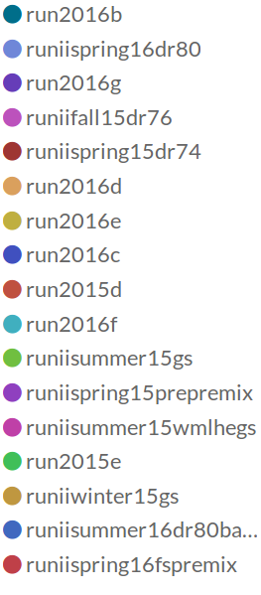
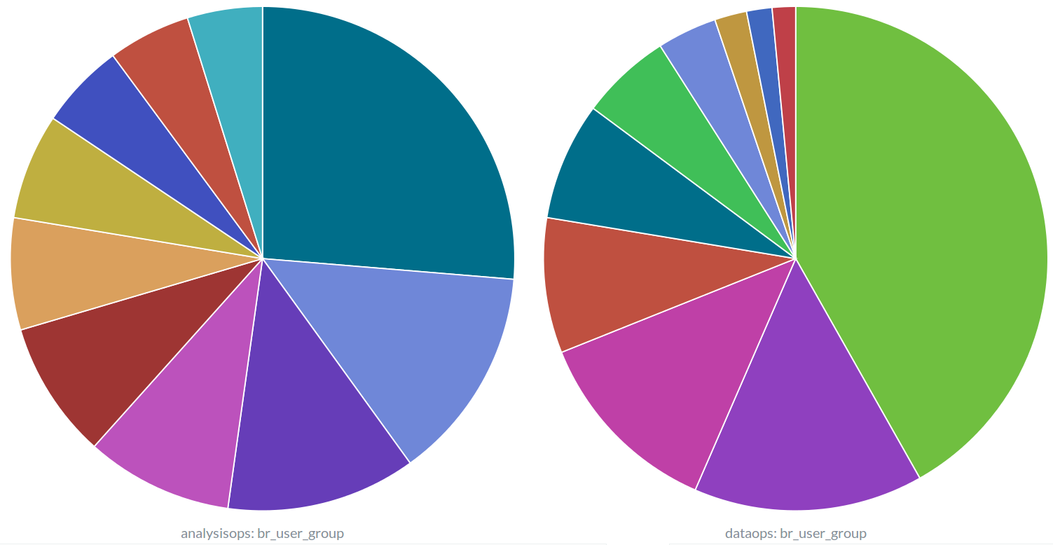
Visualization

Slide 11
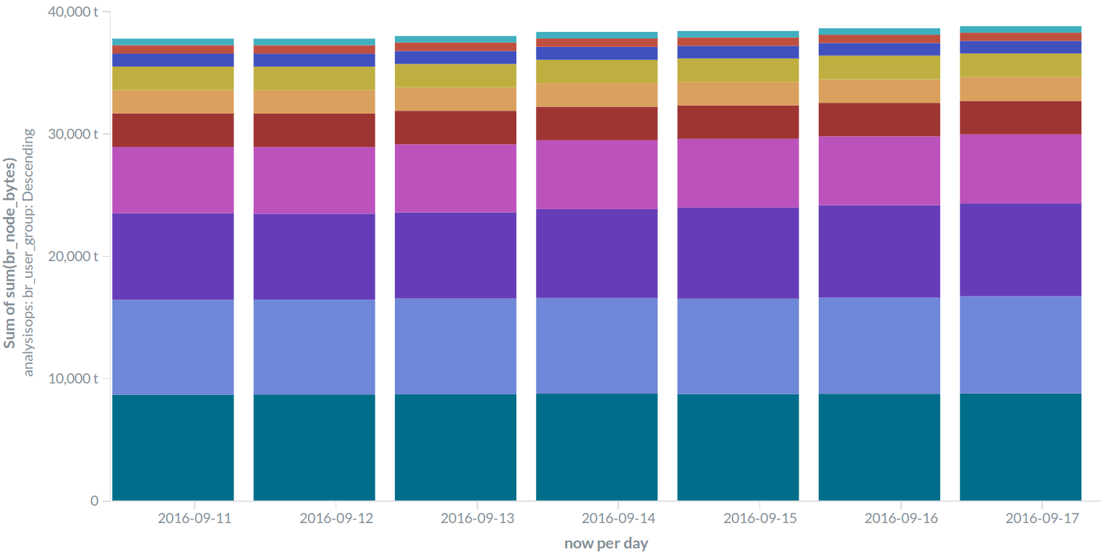
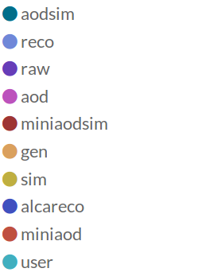
Visualization

Slide 12
Deployment
Development
Spark job submission – analytix cluster
Elasticsearch/kibana – personal virtual environment
Pre-production
WMArchive node
Production (future plan)
DMWM umbrella
Elasticsearch/kibana – central CERN IT service

Slide 13
Conclusion
Enables CMS block replica analysis by aggregating and visualizing data snapshots
Efficient
Fully-covered
Highly configurable
https://github.com/aurimasrep/PhedexReplicaMonitoring

