Slide 1
Large Language Models for Conversational Geodata Search
Faculty of Environmental Sciences
Chair of Geoinformatics
AGILE 2025 Tutorial, Dresden, Germany
Simeon Wetzel, Auriol Degbelo, Stephan Maes
Notes:
Important concepts
Agent (a bit of history)
LLM Agents
Tools
Workflows
Memory
Reflection
Multi-Agent Architectures
Agent-based modelling: https://www.nature.com/articles/s41598-023-35536-3
https://www.ncbi.nlm.nih.gov/books/NBK305917/

Slide 2
Agenda
Part 1 (45min):
Introduction / Motivation / Scenario
Part 2 (75 min):
LLM Calls
Retrieval Augmented Generation (RAG)
Geocoding/ Query Interpretation
Conversation
Part 3 (75 min):
Agents
SmolAgents Framework

Slide 3
Motivation: LLMs for Conversational Geodata Search

Slide 4
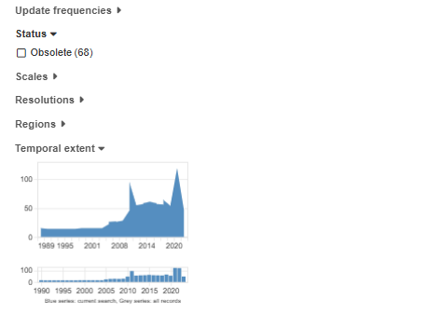
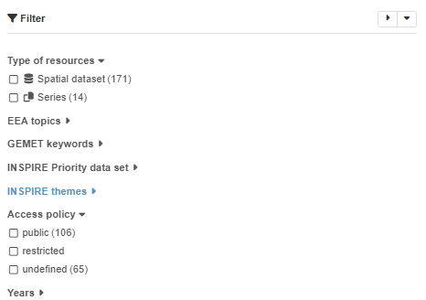
Traditional Search Approach
Metadata Catalogues / Geoportals (e.g. EEA SDI Catalogue)
Full-text interface
Search Filter

Slide 5
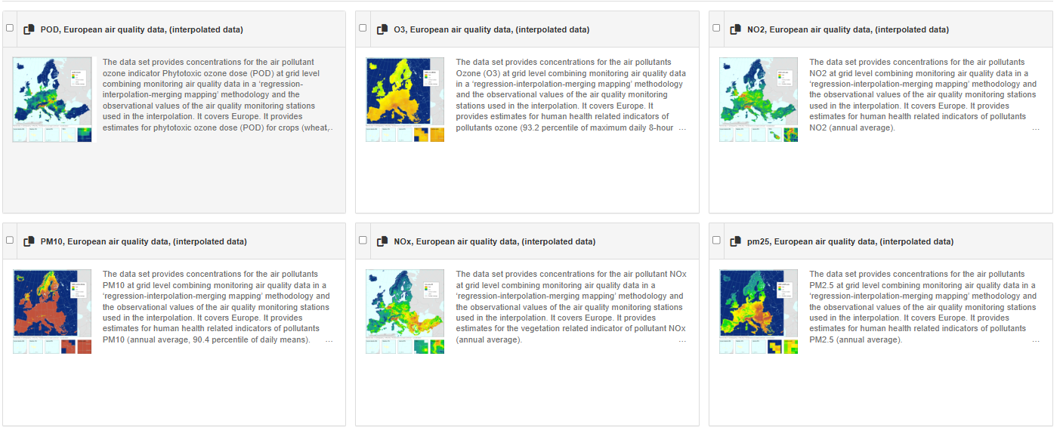
Traditional Search Approach
Metadata Catalogues / Geoportals
SERP-based result list

Slide 6

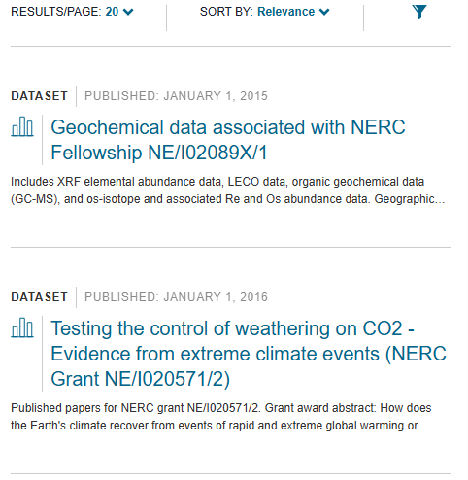
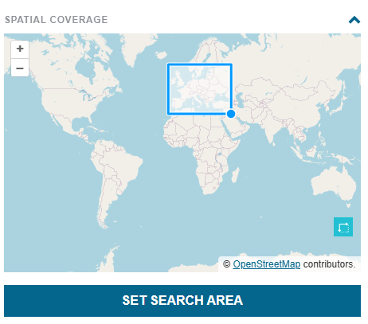
Traditional Search Approach
Cycle of single-hop search + refinements
Full-text search + Filters
Review of the results
Query/Filter Refinement
Evaluation of „fitness for use“

Slide 7
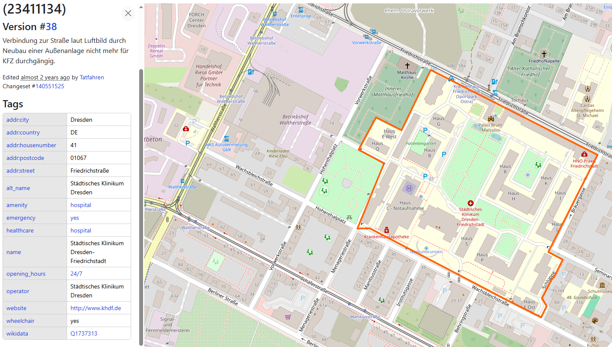
Challenges with traditional search approach
Dependency on attributes / metadata quality (completeness / accuracy)

Slide 8
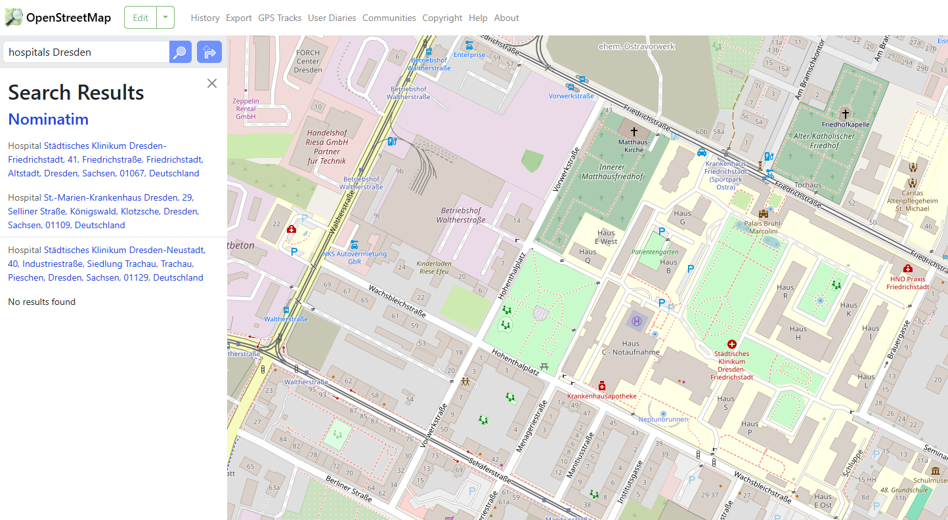
Challenges with traditional search approach
Dependency on attributes

Slide 9


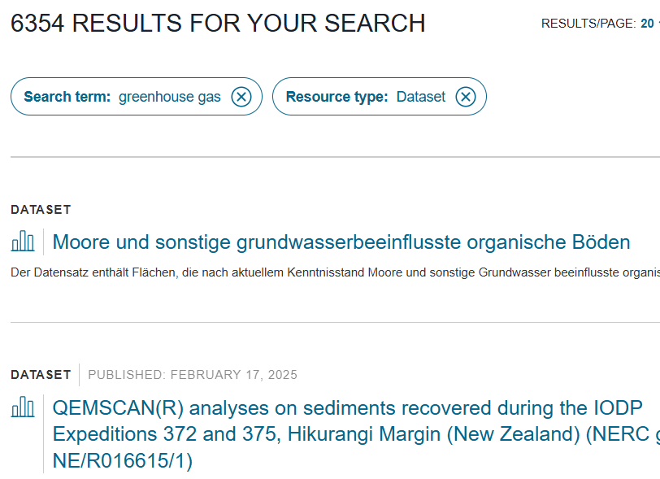
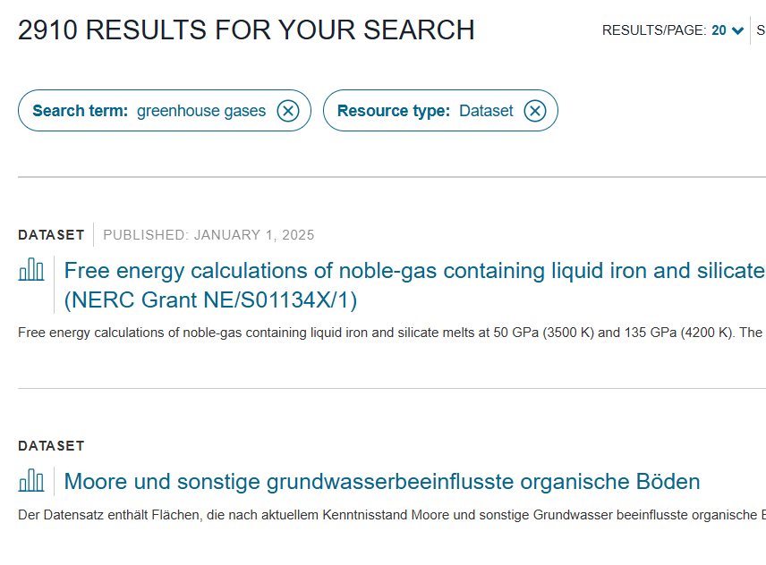
Challenges with traditional search approach
Lexical Search => No semantic search

Slide 10
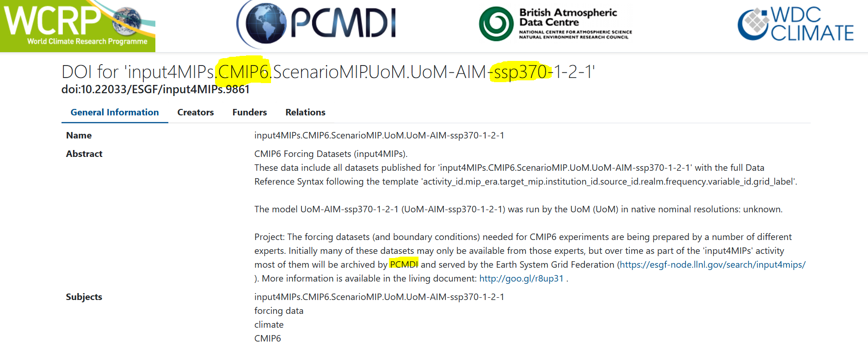
Challenges with traditional search approach
Specific Terminology in ESS data

Slide 11
Challenges with traditional search approach
Context-less single-hop queries
Lexical Search issues
Specific Terminology in ESS data
Complex queries:
🌍🕒 Spatio-temporal queries:
„Historic buildings around…“, „“Heavy Precipitation Europe“, „Climate Projection 2020-2100“
❓ Ambiguous entities:
„Radiation data“, „Buildings in Frankfurt Germany“…
🌍 🤷 Vague spatial entities:
„…East coast…“, „North of Ireland“

Slide 12
Improvements with LLM-based search
Improved capabilities for …
… query interpretation
… search result interpretation
… context-awareness
… semantic search

Slide 13
Scenario in this tutorial

Slide 14
Scenario: Design of a LLM-driven search architecture for geodata
Data:
OpenStreetMap Data (buildings in Dresden, ~50k features used)
Data Pre-processing
Representing OSM data as embeddings
Loading data into a vector store
LLM-based search:
Retrieval of the data
Using data as context

Slide 15
Scenario
Part 1:
1. Fetch Data
2. Try lexical search
3. Prepare data for vector store
Two query scenarios
Queries for a specific buildings (by name) (e.g. "Deutsches Hygiene Museum")
Queries by building type (e.g. "museums in Dresden")

Slide 16
Scenario
Part 2:
1. Create Collection
2. Issues with single collection
3. Semantic Routing
4. Query with multiple collections

Slide 17
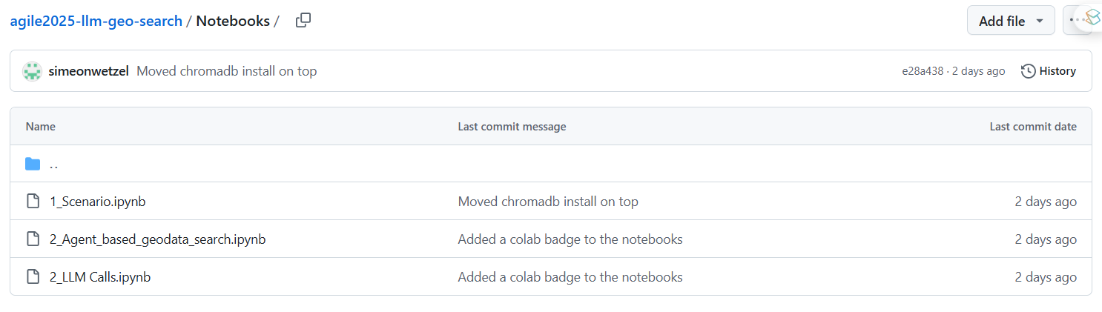

Notebook:
https://bit.ly/agile25-llm

Slide 18

API Keys
https://bit.ly/agile25-key

