Slide 1

Advanced Programing Language
Welcome To
The project of

Slide 2
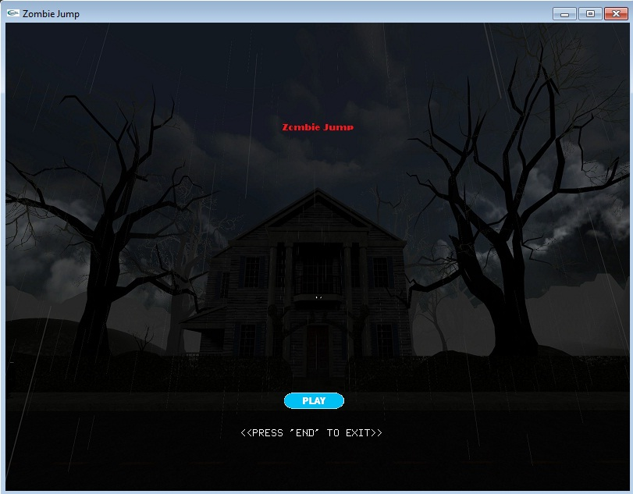
Zombie Jump
Ferdous Zaman Ebtesham
ID : 011 162 125

Slide 3
C language & iGraphics
Game is build with C language and iGraphics platform
iGraphics functions: iDraw, TOMB, zombieMOVE, zombieUP
for the movements and effects
iKeyboard, iSpecialKeyboard for the user to control

Slide 4
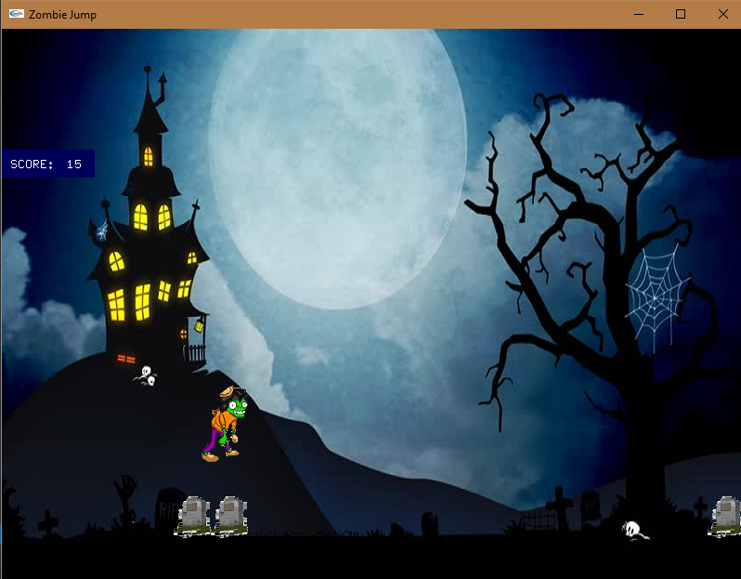
Intro & Gameplay
The game consists ‘Zombie’ walking along a
path at moon night. After walking some steps
suddenly some grave yard tombs come across him.
To survive the player has to make the zombie
get away from those tombs. So the player makes the
zombie jump over those obstacles then the zombie
survives and scores.

Slide 5
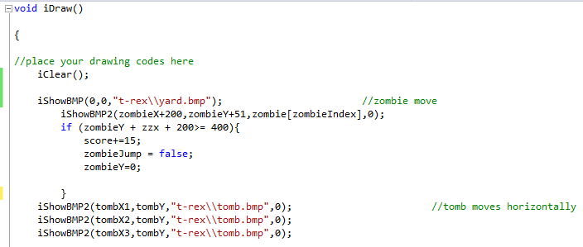
Code Section
Effects & Co-ordinates
The game will start after running the code.
The ‘Zombie’ will be standing on a path walking
towards some tombs. The tombs will be coming
towards the zombie at a specified speed.
The player have to dodge those tombs.

Slide 6
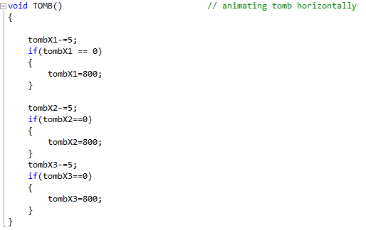
Animating tombs horizontally
Specified horizontal point of the tomb
Horizontal tomb movement speed

Slide 7
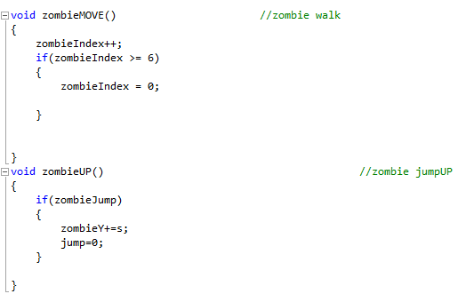
Animating Zombie
Specified zombie point on the screen
Zombie walking animation at a specified speed
Zombie jumps over tombs at a small distance

Slide 8
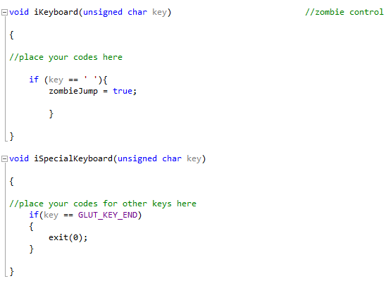
User control Keyboard
Pressing ‘Space’ / ‘ ’ makes the zombie jump.
Pressing ‘end’ exits the game.

Slide 9
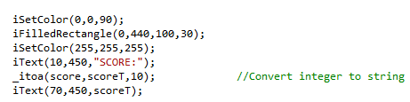
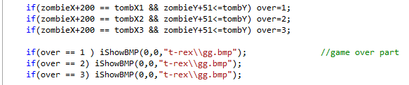
Score & End Game
Score Shows the points for each perfect
jumps.
The end codes recognizes the zombie to
collide with any tombs and ends the game

Slide 10
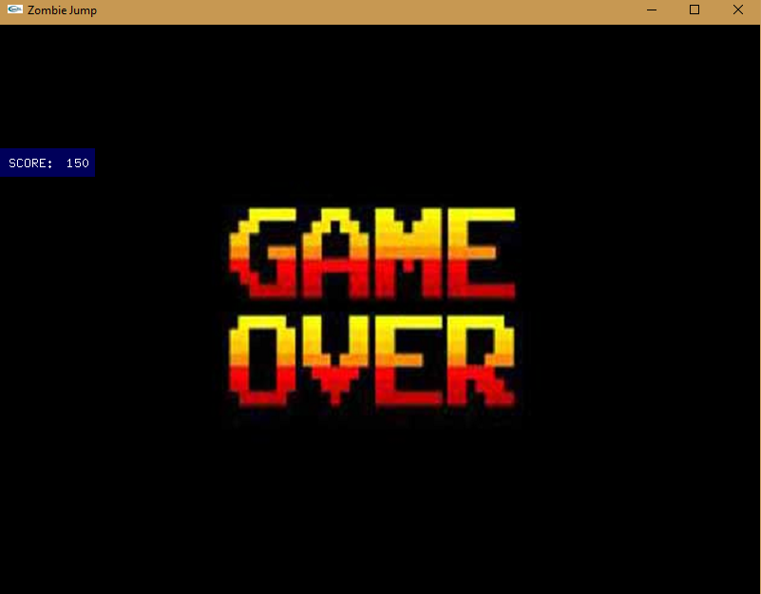
The window at the
end of the game

Slide 11
Thanks to all…

