Slide 1
Aperture Framework
a Java framework to extract data and metadata
Leo Sauermann, DFKI GmbH
Chris Fluit, Aduna Software
Antoni Myłka, DFKI/Aduna
2.10.2008

Slide 2
Overview
Problem of data extraction and transformation
Approach: a Java framework to extract data and transform it to RDF
How to use it
How to extend and develop it
The Aperture Sourceforge Project
Summary

Slide 3
Data Extraction
Data exists in various sources: e-mails, files, webpages, calendars, proprietary databases
We want to integrate them
  for search
  for desktop search/ personal information management
  for company search/ organizational memories / knowledge management
People may think:
Extracting the data is the easy part, storing, searching and making the application useful is the hard part

Slide 4
Problem of Data Extraction
When faced with multiple file types and multiple data sources, and multiple operating systems, its not the easy part
Therefore: Aperture
  should extract data
  should allow the data to be reused
  should be extensible
  should run cross platform

Slide 5
Aperture
A Java project
Cross Platform
Extracts data from various information sources by crawling the information source
Transforms the data from existing format to RDF, using a set of ontologies developed for Aperture
To use Aperture, you have to write an application. Aperture only does the crawling and extraction, not storage or anything else

Slide 6
Overview of components
File System
1
FileSystemCrawler
2
3
Crawler-
Handler
Binary stream
MimeTypeIdentifier
Binary
streams
and
metadata
MIME type
IMAP server
ImapCrawler
ExtractorRegistry
4
PdfExtractor
MS Outlook
OutlookCrawler
Binary stream +
MIME type
HtmlExtractor
Full-text
and/or metadata
WordExtractor
…
Websites
WebCrawler
5
color legend
Aperture Components
Data Storage (LuceneSail)‏
Your Data Sources
Lucene Index
Metadata Store
Your Glue Code
Your Storage

Slide 7
  How to use Aperture?
  Make everything as simple as possible
  but not simpler
  Albert Einstein

Slide 8
Configuring a data source
Create a DataSource instance
Configure the datasource using RDF
public DataSource getFileSystemDataSource(File rootFolder, URI dsUri)
throws Exception {
Model model = RDF2Go.getModelFactory().createModel();
RDFContainer configuration =
new RDFContainerImpl(model,dsUri);
FileSystemDataSource source = new FileSystemDataSource();
source.setConfiguration(configuration);
source.setRootFolder(rootFolder.getAbsolutePath());
return source;
}
More on: http://aperture.wiki.sourceforge.net/DataSources

Slide 9
Handling data: crawler handler
Implement a CrawlerHandler that gets notified when the crawler finds resources
Subclass CrawlerHandlerBase, implement abstract methods
  objectNew()‏
  objectChanged()‏
  objectRemoved()‏
  crawlStopped()‏
public void objectNew(Crawler crawler, DataObject object) {
// first we try to extract the information from the binary file
processBinary(object);
// then we add this information to our persistent model
myDataBase.addModel(object.getMetadata().getModel());
// don't forget to dispose of the DataObject
object.dispose();
}
More on: http://aperture.wiki.sourceforge.net/Crawlers

Slide 10
Setting up a crawler
Create a crawler and configure the datasource
Invoke the crawling functionality of the crawler
public void crawlFolder(File folder)
throws Exception {
FileSystemCrawler crawler = new FileSystemCrawler();
crawler.setDataSource(getFileSystemDataSource(folder));
crawler.setDataAccessorRegistry(new DefaultDataAccessorRegistry());
crawler.setCrawlerHandler(new TutorialCrawlerHandler());
crawler.crawl();
}
More on: http://aperture.wiki.sourceforge.net/Crawlers

Slide 11
Incremental crawling
Set up an AccessData instance
Configure the crawler and crawl (all objects are reported as new)‏
Crawl once more (all objects are reported as unmodified, modified, new or deleted)‏
public void crawlFolder(File folder, AccessData ad)
throws Exception {
FileSystemCrawler crawler = new FileSystemCrawler();
crawler.setDataSource(getFileSystemDataSource(folder));
crawler.setDataAccessorRegistry(new DefaultDataAccessorRegistry());
crawler.setCrawlerHandler(new TutorialCrawlerHandler());
crawler.setAccessData(ad);
crawler.crawl();
}
More on: http://aperture.wiki.sourceforge.net/Crawlers

Slide 12
Extracting Full-text from a file
Get an InputStream from somewhere
Create an extractor and a container for the data
Extract the fulltext
public String getFullTextFromPDF(InputStream pdfStream) throws
ExtractorException {
PdfExtractor ex = new PdfExtractor();
Model model = RDF2Go.getModelFactory().createModel();
model.open();
RDFContainer res = new RDFContainerImpl(model,
new URIImpl("uri:testuri"));
ex.extract(new URIImpl("uri:testuri"), pdfStream, null, null, res);
return res.getString(NIE.plainTextContent);
}
More on: http://aperture.wiki.sourceforge.net/Extractors

Slide 13
Getting the mime type
Get an InputStream from somewhere
Get an array of bytes from the beginning of the stream
Determine the mimeType
public String getMimeType(InputStream stream, URI uri) {
MimeTypeIdentifier mti = new MagicMimeTypeIdentifier();
stream.mark(mti.getMinArrayLength());
byte[] bytes = IOUtil.readBytes(stream, mti.getMinArrayLength());
String mimeType = mti.identify(bytes, null, uri);
stream.reset();
return mimeType;
}
More on:http://aperture.wiki.sourceforge.net/MIMETypeIdentification

Slide 14
Finding the right extractor
Get an InputStream from somewhere
Use MimeTypeIdentifier to get the mime type
public Extractor getExtractor(InputStream stream, URI uri,
RDFContainer res) throws Exception {
String mimeType = getMimeType(stream, uri);
ExtractorRegistry registry = new DefaultExtractorRegistry();
Set set = registry.getExtractorFactories(mimeType);
if (set.size() > 0) {
ExtractorFactory factory = (ExtractorFactory)set.iterator().next();
return factory.get();
} else {
return null;
}
}
More on: http://aperture.wiki.sourceforge.net/Extractors

Slide 15
  How to extend Aperture?
  Don't ask what Aperture can do for you,
  ask what you can do for Aperture
  Aperture Administrators

Slide 16
Extending the framework
Flexible framework, can be extended
Custom
  Crawlers: crawl sources
  Extractors: extract metadata RDF and fulltext from binary stream

Slide 17
Crawlers
API for crawling “information systems” in the broadest sense possible
Input: source description
  e.g. root folder, start URL, IMAP account credentials
Output: a stream of “DataObjects”, encapsulating
  Source-specific metadata: location, size, last modification date, ...
  Binary data stream
Various generic implementations: file system, websites,
IMAP, Outlook (alpha)‏
Supports batch and incremental crawling (change detection)‏
Generic architecture, e.g. uses configurable scheme handlers,
hypertext link extractors, ...
Custom implementations possible
  New generic Crawlers, e.g. Exchange, FTP
  Optimized generic Crawlers, e.g. WindowsFileSystemCrawler
  Client-specific Crawlers, e.g. a proprietary document store

Slide 18
Extractors
API for extracting structured information from binary resources
Typically full-text and metadata like titles and authors,
but theoretically everything than can be expressed in RDF
Generic implementations available for common document formats:
  MS Office (including Office 2007)‏
  OpenDocument/OpenOffice
  PDF
  HTML
  XML
  RTF
  Plain text
  ...
Possible to create tailor-made implementations
  e.g. for a proprietary binary format
  e.g. for a PDF document that follows certain
  enterprise structural standards

Slide 19
Crawler Handler
Event-based API for processing Crawler output
Takes care of what happens to crawl results
  “glues everything together”
  e.g. apply Extractor on binary object stream,
  store results in Sesame/Lucene/...
Typically application-specific
  No generic CrawlerHandler implementation available,
  only example code
  Therefore: some programming to be done for Aperture integrators
  But also: allows for a great deal of flexibility

Slide 20
  The Project
  We are family!
  Get up everybody and see!
  Sister Sledge

Slide 21
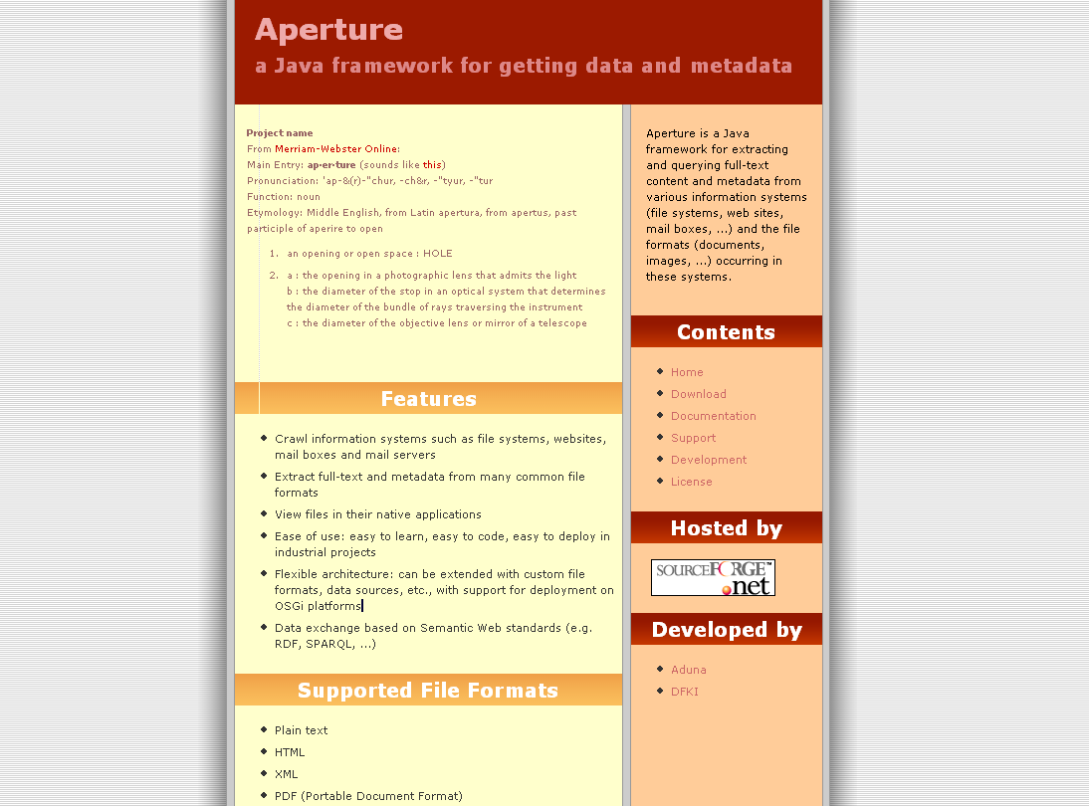

Slide 22



The Aperture Sourceforge Project
Joint project of Aduna and DFKI
  Started on 18th October 2005
  Current version: 1.2.0.beta
  In production use at both organizations
Increasing popularity
  Used in a number of projects, also outside Aduna & DFKI
  Almost 10000 downloads so far
  Growing mailing list activity

Slide 23
Example applications
Aduna Autofocus and AutoFocus Server
Gnowsis 0.9.2
DynaQ by DFKI
Nepomuk
Sun's Customer Engineering Platform
Research projects
  Waves@FZI,
  ForFlow@BayerischeForschungsallianz
  Qualipso@UniReyJuanCarlosMadrid

Slide 24
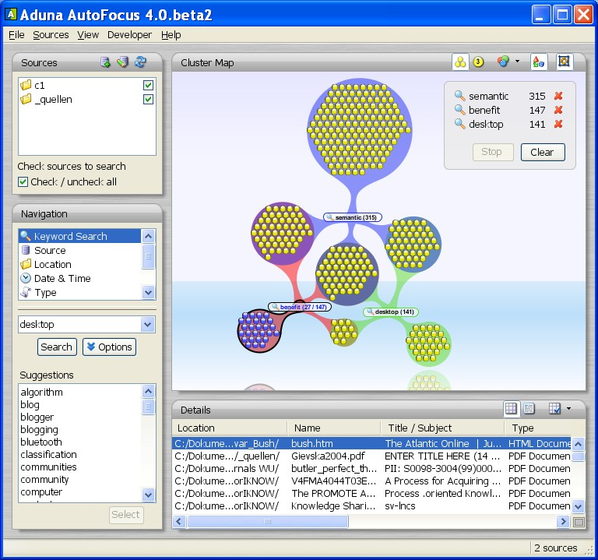

Slide 25

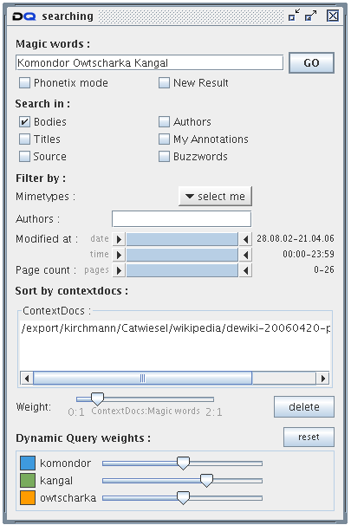
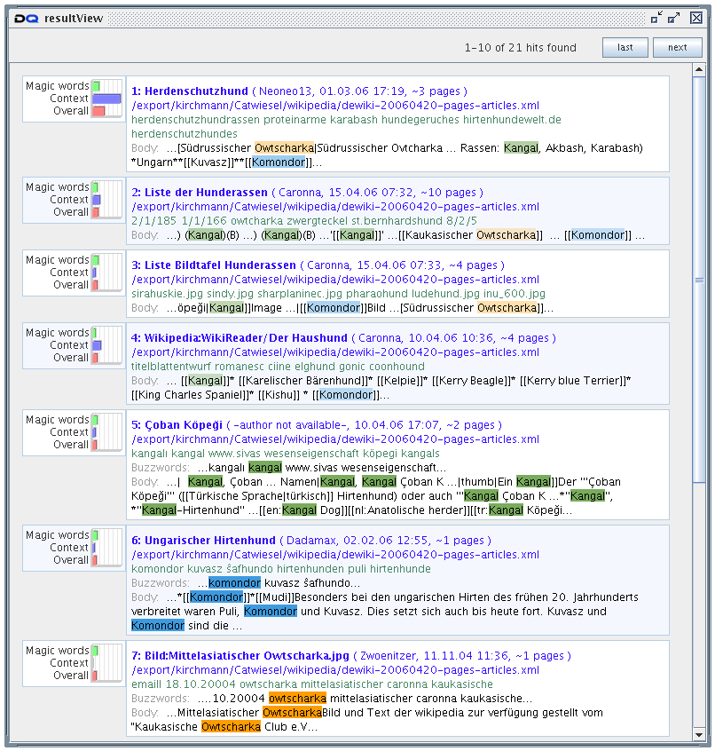
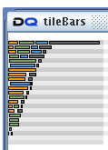
DynaQ – Search front-end

Slide 26
DynaQ – Result view

Slide 27
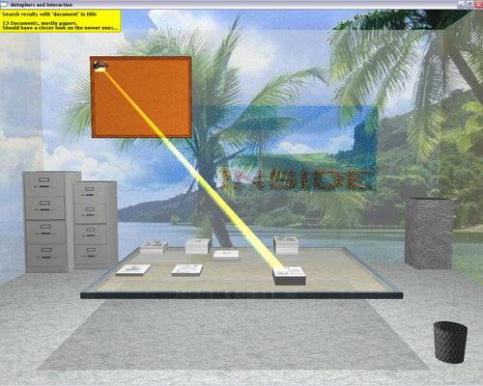
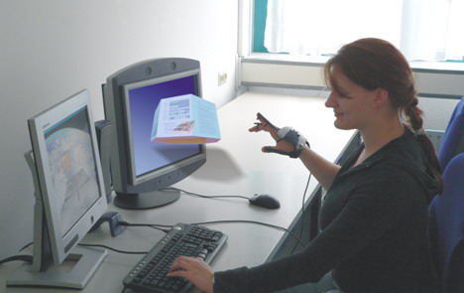
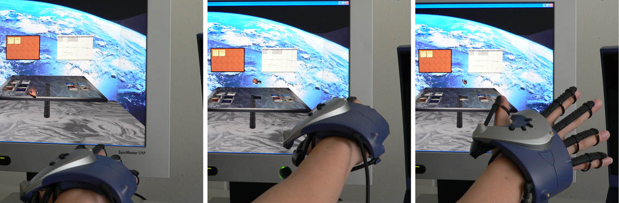
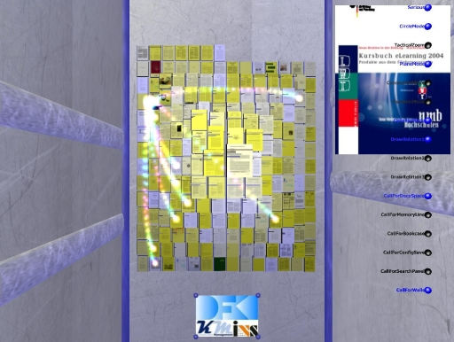
Applications based on the DynaQ back-end

Slide 28
Future Plans
Archive support: RAR, (G|B)ZIP & TAR WORK!!!
Background scanning
  Not an easy task: play nice with OS,
  handle OS shutdown, ...
  Not clear yet whether this falls inside Aperture's scope
Microsoft stuff:
  Outlook
  Outlook Express
  Exchange
Non-document formats:
  Audio MP3 WORKS ALREADY!!
  Video
  Graphics
Document previews

Slide 29
Summary
Aperture is a Java framework to extract data and metadata

