Slide 1
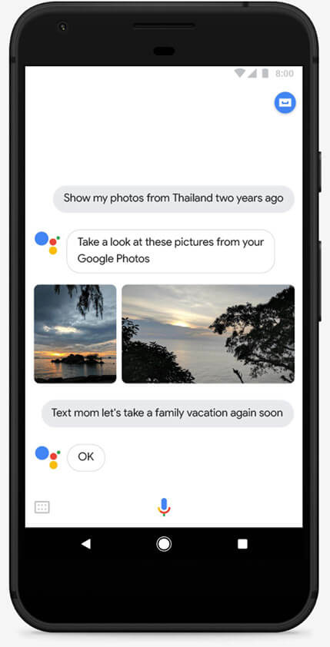
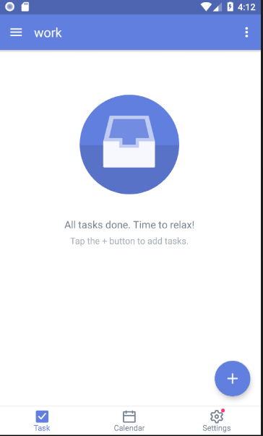



Software Testing and Verification
盧家馨 106598005
李炘潤 106598020
黃靖幃 106598035
吳承軒 106598068

Slide 2

APP INTRODUCTION
TickTick 是一個強大的待辦事項和任務管理軟體，
它可以在您的所有裝置上進行無縫雲端同步。
無論是計劃行程、做備忘錄、與家庭成員分享購物清單還是與您的同事協作，
TickTick都能幫助您輕鬆完成並保持生活軌跡。
4.6
2

Slide 3
Outline
Final presentation
Test criteria
Our planned test criteria for the project
A
Test scripts
Show the test scripts of sample test cases
Method for test cases
Describe the methods used to design the test cases
Live demo
A short Live demo of the test execution
Features to be tested
Test results
All the test cases and their covered features to be tested
The test result showing in tools
Testing tools
The testing tools used for the project
Team member contributions
3

Slide 4
Test criteria
The items under test based on our own criteria
依據Log前方顯示icon顏色來分級
階級 | 需求
Critical | 紅色數量不超過3個
Warning | 黃色數量不超過2個
Normal | 沒有紅色icon且黃色icon數量不大於1
測試通過條件: 符合Warning level
4

Slide 5
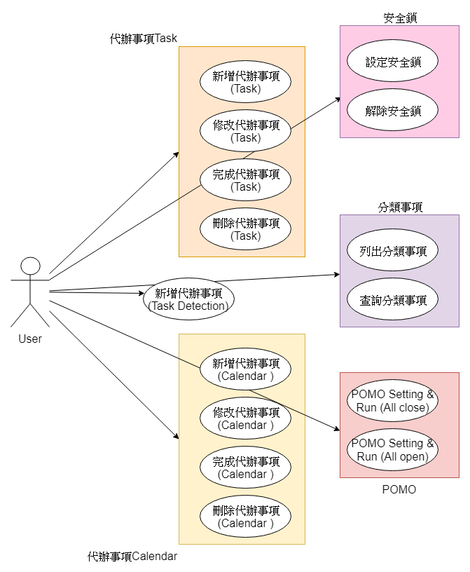
Test case
5

Slide 6
ISP
Method for test cases
ISP
Use case testing
Use case testing
6

Slide 7
Category | Params | Characteristic ID | Characteristic Description | Partitions (Blocks)
inbox | inbox name | C1, C2, C3, C4, C5, C6 | C1: 一般字串”string”, C2: null, C3: 正整數, C4: 負整數, C5: tag開頭符號(#), C6: 一般符號 | C1: {inbox name =’string’}, C2: {inbox name = null}, C3: { inbox name = 88}, C4: { inbox name = -88}, C5: { inbox name = ‘#’}, C6: { inbox name = ‘@’}
Tag | tag name | C1, C2, C3, C4, C5 | C1: 一般字串” normal_tag”, C2: null, C3: 正整數, C4: 負整數, C5: 符號 | C1: {inbox name =’ normal_tag}, C2: {inbox name = null}, C3: { inbox name = positive_tag}, C4: { inbox name = negative_tag}, C5: { inbox name = ‘symbol_tag’}
7

Slide 8
Category | Params | Characteristic ID | Characteristic Description | Partitions (Blocks)
date | Date | C1, C2, C3, C4, C5, C6, C7, C8, C9, C10, C11 | C1: 月正常日正常, C2: 月0日正常, C3: 月>12日正常, C4: 月<1日正常, C5: 月字串日正常, C6: 月null日正常 C7: 月正常日>31, C8: 月正常日<1, C9: 月正常日字串, C10: 月正常日null, C11: 日期不在月曆上 | C1: { Date =1/10}, C2: { Date = 0/10}, C3: { Date = 13/10}, C4: { Date =-1/10}, C5: { Date =S/10}, C6: { Date =null/10}, C7: { Date =10/32}, C8: { Date =10/-10}, C9: { Date =10/S}, C10: { Date =10/null}, C11: { Date =6/31},
time | Time | C1, C2, C3, C4, C5, C6, C7, C8, C9, C10 | C1: 時正常分正常 C2: 時>24分正常 C3: 時<0分正常, C4: 時字串分正常, C5: 時null分正常, C6: 時正常分>59 C7: 時正常分<0, C8: 時正常分>60, C9: 時正常分null, C10: 時正常分字串, | C1: { Time = 00:00 }, C2: { Time = 25:00}, C3: { Time = -1:00}, C4: { Time =one:00}, C5: { Time =null:00}, C6: { Time =00:60}, C7: { Time =00:-10}, C8: { Time =00:61}, C9: { Time =00:null}, C10: { Time =00:S}
8

Slide 9
Features to be tested
All the test cases and their covered features to be tested
Feature to be Tested | Test Case ID | Description
代辦事項 CRUD | TC-01 | 新增代辦事項 ( Task Detection )
 | TC-02 | 新增代辦事項 ( Task General )
 | TC-03 | 修改代辦事項 ( Task )
 | TC-04 | 完成代辦事項 ( Task )
 | TC-05 | 刪除代辦事項 ( Task )
 | TC-06 | 新增代辦事項 ( Calendar )
 | TC-07 | 修改代辦事項 ( Calendar )
 | TC-08 | 完成代辦事項 ( Calendar )
 | TC-09 | 刪除代辦事項 ( Calendar )
分類事項 | TC-10 | 列出分類事項
 | TC-11 | 查詢代辦事項
Pomo | TC-12 | Pomo Setting & Run ( all close )
 | TC-13 | Pomo Setting & Run ( all open )
安全鎖 | TC-14 | 設定安全鎖
 | TC-15 | 移除安全鎖
9

Slide 10
Testing tools
System | Windows 10
 | JDK9
Maven project (Test script) | UI Automator Viewer
 | Appium v1.6.4
Device | Android (8.0)
Test Server | Appium v1.6.4
10

Slide 11
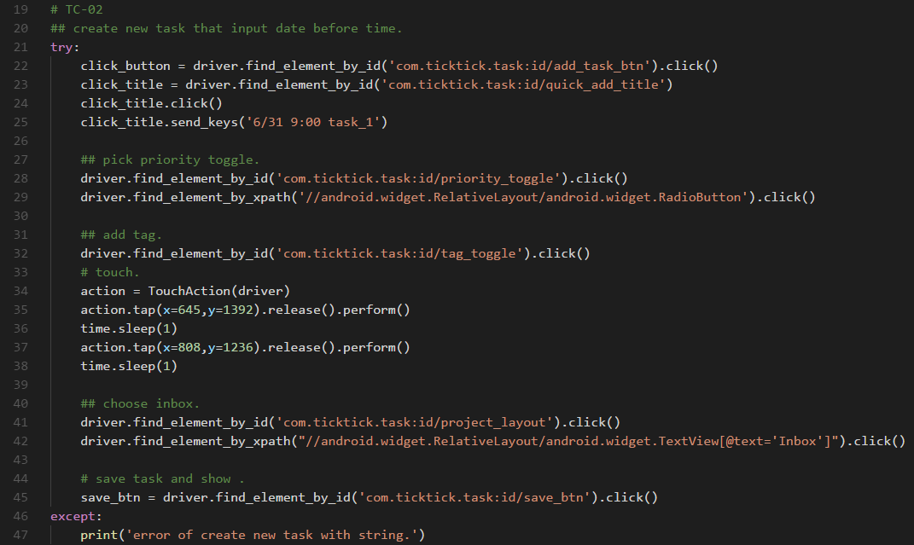
Test scripts(TC-02)
11

Slide 12
Live demo
請參閱雲端連結
https://drive.google.com/drive/folders/1PheLbfw8pWycbpDIWLsniJdD3UhqHOR5?usp=sharing
12

Slide 13
Test results
Test Case ID | Description | Output
TC-01 | 新增代辦事項 ( Task Detection ) | 新增代辦事項成功
TC-02 | 新增代辦事項 ( Task General ) | 修改代辦事項成功
TC-03 | 修改代辦事項 ( Task ) | 修改代辦事項成功
TC-04 | 完成代辦事項 ( Task ) | 完成代辦事項成功
TC-05 | 刪除代辦事項 ( Task ) | 刪除代辦事項成功
TC-06 | 新增代辦事項 ( Calendar ) | 新增代辦事項成功
TC-07 | 修改代辦事項 ( Calendar ) | 修改代辦事項成功
TC-08 | 完成代辦事項 ( Calendar ) | 完成代辦事項成功
TC-09 | 刪除代辦事項 ( Calendar ) | 刪除代辦事項成功
TC-10 | 列出分類事項 | 列出分類事項成功
TC-11 | 查詢代辦事項 | 查詢代辦事項成功
TC-12 | Pomo Setting & Run ( all close ) | all open 成功
TC-13 | Pomo Setting & Run ( all open ) | all open 運行成功
TC-14 | 設定安全鎖 | 設定安全鎖成功
TC-15 | 移除安全鎖 | 解除安全鎖成功
13

Slide 14
Team member contributions
文件撰寫、測試案例設計、測試腳本撰寫
文件撰寫、測試案例設計、測試腳本撰寫
文件撰寫、測試案例設計、測試腳本撰寫
文件撰寫、測試案例設計、測試腳本撰寫
14

Slide 15
Thanks for listening

