Slide 1
Course Overview:
Big Data Mining and Applications
J. H. Wang
Mar. 2, 2018

Slide 2
Instructor & TA
Instructor
  J. H. Wang (王正豪)
  Associate Professor, CSIE, NTUT
  Office: R1534, Technology Building
  E-mail: jhwang@csie.ntut.edu.tw
  Tel: ext. 4238
  Office Hour: 4:10-6:00pm, every Monday and Wednesday
TA
  Jack Lin (@ R1424, Technology Building)
  E-mail: jack888835@gmail.com
Big Data Analytics, Spring 2018
NTUT CSIE

Slide 3
What is Data Mining
Data mining is the computational process of discovering patterns in large data sets involving methods at the intersection of artificial intelligence, machine learning, statistics, and database systems. [source: Wikipedia]
Big Data Analytics, Spring 2018
NTUT CSIE

Slide 4
Knowledge Discovery (KDD) Process
Knowledge
This is a view from typical database systems and data warehousing communities
Data mining plays an essential role in the knowledge discovery process
Pattern Evaluation
Data Mining
Task-relevant Data
Data Warehouse
Selection
Data Cleaning
Data Integration
[source: Han 2011]
Databases
Big Data Analytics, Spring 2017
NTUT CSIE

Slide 5
KDD Process: A Typical View from ML and Statistics
Pattern
Information
Knowledge
Input Data
Data Pre-Processing
Data Mining
Post-Processing
Data integration
Normalization
Feature selection
Dimension reduction
Pattern discovery
Association & correlation
Classification
Clustering
Outlier analysis
… … … …
Pattern evaluation
Pattern selection
Pattern interpretation
Pattern visualization
This is a view from typical machine learning and statistics communities
[source: Han 2011]
Big Data Analytics, Spring 2017
NTUT CSIE

Slide 6
What is Big Data?
Big data is a term for data sets that are so large or complex that traditional data processing application softwares are inadequate to deal with them
Challenges include capture, storage, analysis, data curation, search, sharing, transfer, visualization, querying, updating and information privacy [source: Wikipedia]
Big Data Analytics, Spring 2018
NTUT CSIE

Slide 7
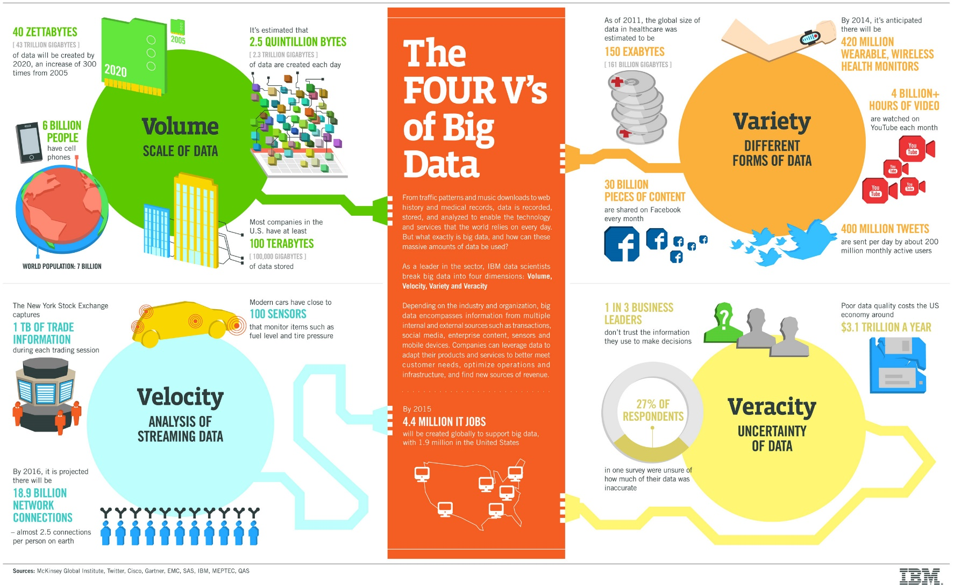
The Four V’s of Big Data
[source: IBM]
Big Data Analytics, Spring 2018
NTUT CSIE

Slide 8
What is Big Data?
“Big data is data whose scale, distribution, diversity, and/or timeliness require the use of new technical architectures and analytics to enable insights that unlock new sources of business value.”
[source: C. Manyika, Big Data: The next frontier for innovation, competition, and productivity, McKinsey Global Institute, 2011]
Big Data Analytics, Spring 2017
NTUT CSIE

Slide 9
Characteristics of Big Data
Five V’s:
  Volume: scale
  Velocity: timeliness
  Variety: diversity
  Veracity: uncertainty
  Value
Big Data Analytics, Spring 2017
NTUT CSIE

Slide 10
Data Structures
Variety: different forms
  Structured: databases, spreadsheets, …
  Semi-structured: textual files such as Web pages, XML, …
  Unstructured: text documents, images, videos, …
Data growth is increasingly unstructured
  Social media: Facebook, Twitter, …
Big Data Analytics, Spring 2017
NTUT CSIE

Slide 11
Differences from traditional data analysis
Distinct requirements
  Combining of multiple unrelated datasets
  Processing of large amounts of unstructured data
  Harvesting of hidden information in a time-sensitive manner
Newer techniques that leverage computational resources
Interdisciplinary
  Mathematics, statistics, computer science, subject matter expertise
Benefits
  Optimization, predictions, fault or fraud detection, improved decision making, discoveries
Big Data Analytics, Spring 2017
NTUT CSIE

Slide 12
Big Data: Some Examples
Web pages and social media
Retail sales and e-commerce
Sensors, mobile and wearable devices
And many others: healthcare, natural resources, education, public sector, insurance, transportation, finance and crime detection, …
Big Data Analytics, Spring 2018
NTUT CSIE

Slide 13
Related Terms
Data science, predictive analytics
Business intelligence, FinTech
IoT, CPS, Industry 4.0
Smart homes, smart cities
Data mining, machine learning, artificial intelligence
Cloud computing, data-intensive computing, parallel computing, distributed computing
…
Big Data Analytics, Spring 2018
NTUT CSIE

Slide 14
The Major Focus in Big Data Analytics
The management of complete data lifecycle
  Collecting
  Cleansing
  Organizing
  Storing
  Analyzing
  Visualization
  Governing
Big Data Analytics, Spring 2018
NTUT CSIE

Slide 15
Limitations of Data Analysis
CPU: computing time to execute the analysis
I/O: how much data can be put in memory per time unit
Memory: how much data can be processed at a time

Slide 16
Data to be analyzed
Tall data: large number of cases
Wide data: large number of features
Tall and wide data: large number of both cases and features
Sparse data: large number of zero entries

Slide 17
Algorithm to be used
How complex is your algorithm
How many parameters in your model
Are the optimization processes parallelizable
Does your algorithm learn from all data or small batches of data

Slide 18
Possible solutions
Scale up: performance improvement on a single machine
  More memory, faster CPU, faster storage, using GPUs, …
Scale out: performance improvement by distributing computations
  Using outside resources: other CPUs, GPUs, storage
Scale up and out

Slide 19
This Class
This class overlaps with machine learning, statistics, artificial intelligence, databases but more focus on
  Scalability (big data)
  Algorithms
  Computing architectures
  Automation for handling
  large data
Statistics
Machine
Learning
Data Mining
Database systems
J. Leskovec, A. Rajaraman, J. Ullman: Mining of Massive Datasets, http://www.mmds.org

Slide 20
The Topics to be Covered
Introduction
Data mining concepts
  Data preprocessing
  Frequent pattern mining
  Data classification
  Data clustering
Distributed platform and parallel programming
  Introducing distributed platforms: Hadoop, Spark
  Parallel programming paradigm and concepts
  MapReduce programming
Advanced topics: applications of big data analytics
  Link analysis
  Mining social network graphs
  Frequent Itemset
  Recommender systems
  Large-scale machine learning
Big Data Analytics, Spring 2018
NTUT CSIE

Slide 21
Tentative Schedule
Before midterm
  Introduction to big data analytics (1 wk)
  Introducing distributed platforms: Hadoop, Spark (1 wk)
  MapReduce programming: pairs & stripes, relational algebra (2 wk)
  More examples: matrix multiplication, similarity (1 wk)
  Machine Learning Methods: NN, SVM (3 wks)
  Finding Similar Items (1 wk)
After midterm
  Mining Data Streams (1 wk)
  Link Analysis (1 wk)
  Frequent Itemset (1 wk)
  Recommendation Systems (1 wk)
  Social Network Graph Mining (1 wk)
  Others: Dimensionality Reduction (1 wk)
  Term Project Presentation (3-4 wks)
Big Data Analytics, Spring 2018
NTUT CSIE

Slide 22
Tentative Schedule
Week | Date | Content | Reading
1 | 3/2 | Course Overview
2 | 3/9 | Introducing distributed platforms: Hadoop, Spark
3 | 3/16 | MapReduce programming: pairs & stripes, relational algebra
4 | 3/23 | More MapReduce examples: matrix multiplication, similarity
5 | 3/30 | Finding Similar Items
6 | 4/6 | (Compensation Leave for Spring Break)
7 | 4/13 | TA: demonstration, and term project proposal; (Leave for SAC 2018)
8 | 4/20 | (Quiz): to be confirmed
Big Data Analytics, Spring 2018
NTUT CSIE

Slide 23
Week | Date | Content | Reading
9 | 4/27 | Frequent Itemsets
10 | 5/4 | (Midterm exam): to be confirmed
11 | 5/11 | Clustering | Due: Proposal
12 | 5/18 | Recommendation Systems
13 | 5/25 | PageRank & link analysis
14 | 6/1 | Large-scale machine learning
15 | 6/8 | Term Project Presentation: Week 1
16 | 6/15 | Term Project Presentation: Week 2
17 | 6/22 | Term Project Presentation: Week 3
18 | 6/29 | Term Project Presentation: Week 4 | Due: Final Report
Big Data Analytics, Spring 2018
NTUT CSIE

Slide 24
Course Information
Course Website: http://www.ntut.edu.tw/~jhwang/BDM/
  Please check often for the latest announcements and updates of schedule, slides, and homeworks
Time: 9:10-12:00am, Fri.
Classroom: R327, 6th Teaching Building
Textbook: (selected chapters)
  Jure Leskovec, Anand Rajaraman, Jeffrey David Ullman, Mining of Massive Datasets, 2nd Edition, Cambridge University Press, November 2014. (Available at: http://www.mmds.org/)
Reference book:
  Jimmy Lin and Chris Dyer, Data-Intensive Text Processing with MapReduce, Morgan & Claypool Publishers, 2010.
Prerequisites:
  Basic knowledge of data structures (and algorithms), database systems, discrete math (probability), linear algebra, and basic data mining
  Programming experience is *required* for completing homeworks & projects
Big Data Analytics, Spring 2018
NTUT CSIE

Slide 25
Additional Reading Materials
Books
  Jiawei Han, Micheline Kamber and Jian Pei, Data Mining: Concepts and Techniques, 3rd ed., Morgan Kaufmann Publishers, July 2011.
  Tom White, Hadoop: The Definitive Guide, 4th ed., O’Reilly Media, 2015.
  Holden Karau, Andy Konwinski, Patrick Wendell, Matei Zaharia, Learning Spark: Lightning-Fast Big Data Analysis, O'Reilly Media, January 2015.
Official online documents: Hadoop, Spark, …
Selected academic papers
Big Data Analytics, Spring 2018
NTUT CSIE

Slide 26
Grading Policy
Homework assignments and programming exercises: ~30%
One quiz & one mid-term exam: ~40%
Term project: ~30%
  Including proposal, presentation, and final report
All homeworks, projects, and reports must be submitted *before* the end of the semester (Jun. 29, 2018)
Big Data Analytics, Spring 2018
NTUT CSIE

Slide 27
Homeworks and Projects
About 5 programming exercises
  Team-based (<= 2 students per team)
The term project (to be detailed later)
  Either team-based system development
    e.g. extension to exercises
  Or academic paper presentation
    Only one person per team allowed
Responsibility of each member must be specified in the document for team-based works
Big Data Analytics, Spring 2018
NTUT CSIE

Slide 28
Homework Submission
Written exercises
  To hand-in in class
Programming exercises/programs/project proposals/reports
  To be submitted directly to the TA
    Homework submission site: http://mslin.ee.ntut.edu.tw
You will get discounted score when there’s delay in homework submission
  The longer the delay, the higher the discount
Big Data Analytics, Spring 2018
NTUT CSIE

Slide 29
Homework Submission Site
Programs or projects in electronic files must be submitted directly to the TA online at Open Cyber Classrooms
  http://mslin.ee.ntut.edu.tw
Please follow the instructions before your first login
  Account: Use your student ID as the account and password at your first login. Please change the password *as soon as possible* for better security.
  Note: Even if you already have accounts for other courses, you are still *required* to do it at your first login for this course.
  Filename: Compress your source code and related files into one compressed file. Please name it according to your ID and each homework. For example, [id]_HW1.zip, [id]_Quiz.tar.gz.
If you cannot successfully submit your work, please contact with the TA or the instructor.
Big Data Analytics, Spring 2018
NTUT CSIE

Slide 30
Notes on Homeworks
Rule 1: Plagiarism is strictly prohibited.
  Near-duplicate codes will get equal and minimum basic scores
Rule 2: Clear documentation is required in your system projects.
  Instructions on downloading, installing, configuring, and executing your code and open source library, APIs, or codes must be submitted
  Package control is recommended
Big Data Analytics, Spring 2018
NTUT CSIE

Slide 31
About the Exams
Quiz: programming
  Date: Apr. 21, 2018 (Sat.) (3F, Computer Center)
Midterm exam
  Date: May 4, 2018 (to be confirmed)
  Range: (TBD)
  Question Types: Calculation, Short Answer, True-False, Multiple Choice
Time: 9:10-12:00
Location: R327, 6th Teaching Building
Big Data Analytics, Spring 2018
NTUT CSIE

Slide 32
About the Term Project
The score you’ll get depends on the functionality, difficulty, and quality of your project
  For system development:
    System functions and correctness
    You can either write your own program, or call existing open source code or library (but NOT only executing existing binary)
  For academic paper presentation
    Quality and your presentation of the paper is critical
    Major methods/experimental results *must* be presented
    Papers from top conferences are strongly suggested
  Proposals, presentations, and reports are *required* for each team, and will be counted in the score
Big Data Analytics, Spring 2018
NTUT CSIE

Slide 33
More on Term Projects
Options for term projects
  Option 1: team-based system project
    e. g., extension to system exercises
  Option 2: academic paper presentation
    Only one person, NOT team-based
Tentative schedule for all teams:
  Proposal: *required* one week after midterm (May 11, 2018)
  Presentations (including demos): *required* in the last three-four weeks (starting as early as Jun. 8, 2018)
  Final report: *required* before the end of the semester (Jun. 29, 2018)
    Slides, source code, documentation
Big Data Analytics, Spring 2018
NTUT CSIE

Slide 34
For System Development
You can write your own code in any programming language
You can also call existing open source APIs or libraries
  E.g. Hadoop, Spark, TensroFlow, CUDA, …
  But simply running existing binary executables or commercial tools is NOT acceptable
The characteristics of dataset will be taken into account that make it “big data”
  Selected datasets might be announced in the course
Any topic relevant to big data analytics
  Analysis of various types of media (text, Web, social media) with big data characteristics (3V’s) using data mining methods (regression, classification, clustering)
Big Data Analytics, Spring 2018
NTUT CSIE

Slide 35
Some Example Open Source Tools for Big Data Analytics
Apache Hadoop, Spark (in Java, Scala, Python, R)
  For distributed computing and data analysis
Apache Pig, Hive, Flume, Hbase, Cassandra, Alluxio, Mahout, …
  For data flow, SQL, streaming data, distributed databases, distributed storage, machine learning,
Spark SQL, Streaming, Mlib, GraphX
  For SQL, streaming, machine learning, and graph processing
Big Data Analytics, Spring 2018
NTUT CSIE

Slide 36
More Popular Tools
PyTorch
TensorFlow, Distributed TensorFlow
CUDA for GPU processing
…
Big Data Analytics, Spring 2018
NTUT CSIE

Slide 37
Thanks for Your Attention!
Big Data Analytics, Spring 2018
NTUT CSIE

