Slide 1
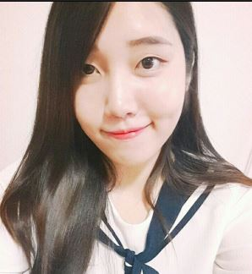
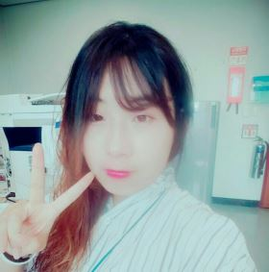

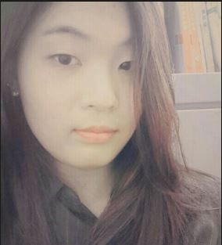
Computer Engineering Project
20140350 김 한설
20140998 이 정은
20141280 진 연주
20141337 최 은선

Slide 2
CEP
TALK
Index
TEAM Introduce
전체 구현사항
코드 & UI 소개
Demo
결과

Slide 3








TEAM Introduce
Client
Server & Database
김 한설 & 이 정은
최은선 & 진 연주

Slide 4
전체 구현 사항
Improvement ( 진 연주) | Challenge
Add support for nickname | Data Base (진 연주)
Connect or disconnects | Login / Sign Up ( 진 연주)
자신이 보낸 메시지는 append | UI( 김 한설 , 이 정은)
Add “{users} is typing” functionality | Send File ( 김 한설, 진 연주)
Show who’s online | emoticon ( 이 정은 , 진 연주)
 | Private Send (최 은선)
 | 메시지 삭제 ( 진 연주)

Slide 5
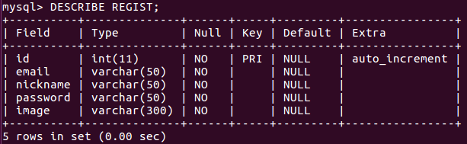
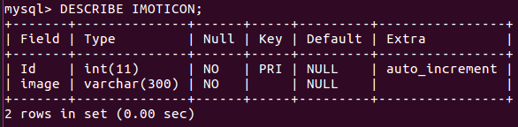

Data Base
회원 정보
emoticon

Slide 6
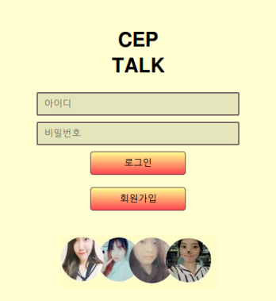
Login
<form action=“/Chat” method=“POST”>
<input type=“text” name=“id” placeholder=“아이디”/><br/>
<input type=“password” name=“password” placeholder=“비밀번호”/><br/>
<Button>로그인</Button>
</form>
<form action=“/signup” method=“GET”>
<Button>회원가입</Button>
</form>
<img src=“login.JPG” alt=“login”/>

Slide 7
Login
(1)아이디 / 비밀번호를 입력하지 않을 경우
If(req,body.id == “” || req.body.password == “”)
(2)아이디와 비밀번호 비교
Connect.query(‘select * from REGIST where email=?’,[req,body.id],function(error,result){});
If(result[i].password == req.body.password){
fs.readFile(‘index.ejs’,’utf8’,function(error,data){
res.writeHead(200,{‘Content-Type’:’text/html’});
res.end(ejs.render(data,{nickname:result[i].nickname,image:result[i].image}));
}
(3)모든 오류 처리
res.writeHead(200,{‘Content-Type’:’text/html’});
res.end(‘<script>alert(‘Wrong Data”);document.location.href=“/”;</script>

Slide 8
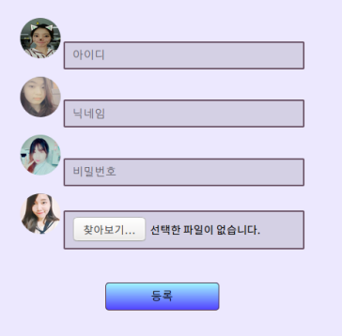
Sign Up
<form action=“/SignUp” method=“POST”
enctype=“multipart/form-data”>
<img src=“/a.jpg” alt=“”/>
<input type=“text” name=“email” placeholder=“아이디”/><br/>
<img src=“./b.jpg” alt=“”/>
<input type=“text” name=“nickname” placeholder=“닉네임”/><br/>
<img src=“./c.jpg” alt=“”/>
<input type=“password” name=“password” placeholder=“비밀번호”/><br/>
<img src=“./d.jpg” alt=“”/>
<input type=“file” name=“image”/><br/><br/>
<button>등록</button><br/>
</form>

Slide 9
Sign Up
(1)아이디 / 닉네임 / 비밀번호 / 프로필 사진을 입력하지 않았을 경우
If(req,body.email == “” || req.body.nickname == “” || req.body.password == “” || req.files.image.size == 0)
(2)아이디 / 닉네임이 이미 존재하는지 검사
Connect.query(‘select * from REGIST where email=? OR nickname = ?’,[req,body.id, req,body,nickname],function(error,result){});
If(result[i].email == req.body.email) // else if(result[i].nickname == req,body.nickname)
res.writeHead(200,{‘Content-Type’:’text/html’});
res.end(‘<script>alert(‘Already use Nickname/Email”);document.location.href=“/signup”;</script>);
(2)아이디 / 닉네임이 이미 존재하지 않는다면
Connect.query(‘insert into REIGST(email,nickname,password,image) values(?,?,?,?)’,[req.body.email,req.body.nickname,req.body.password,req.files.image.name],function(error,result){});

Slide 10
Nick Name (User list & Connect)
Socket.on(‘start’,function(data){
clientid[data]=socket.id;
socketed[socket.id]=data;
io.sockets.emit(‘user list’,Object.keys(clientid));
io.sockets.emit(‘adduser’,data);
Socket.emit(‘start’,nickname);
Connect.query(‘select * FROM IMOTICON’,function(error,result){
for(var i=0;i<result.length;i++){
socket.emit(‘imoticon’,{id:result[i].id,icon:result[i].image});
}
});

Slide 11
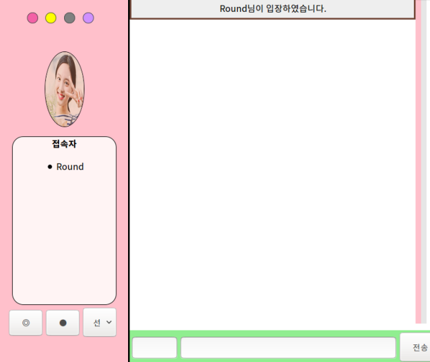
Nick Name (User list & Connect)
Socket.on(‘user list’,function(client){
$(‘#client’).empty();
for(var i=0;i<client.length;i++){
$(‘#client’).append($(‘<li>’).text(client[i]+”\n”);
}
});
Socket.on(‘adduser’,function(nickname){
$(‘#messages’).append($(‘<li id=“undefined”>’).text(nickname+’님이 입장하셨습니다.’));
$(‘#chatting’).scrollLeft(300).scrollTop(1010);
});

Slide 12
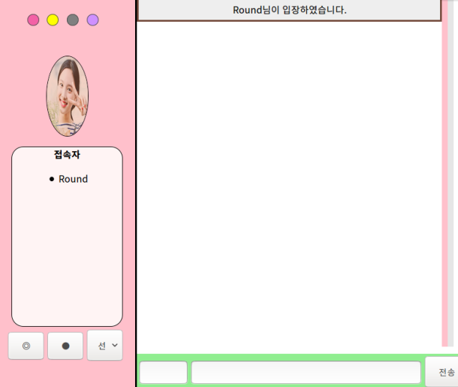
Background Color
<ul id=“bgChange”>
<button id=“color” onclick=“bgPink()” style=background-color:#F361A6></button>
<button id=“color” onclick=“bgOrange()” style=background-color:#F361A6></button>
<button id=“color” onclick=“bgBlack()” style=background-color:#F361A6></button>
<button id=“color” onclick=“bgPurple()” style=background-color:#F361A6></button>
</ul>

Slide 13
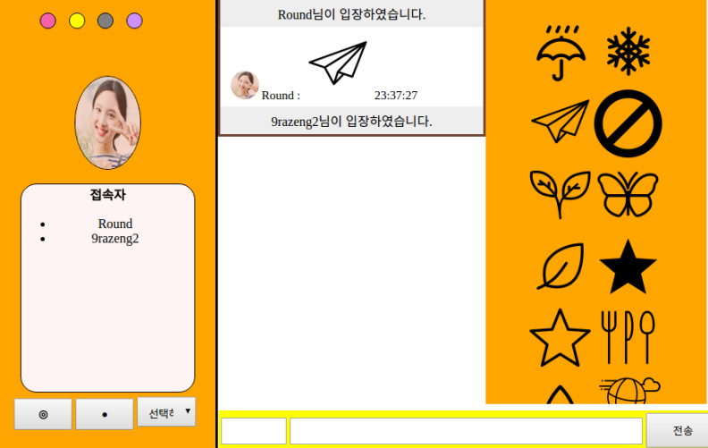
Background Color
(1)노란색버튼 클릭
Function bg<원하는 색>(){
side.style.backgroundColor=<원하는 색>
form.style.backgroundColor=<원하는 색>
hide.style.backgroundColor=<원하는 색>
}

Slide 14

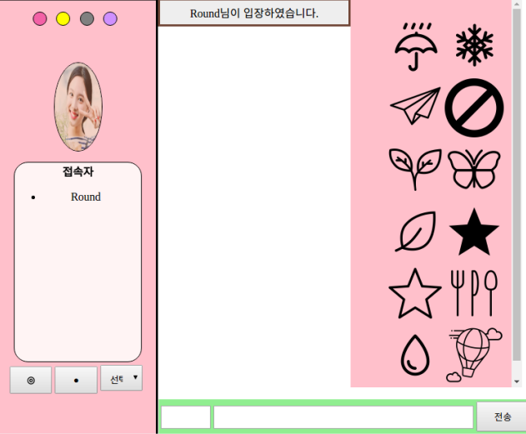
Imoticon
Hide.style.width=“0%”
Hide.style.width=“30%”
Button Click

Slide 15
Imoticon
$(‘#hide’).on(‘click’,’img’,function(e){
socket.emit(‘imoticon’,{id:this.id,nickname:nickname,image:image});
});
Socket.on(‘imoticon’,function(data){
count=count+1;
Connect.query(‘SELECT image FROM IMOTICON WHERE id=?”,[data.id],function(error,result){{);
Io.sockets.emit(‘icon’,{icon:result[i].image,nickname:data.nickname,image:data.image,count:count});

Slide 16
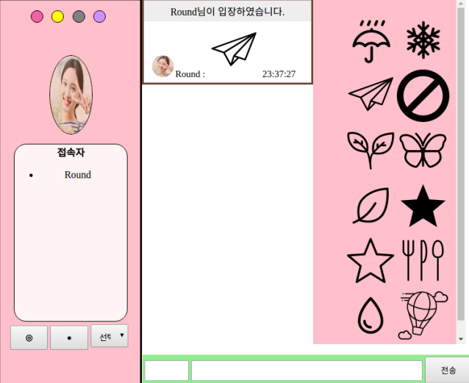
Imoticon
Socket.on(‘icon’,function(data){
$(‘#message’).append(‘<li id=‘+data.count+’>
<img id=image src=“+data.image+’>’+data.nickname+’ :
<img src=‘+data.icon+’> </li>’);
});

Slide 17
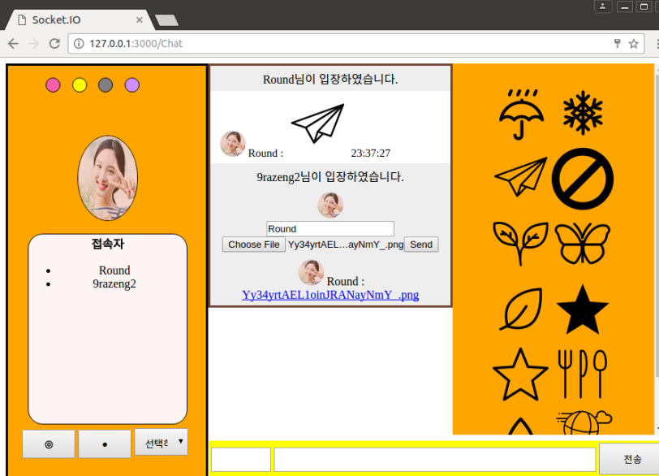
Send File

Slide 18
Send File
$(‘filebutton’).click(function(){
if(click==0){
$(‘messages’).append(‘<div id=“file”>
<li id=“undefined”>
<img id=image src=‘+image+’>
<form action=“/ “ method = “POST” enctype=“multipart/form-data”>
<input name=nickname” value=‘+nickname+’>
<input type=“file” name=“image”>
<button>Send</button>
</form>
</div>’);
click=1;
}
else{
$(‘#file’).remove();
click=0;
}
app.post(‘/’,function(req,res){
var File=req.files.image;
var name=File.name;
connect.query(‘select image from REGIST where nickname=?’,[req.body.nickname],function(error,result){});
Io.sockets.emit(‘file’,{name:req.body.nickname,file:name,image:result[i].image});

Slide 19
Send File
Socket.on(‘file’,function(msg){
$(‘#message’).append(‘<li id=“undefined”>
<img id=“image” src=‘+msg.image+’>’
+msge.name+
<a href=‘+msg.file+’ download>’+msg.file+’</a>’
);
});

Slide 20

User Typing
(1)Writing
(1)Write Stop
$(‘#msg’).keydown(function(event){
Socket.emit(‘write’,nickname);
});
$(‘#msg’).keyup(function(event){
Enumber=number-1;
Var keyed=event.keyCode;
If(number==0 || keyed ==13){
Socket.emit(‘finish’,nickname);
}
});
Socket.on(‘write’,function(nickname){
Io.sockets.emit(‘write’,nickname);
});
Socket.on(‘finish’,function(nickname){
Io.sockets.emit(‘finish’,nickname);
});
Socket.on(‘write’,function(nickname){ $(‘#message’).append($(‘<li id=‘+nickname+’>’.text(‘ooo’+nickname+’ 입력중‘));
});
Socket.on(‘finish’,function(nickname){
$(‘#’+nickname).remove();
});

Slide 21
Private Message
Socket.on(‘chat message’,function(msg){
count=count+1;
message[count]=msg.nickname;
socket.emit(‘Self’,count);
If(msg.nick == ‘’){
socket.broadcast.emit(‘chat message’,{msg:msg.msg,count:count,client:msg.nickname,image:msg.image});
Else{
io.to(clientid[msg.nick]).emit(‘chat message’,{msg:msg.msg,count:count,client:nickname+”->”+msg.nick,image:msg.image});
}
});
$(‘#form’).submit(function(){
if($(‘msg’).val()!=‘’){
socket.emit(‘chat message’,{msg:$(‘#msg’).val(),nick:$(‘#to’).val(),nickname:nickname,image:image});
return false;
}
});

Slide 22

Private Message
Socket.on(‘chat message’,function(msg){
$(‘#messages’).append(‘<li id=‘+msg.count+’>
<img id=image src=‘+msg.image+’>’
+msg.client+’\t:’+msg.msg+’ ‘+hours+’ : ‘+minuates+’ : ‘+seconds+’</li>’);

Slide 23
Delete Message
(1)삭제하고 싶은 메시지 Click
$(‘#message’).on(‘click’,’li’,function(e){
if(this.id != ‘undefined’){
this.remove();
socket.emit(‘remove’,this.id);
}
});
(1)만약 자신의 메시지라면 전체 삭제
Socket.on(‘remove’,function(data){
var nickname=message[data];
if(socket.id == clientid[nickname]){
socket.broadcast.emit(‘remove’,data);
}
});
Socket.on(‘remove’,function(id){
$(‘#’+id).remove();
});

Slide 24
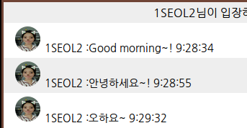
Time
function srvTime(){ if(window.XMLHttpRequest){ xmlHttp=new XMLHttpRequest(); } else if(window.ActiveXObject){ xmlHttp=new ActiveXObject('Msxml2.XMLHTTP'); } xmlHttp.open('HEAD',window.location.href.toString(),false); xmlHttp.setRequestHeader("Content-Type","text/html"); xmlHttp.send(''); st=xmlHttp.getResponseHeader("Date"); today=new Date(st); return today; }
socket.on('chat message', function(msg){ var day=srvTime(); var hours=day.getHours(); var minutes=day.getMinutes(); var seconds=day.getSeconds(); $('#'+msg.client).remove(); $('#messages').append('<li id='+msg.count+'><img id=image src='+msg.image+'>'+msg.client+"\t:"+msg.msg+' '+hours+':'+minutes+':'+seconds+'</li>'); //count.style.fontFamily=font; $('#Chatting').scrollLeft(300).scrollTop(1010); });

Slide 25
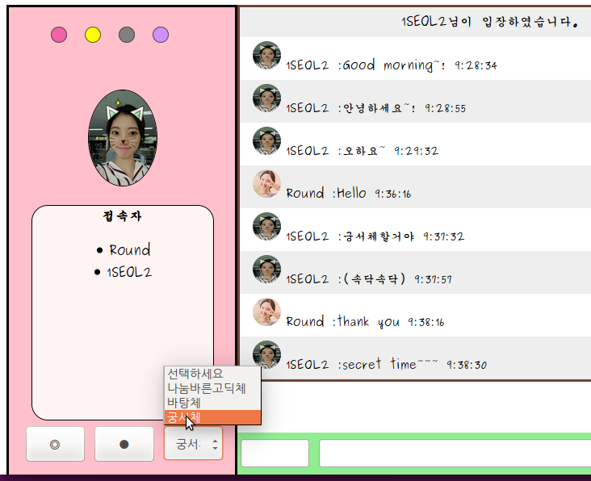
Font
<p> <td> <select> <option onclick="myFont0()">선택하세요</option> <option onclick="myFont1()">나눔바른고딕체</option> <option onclick="myFont2()">바탕체</option> <option onclick="myFont3()">궁서체</option>
</select> </td> </p>
function myFont1(){ document.getElementById("BODY").style.fontFamily = "나눔바른고딕,Tahoma"; }

Slide 26
disconnect
(1)User가 창을 나가면 disconnect 발생
Socket.on(‘subuser’,function(nickname){
$(‘#messages’).append($(‘<li id=“undefined”>’).
text(nickname+’님이 퇴장하셨습니다.’);
Socket.on(‘disconnect’,function(){
var nickname=socketed[socket.id];
if(nickname != null){
io.sockets.emit(‘subuser’,nickname);
delete socketid[socket.id];
delete clientid[nickname];
io.sockets.emit(‘disconnect users list’,Object.keys(clientid));
}
});
Socket.on(‘disconnect user list’,function(nickname){
$(‘#client’).empty();
for(var i=0;i<nickname.length;i++){
$(‘#client’).append($(‘<li>’).
text(nickname[i]+’\n’));
}
});

Slide 27
Demo

Slide 28
Q&A

Slide 29
Thank You

