Slide 1
CDS528 / DEFI SMART CONTRACT DEVELOPMENT
SafeVendor
A fixed-price token sale where every payment settles directly into a 2-of-3 treasury
SEPOLIA / CHAIN ID 11155111
SafeVendor Group
18 November 2026
Members: Yang Qingchen, Xu Fang, Wang Zijian, Wu Fei, Chen Qikai
github.com/aurora371624-star/safevendor
Notes:
0:00-0:45. Introduce the project and state the central design claim: sale proceeds never enter a seller-controlled account. Confirm the final formal group ID before submission.

Slide 2
PROBLEM STATEMENT
Buyers should not have to trust the seller's next step
A conventional token sale asks buyers to send ETH to an operator, then relies on a promise that the funds will later reach shared custody.
Custody gap
1 person
A database records the promise. It cannot make the transfer non-discretionary.
controls the money before shared custody exists
Seller promise
Treasury
off-chain and discretionary
not yet funded
Buyer goal: make this path automatic
SafeVendor / CDS528 Group Project
Problem
02
Notes:
0:45-2:15. Define the users and the custody gap. Explain why a conventional database cannot enforce the later transfer. End on the design requirement: settlement and shared custody must happen in one transaction.

Slide 3
SOLUTION DESIGN
Three contracts, one settlement path
ETH never lands in a seller-controlled account.
ETH + minimum token output
net ETH to Treasury
TokenVendor
MultiSigTreasury
Buyer
fixed price
atomic settlement
2-of-3 custody
proposal execution
pays ETH
receives SVT
SVT delivery
Recipient
receives funds only after 2 confirmations
Fixed owners / Threshold 2 / No upgrade path / No pause key
SafeVendor / CDS528 Group Project
Solution design
03
Notes:
2:15-3:30. Walk left to right. The vendor prices and checks the purchase, but the ETH path terminates at Treasury. The buyer receives SVT. Treasury can send funds only after two distinct confirmations.

Slide 4
IMPLEMENTATION
Purchase is atomic
If the treasury transfer, refund, or token delivery fails, the complete purchase reverts.
01
02
03
04
Quote
Check
Settle
Deliver
Math.mulDiv converts ETH into token units at the immutable price.
Reject zero payment, slippage, and insufficient inventory.
Forward net ETH to Treasury; refund the integer remainder.
Transfer SVT with SafeERC20 and emit TokensPurchased.
The seller can supply inventory, but cannot withdraw sale ETH from the vendor.
SafeVendor / CDS528 Group Project
Purchase flow
04
Notes:
3:30-5:00. Explain the four checks and the direct settlement path. Emphasize atomicity: there is no partial success state and no seller custody window.

Slide 5
SHARED CUSTODY
One owner can propose. One owner cannot move funds.
Owner set
Execution sequence
Owner 1
O
submits + confirms
1
Submit
THRESHOLD
Records first confirmation
2 / 3
Owner 2
O
second confirmation
Confirm
2
A different owner adds the threshold vote
Owner 3
O
backup approval
3
Execute
Any owner calls; executed is set before the external call
Residual risk: two compromised owners can collude. Availability requires at least two live owner keys.
SafeVendor / CDS528 Group Project
Treasury flow
05
Notes:
5:00-6:30. Explain the submit, confirm, execute sequence. Submission is the first vote. A second distinct owner is required. Mention key loss and collusion assumptions.

Slide 6
TESTING AND SECURITY
Security is enforced at the state boundary
Threat | Attack path | Control
Single-owner exfiltration | One owner tries to move funds | 2-of-3 threshold
Replay | Execute the same proposal twice | executed set before the call
Duplicate approval | One owner votes repeatedly | per-owner confirmation map
Unauthorized action | Non-owner submits or executes | onlyOwner checks
Payment ambiguity | Rounding or failed transfer | minimum output + atomic revert
Reentrancy | Recipient re-enters during ETH delivery | CEI + ReentrancyGuard
Static scan: two INFO-level low-level call findings; both are required and both return flags are checked.
SafeVendor / CDS528 Group Project
Security
06
Notes:
6:30-8:00. Focus on the state transition controls, not a generic list of attacks. The two Slither findings are informational and intentional.

Slide 7
VERIFICATION
The implementation is tested and verified
17
100%
3
0
tests passing
line coverage
verified contracts
High / Medium findings
What the tests cover
Why the scan is credible
successful purchase, rounding refunds, slippage, inventory limits, invalid configuration, duplicate approval, replay, unauthorized access, and reentrancy
Slither analyzed the reduced production scope with dependencies excluded. The complete command and raw output are stored in the repository.
Coverage
Statements 100% Functions 100% Lines 100% Branch 79.03%
SafeVendor / CDS528 Group Project
Verification
07
Notes:
8:00-9:00. Give the evidence, not a claim. Mention 17 tests, full production line and function coverage, three verified contracts, and the two INFO findings.

Slide 8
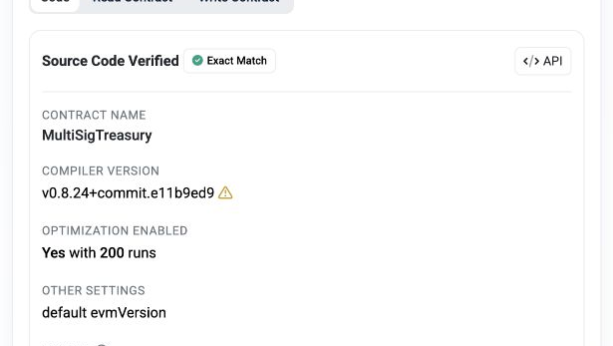
DEPLOYMENT AND DEVOPS
Sepolia deployment is live and reproducible
Contract | Address | State
SafeVendorToken | 0x734c…8B79B | Verified
MultiSigTreasury | 0xaCCb…617B4 | Verified
TokenVendor | 0x96fA…74717 | Verified
Etherscan: matching bytecode and ABI
Deployment order
Token → Treasury → Vendor → Inventory
Ops stance
Immutable by choice: no pause, proxy, owner replacement, or threshold setter. Defects require redeployment.
pnpm compile / pnpm test / pnpm deploy / pnpm verify
Generated deployment metadata:
addresses, constructor data, receipts, and frontend config
SafeVendor / CDS528 Group Project
Deployment
08
Notes:
9:00-10:00. Show that live deployment and source verification are complete. State the immutable operations choice and its trade-off.

Slide 9
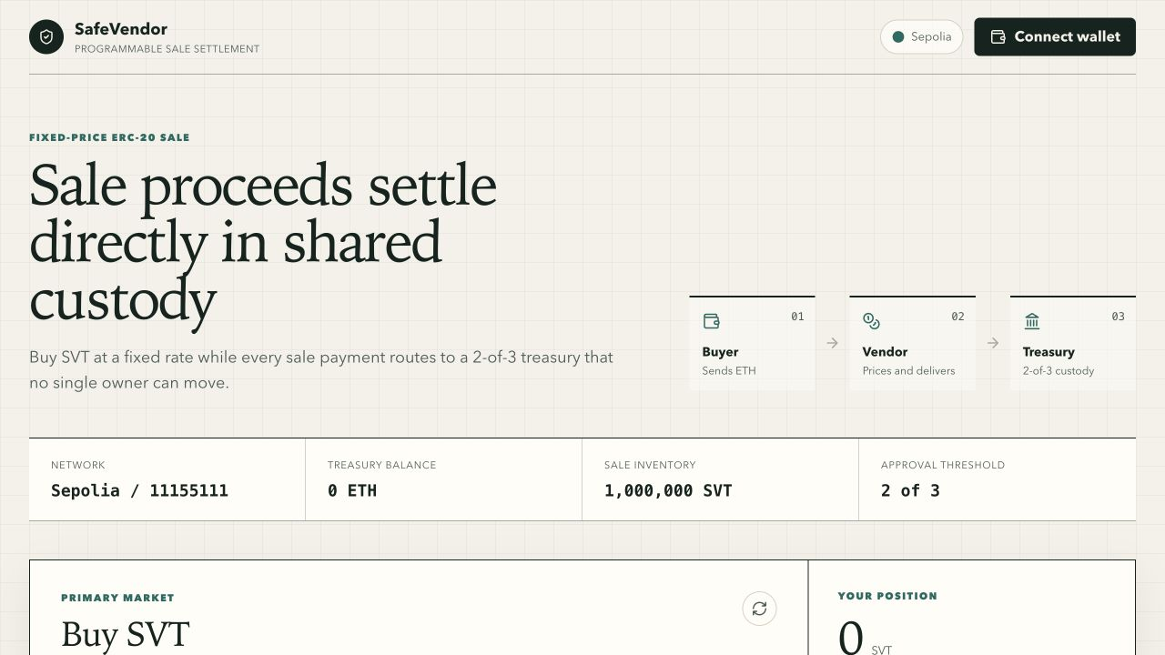
DEPLOYED STATE
The contract set is live on Sepolia
Sepolia state
1,000,000
SVT in Vendor inventory
0 ETH
Treasury balance at deployment
3 / 3
contracts verified on Etherscan
Owner 1 is the project wallet. Owner 2 and Owner 3 complete the fixed 2-of-3 treasury configuration.
SafeVendor / CDS528 Group Project
Deployed state
09
Notes:
10:00-11:30. Show the current Sepolia state: full vendor inventory, zero treasury balance, three verified contracts, and the fixed owner set. The buy and treasury actions are available for the live Q&A demonstration.

Slide 10
CONCLUSION
The trust boundary is smaller by design
01
02
03
Atomic settlement
Shared control
Public evidence
Payment, custody, and token delivery share one transaction.
One owner cannot move treasury funds alone.
Source, tests, deployment, and verification are reproducible.
Known limits
Sepolia only / fixed price / immutable / no pause or recovery / key management remains operational
Questions
Thank you
Notes:
11:30-12:00. Close on the smaller trust boundary. State the limitations without hiding them, then hand over to Q&A. Keep the Etherscan links ready.

