Slide 1
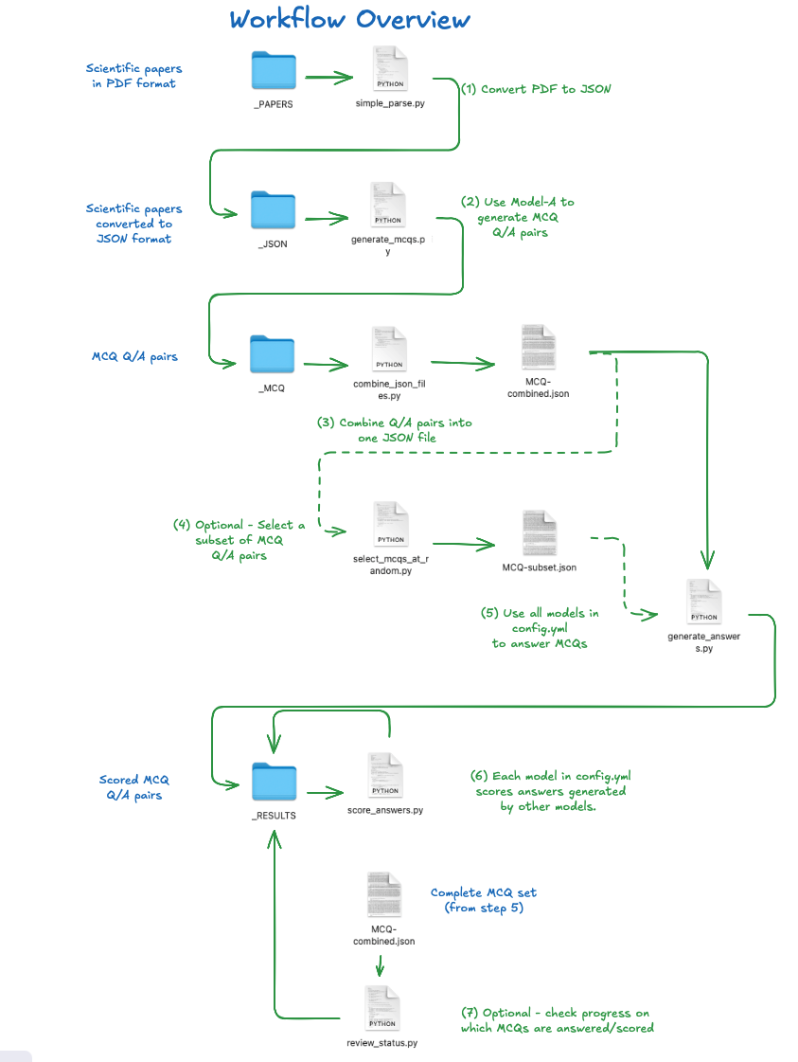

Slide 2
Model_A
Model_B
Model_A
simple_parse
generate_mcqs
generate_answers
score_answers
pdf
jsonl
jsonl
jsonl
pdf
jsonl
pdf
jsonl
pdf
jsonl
yaml
Models
General settings
Prompts
yaml
General settings
Prompts
yaml
Models
yaml
Endpoints

Slide 3
Model_A
Model_B
Model_A
simple_parse
generate_mcqs
generate_answers
score_answers
Model_C
Model_A
yaml
General settings
Prompts
yaml
Models
generate_answers
score_answers
yaml
Endpoints
Model_D
Model_A
generate_answers
score_answers

Slide 4
Model_A
simple_parse
generate_nuggets
Test model knowledge
pdf
jsonl
pdf
jsonl
pdf
jsonl
pdf
jsonl
DOI
DOI
Chunk
DOI
Chunk
yaml
Chunk
General settings
Prompts
yaml
Models
DOI
Chunk
yaml
Endpoints

