Slide 1
MCQ Pipeline Update
Charlie Catlett, Ian Foster, Rick Stevens
June 25, 2025
An update on a pipeline experiment to use scientific papers to create data for fine-tuning models.

Slide 2
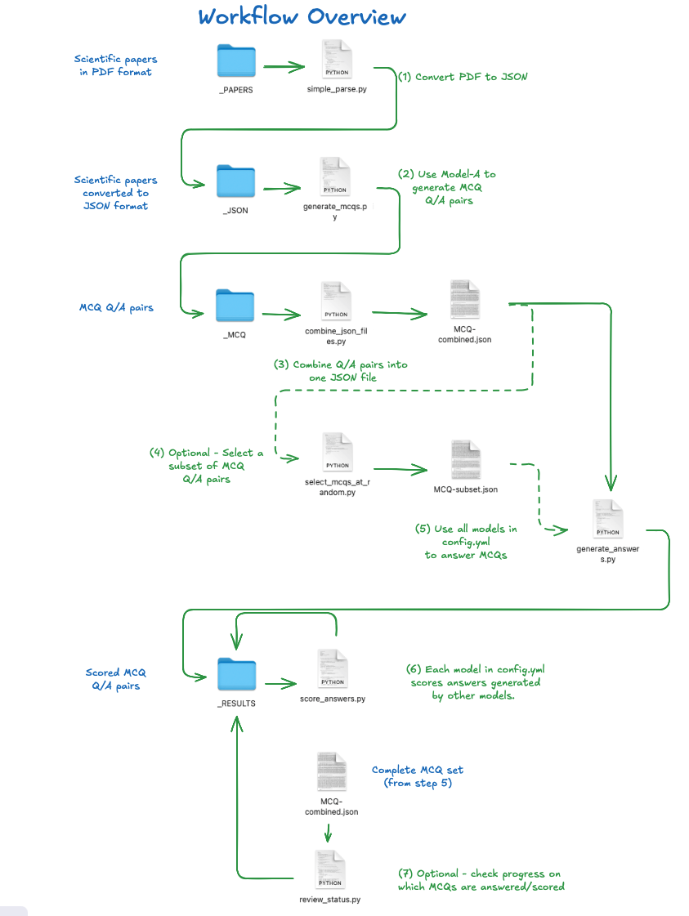
Starting point – a set of CLI tools (python scripts) that can be used to implement a workflow to create MCQs from PDF format papers.

Slide 3
Model_A
Model_B
simple_parse
generate_mcqs
generate_answers
score_answers
pdf
jsonl
jsonl
jsonl
pdf
jsonl
pdf
jsonl
Answers
Grade
pdf
jsonl
yaml
Models
General settings
Prompts
MCQ/A pairs
MCQ
Answers
Initial work proceeded as follows:
Papers converted to JSON (text only) and broken into n-byte chunks, each of which is used to generate an MCQ. MCQ model interactions on chunks are independent, thus we parallelized this step, adding a general config setting for n-way parallel (can specify/override on command line).
Pull general settings, model choices into yaml config files to simplify CLI use in workflows (can be overridden by CLI options)
Pull prompts out of python code into yaml config file to facilitate ease of prompt engineering.
Pull model specifications out of python code, defining endpoints in yaml config files.
Redesign config handling to allow for both general (relatively static) config and local (user-specific, dynamic) config files.
yaml
General settings
Prompts
yaml
Models
yaml
Endpoints

Slide 4
Model_A
Model_B
simple_parse
generate_mcqs
generate_answers
score_answers
yaml
General settings
Prompts
Model_C
yaml
Models
yaml
Endpoints
generate_answers
score_answers
Model_D
With the improvements outlined earlier, we developed a workflow script that allows a user to specify n models and process them concurrently.
generate_answers
score_answers

Slide 5
Model_A
Model_B
Model_A
simple_parse
generate_nuggets
generate_answers
score_answers
jsonl
jsonl
yaml
General settings
Prompts
jsonl
jsonl
DOI
Model_C
Model_A
DOI
Chunk
DOI
Models
Chunk
yaml
DOI
Chunk
Chunk
generate_answers
score_answers
yaml
Endpoints
In Progress:
Extract knowledge nuggets (“factoids”” from papers, test model knowledge, retaining “new” nuggets for general evaluation and fine-tuning.
Each nugget tagged with paper DOI (found in PDF or using a model to search)
Model_D
Model_A
generate_answers
score_answers

