Slide 1

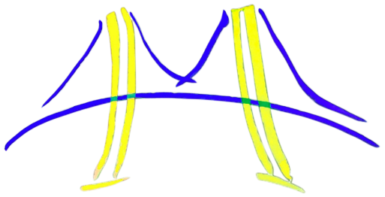
Final Project Template
CS194-15 Fall 2012:
Engineering Parallel Software
Charles Bin, Rohan Choudhury, Jason Cramer, Sean Han, Som Mishra, Tianyu (Allan) Wang, Yuhua Wang
University of California, Berkeley

Slide 2
Outline
Problem/application
Algorithm
High-level software architecture of implementation of algorithm
Parallelizing the Software Architecture
Strategy: Concurrent Algorithm Strategy used
Implementation: Implementation Strategy Patterns used
Execution: Parallel Execution Patterns used
Optimization: Optimization Patterns used
Final results
Lessons Learned

Slide 3
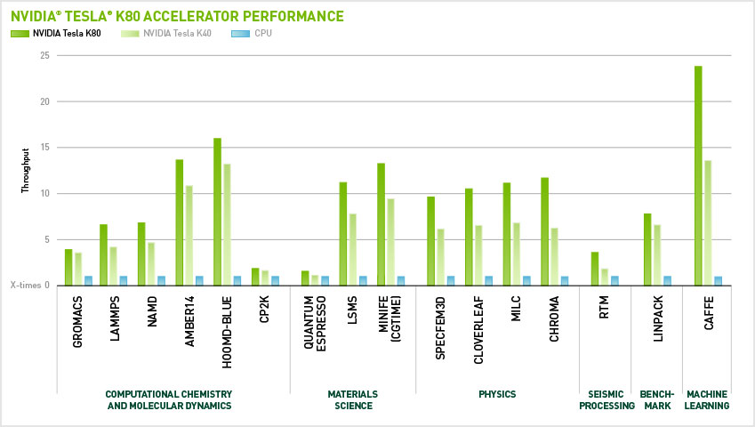
Motivation
Neural networks are an extremely powerful and popular tool for machine learning
CAFFE is a fast framework for neural networks created at Berkeley
One of the leading DNN frameworks for object recognition
Even used to benchmark NVIDIA GPUs

Slide 4
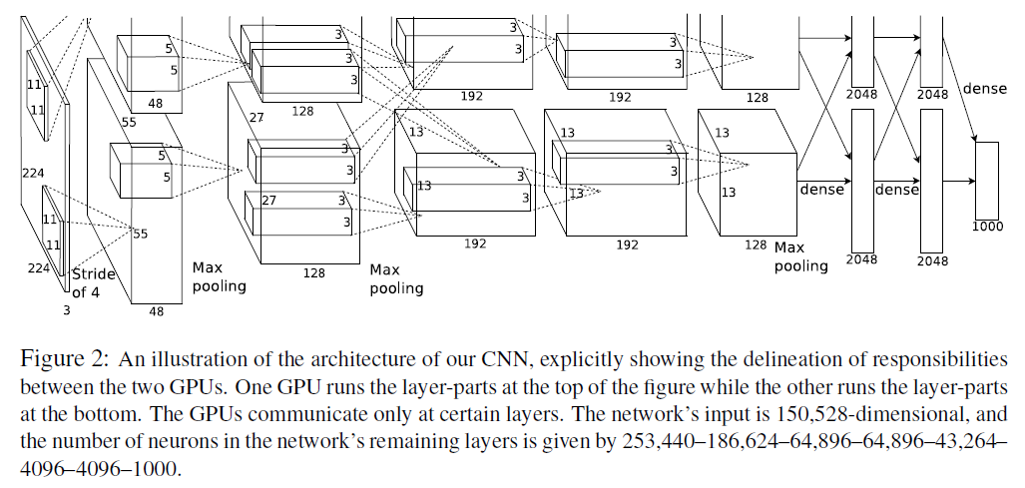
Problem: Improving Speed of Layers
Convolutional layers have been carefully optimized for speed
However, many of the less intensive layers have not had as much optimization work done
Pooling layers
ReLU

Slide 5
Outline
Problem/application
Algorithm
High-level software architecture of implementation of algorithm
Parallelizing the Software Architecture
Strategy: Concurrent Algorithm Strategy used
Implementation: Implementation Strategy Patterns used
Execution: Parallel Execution Patterns used
Optimization: Optimization Patterns used
Final results
Lessons Learned

Slide 6
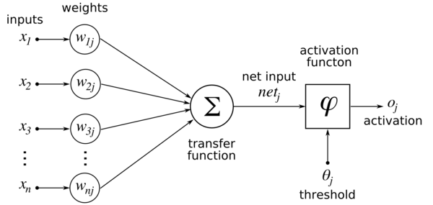
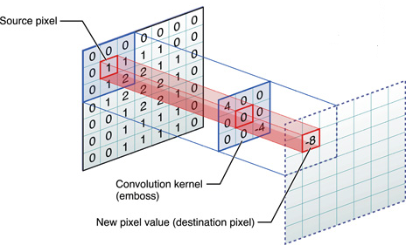
Deep Convolutional Neural Nets
Traditional neural networks are formulated as layers of neurons that calculate a linear combination of inputs from a previous layer and pass the output through an activation function.
Convolutional layers reduce the number of model parameters, and provide natural interpretations for image processing

Slide 7
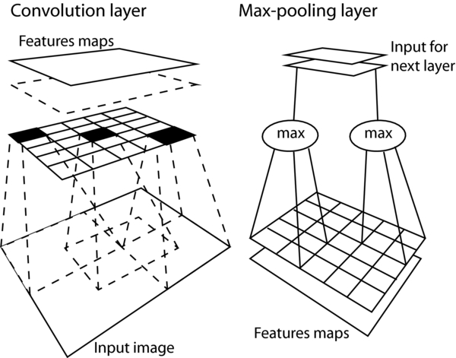
Deep Convolutional Neural Nets
Pooling Layers
Perform an operation over a sliding window of the output of a layer
Reduces the size of the layers, while maintaining the important features of the data
Types
Max-pooling: output the maximum of each pool

Slide 8
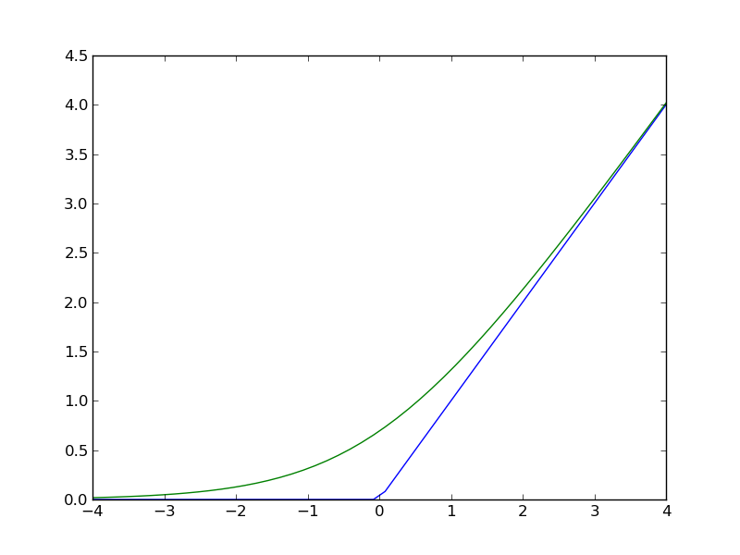
Deep Convolutional Neural Nets
ReLU
Most traditional neural nets use sigmoidal activation functions
However, if data is not properly preprocessed, saturation can occur very often, which can hinder results
Use to avoid saturation
Also cause faster training
CAFFE version also optionally brings negative values closer to 0

Slide 9
Outline
Problem/application
Algorithm
High-level software architecture of implementation of algorithm
Parallelizing the Software Architecture
Strategy: Concurrent Algorithm Strategy used
Implementation: Implementation Strategy Patterns used
Execution: Parallel Execution Patterns used
Optimization: Optimization Patterns used
Final results
Lessons Learned

Slide 10
Software Architecture
Image
Structural Pattern: Pipe and Filter
Convert Colorspace
Textons:
K-means
Intervening Contour
Bg
Cga
Cgb
Texture Gradient
Generalized Eigensolver
Combine
Oriented Energy Combination
Non-max
suppression
Combine, Normalize
Contours

Slide 11
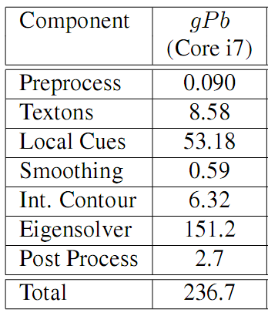
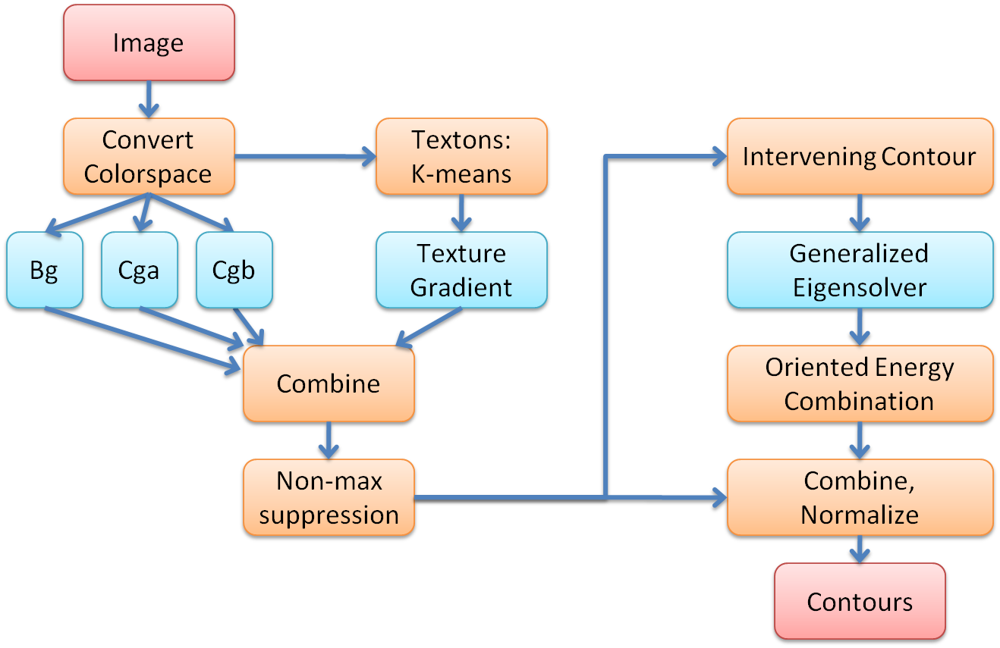
Profile of the Execution Time

Slide 12
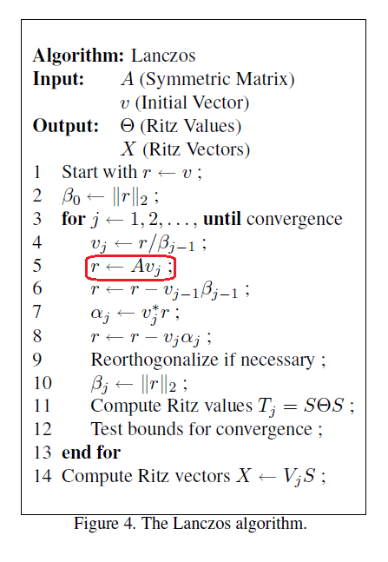
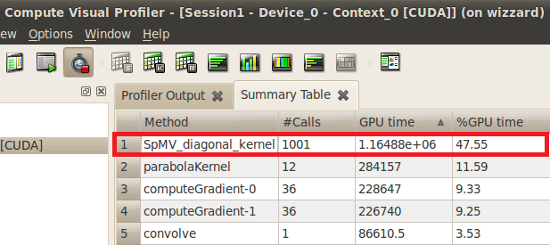
Applying Lanczos Algorithm
Since W is a symmetric sparse matrix, the Lanczos Algorithm can be used to approximate the eigenvalues and eigenvectors
Repeatedly multiplying A*v_{j} is computationally expensive, since the size of matrix, A, is the square of the number of pixels in the image
Source: Berkeley Par-Lab

Slide 13
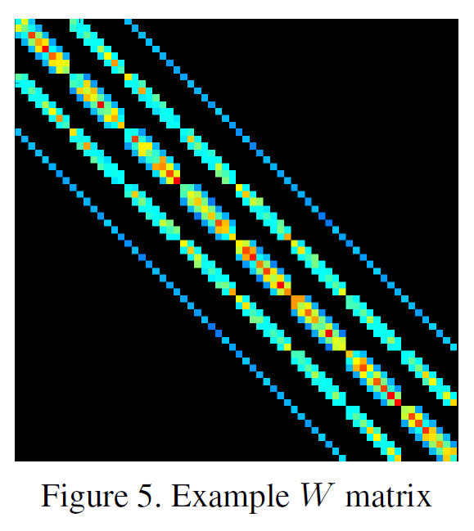
Key Kernel
Sparse matrix vector multiplication
Computational pattern
Sparse linear algebra

Slide 14
Outline
Problem/application
Algorithm
High-level software architecture of implementation of algorithm
Parallelizing the Software Architecture
Strategy: Concurrent Algorithm Strategy used
Implementation: Implementation Strategy Patterns used
Execution: Parallel Execution Patterns used
Optimization: Optimization Patterns used
Final results
Lessons Learned

Slide 15
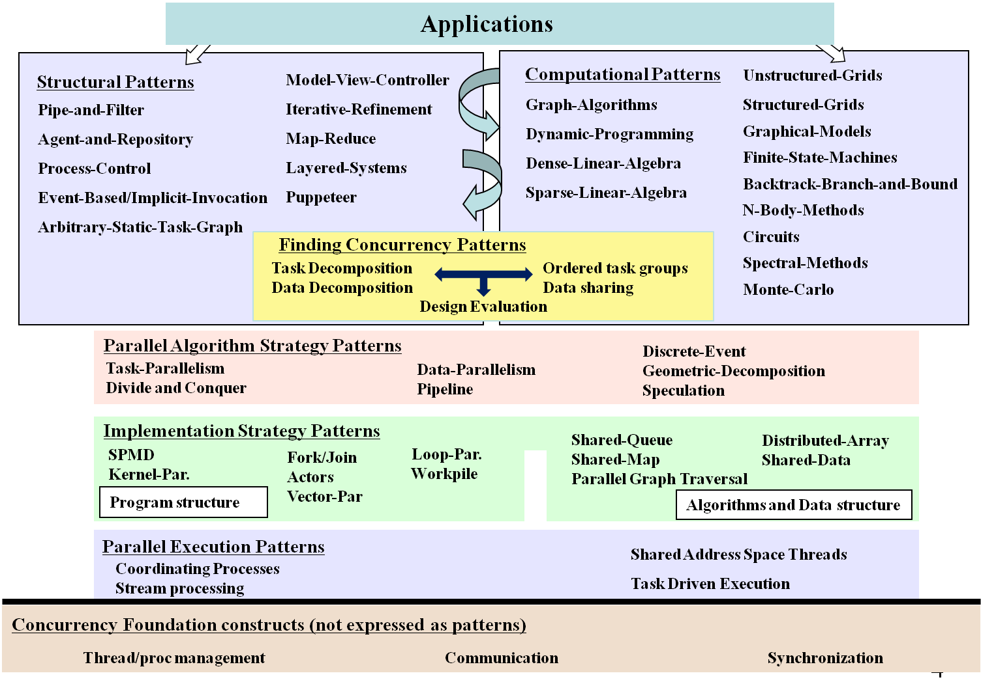
PLPP/OPL 2012

Slide 16
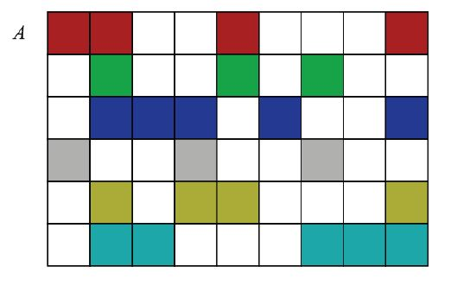
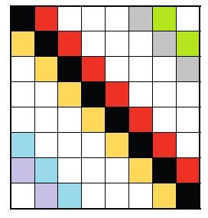
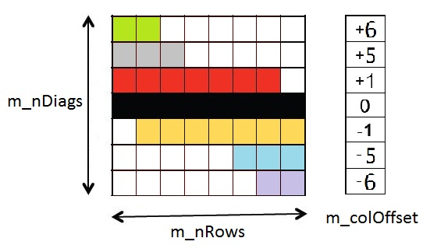
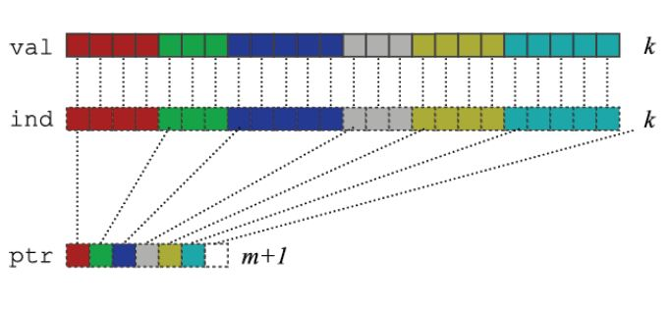
Lessons from the Sparse Linear Algebra Pattern
Many ways of representing the matrix
CSR Representation
Diagonal Representation

Slide 17
Analysis of the Possible Solutions
The matrix has many dense diagonals
The memory footprint of the diagonal representation is less
Choose the diagonal representation

Slide 18
Software Architecture of the DIA Format - I
For each Diagonal
For each Row
Compute column index
Multiply-add
Dia 2, Vec b, c
Dia n, Vec b, c
...
Matrix A and Vector b, c
Dia 1, Vec b, c
*
=
*
=
A
b
c
A
b
c
Map reduce? No
Agent and repository? Yes
because vector c is shared among agents

Slide 19
Software Architecture of the DIA Format - II
For each Row
For each Diagonal
Compute column index
Multiply-add
Row 1, Vec b
Row 2, Vec b
Row n, Vec b
...
Vec c1
Vec c2
Vec cn
*
=
A
b
c
Map reduce? Yes
Agent and repository? Yes

Slide 20
Analysis
Software Architecture – I
Vector c is shared among agents
Has dependency, need atomic updates
Software Architecture – II
Can be represented using the Map-Reduce Pattern
Does not have dependency
Software Architecture – II should be a better solution
*
=
A
b
c

Slide 21
PLPP/OPL 2012

Slide 22
Finding Concurrency
Each matrix row contributes to a single element in vector c
Data decomposition over Rows
Row 1, Vec b
Row 2, Vec b
Row n, Vec b
...
Vec c1
Vec c2
Vec cn
*
=
A
b
c
Map reduce? Yes
Agent and repository? Yes

Slide 23
Parallelizing the Dia SpMV

Slide 24
Parallelizing the Dia SpMV on CPU

Slide 25
Parallelizing the Dia SpMV on CPU Using OpenMP

Slide 26
OpenMP Diagonal SpMV
void DiagMatrix::SpMV(float* vecIn, float* vecOut)
{
#pragma omp parallel for
for (int i = 0; i < m_nRows; i++)
{
float sum = 0.0;
float * rowPtr = i * m_nDiags + m_diags;
for (int j = 0; j < m_nDiags; j++)
{
int col = m_colOffset[j] + i;
if (col >= 0 and col < m_nRows)
sum += rowPtr[j] * vecIn[col];
}
vecOut[i] = sum;
}
}
Decomposing data over rows using the loop parallelism pattern

Slide 27
Other Optimization – Loop Unrolling
void DiagMatrix::SpMV(float* vecIn, float* vecOut)
{
int biggestOffset = 0;
for (int i = 0; i < m_nDiags; i++)
if (m_colOffset[i] > biggestOffset)
biggestOffset = m_colOffset[i];
if (m_nRows <= 2*biggestOffset)
{
#pragma omp parallel for
for (int i = 0; i < m_nRows; i++)
{
float sum = 0.0;
int col;
float * rowPtr = i * m_nDiags + m_diags;
col = m_colOffset[0] + i;
if (col >= 0 and col < m_nRows)
sum += rowPtr[0] * vecIn[col];
col = m_colOffset[1] + i;
if (col >= 0 and col < m_nRows)
sum += rowPtr[1] * vecIn[col];
col = m_colOffset[2] + i;
if (col >= 0 and col < m_nRows)
sum += rowPtr[2] * vecIn[col];
col = m_colOffset[3] + i;
if (col >= 0 and col < m_nRows)
sum += rowPtr[3] * vecIn[col];
col = m_colOffset[4] + i;
if (col >= 0 and col < m_nRows)
sum += rowPtr[4] * vecIn[col];
col = m_colOffset[5] + i;
if (col >= 0 and col < m_nRows)
sum += rowPtr[5] * vecIn[col];
col = m_colOffset[6] + i;
if (col >= 0 and col < m_nRows)
sum += rowPtr[6] * vecIn[col];
col = m_colOffset[7] + i;
if (col >= 0 and col < m_nRows)
sum += rowPtr[7] * vecIn[col];
col = m_colOffset[8] + i;
if (col >= 0 and col < m_nRows)
sum += rowPtr[8] * vecIn[col];
col = m_colOffset[9] + i;
if (col >= 0 and col < m_nRows)
sum += rowPtr[9] * vecIn[col];
col = m_colOffset[10] + i;
if (col >= 0 and col < m_nRows)
sum += rowPtr[10] * vecIn[col];
col = m_colOffset[11] + i;
if (col >= 0 and col < m_nRows)
sum += rowPtr[11] * vecIn[col];
col = m_colOffset[12] + i;
if (col >= 0 and col < m_nRows)
sum += rowPtr[12] * vecIn[col];
col = m_colOffset[13] + i;
if (col >= 0 and col < m_nRows)
sum += rowPtr[13] * vecIn[col];
col = m_colOffset[14] + i;
if (col >= 0 and col < m_nRows)
sum += rowPtr[14] * vecIn[col];
col = m_colOffset[15] + i;
if (col >= 0 and col < m_nRows)
sum += rowPtr[15] * vecIn[col];
col = m_colOffset[16] + i;
if (col >= 0 and col < m_nRows)
sum += rowPtr[16] * vecIn[col];
col = m_colOffset[17] + i;
if (col >= 0 and col < m_nRows)
sum += rowPtr[17] * vecIn[col];
col = m_colOffset[18] + i;
if (col >= 0 and col < m_nRows)
sum += rowPtr[18] * vecIn[col];
col = m_colOffset[19] + i;
if (col >= 0 and col < m_nRows)
sum += rowPtr[19] * vecIn[col];
col = m_colOffset[20] + i;
if (col >= 0 and col < m_nRows)
sum += rowPtr[20] * vecIn[col];
col = m_colOffset[21] + i;
if (col >= 0 and col < m_nRows)
sum += rowPtr[21] * vecIn[col];
col = m_colOffset[22] + i;
if (col >= 0 and col < m_nRows)
sum += rowPtr[22] * vecIn[col];
col = m_colOffset[23] + i;
if (col >= 0 and col < m_nRows)
sum += rowPtr[23] * vecIn[col];

Slide 28
Outline
Problem/application
Algorithm
High-level software architecture of implementation of algorithm
Parallelizing the Software Architecture
Strategy: Concurrent Algorithm Strategy used
Implementation: Implementation Strategy Patterns used
Execution: Parallel Execution Patterns used
Optimization: Optimization Patterns used
Final results
Lessons Learned

Slide 29
Experimental Results
Method | Runtime
Serial CSR | 21.5ms
OpenMP CSR | 4.4ms
Serial DIA Architecture I | 25.2ms
Serial DIA Architecture II | 22.4ms
OpenMP DIA Architecture II | 3ms
OpenMP DIA Architecture II Loop Unrolled | 2.4ms

Slide 30
Theoretical Max Speedup with OpenMP
Running the stream benchmark with 8 threads on the lab machine:
-------------------------------------------------------------------------------- Function Rate (MB/s) Avg time Min time Max time Copy: 19477.2497 0.0017 0.0016 0.0018 Scale: 18890.6021 0.0019 0.0017 0.0033 Add: 19378.8230 0.0027 0.0025 0.0043 Triad: 20142.7306 0.0029 0.0024 0.0066 --------------------------------------------------------------------------------
Bandwidth achieved from SpMV = matrix read + input vector read + output vector write + column_offset read = 153600 * 81 * 4 + 153600 * 4 + 153600 * 4 + 81 * 4 = 50,995,524 bytes
Theoretical best running time = 50,995,524 / (19477.2497 * 10^6) = 2.62ms
Experimental results even better than theoretical results?

Slide 31
Theoretical Max Speedup with OpenMP
Why could OpenMP implementation show more than P-X speedup with P processors? (for lab machine, P=8)
Caching effect: As we increase the number of threads, we are also increasing the amount of cache (and associated prefetchers) available, and therefore decreasing our bandwidth requirement.
On x86 CPUs, IIRC, each cache at every level has its own prefetcher, load-store queues, associative sets, etc. These aspects of the memory system can have as big an impact on performance as the size of the cache.
Credit: Mark Murphy @ Par-Lab

Slide 32
Outline
Problem/application
Algorithm
High-level software architecture of implementation of algorithm
Parallelizing the Software Architecture
Strategy: Concurrent Algorithm Strategy used
Implementation: Implementation Strategy Patterns used
Execution: Parallel Execution Patterns used
Optimization: Optimization Patterns used
Final results
Lessons Learned

Slide 33
Conclusions
SpMV represents the dominant cost in many iterative methods for solving large-scale linear systems and eigenvalue problems.
The diagonal storage scheme (DIA) efficiently encodes matrices arising from the application of stencils to regular grids.
We implemented SpMV in DIA format in both CUDA and OpenMP.
On a 153600x153600 matrix, the OpenMP implementation is 9x faster after unrolling the loop. The CUDA implementation is 31x faster, after unrolling the loop and optimizing memory accesses to efficiently utilize Global DRAM, __shared__ memory, texture memory and constant memory.
On Damascene code, the SpMV kernel utilizes 45% memory bandwidth and has a texture hit rate of about 96%. The performance is slightly faster than that of stencilMVM implementation.

