Slide 1


Studio dell’attività dei radionuclidi prodotti dal bersaglio SPES-ISOLPHARM
Laureando: Aurora Leso

Slide 2
Calibration steps: ¹⁵²Eu & ²⁴¹Am sources

Slide 3
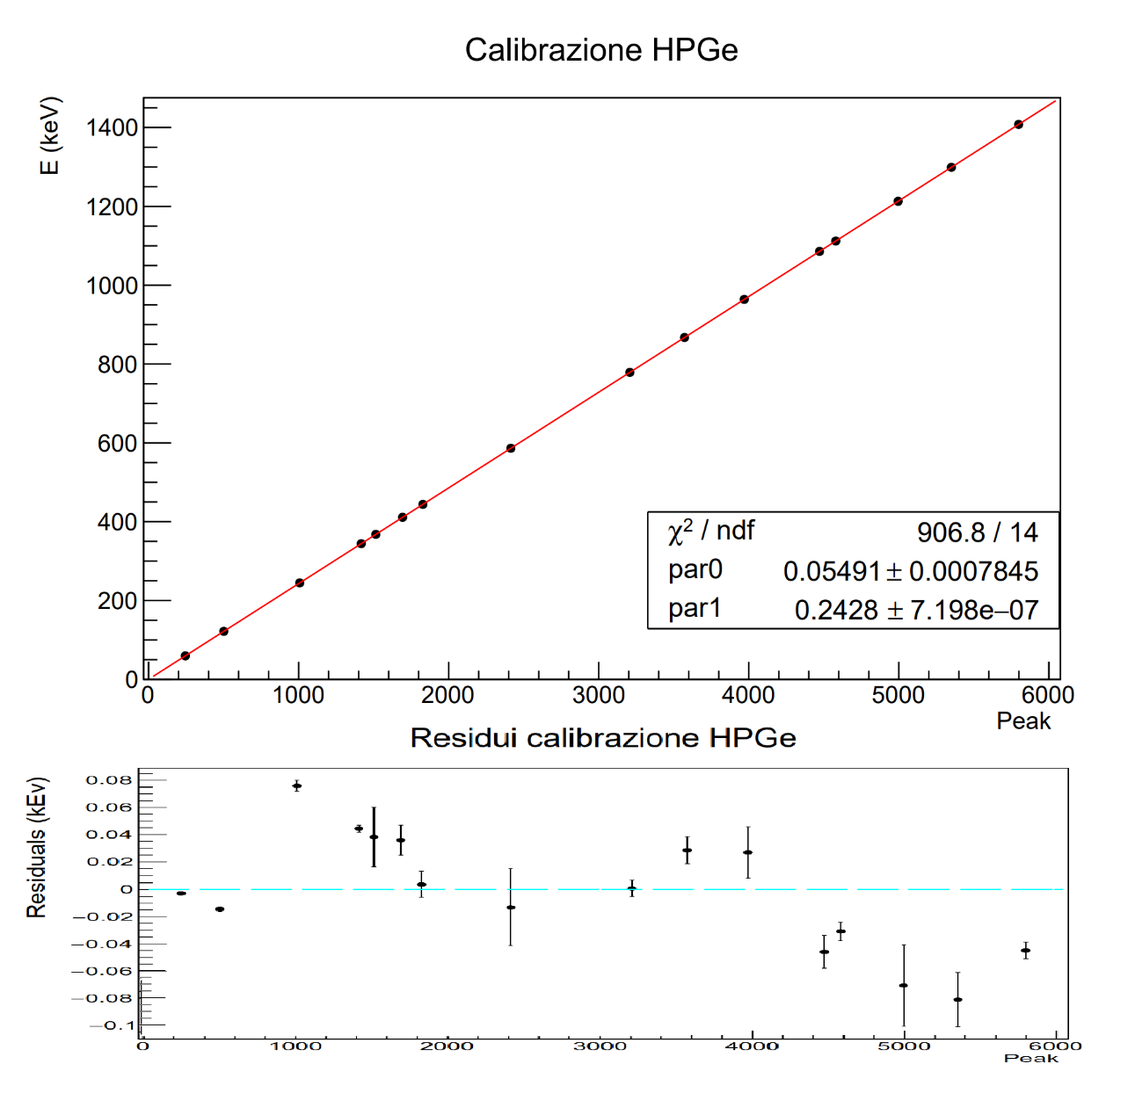
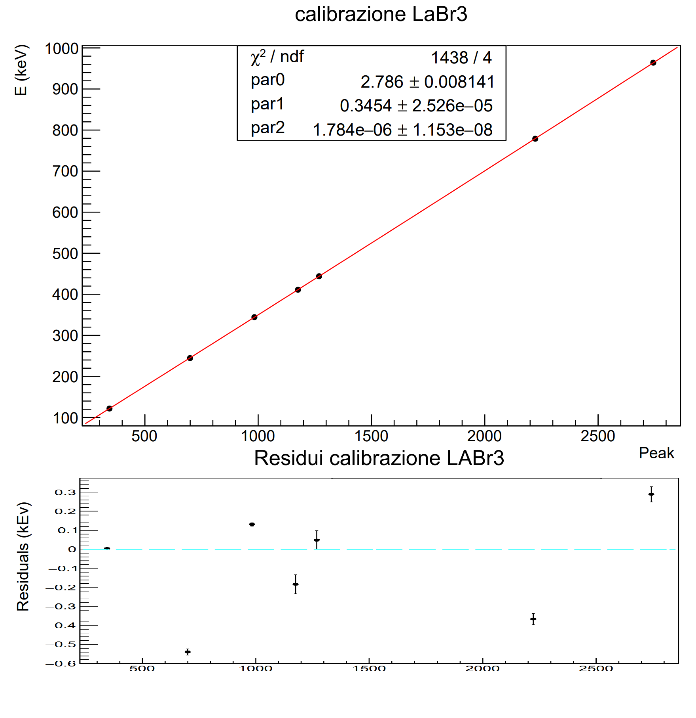
Results: calibration fits

Slide 4
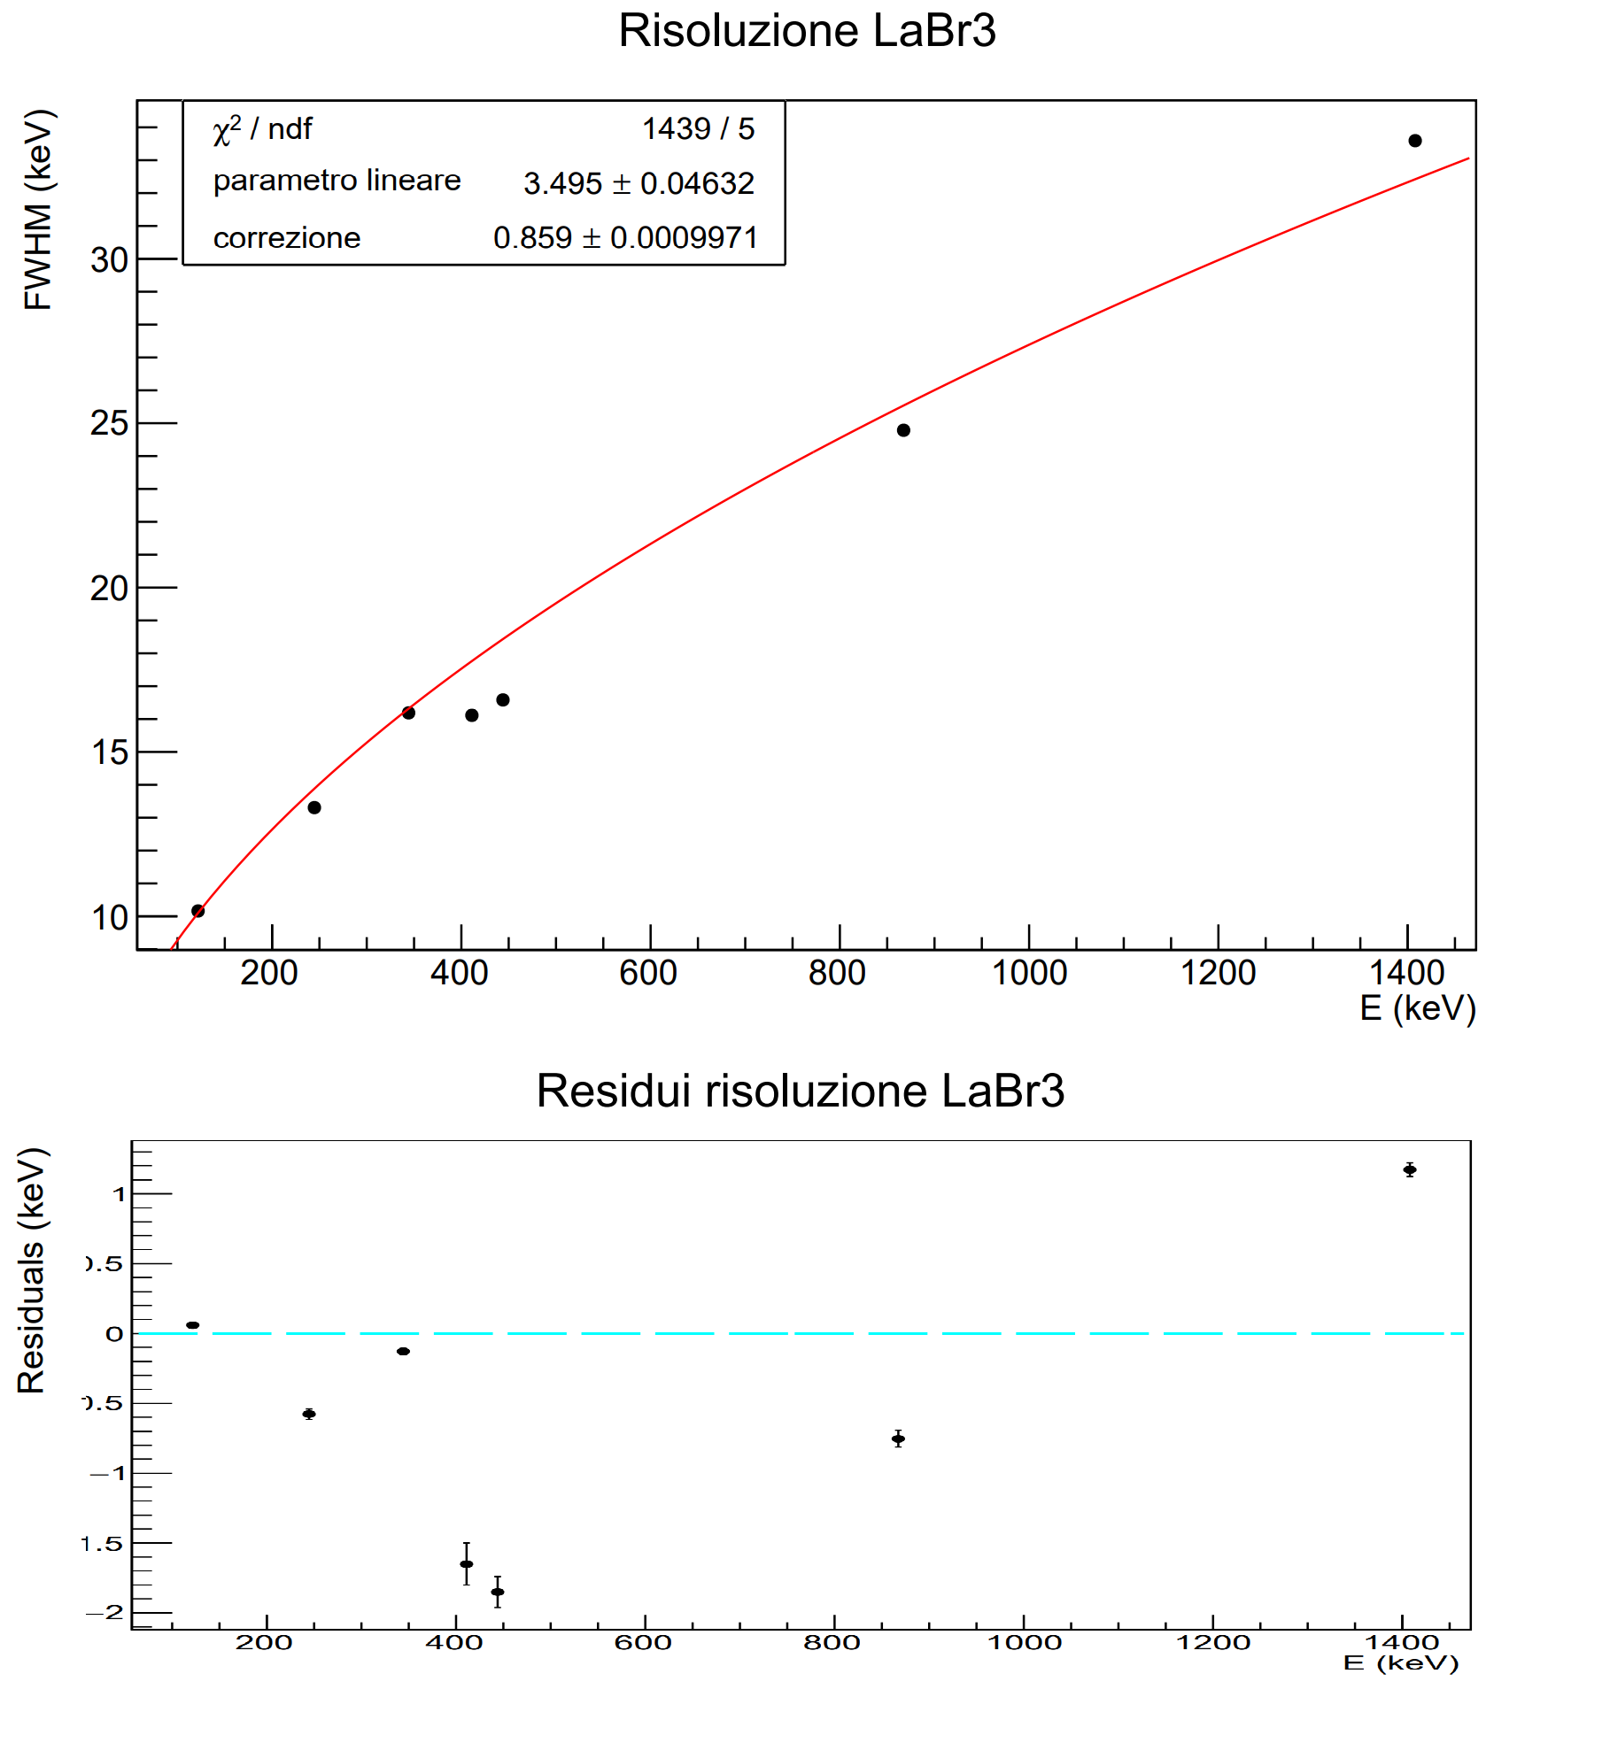
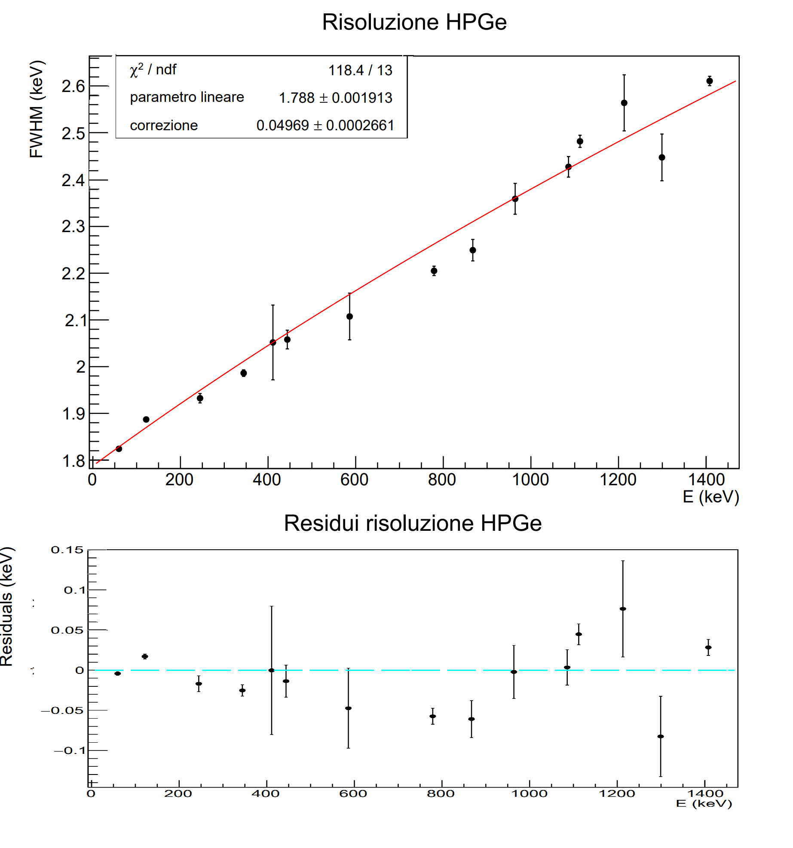
Results: resolution fits

Slide 5
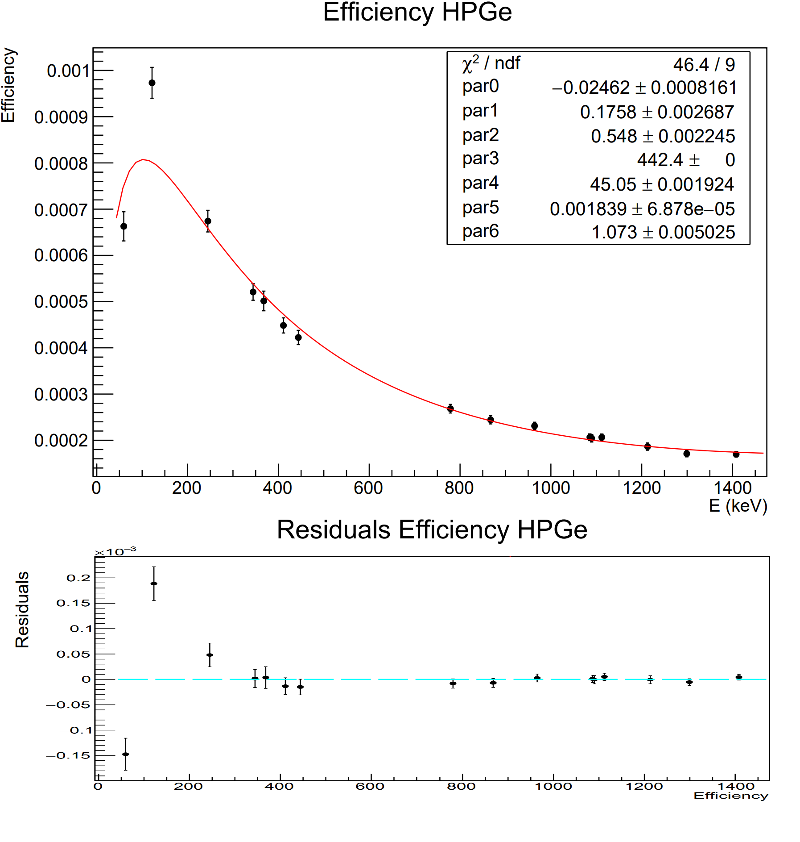
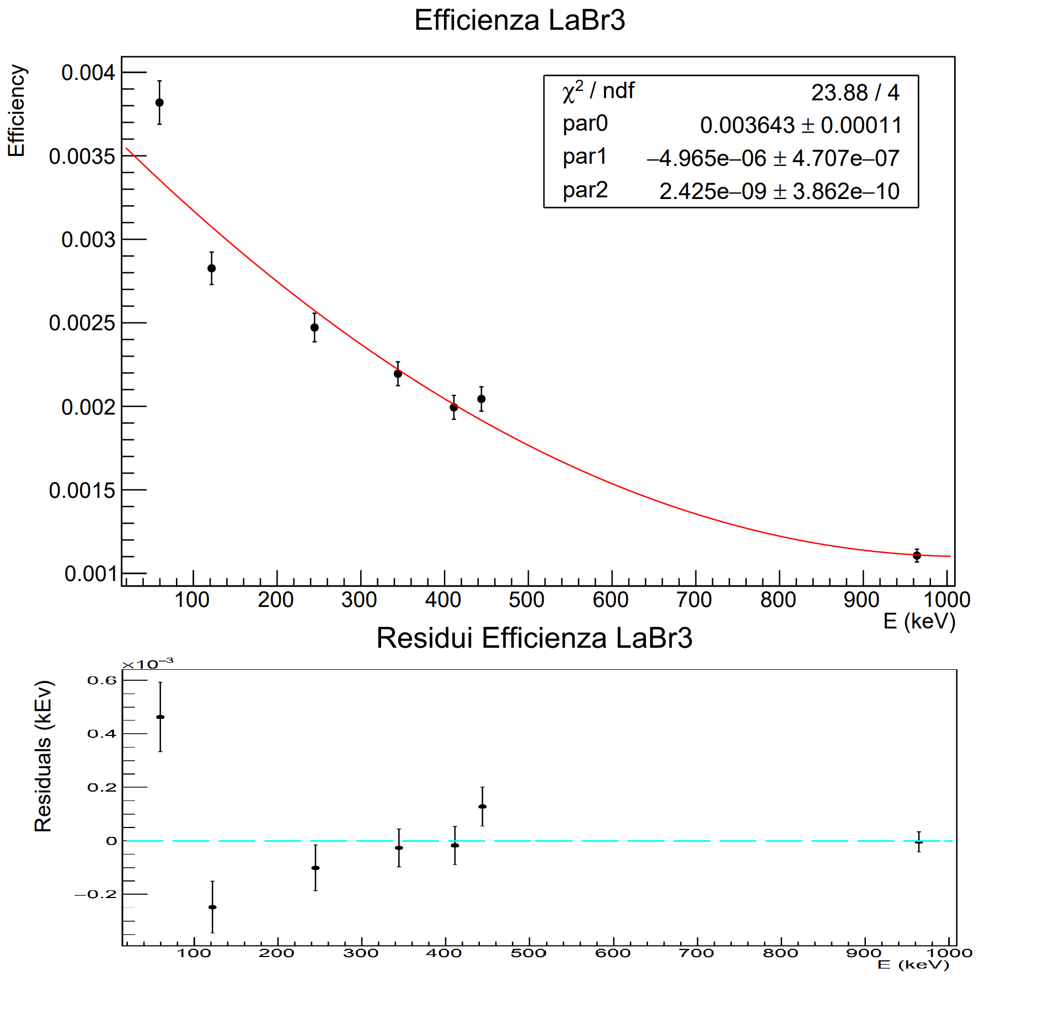
Results: efficiency fits

Slide 6
Analysis of Pd-enriched data Activity and half-life estimation

Slide 7
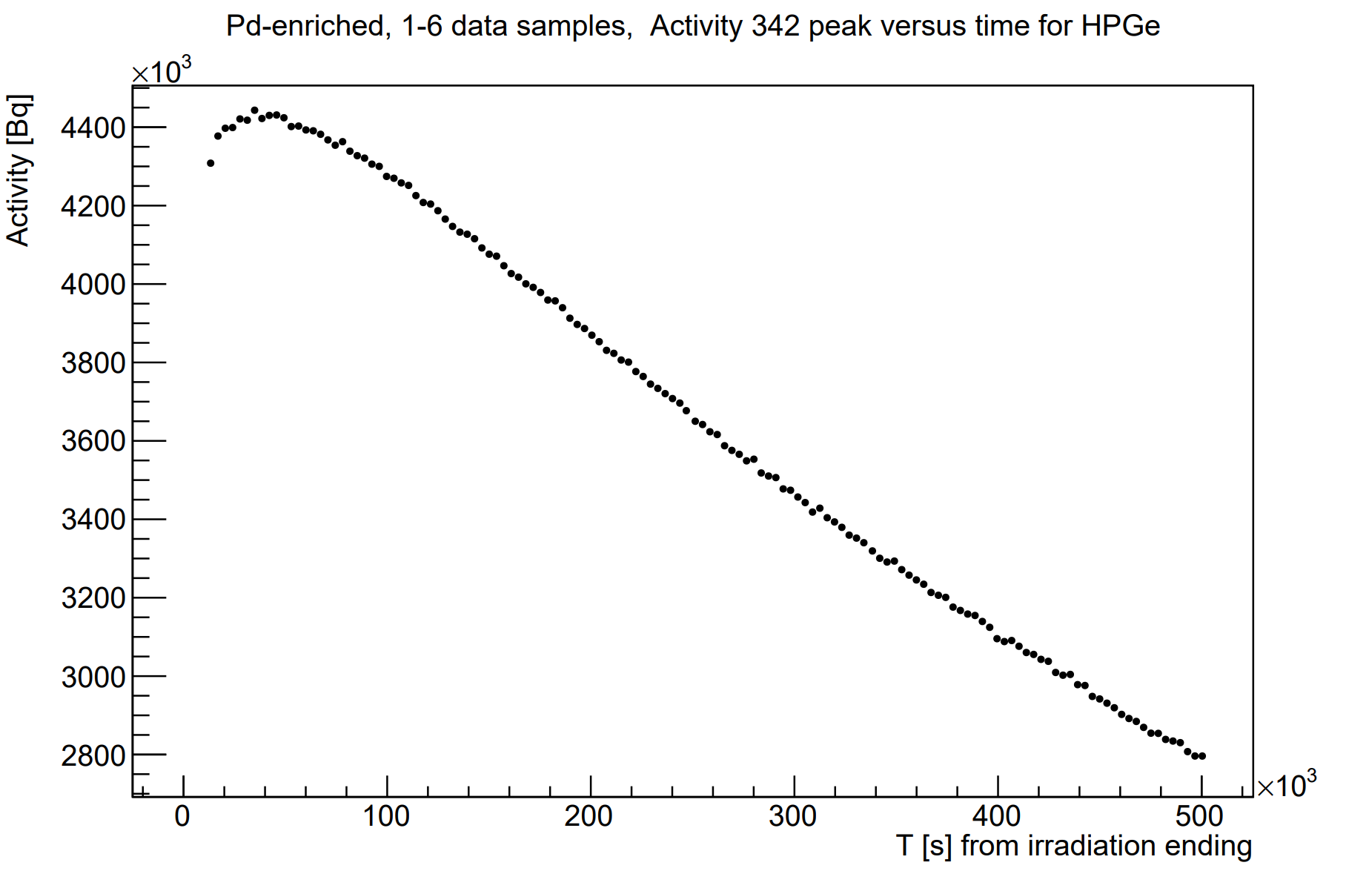
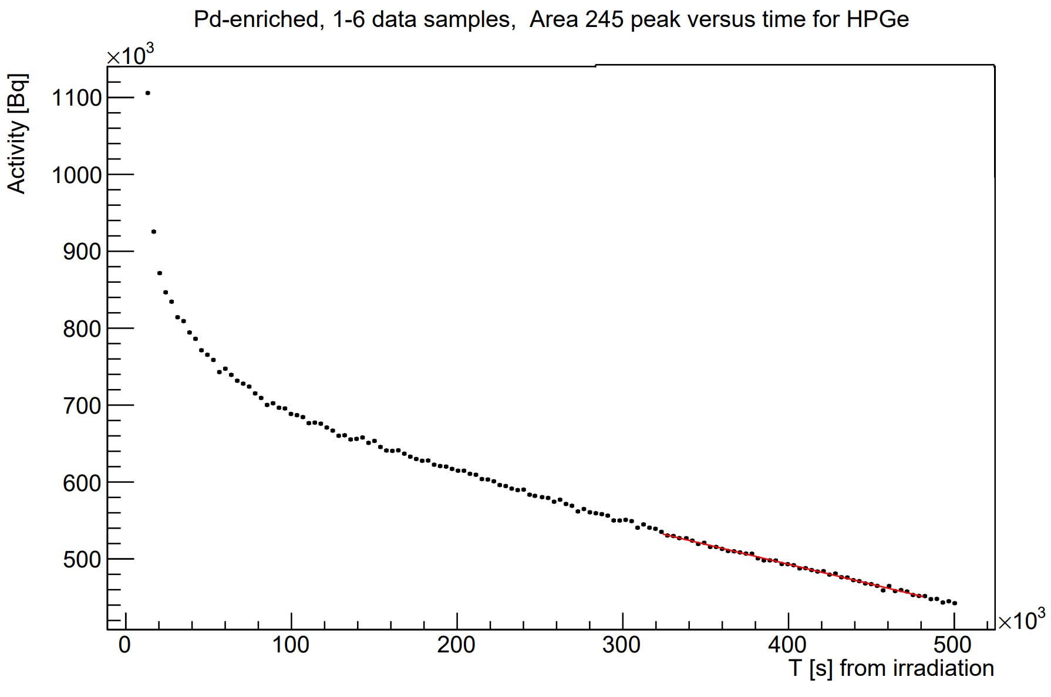
Plot activity vs time from irradiation ending ¹¹¹Ag peaks
342 keV
245 keV

Slide 8
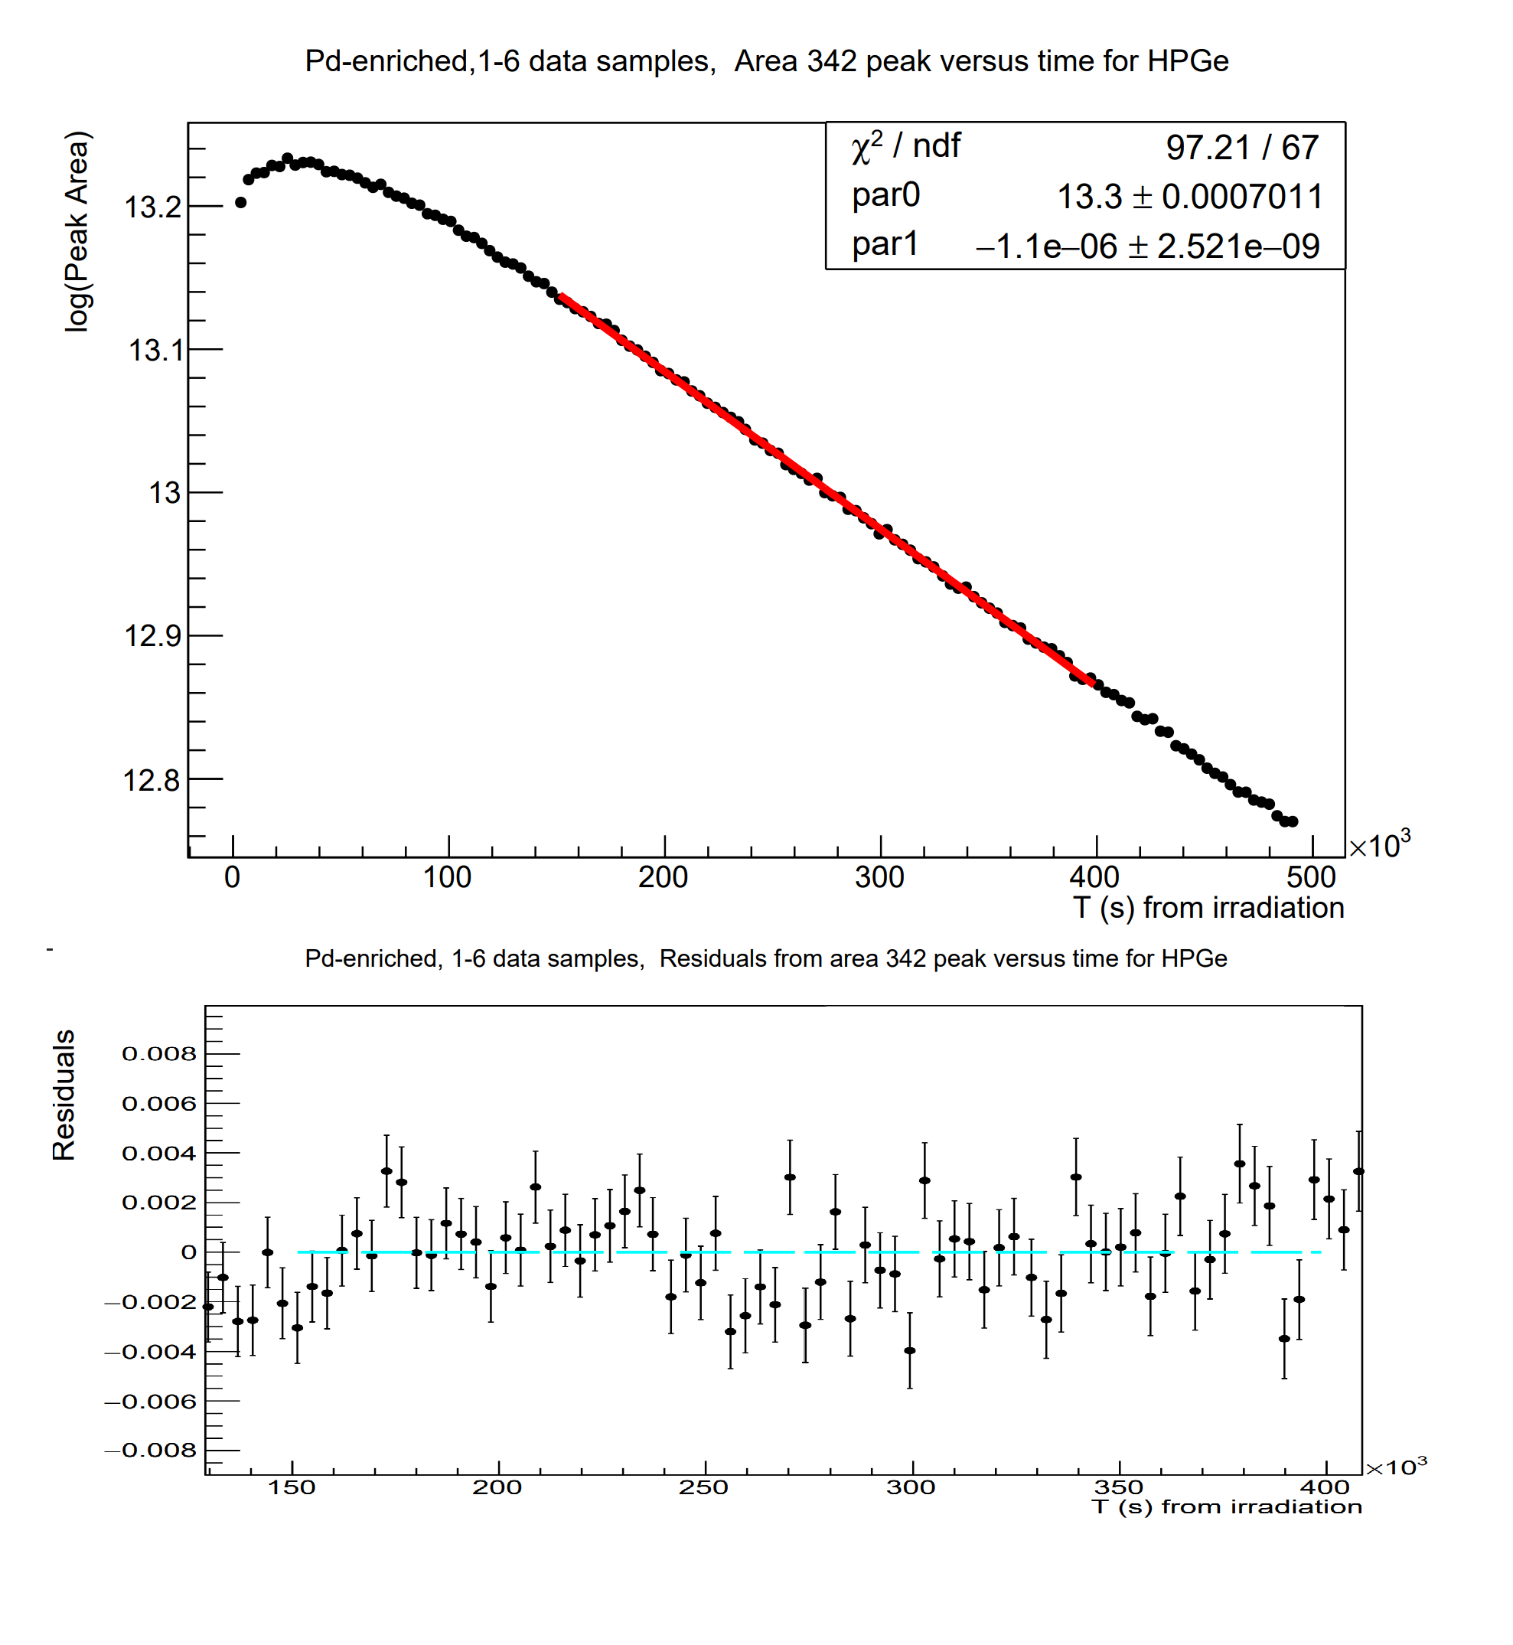
Half-life results
for 342 keV
T1/2=7.29 days (expected ≈7.5d)

Slide 9
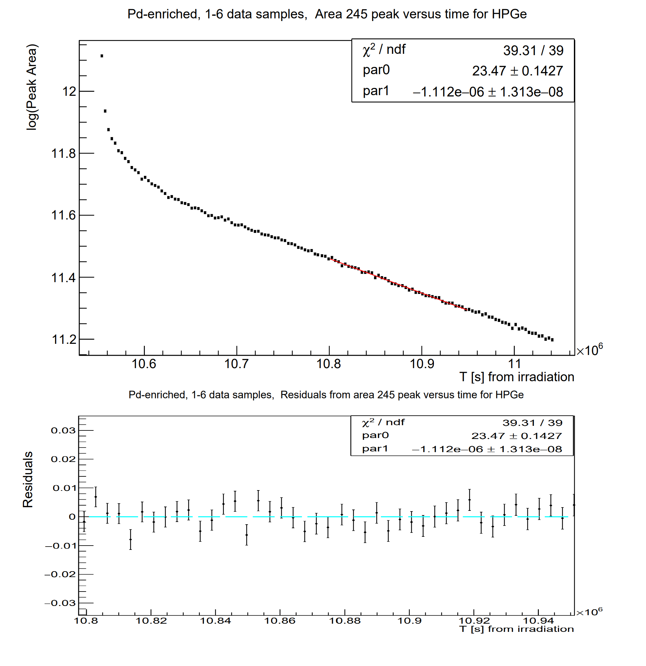
Half-life results
for 245 keV
T1/2=7.21 days (expected ≈7.5d)

Slide 10
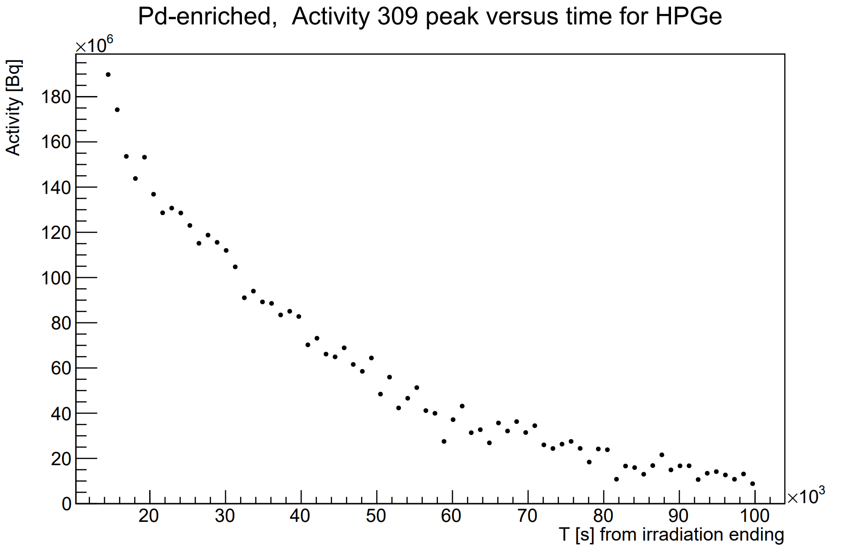
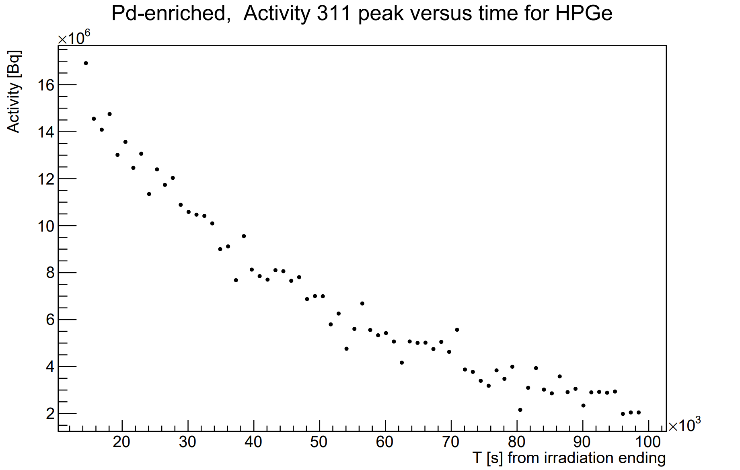
Plot activity vs time from irradiation ending ¹⁰⁹Pd peaks
309 keV
311 keV

Slide 11
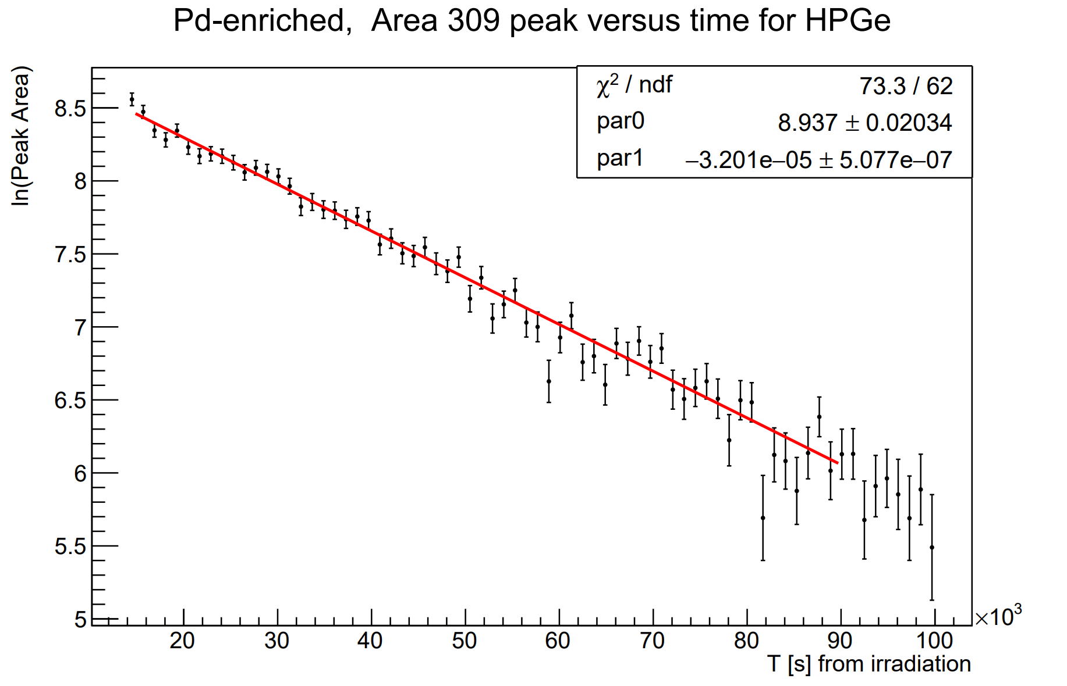
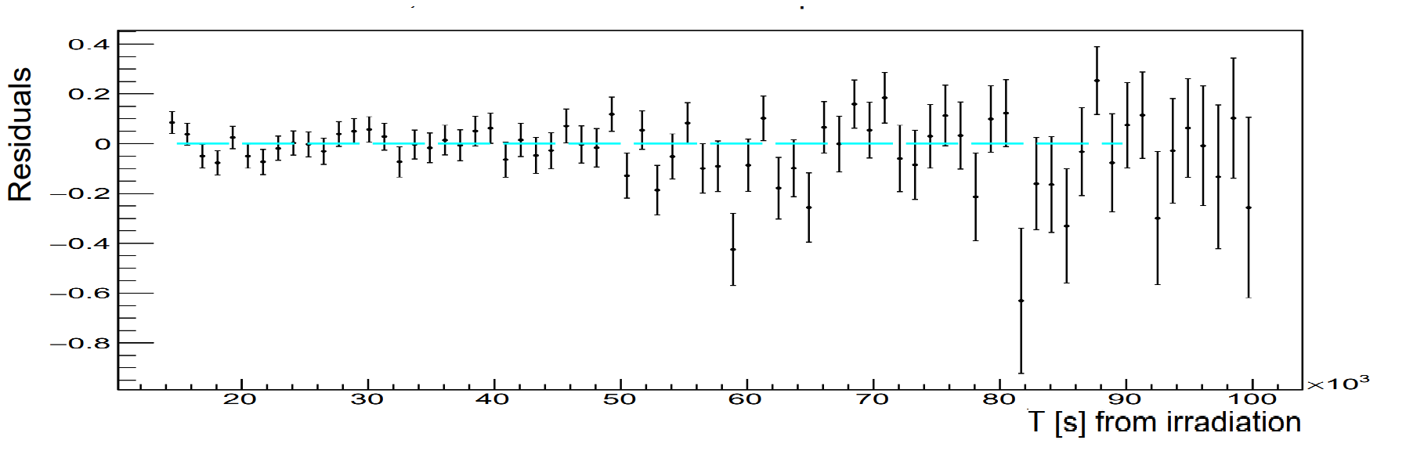
Half-life results
for 309 keV
T1/2=6h (expected ≈13h)

Slide 12
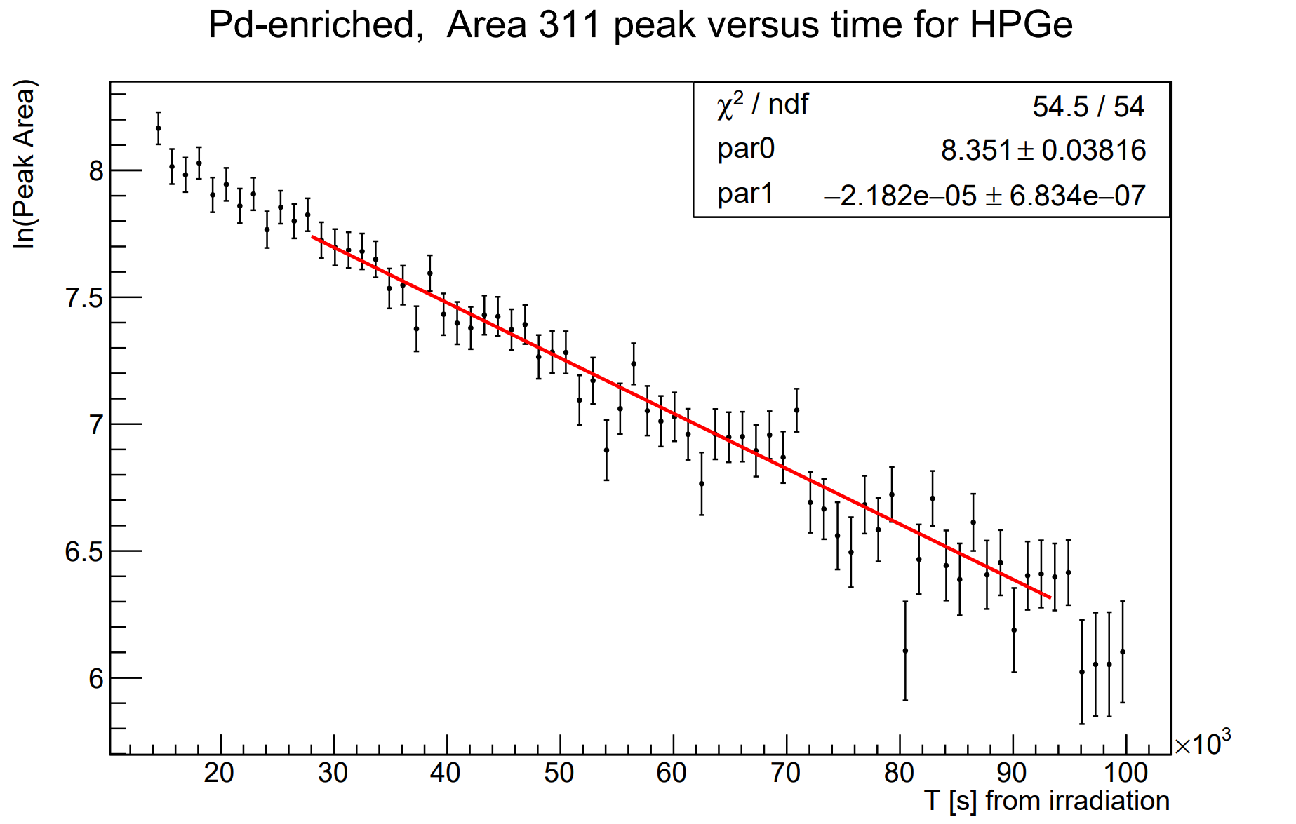
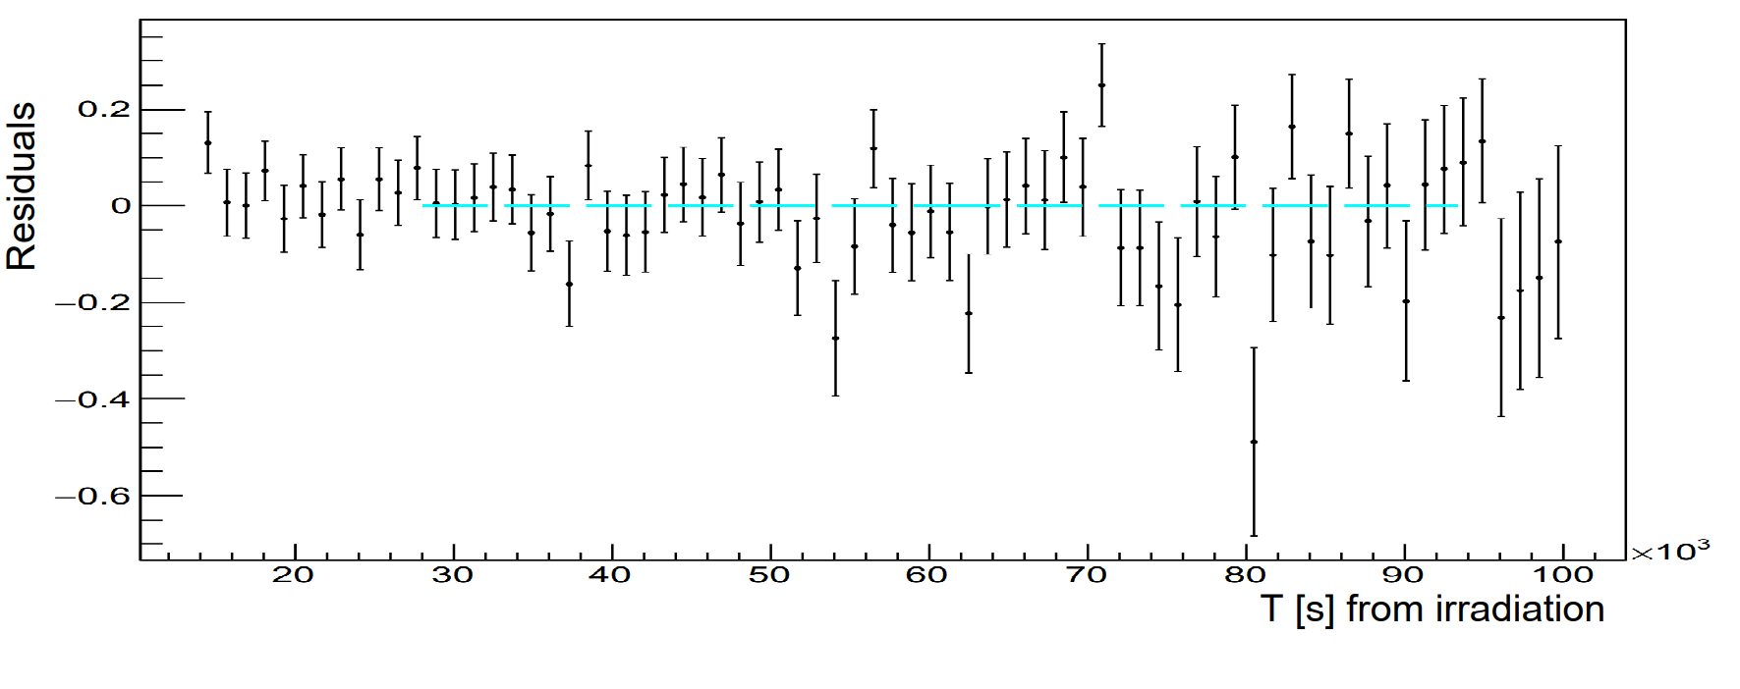
Half-life results
for 311 keV
T1/2=9h (expected ≈13h)

Slide 13
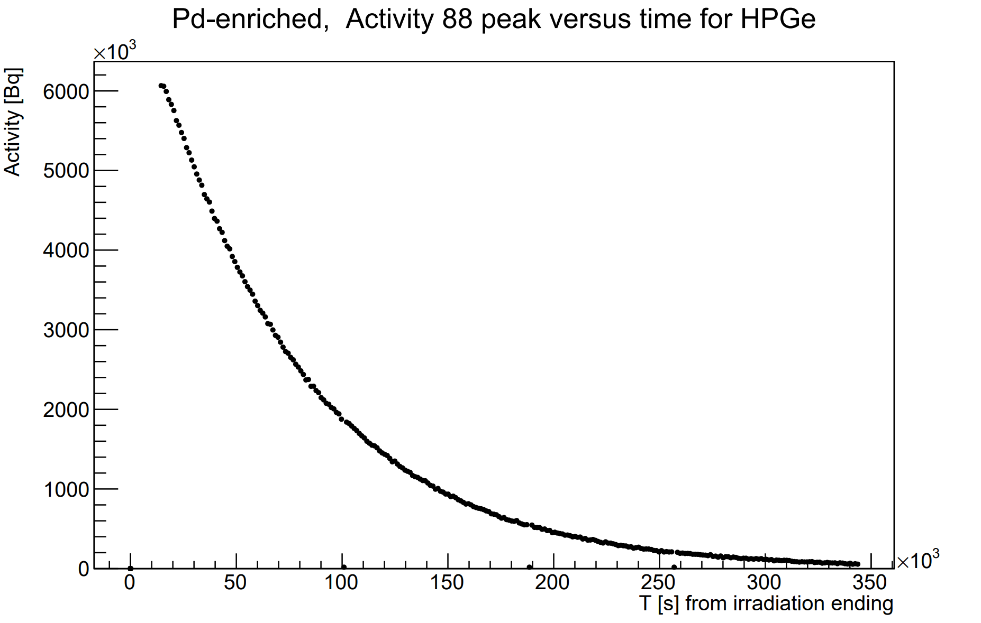
Plot activity vs time from irradiation ending ¹⁰⁹Pd peaks
88 keV

Slide 14
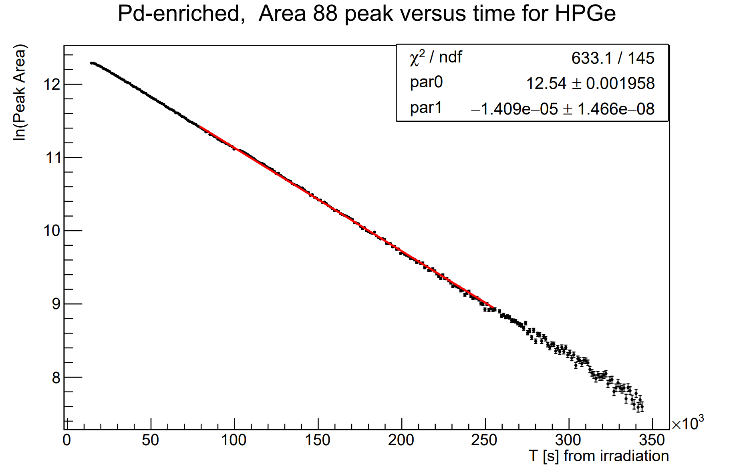
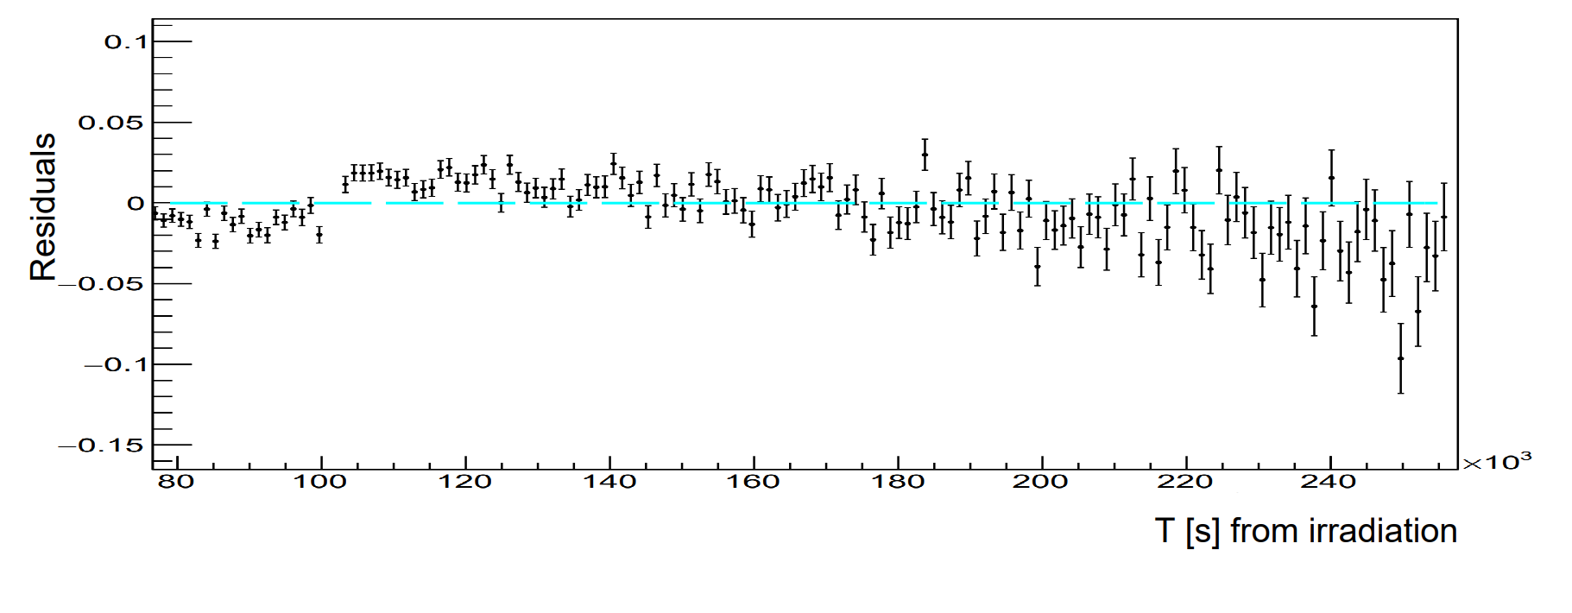
Half-life results
for 88 keV
T1/2=13.7h (expected ≈13h)

Slide 15
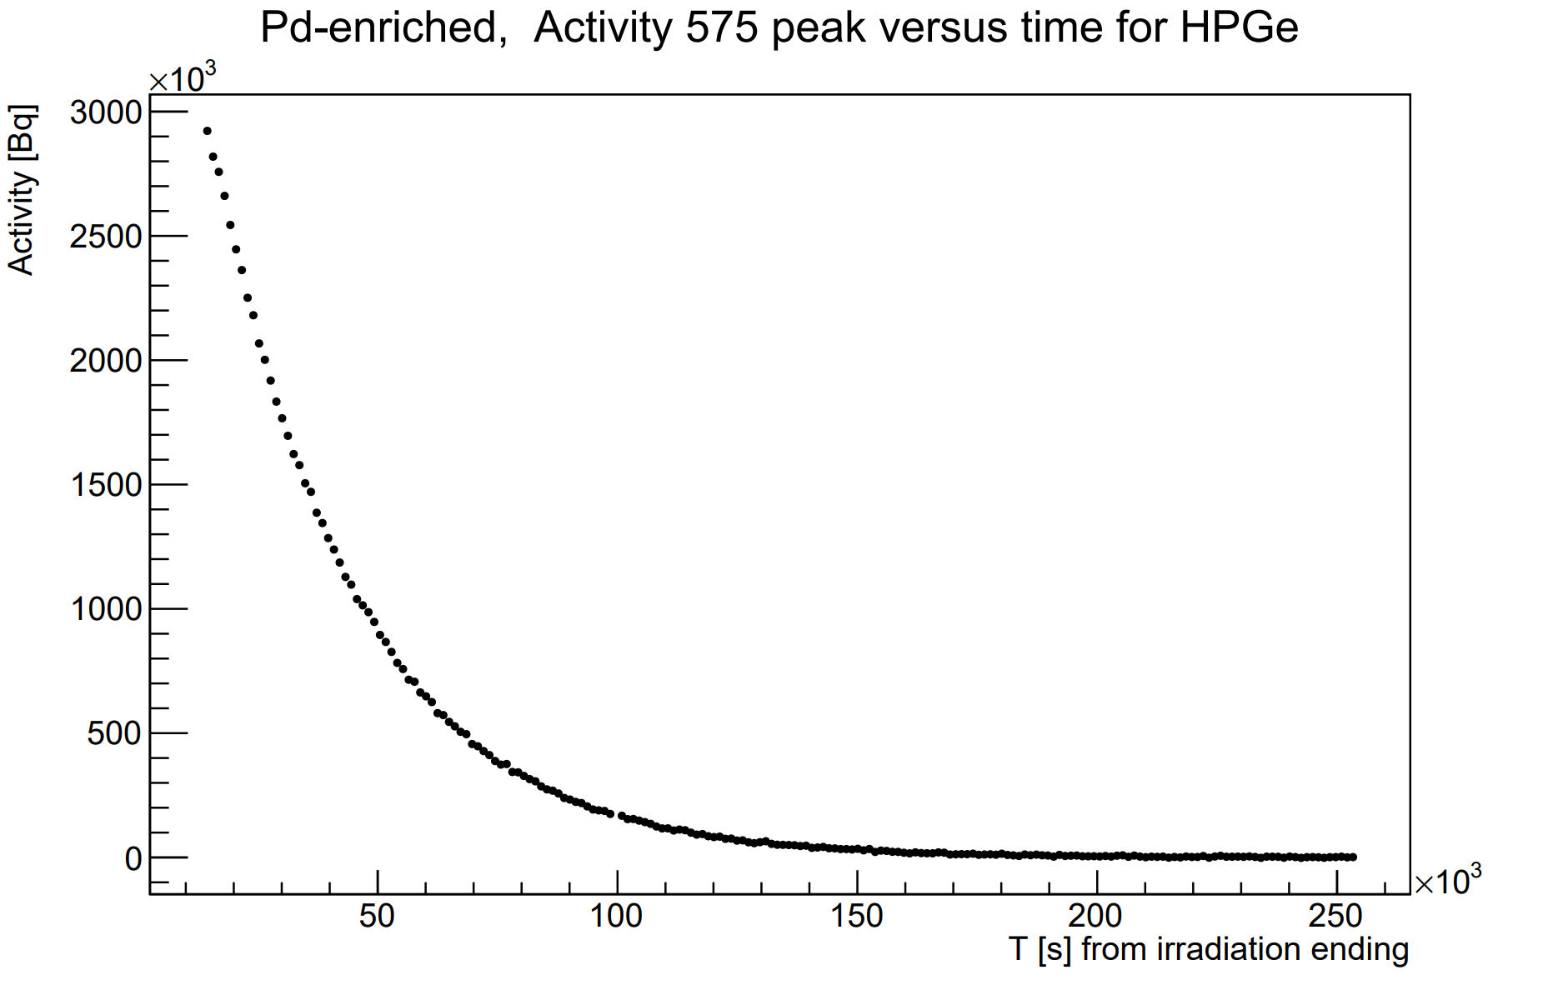
Plot activity vs time from irradiation ending ^{111m}Pd peak
575 keV

Slide 16
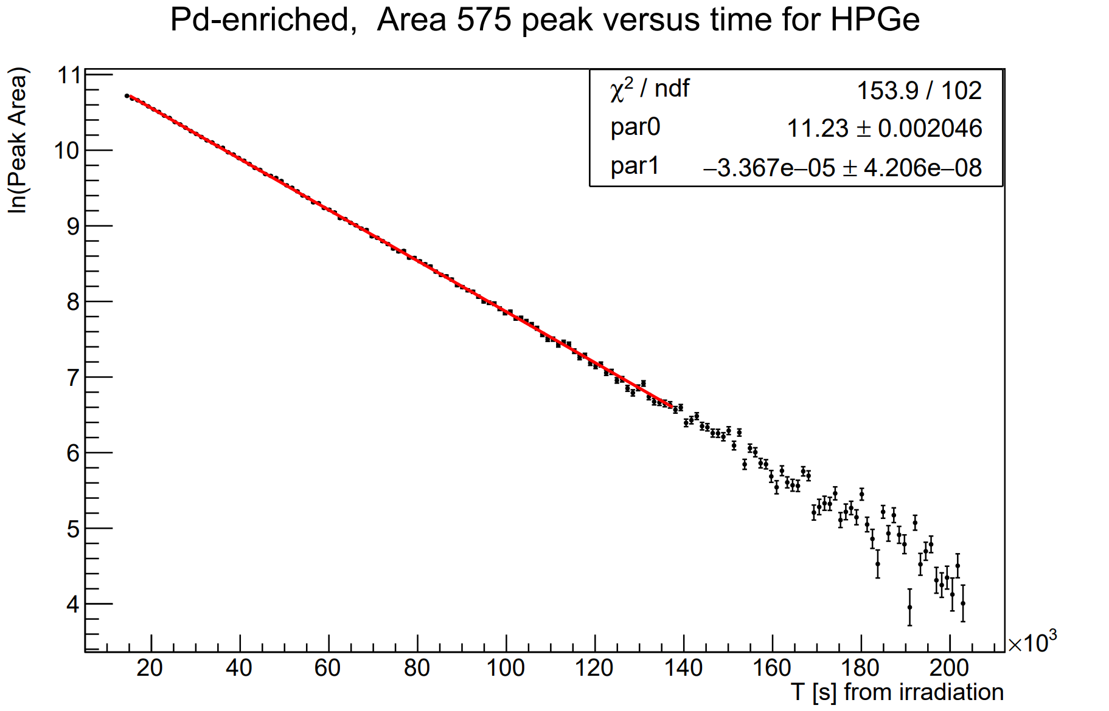
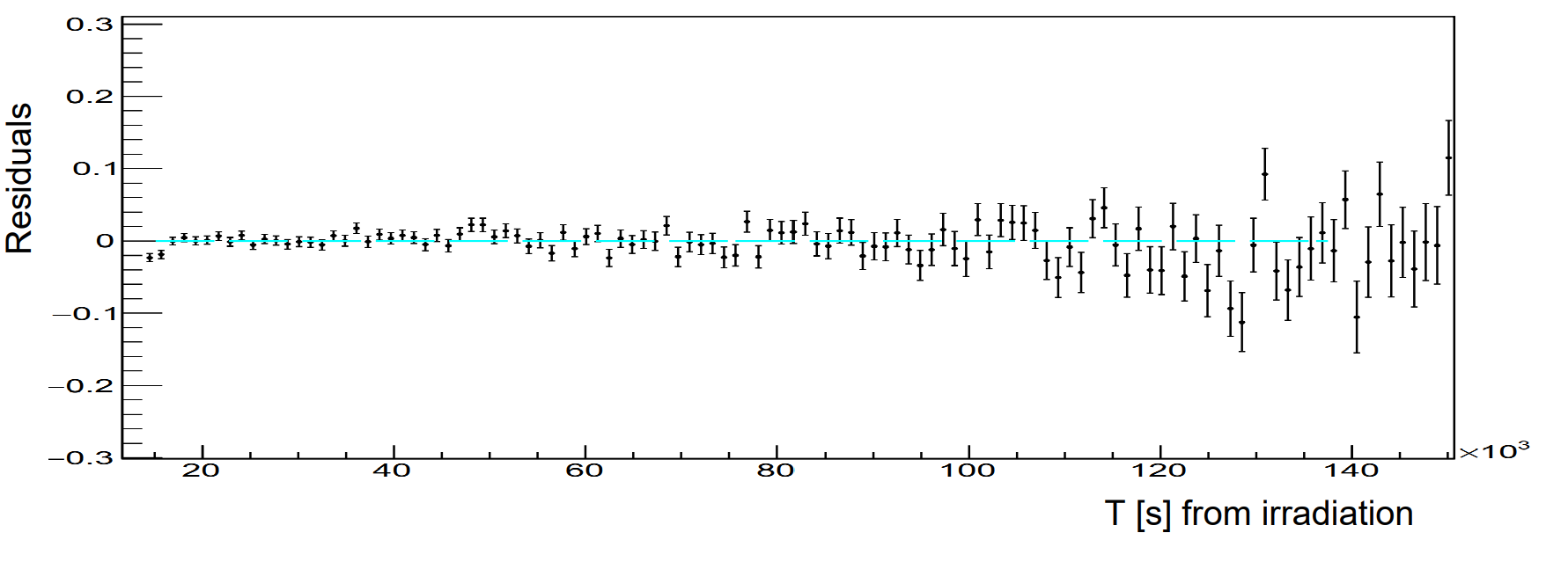
Half-life results
for 575 keV
T1/2=5.7h (expected ≈5.5h)

Slide 17
Future objectives

Slide 18
Future objectives
Integrate 172 keV peak for 111m-Pd
Check dead time corrections
Justify or correct half-life results
Compute uncertanties

