Slide 1
Marketing Executive Salary Analysis
Data Analyst
Analisis about salary range and gig jobs Marketing Executive

Slide 2
Introduction
Important Field
Hiring Employer
Find Fair Salary Range
Gig Jobs

Slide 3
Method
Data
Process
Technical
Data that be used for this analysis is database job and excel file responsibilities
Data processing for this analysis start from data cleaning, data analysis and interpretation data
Tools that be used for this analysis is python and sql language programming and Micorsoft Power BI

Slide 4
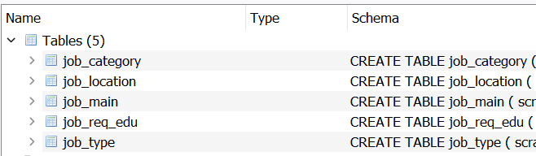
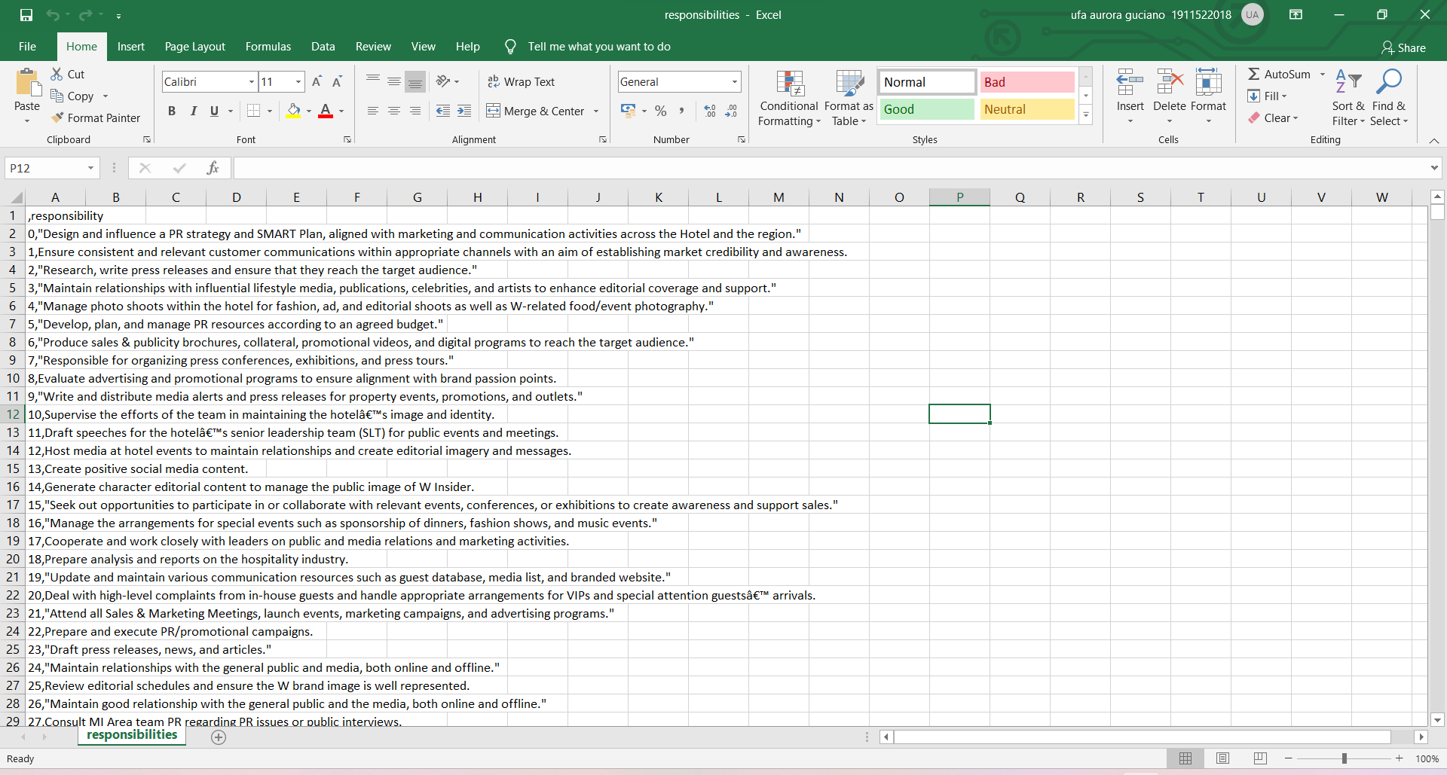
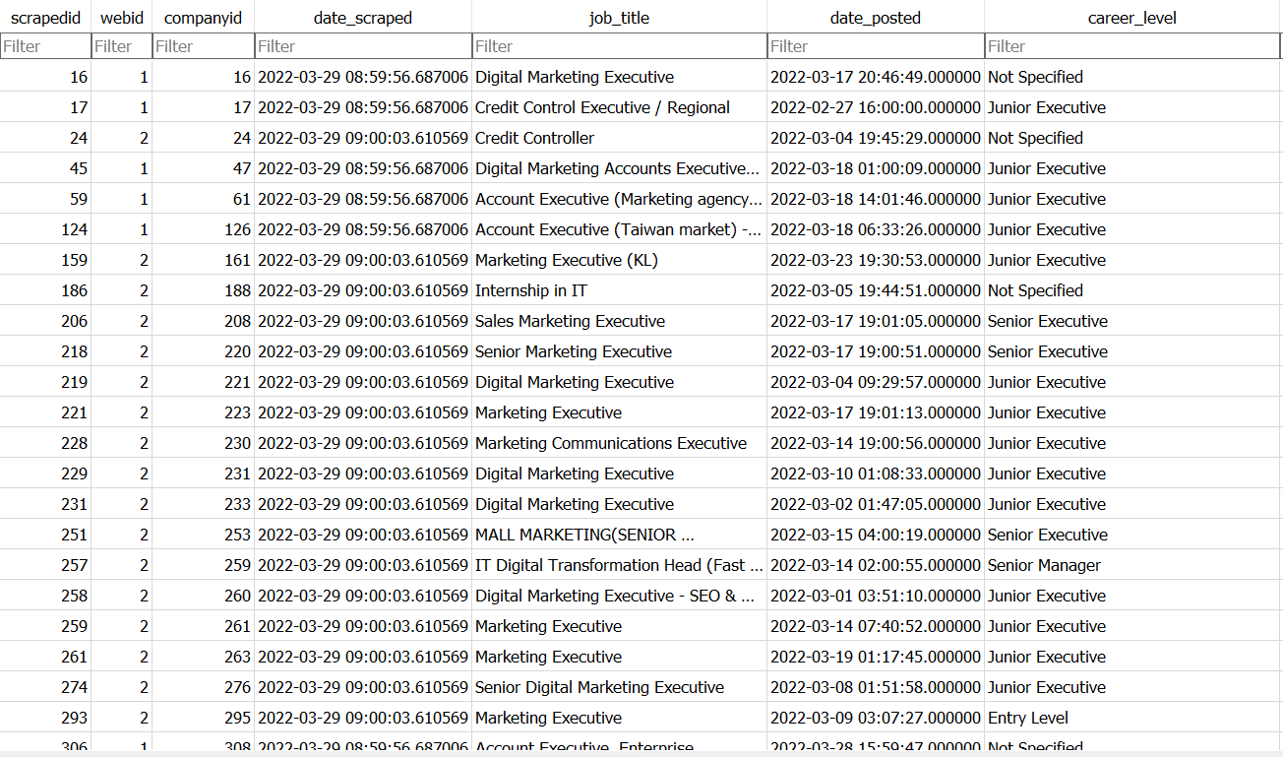
Data
Database Job
Responsibility File

Slide 5
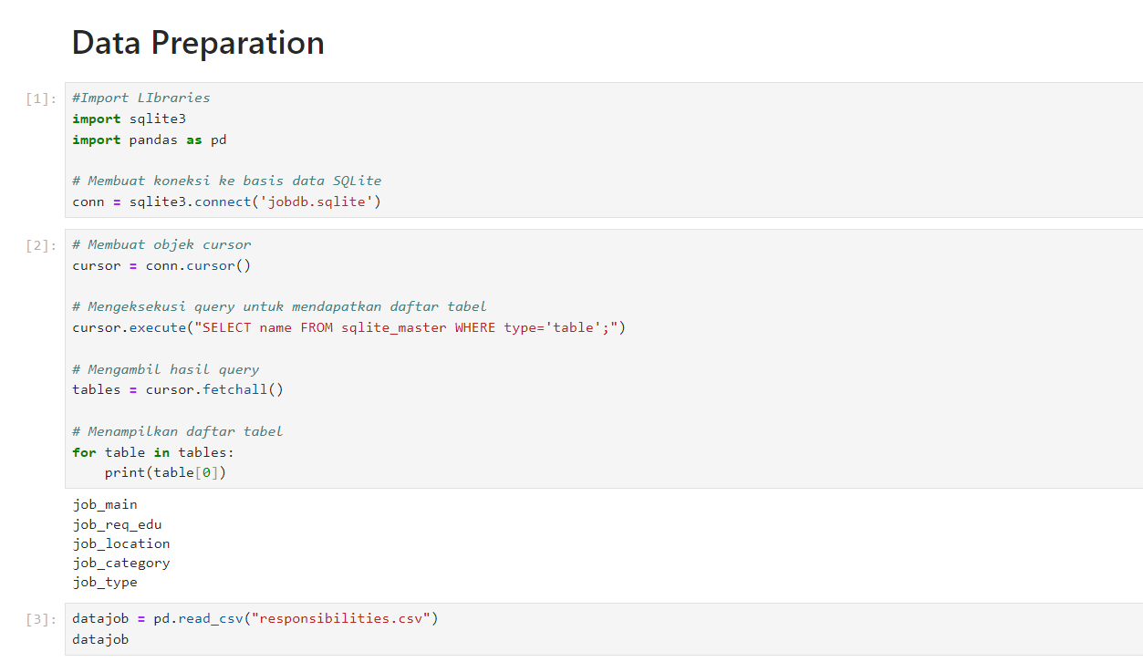
Process
1. Data Preparation
1. Load the data from Database SQLite

Slide 6
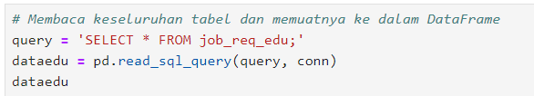
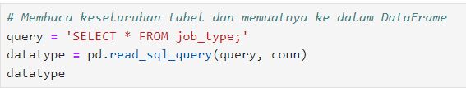
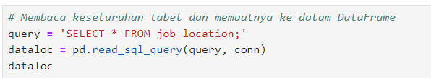
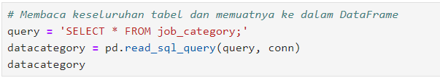
Process
1. Data Preparation
2. Read all of the table and load the data into dataframe

Slide 7




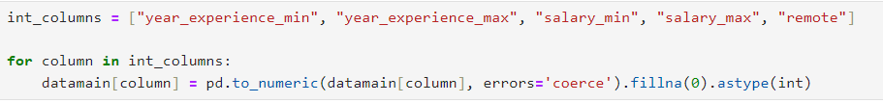
Process
1. Data Preparation
2. Conduct a data assessment to find out about the data to be analyzed and find out what deficiencies the data has. Data assessment is the first step before starting data cleaning. Do this to all data.
2. Data Cleaning
3. After doing the data assessment, the data can be cleaned. Here, several data cleaning steps are performed: deleting unnecessary tables, resolving missing values by deleting rows and filling empty values with specific values and changing data types that are not appropriate.

Slide 8
Process
3. Analysis Data
Data analysis was conducted in several steps:
1. Combining data from the job_main table and Job_type data because these 2 data provide enough information according to business needs.
2. Analyzed the data to find the fair salary range by finding the relationship between the career_level, year_experience_mean, salary_mean and salary_max columns. The data is grouped by career_level, year_experience_mean and currency to represent the country. Fair Salary range is obtained from the min range of the salary_min column, the max range of the salary_max column and the average salary.
3. For responsibility data, data analysis was conducted to find gig jobs by searching for keywords that represent marketing executives.

Slide 9
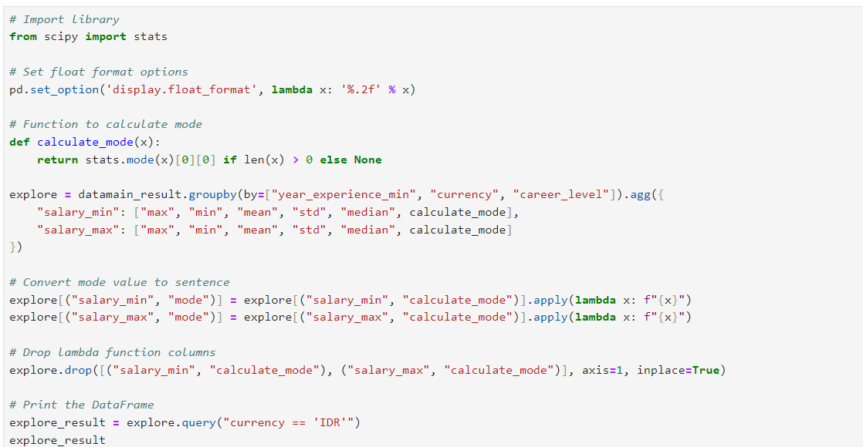
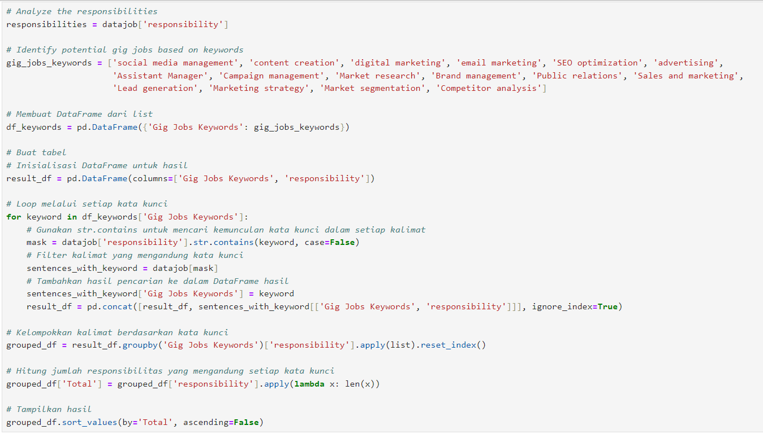
Process
3. Analysis Data

Slide 10
Results
Indonesia(IDR)
Average Salary Range
20.000.000 – 25.000.000
CEO/Directur
10.000.000 – 25.000.000
Senior
9.000.000 – 14.000.000
Mid-level
5.000.000 – 12.000.000
Associate
5.000.000 – 12.000.000
Junior

Slide 11
Results
Singapore (SGD)
Average Salary range
8.000 – 10.800
Senior
4.000 – 5.200
Mid-level
3.500 – 4.700
Associate
3.000 – 4.000
Junior

Slide 12
Results
Malaysia (RM)
Average Salary range
8.000 – 10.500
Senior
4.400 – 6.000
Mid-level
4.000 – 5.000
Associate
3.000 – 4.000
Junior

Slide 13
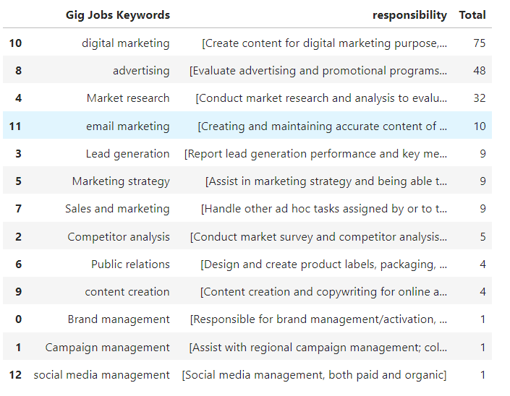
Possible Gig Jobs

Slide 14
Possible Gig Jobs (Top 4)
Market Researcher
Digital Marketing Specialist
01
02
04
Advertising
Email Marketer
03

Slide 15
Thank You!!
Data Analyst
ufaaurora@gmail.com

