Slide 1

AWS Machine Learning Engineer - Associate
TF-IDF (Term Frequency-Inverse Document Frequency)
Transforming Text into ML features
- RJ Programming

Slide 2
What is TF-IDF?
TF = Term Frequency
IDF = Inverse Document Frequency
Combines word importance and rarity
Produces weighted numerical values
Used in NLP and information retrieval
TF-IDF = TF x IDF

Slide 3
Why do we need TF-IDF?
Machine learning models require numerical input
Raw text cannot be processed directly
Some words are more informative than others
Common words provide little meaning
TF-IDF identifies important words

Slide 4
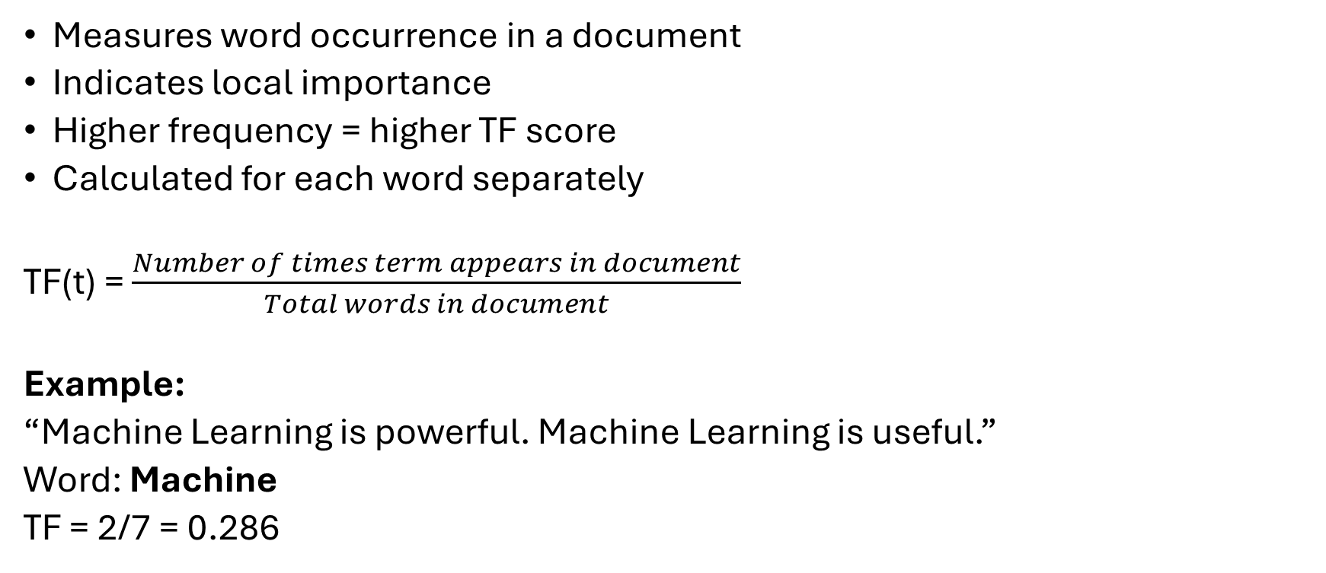
Term Frequency (TF)
Measures word occurrence in a document
Indicates local importance
Higher frequency = higher TF score
Calculated for each word separately
TF(t) = $\frac{Number of times term appears in document}{Total words in document}$
Example:
“Machine Learning is powerful. Machine Learning is useful.”
Word: Machine
TF = 2/7 = 0.286

Slide 5
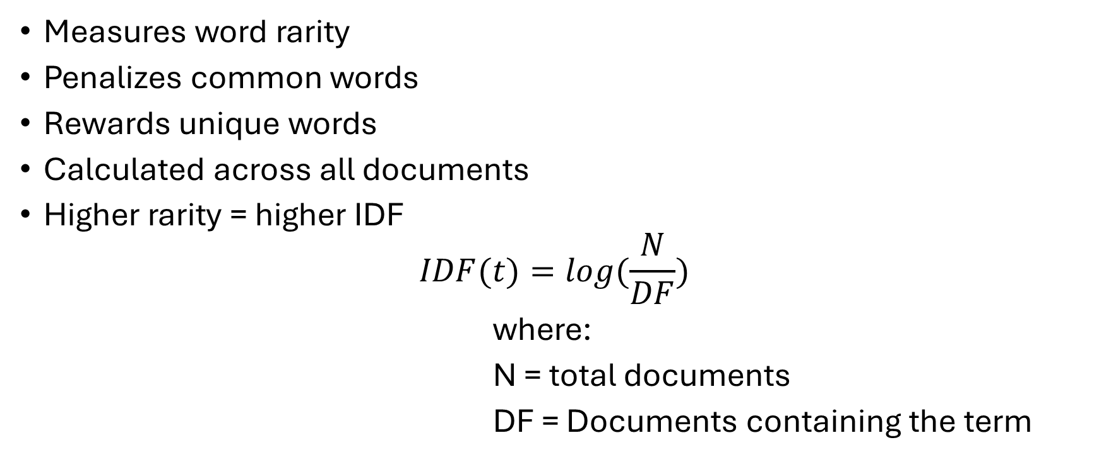
Inverse Document Frequency (IDF)
Measures word rarity
Penalizes common words
Rewards unique words
Calculated across all documents
Higher rarity = higher IDF
$$IDF(t)=log(\frac{N}{DF})$$
where:
N = total documents
DF = Documents containing the term

Slide 6
TF-IDF Example Calculation
Document 1 : “AWS provides cloud services”
Document 2 : “AWS supports machine learning”
Document 3 : “Machine leaning uses data”
Example:
Term: “cloud”
TF in Document 1 = ¼
DF = 1 N = 3
IDF = log(3/1)
TF-IDF = TF*IDF

Slide 7
Applications of TF-IDF
Search engines
Document classification
Spam detection
Recommendation systems
Sentiment analysis
Text clustering

Slide 8
TF-IDF vs Bag of Words
Feature | Bag of Words | TF-IDF
Counts Words | Yes | Yes
Considers Importance | No | Yes
Reduces Common Words Impact | No | Yes
Better for NLP Tasks | Limited | Strong

Slide 9
TF-IDF in Machine Learning Pipelines
Text Collection
Data Cleaning
Tokenization
TF-IDF vectorization
Model training
Prediction
Raw Text
↓
Text Cleaning
↓
Tokenization
↓
TF-IDF Vectorizer
↓
Feature Matrix
↓
Machine Learning Model
↓
Predictions

Slide 10
Summary
TF-IDF converts text into numerical features
Combines frequency and rarity
Highlights important words
Improves NLP model performance
Widely used in search and classification
Fundamental feature engineering technique

Slide 11
THANK YOU

