Slide 1
Identification and Classification of
Encrypted Network Traffic Flows
Systems and Network Security — Project Report
Tony Vukovic · Arij Kristou · Aurore Bellessa

Slide 2
Context & Motivation
Encryption is the new default
Research Question
TLS 1.3, QUIC, DoH — the majority of internet traffic is now encrypted
To what extent can statistical flow metadata alone support reliable, privacy-preserving threat detection in fully encrypted network environments — and how does the choice of extraction tooling affect that capacity?
DPI is no longer viable
Traditional Deep Packet Inspection cannot inspect encrypted payloads
ML as a solution
Flow-level metadata (timing, packet sizes, window init) enables payload-free classification

Slide 3
Related Work
Classification
Extraction Tools
Benchmark Datasets
Flow metrics suffice without payload access (Moore & Papagiannaki, 2005)
JA3/JA3S TLS fingerprinting
QUIC metadata & inter-packet timing
CNN-based encrypted classifiers (Okonkwo et al., 2022)
NFStream — Python-native, rich flow stats
Cisco Joy — TLS/SSH handshake telemetry
PcapPlusPlus — C++, high-speed capture
PyShark / Scapy — ground-truth validation
CIC-IDS2017, CSE-CIC-IDS2018, CIC-DDoS2019
Known limitation: severe class imbalance
CIC-IDS-Collection (Kaggle): harmonized labels across all datasets

Slide 4
Plan of the study
Pre-labeled Dataset Baseline
Data Ingestion & Refinement
Model Evaluation
Traffic Generation & Multi-Extractor Benchmark
Pipeline Training & Cross-Validation
Synthetic & Raw Traffic Engineering

Slide 5
Dataset & Encrypted Traffic Isolation
9.1M
59
4.75M
8
Total flow records
Statistical features
Encrypted flows retained
Attack categories
Behavioral Fingerprinting Heuristic
Isolates bidirectional handshake patterns characteristic of TLS and SSH sessions.
Port numbers and IP excluded deliberately to prevent overfitting.
Init_Fwd_Win_Bytes > 0 — positive forward window size
Init_Bwd_Win_Bytes > 0 — positive backward window size
Fwd_Seg_Size_Min ≥ 20 — minimum forward segment length
8 Attack Categories:
Benign
DDoS
DoS
Botnet
Bruteforce
Infiltration
Webattack
Portscan

Slide 6
Issues
Unbalenced
Class unbalanced
Severe baseline asymmetry. Benign network traffic dominates the dataset, reflecting real environment.
Trivial Classification shortcut. Standard ML models bias heavily toward the majority class, leading to high global accuracy but a critical blindness toward active threats.
Infiltration attack
Statistical indistinguishability of infiltration threats. Their behaviors are heavily overlapping with legitimate web features within highly encrypted domains.

Slide 7
Classification Pipelines
1
2
3
4
5
Baseline Random Forest
Custom Feature
MLP Neural Network
SMOTE Oversampling
Cost-Sensitive RF
50 estimators · max depth 15
Stratified 70/30 split · StandardScaler
Flow_Repetition_Count: flows sharing identical mean & max forward packet length
2 hidden layers (50 + 25 neurons)
Early stopping · max 30 iterations
Synthetic minority oversampling targeting rare attack classes
class_weight='balanced'
Prioritizes sensitivity over global accuracy
Goal: identify the best strategy for detecting stealthy attacks like Infiltration in encrypted flows

Slide 8
Feature Importance Results
Backward stats dominate — server response patterns are the primary fingerprint
Packet shape > volume — distribution matters more than total bytes
Flow_Repetition_Count absent from top 15 — repetition-based signatures add no signal

Slide 9
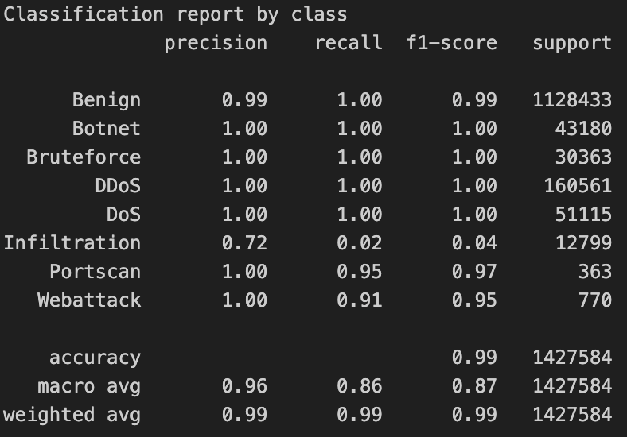
Model Comparison Results

Slide 10
Model Comparison Results
Model | Accuracy | Inf. Recall | Inf. Precision | Inf. F1
Baseline RF | ~99% | ≈ 0 | ≈ 0 | ≈ 0
RF + SMOTE | 99.00% | 0.03 | 0.60 | 0.06
RF + Class Weight | 82.51% | 0.93 | 0.05 | 0.09
MLP Neural Network | 98.45% | 0.11 | 0.17 | 0.13
Volumetric attacks (DDoS, DoS, Botnet, Bruteforce) → near-perfect detection across all models
Sensitivity vs. reliability trade-off: high recall = high false-positive rate (RF + Class Weight)
Infiltration remains unresolved — not a model problem, but a feature-space overlap problem

Slide 11
Benchmark Pipeline Overview
From raw captured traffic to classified flows — three extraction tools, one ML pipeline
1
2
3
4
5
Traffic Capture
Flow Extraction
Cleaning
ML Training
Results
Raw .pcap files
Scapy-generated
simulation_trafic.pcap
Linked to csv with labels
NFStream
PcapPlusPlus
Cisco Joy
59 flow features
Inf/NaN removal
TLS heuristic filter
Label joining
4.75M flows retained
Random Forest
SMOTE balancing
MLP Neural Net
StandardScaler
Classification report
Tool comparison
F1 / Recall / Precision
Confusion matrix
Each extraction tool feeds an independent ML pipeline — results are compared across tools to assess structural impact on classification

Slide 12
Flow Extraction Tools
NFStream
91%
PcapPlusPlus
78%
Cisco Joy
79%
Leakage
Insufficient
Binary only
Python-focused, high-performance live and pcap processing framework.
Rich statistical metadata (87 features)
Flow stats overshadowed by app metadata
Multiplatform C++ engine for low-level packet parsing and analysis.
Extremely fast execution with minimal memory footprint, directly wrapping
Only 2 features extracted
Designed for capture speed, not statistical analysis
Industry-standard enterprise network telemetry
Produces lightweight, highly standardized flow records optimized for high-throughput production environment
Binary schema: Attack vs. Benign only
No per-category analysis possible

Slide 13
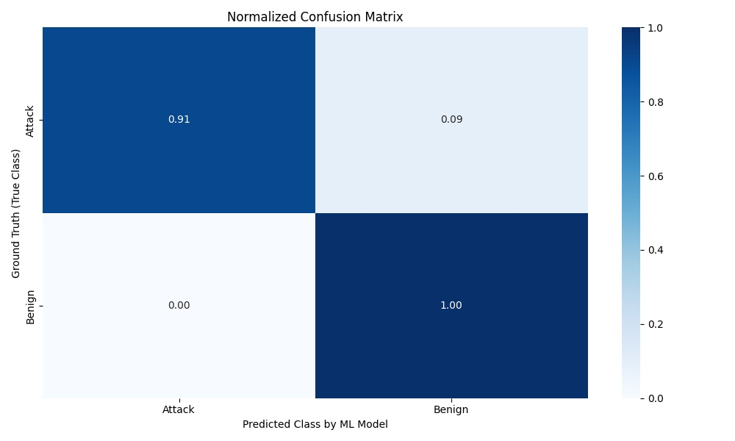
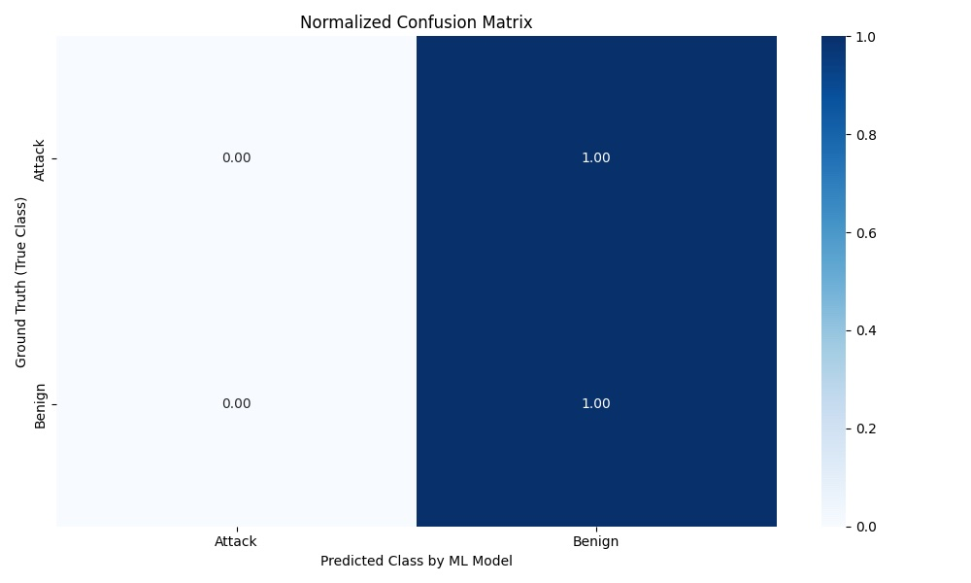
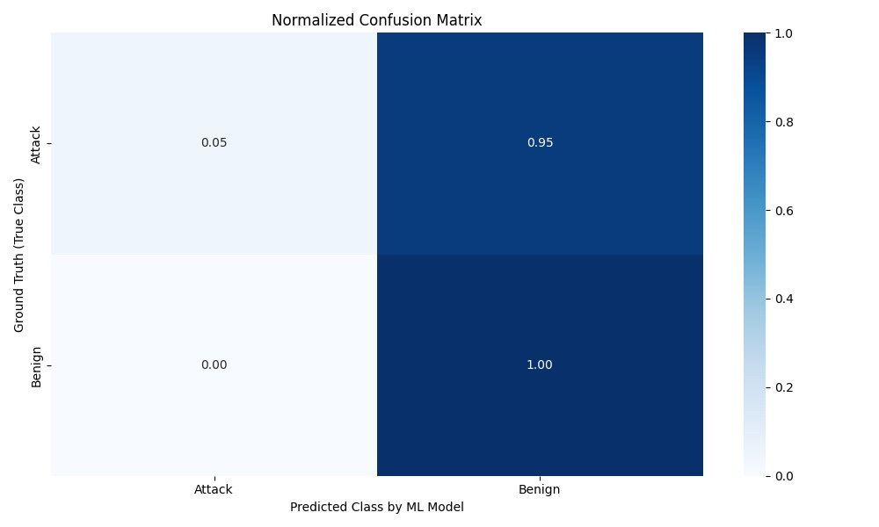
Confusion Matrices — Extraction Tool Benchmark
Normalized per true class
NFStream — Binary (Attack vs. Benign)
PcapPlusPlus — Binary (Attack vs. Benign)
Cisco Joy — Binary (Attack vs. Benign)
98%
78%
79%

Slide 14
Discussion
No single tool is sufficient
NFStream offers rich statistics but use future leakage. PcapPlusPlus is operationally fast but statistically sparse. Cisco Joy is also fast but produces mixed results and forces binary classification.
Infiltration is a representation problem
Neither SMOTE, cost-sensitive learning, nor a neural architecture resolves Infiltration detection. The failure is in the feature space — stealthy flows are statistically indistinguishable from benign encrypted traffic without richer protocol-level telemetry.
Toward a multi-tool production pipeline
Combining NFStream's statistical depth (with application metadata excluded) and Cisco Joy's handshake fingerprinting, while reserving PcapPlusPlus for high-speed capture, represents the most promising direction.

Slide 15
Conclusion
Answer to the research question
Flow-level metadata reliably detects volumetric encrypted attacks, but is fundamentally insufficient for low-volume stealthy intrusions without richer protocol-level telemetry.
DDoS, DoS, Botnet, Bruteforce → near-perfect detection with flow metadata alone
Infiltration → unresolved across all models and balancing strategies
Tool choice is not neutral — NFStream, PcapPlusPlus, and Cisco Joy each impose structural limitations
Future work: live NFStream integration + multi-tool pipeline + temporal behavioral modeling
Tony Vukovic · Arij Kristou · Aurore Bellessa

